Slide 1
3D Tank Game
By Louis Orleans

Slide 2
Objective
The objective is to destroy all of the other tanks while avoiding being destroyed.

Slide 3
Players
The number of players in the game will depend on if I choose to look in to online multiplayer.
In single player, there will be one player
In multiplayer (if implemented) there will be somewhere between 2-10 players (10 being a very high cap)

Slide 4
Controls
Hardware required to control the game will include a keyboard and mouse.
The WASD keys will be used for movement, and mouse position will be used for look.

Slide 5
Prerequisites
In order to play this game, you will need to know the controls, which will be explained.
There are no other real requirements.

Slide 6
Scoring
Single player
  Scoring determined by number of tanks destroyed
  Also, possibly time taken
Multiplayer
  Scoring determined by kill death ratio

Slide 7
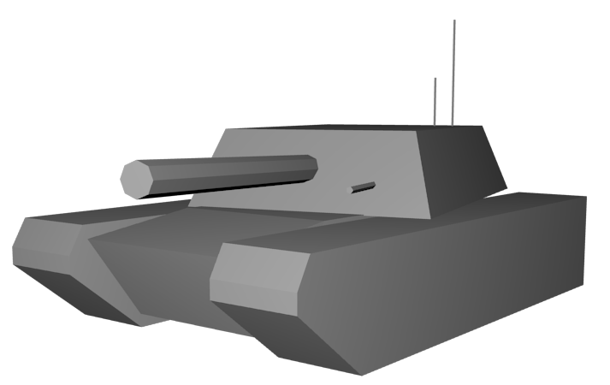
Characters
Tanks (currently not textured)

Slide 8
Levels
You will progress through levels once you have destroyed all the tanks in the current level
Levels will gradually become harder by adding more tanks, and possibly new weapons on the enemy tanks

Slide 9
The challenge
What makes this game challenging to the player is the number of tanks, and the AI given to the tanks.

Slide 10
Fun factor
This game will be fun because everyone likes blowing stuff up. (at least, most males do)

Slide 11
How it stands out
This game will stand out because
  The AI
  The fact that it’s 3D
  It can potentially never end
  If multiplayer is implemented, it will be cross-platform, which is unheard-of.

