Slide 1



Machine Learning: Tree Models
Peer 2 Peer Learning Series
Stephen Frein, College of Technologists
September 4th, 2019
***Install Anaconda if you haven’t already – see slide 8 for link***

Slide 2

About Me
Executive Director, Comcast University College of Technologists
Go to http://cot.cable.comcast.com/ to see what we do
Adjunct professor at Drexel (Info Systems) and Villanova (Computer Science)
Career mostly web and database application development

Slide 3
Peer 2 Peer Learning Series
“Brown bags” at scale – presenters bring knowledge, and COT does the rest
Broad mix of technical and business topics, beginner to advanced
Program described here: http://cot.cable.comcast.com/programs/peer-to-peer-training/
Please consider proposing a session (at link above)

Slide 4

Goals for Today
Describe basic machine learning concepts
Build decision trees with Python and scikit-learn
I’m really only 6 inches off the ground.
Procedural Notes
I sent slides and code earlier by email.
If you get stuck, may be hard to help you in real time, but I promise to help you later. Do your best to follow along for now.

Slide 5
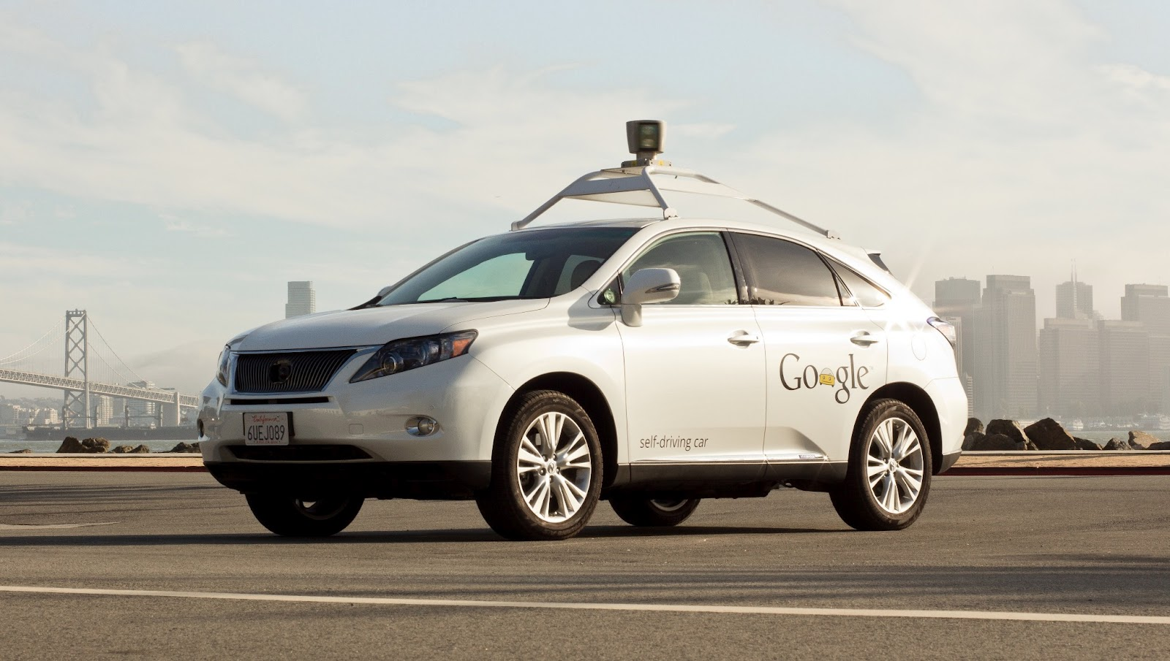
Machine Learning
When machines get better at a task through experience
e.g., seeing data about some process
We build machine learning models to represent the learning

Slide 6

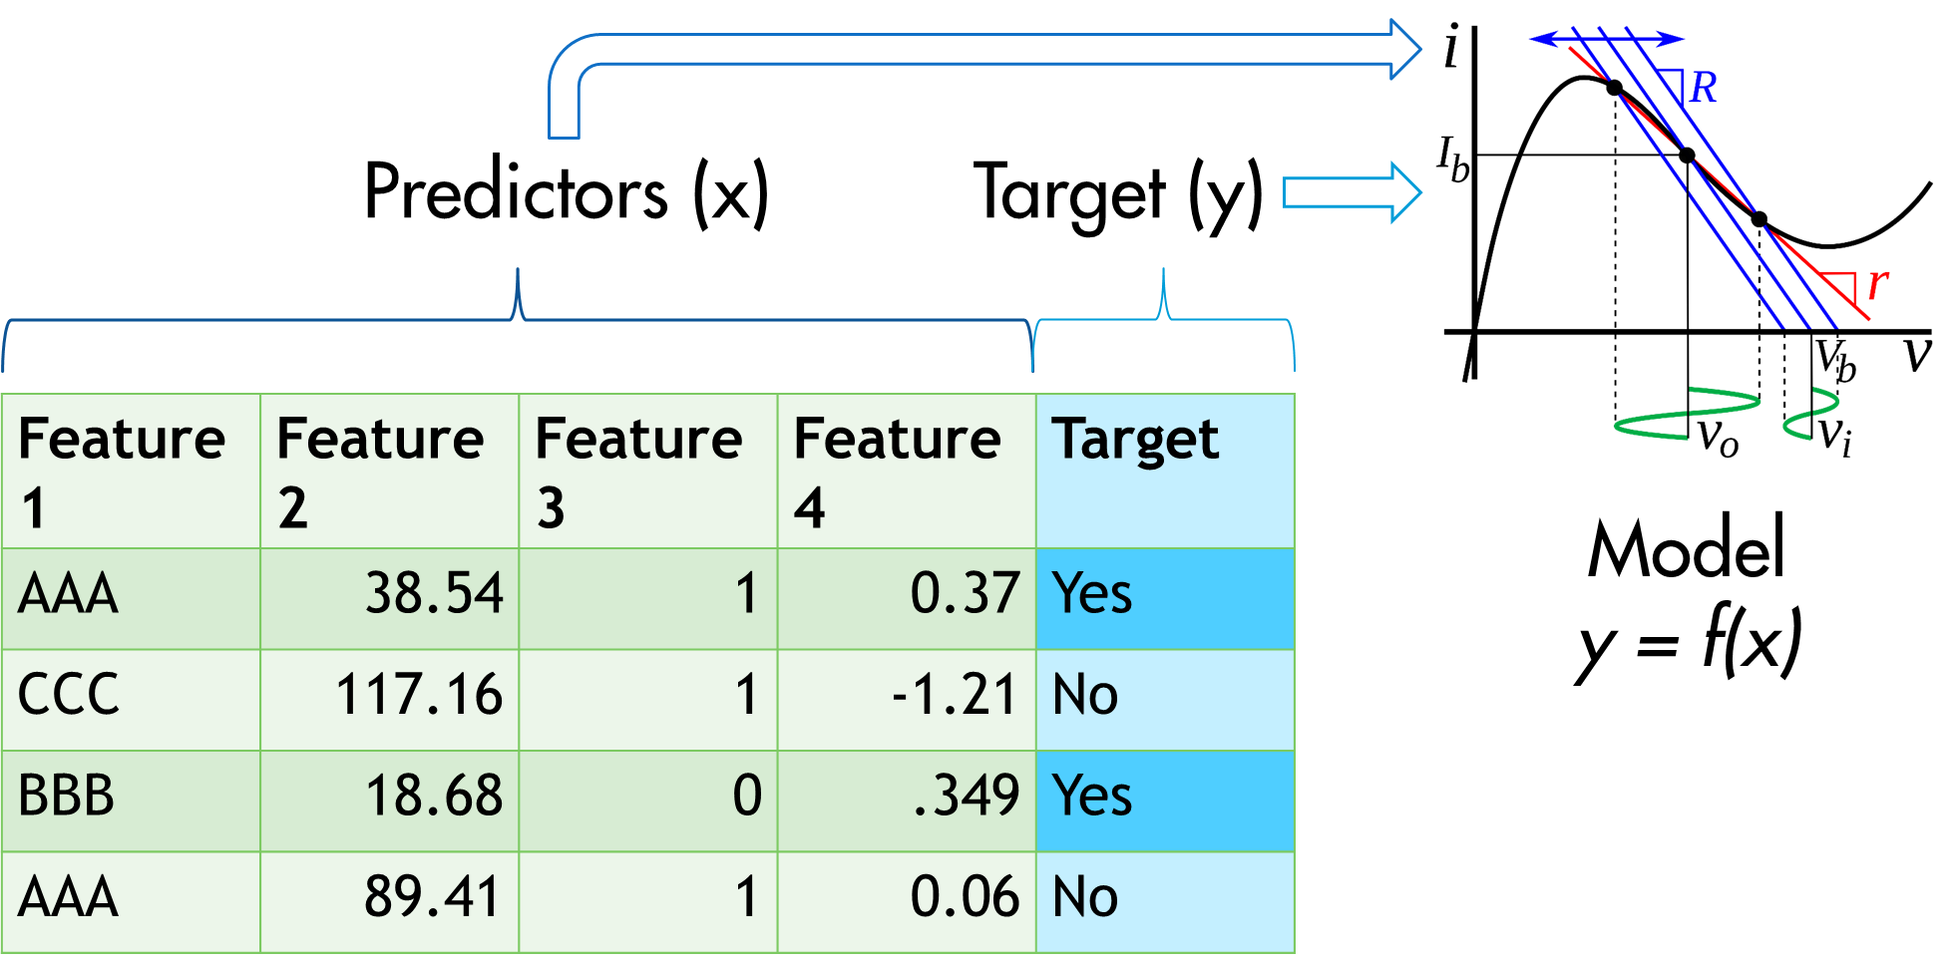
Supervised Learning: Labeled Examples

Slide 7
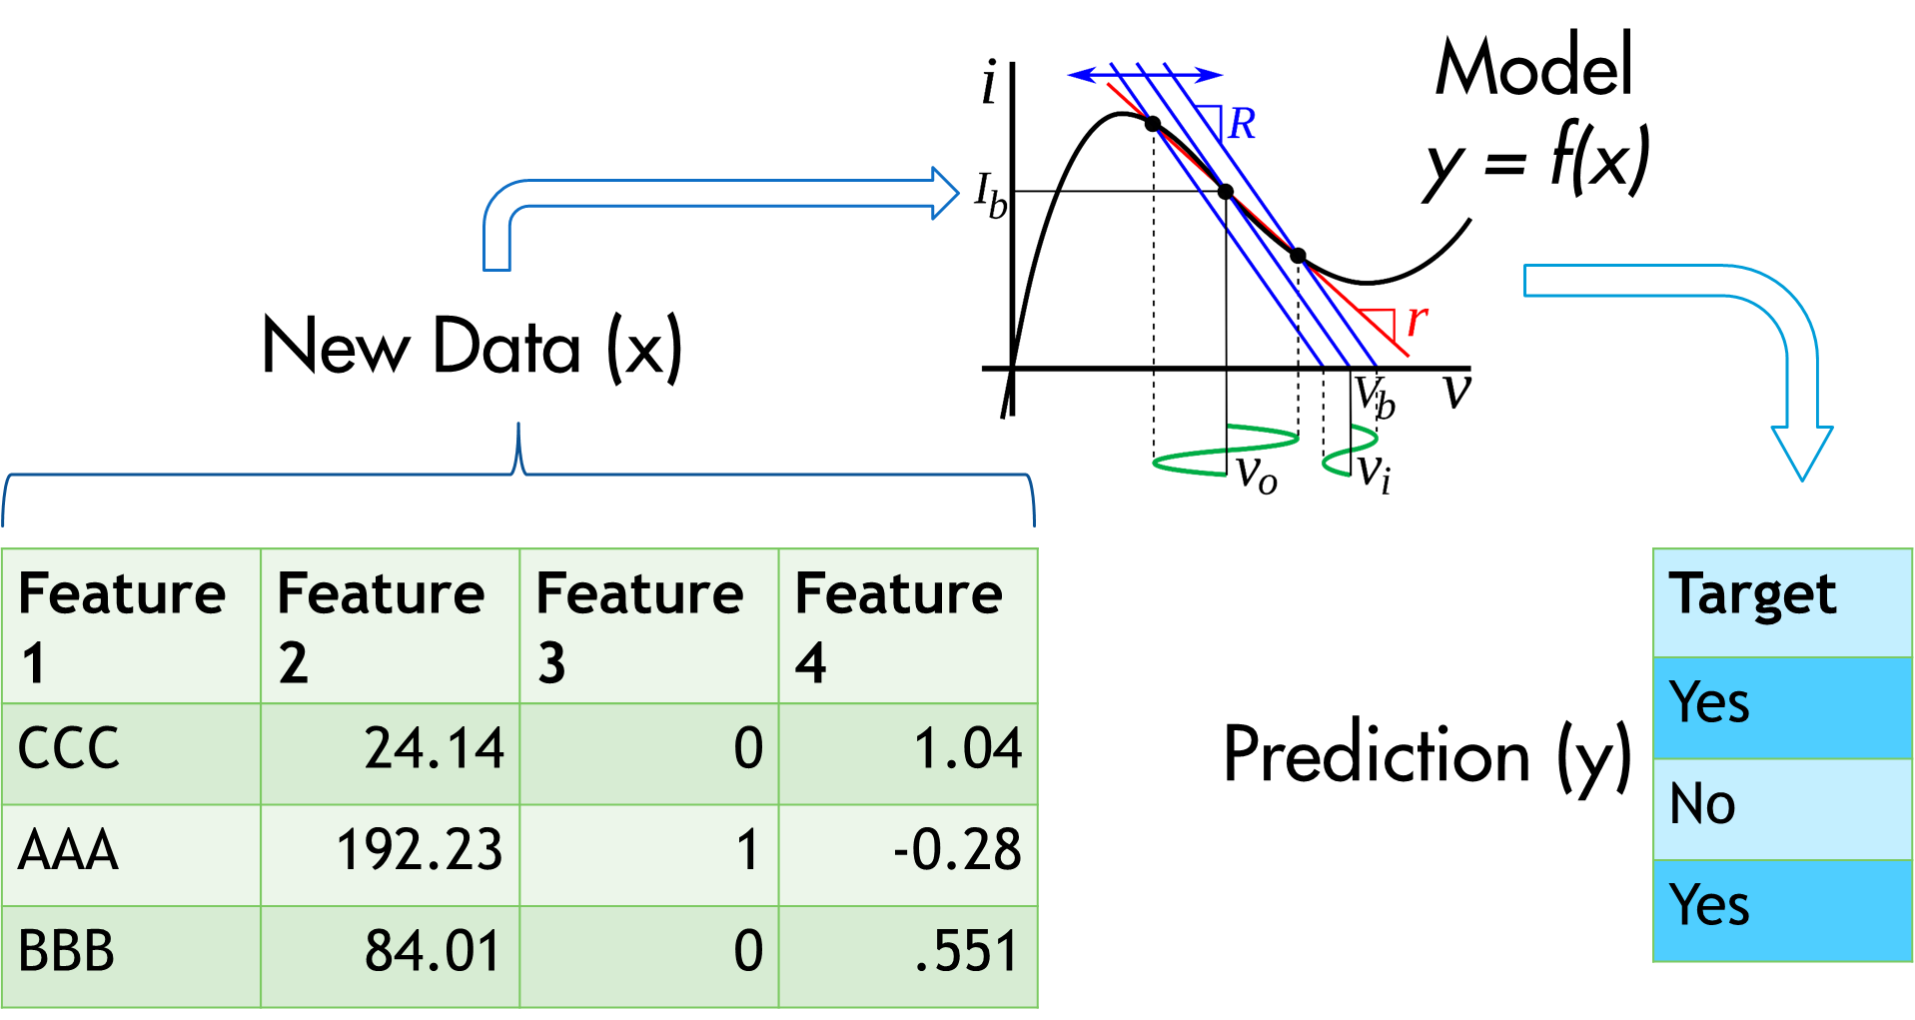
Supervised Learning: Model Predictions

Slide 8


Python and scikit-learn
Commonly used machine learning platform
Python is a general purpose software development language
scikit-learn is a set of related libraries that are useful for machine learning
I’ll be using the Anaconda distribution, a popular way to set up a Python-based machine learning environment
Spyder IDE within Anaconda (could also use Jupyter notebook)

Slide 9
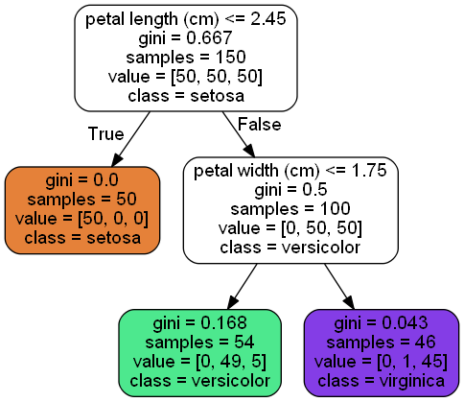
Decision Trees
Many different kinds of machine learning models
logistic regression, decision trees, support vector machines, neural networks, etc.
Will focus on decision trees today
Using these to predict categories (classification)
Could also use them to predict numbers (regression)
Model rules as a series of if/then statements
Easy to understand/interpret
Require minimal data preparation
Built to maximize node purity (lower gini impurity)

Slide 10

Gini Impurity
Lower gini impurity = more “pure” node
A ten-item node with an 80-20 split of a binary target:
1 – (.8² ⁺ .2²) = 1 – (.64 + .04) = 1 - .68 = .32
A ten-item node with a 50-50 split:
1 – (.5² ⁺ .5²) = 1 – (.25 + .25) = 1 - .5 = .50
p is proportion of node items in that class
j is a class

Slide 11

Your Mission
Build a model that predicts NPS detractors
Can we change the things that make them detractors?
If we know who they are, can we give them special care?
We will be using doctored data
Cleaned up and simplified
Patterns injected (impact of certain variables exaggerated)

Slide 12

Getting Started – Imports and Getting Data
Create a Python source file named whatever you like (e.g., tree_models.py) in a new folder
Start with the following code:
# modules we will need
import matplotlib.pyplot as plt
import pandas as pd
from sklearn import metrics
from sklearn import tree
from sklearn.model_selection import train_test_split
from sklearn.tree import DecisionTreeClassifier
from sklearn.tree.export import export_text
# get raw data
url = "https://drive.google.com/uc?export=download&id=15t4zoevy39y3LbyMa-F0CmjTIJRtctUw"
detractors_raw = pd.read_csv(url)
for graphing things
working with data frames (tables)
evaluating model performance
utility methods for decision trees
subsetting tools for testing models
builds our tree
helps us see tree structure
download data into a data frame (table)
Exercise
Examine the data frame in Variable Explorer
(top right in Spyder IDE)

Slide 13
Examine the Data
More details about data (types, summary stats, etc.)
Understand distribution of target variable
# modules we will need
import matplotlib.pyplot as plt
import pandas as pd
from sklearn import metrics
from sklearn import tree
from sklearn.model_selection import train_test_split
from sklearn.tree import DecisionTreeClassifier
from sklearn.tree.export import export_text
# get raw data
url = "https://drive.google.com/uc?export=download&id=15t4zoevy39y3LbyMa-F0CmjTIJRtctUw"
detractors_raw = pd.read_csv(url)
#detractors_raw = pd.read_csv("detractors_demo.csv")
# examine data
description = detractors_raw.describe(include='all')
# base rates of detractors
print(detractors_raw['target_detractor'].value_counts(normalize=True))
What does value_counts return without normalize=True argument?
create new data frame with metadata
% of total for each unique value in target_detractor column

Slide 14
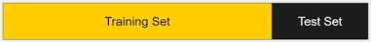
Training/Test Split
We will break our data into training and test sets
Training set is used to build model – what X values explain our Y?
Test set allows us to check our model against data it has never “seen” and allows us to estimate its performance against future data
Other methods involve use of cross-validation and validation sets so we can tune models without compromising independence of test data (but we won’t go there today)

Slide 15
Create a Tree
Run and unlock the secrets of the universe!
<…snip…>
# examine data
description = detractors_raw.describe(include='all')
# base rates of detractors
print(detractors_raw['target_detractor'].value_counts(normalize=True))
# create a separate copy - usually need to massage the data
detractors_clean = detractors_raw
# predictor variables - all but column called target_detractor
X = detractors_clean.drop("target_detractor",1)
# target variable
Y = detractors_clean["target_detractor"]
# split into training (70%) and test (30%) sets
X_train, X_test, Y_train, Y_test = train_test_split(X, Y, test_size=0.3, random_state=1)
# decision tree classifier
simple_tree = DecisionTreeClassifier(max_depth=3, criterion='gini')
# train decision tree classifer
simple_tree = simple_tree.fit(X_train,Y_train)
create “Y” data frame with just target variable
Randomly assign records to training and test groups
seed value for reproducibility
don’t chase noise
set up tree parameters
train tree based on training X and Y values

Slide 16

Ruh-roh! What happened?
ValueError: could not convert string to float: 'U'
Implementation of decision trees in scikit-learn can’t handle character values – need to “one-hot” encode these!
<…snip…>
# create a separate copy - usually need to massage the data
detractors_clean = detractors_raw
# one-hot encode character variables
detractors_clean = pd.get_dummies(detractors_raw,columns=["e_c_contribute_to_charity","r_home_own_rent","r_marital_status","serloc_curr_reg_nm","svcs_cdv_tier_name","svcs_hsd_tier_name","svcs_video_tier_name","svcs_xh_tier_name"])
# predictor variables - all but column called target_detractor
X = detractors_clean.drop("target_detractor",1)
# target variable
Y = detractors_clean["target_detractor"]
<…snip…>
Examine changes to structure of detractors_clean and run again

Slide 17
Who the #%@! Is NaN?
ValueError: Input contains NaN, infinity or a value too large for dtype('float32').
Implementation of decision trees in scikit-learn does not like null (NaN) values – get rid of ‘em!
<…snip…>
# create a separate copy - usually need to massage the data
detractors_clean = detractors_raw
# one-hot encode character variables
detractors_clean = pd.get_dummies(detractors_raw,columns=["e_c_contribute_to_charity","r_home_own_rent","r_marital_status","serloc_curr_reg_nm","svcs_cdv_tier_name","svcs_hsd_tier_name","svcs_video_tier_name","svcs_xh_tier_name"])
# drop na (null values)
detractors_clean = detractors_clean.dropna()
# predictor variables - all but column called target_detractor
X = detractors_clean.drop("target_detractor",1)
# target variable
Y = detractors_clean["target_detractor"]
<…snip…>
Okay – now try it!

Slide 18
Check Performance and Predict New Values
<…snip…>
# decision tree classifier
simple_tree = DecisionTreeClassifier(max_depth=3, criterion='gini')
# train decision tree classifer
simple_tree = simple_tree.fit(X_train,Y_train)
# predict the response for test dataset
Y_pred = simple_tree.predict(X_test)
# how many were classified correctly
print("Accuracy:", metrics.accuracy_score(Y_test, Y_pred))
# set up a new customer
# places 10 and 12 represent triple play and x1
# tp x1
new_cus1 = [[0,0,7,0,0,0,0.0,0,0,1,0,1,0,0,0,0,0,1,0,1,0,0,0,0,0,0,0,1,0,0,0,0,0,0,0,0,0,0,0,1,
0,0,0,0,0,0,0,0,0,0,0,0,0,0,1,0,1,0,0,0,0,0,0,0,1,0,0,0,0]]
new_cus2 = [[0,0,7,0,0,0,0.0,0,0,0,0,0,0,0,0,0,0,1,0,1,0,0,0,0,0,0,0,1,0,0,0,0,0,0,0,0,0,0,0,1,
0,0,0,0,0,0,0,0,0,0,0,0,0,0,1,0,1,0,0,0,0,0,0,0,1,0,0,0,0]]
pred_for_new_cust = simple_tree.predict(new_cus1)
print('New customer detractor prediction: ' + str(pred_for_new_cust[0]))
What happens to accuracy with max_depth=20?

Slide 19
Visualize It
<…snip…>
pred_for_new_cust = simple_tree.predict(new_cus1)
print('New customer detractor prediction: ' + str(pred_for_new_cust[0]))
# plot it
plt.figure(figsize=(8,4), dpi=600)
tree.plot_tree(simple_tree.fit(X_train,Y_train), feature_names = list(X.columns),
class_names=['non-detractor','detractor'])
plt.savefig('tree_export.png')
print(export_text(simple_tree, feature_names = list(X.columns)))
This code should work as of May 2019 version of scikit-learn. If you have older, check appendix.

Slide 20
Random Forest
Individual trees are easy to interpret, but highly dependent on sample
Change or remove your train/test split seed value and see what happens
Random forests create an ensemble of trees (e.g., hundreds)
Trees are randomly constrained in which variables they can look at
Often, number is ceiling of square root of number of variables
Each tree gets a different sample of training data
All the trees get to “vote” on a classification
Usually outperforms individual decision trees – diversity of perspectives generalizes better to unseen data

Slide 21
Build a Forest
<…snip…>
plt.savefig('tree_export.png')
print(export_text(simple_tree, feature_names = list(X.columns)))
## random forest approach
from sklearn.ensemble import RandomForestClassifier
# create new classifier - 100 trees with max depth of 3 per tree
rf=RandomForestClassifier(n_estimators=500, max_depth=3)
# train the model
rf.fit(X_train,Y_train)
# predict the response for test dataset
Y_pred=rf.predict(X_test)
# how many were classified correctly
print("Accuracy:", metrics.accuracy_score(Y_test, Y_pred))
Predictive accuracy limited here because of artificial way I built the data set

Slide 22

If We Had More Time
More realistic data cleaning
Deeper dive on gini impurity calculations
Better alternatives to accuracy score
How we tune tree parameters (e.g., max_depth)
Cross-validation
Using trees for regression
Boosted trees
How to choose the right spouse

Slide 23
Thank You!
Please take survey – less than 60 seconds:
http://comcast.decipherinc.com/survey/selfserve/1ff2/g5a8/190900#?

Slide 24
Appendix

Slide 25
Graph Tree in Older Versions of scikit-learn
***Not needed as of scikit-learn 0.21+ (May 2019)***
import os
from sklearn.tree import export_graphviz
from sklearn.externals.six import StringIO
from IPython.display import Image
import pydotplus
# your path to graphviz executable
os.environ["PATH"] += os.pathsep + 'C:/Program Files (x86)/Graphviz2.38/bin/'
dot_data = StringIO()
export_graphviz(simple_tree, out_file=dot_data,
filled=True, rounded=True,
special_characters=True,feature_names = list(X.columns),class_names=['non-detractor','detractor'])
graph = pydotplus.graph_from_dot_data(dot_data.getvalue())
graph.write_png('tree.png')
Image(graph.create_png())
Install GraphViz executable
pip install graphviz
pip install pydotplus

Slide 26
Supervised Learning: Labeled Examples
Often, we will want to predict some outcome:
Inches of rain next month
Whether person will default on a loan
We assemble historical data that contains both the outcome and the information we will have prior to making our prediction
Ask machine learning algorithms to build a model that (imperfectly) describes relationship between the predictor variables and known outcome
Outcome embedded in the existing data “supervises” the process of training the model to predict the outcome based on the predictors

