Slide 1


Analyzing and Predicting London Home Prices from Free, Public Data
A Springboard Capstone project by David Bender
March 25, 2020

Slide 2

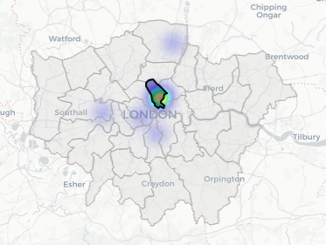
The Purpose: Real estate investment firms have to incorporate many factors when deciding where and how to invest. To simulate this challenge, in particular for residential real estate, this analysis will look at London residential data to identify patterns, generate insights, and develop predictive models for price.
Data:
https://www.gov.uk/government/statistical-data-sets/price-paid-data-downloads
Code notebook:
https://github.com/dudikbender/springboard/blob/master/Springboard%20Capstone%201%20-%20London%20Home%20Prices.ipynb

Slide 3
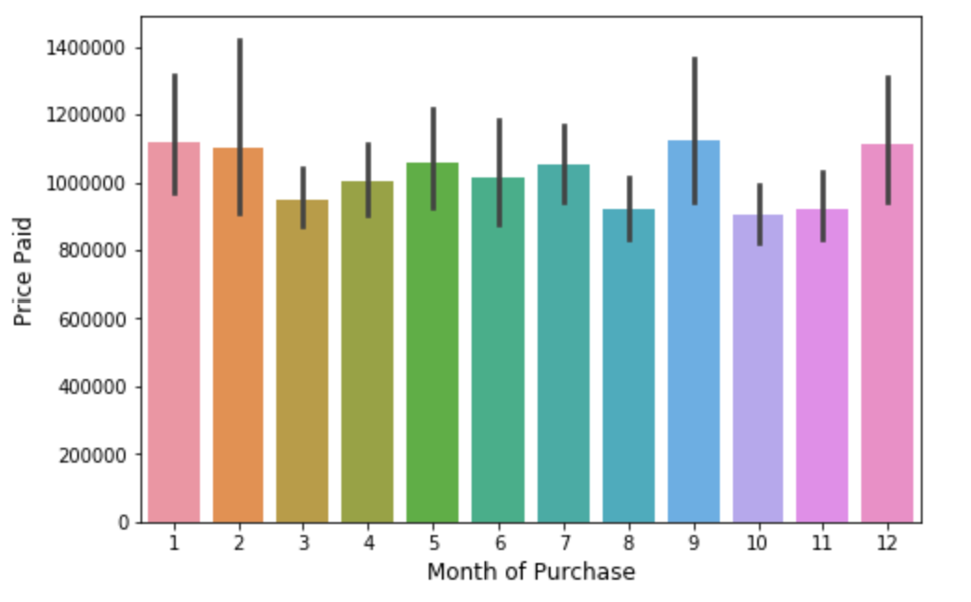
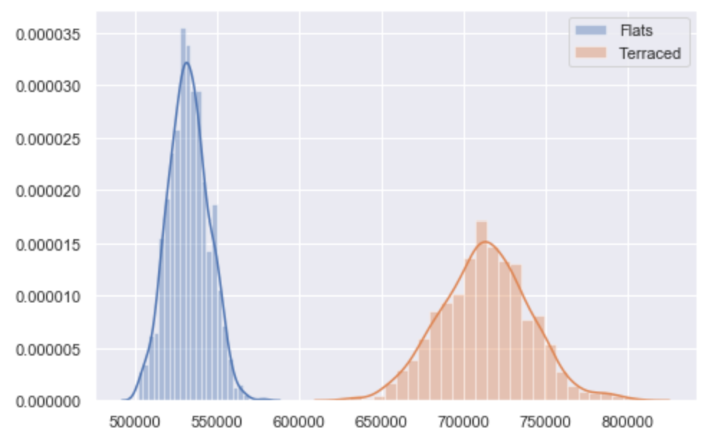
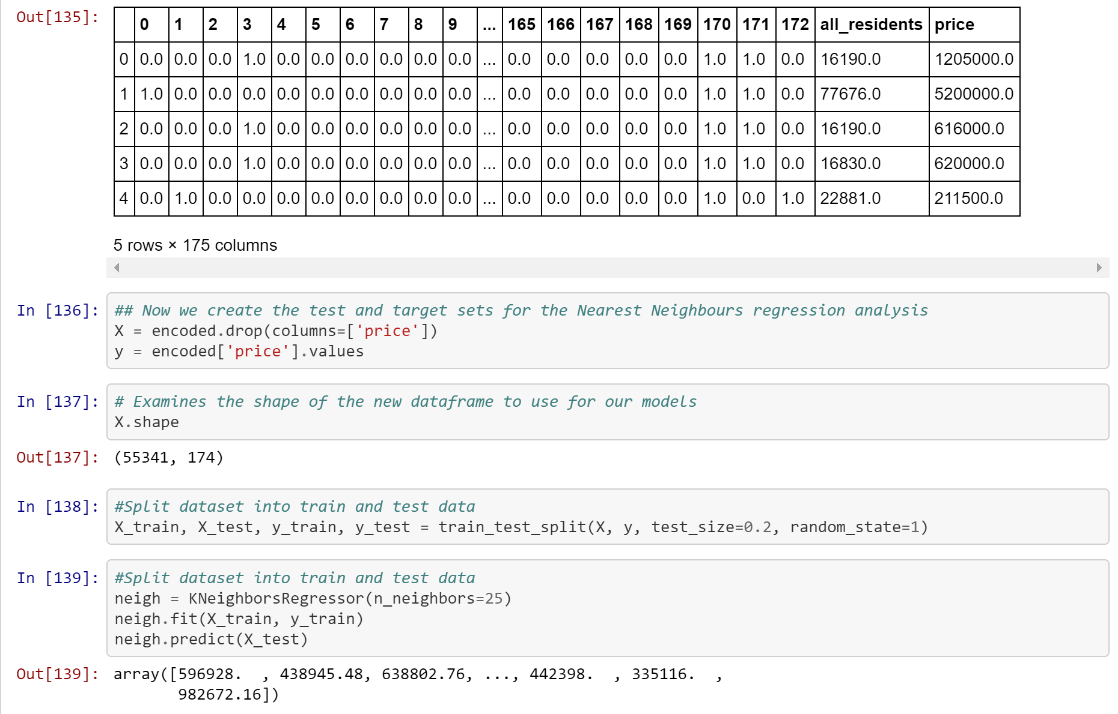
The analysis process
1
2
3
Examining the Data
Statistical Analysis & Mapping
Predictive Modelling
First, we excerpted London data from a national UK dataset of prices paid for residential properties. We cleaned, re-labelled, and examined the data in multiple ways.
Next, we looked more deeply at the data – including visualizations, inferential statistical analysis, and mapping the locations using the folium package.
Lastly, we performed machine learning regression analysis utilizing scikit-learn – including KNeighborsRegressor and DecisionTreeRegressor.

Slide 4
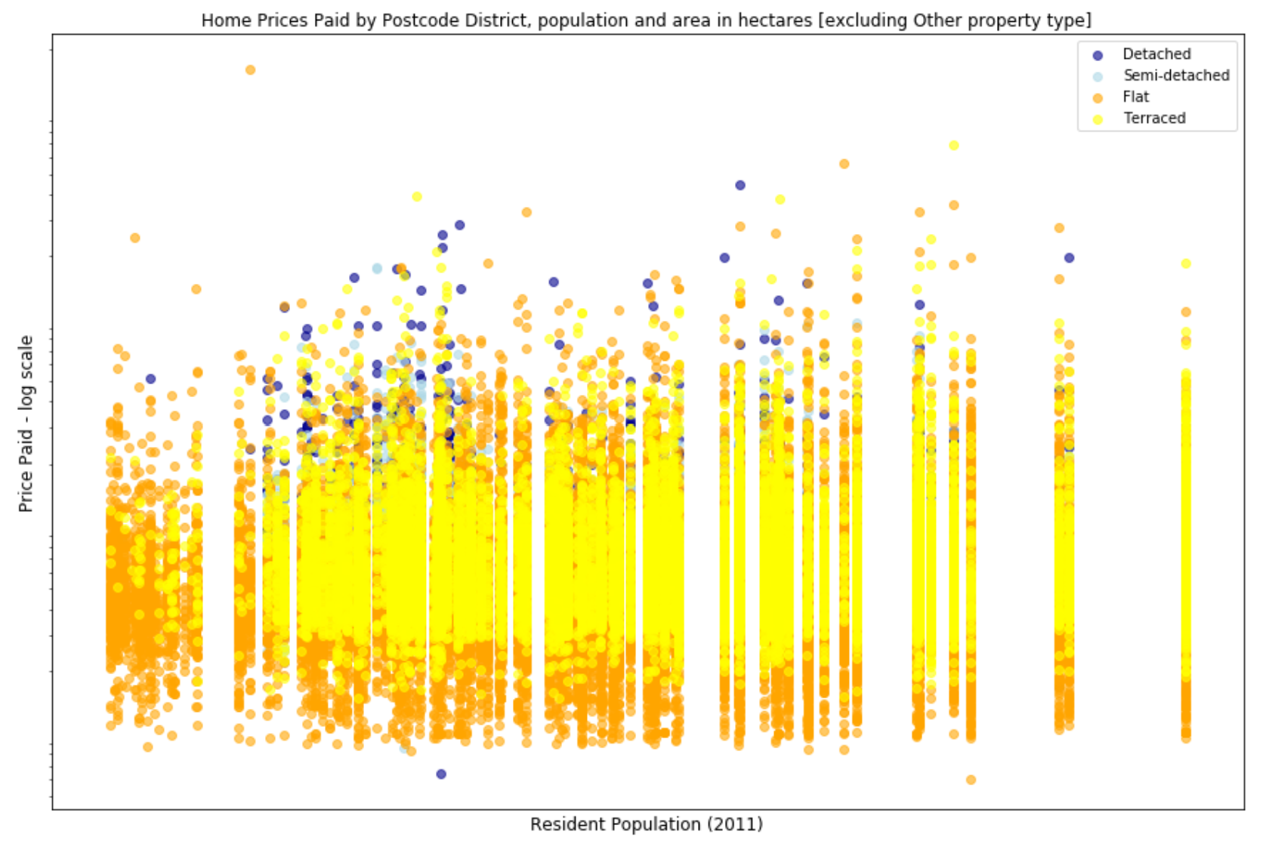
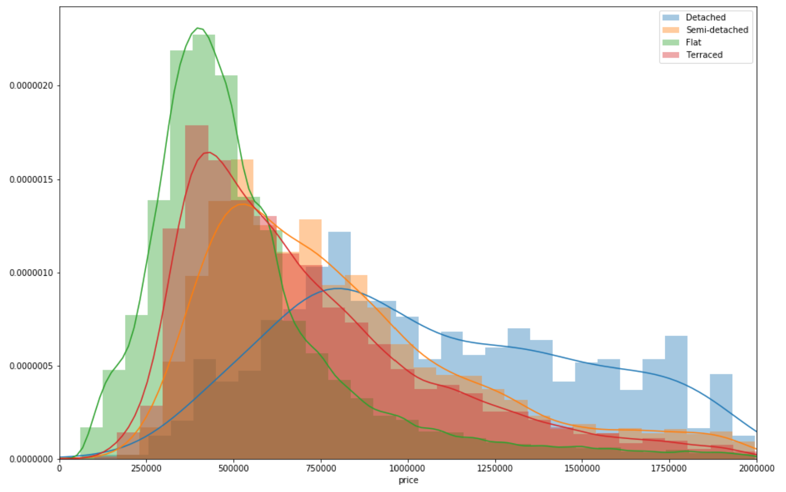
Examining the data
Steps taken to prepare and examine the dataset:
‘Chunking’ when importing because the original file was quite large (~22M lines)
Renaming columns for easier readability
E.g., home types such as ‘Flat’ or ‘Terraced’ were indicated with values ‘F’ and ‘T’
Adding new columns, including month and year of purchase, and postcode district (the first 4 characters of a postcode in the UK)
Adding features related to population density from the UK Datastore, including total population and school-age children population by postcode district
Creating charts to visualize the distributions of prices by varying features – such as month purchased, price & population density by property type (fig. 1), and histogram of prices by property type (fig. 2)
Also, we filtered the data using pandas for some analysis (particular the mapping) to only include properties in selected Islington postcode districts
Fig 1.
Fig 2.

Slide 5

Statistical Analysis and Mapping
Visualizing and analysing the data statistically and geographically:
Approaches;
Bootstrapped inference for comparison of ‘Flat’ and ‘Terraced’ property types
Geocoding the address information to extract latitude and longitude co-ordinates
Using the folium mapping package in Python to create heatmaps of property locations, overlaid onto additional map layers of London borough boundaries (see image to right)
Adding interactivity to the map to, for example, allow the user to hover over boroughs for tooltip information or toggle the visibility of layers
Some conclusions;
There are statistical differences between prices for ‘Flat’ and ‘Terraced’ properties – interesting as ‘Terraced’ is not a property type used in North America!
More data is needed to correctly identify the co-ordinates for some properties – as can be seen the map some properties were outside of the Islington postcodes that we had filtered for. But the resulting maps are quite nice and the location data could be used for even more advanced feature creation using location analysis packages such as geopandas.

Slide 6

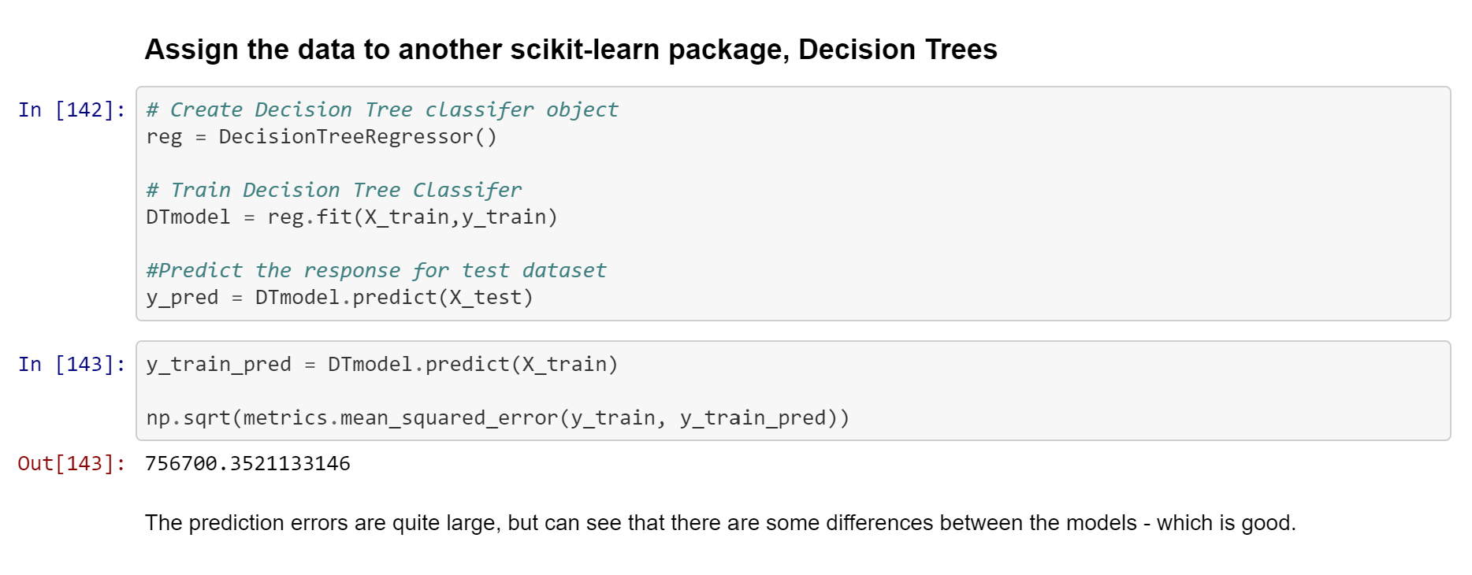
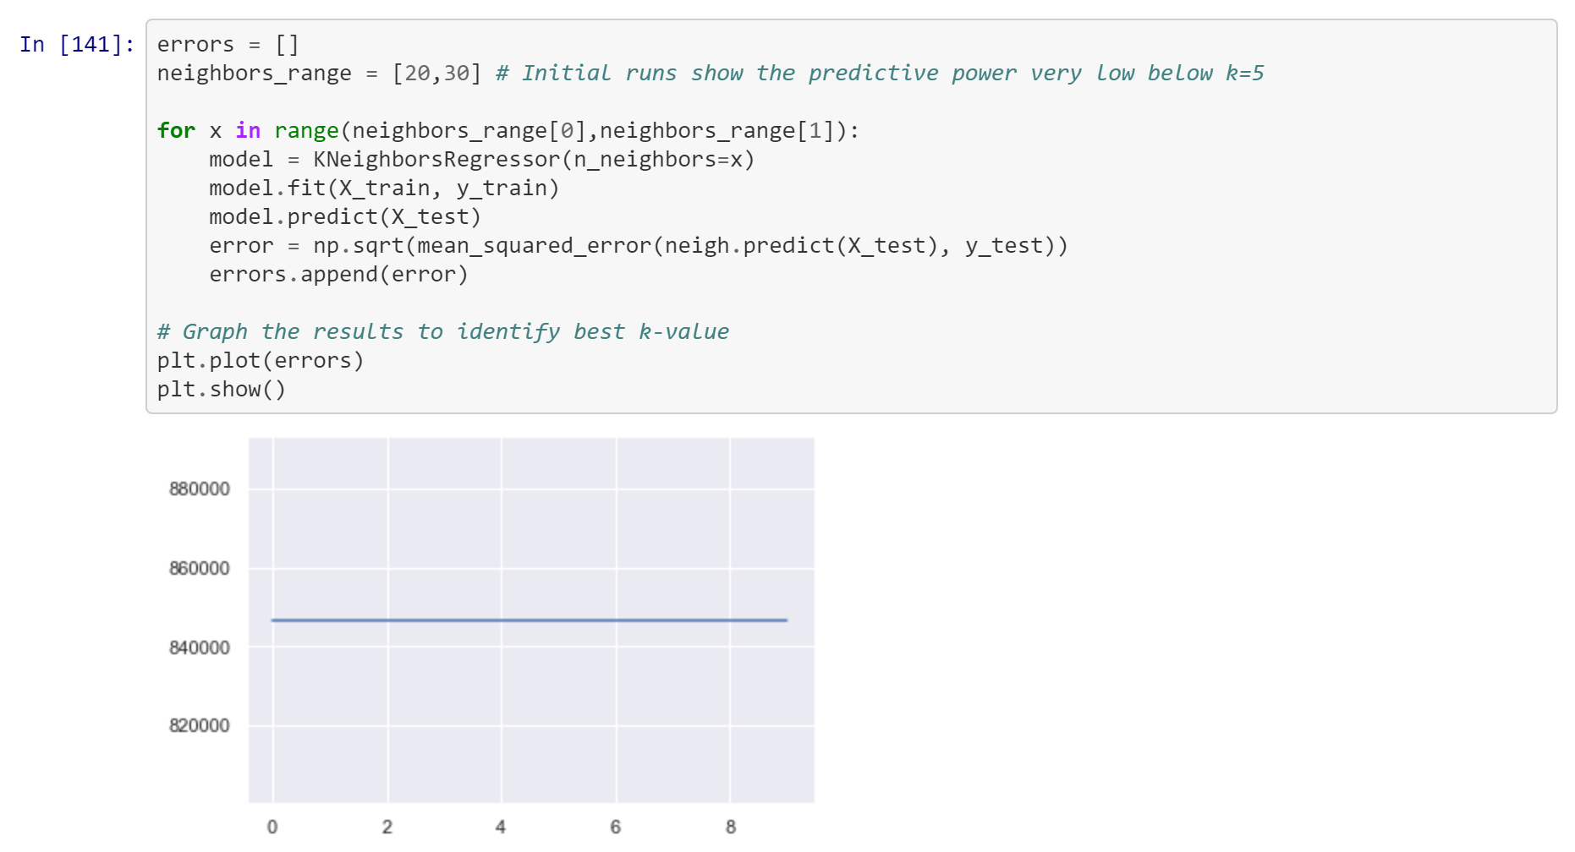
Predictive Modelling
Applied machine learning models using scikit-learn;
Approaches;
Preprocessed the categorical data using scikit-learn’s OneHotEncoder method (after eliminating the property type ‘Other’ because its value were not reflective of typical residential properties)
Split the data into training and test sets using train_test_split
KNeighborsRegressor, with a for loop to determine optimal k-value
DecisionTreeRegressor
Conclusions;
We used mean squared error to measure accuracy
The models did not provide good accuracy, likely due to the features of the dataset not being highly predictive; however, a Decision Tree approach did have a lower error than Kneighbors
Next Steps: develop the dataset to include more predictive features

Slide 7

CONCLUSIONS
The features in the data have limited predictive power. There are insights to draw but more features will need to be included to make any predictive model useful to generate strong estimates of price.
POSSIBLE NEXT STEPS
Identify other datasets with additional features with higher predictive power, such as number of rooms or London tube stations
Generate new features using location analysis, such as proximity to transit or points of interest, using packages such as geopandas

