Slide 1
자폐아동의 사회성발달 학습을 위한 교육용 프로그램
D조 삼김이최고

Slide 2
Progress according to our timeline (F/B)
idx | content | week
 |  | 1 | 2 | 3 | 4 | 5 | 6 | 7 | 8 | 9 | 10 | 11 | 12
Front /Back | UI / UX
 | DB / webcam fps 성능

Slide 3
Progress according to our timeline (AI)
idx | content | week
 |  | 1 | 2 | 3 | 4 | 5 | 6 | 7 | 8 | 9 | 10 | 11 | 12
AI | 데이터셋확보 및 라벨링
 | 모델 구축 및 성능평가

Slide 4
Progress according to our timeline (공통)
idx | content | week
 |  | 1 | 2 | 3 | 4 | 5 | 6 | 7 | 8 | 9 | 10 | 11 | 12
공통 | yolo 실습 및 라벨링
 | 설문 진행 /성능평가 /결과 리뷰

Slide 5
What have done by whom this week
yolov5 실습 ( 전인원)
about coco-dataset ( 용택)
colab webcam opencv 구현 (종우 / 지원)
ai 관련 논문 학습 (나영)

Slide 6
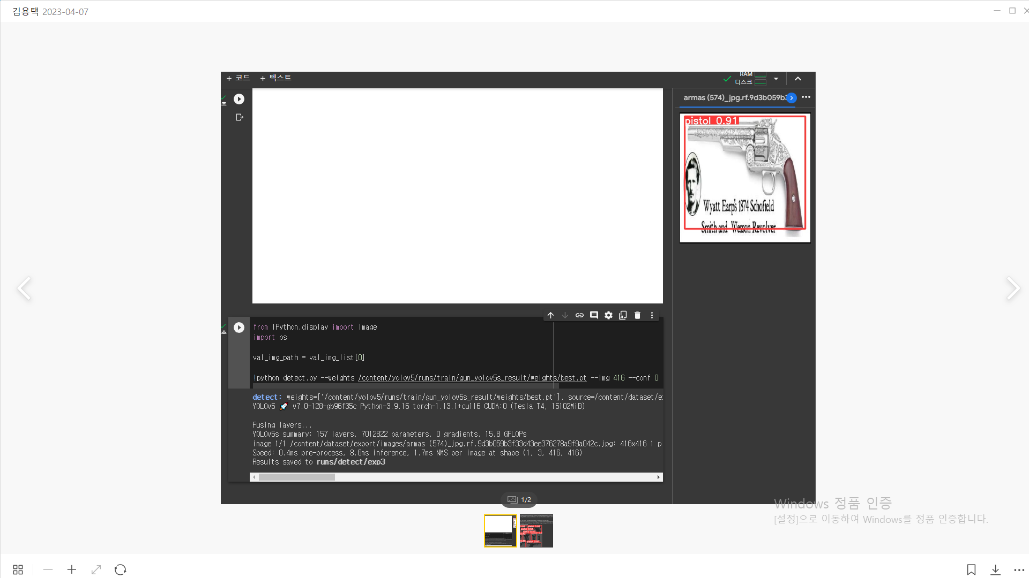
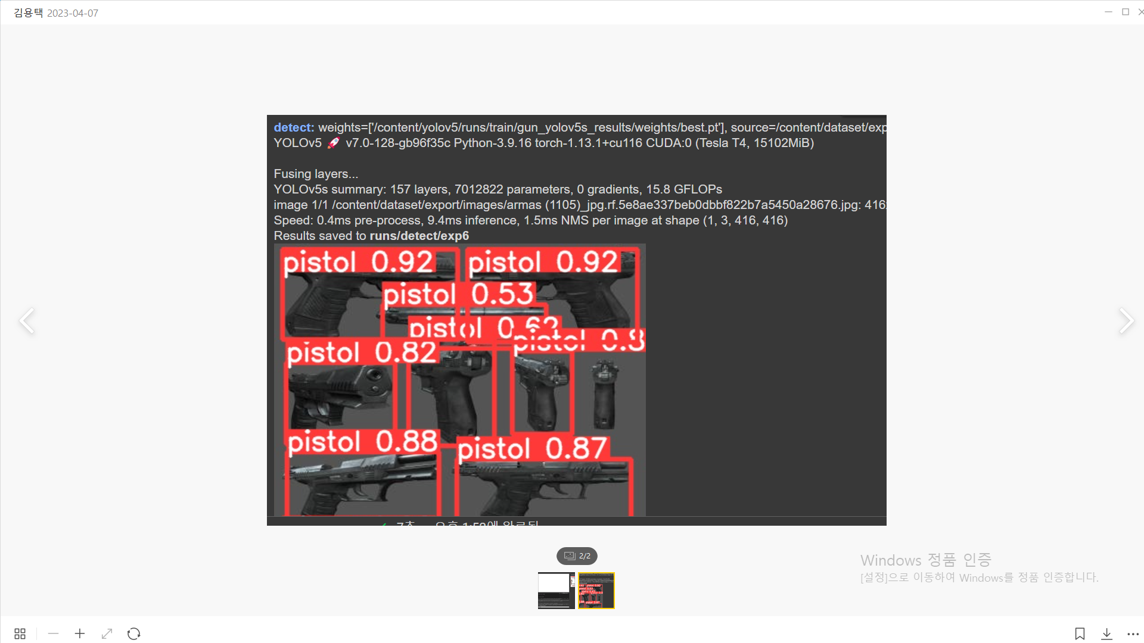
Yolov5 실습 전원

Slide 7
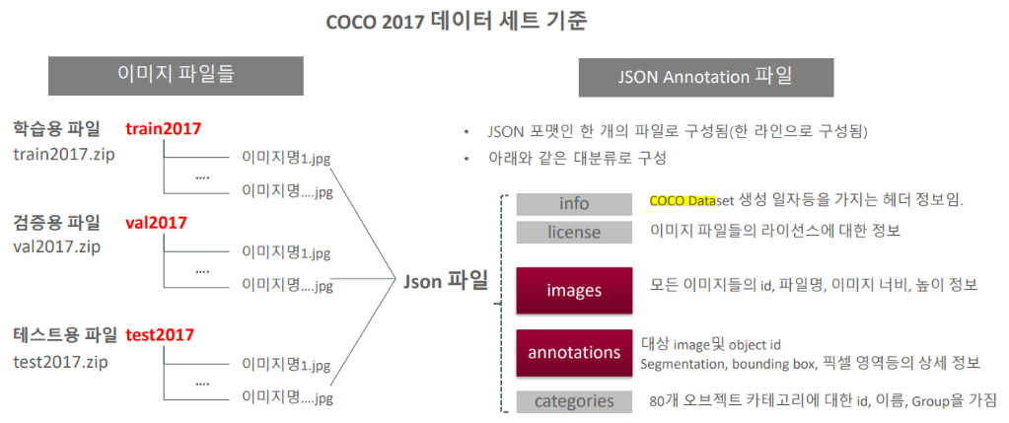
COCO DATASET
Common Object in Context

Slide 8
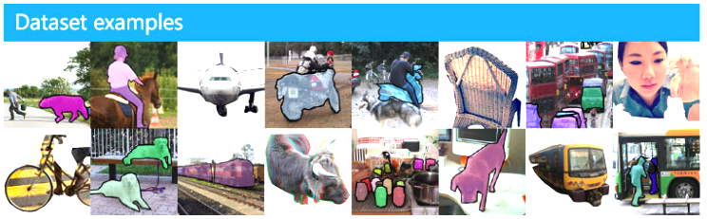
COCO DATASET
Trying to Add Our Own Dataset!!
https://cocodataset.org/#explore

Slide 9
Webcam on Colab Server
cv2.VideoCapture(0) – Not Work…
Run YOLOv8 on COLAB rather than locally, we need to enter the webcam via the colab server.

Slide 10
Web Cam Images
Running code on images taken from webcam is fairly straight-forward. We will utilize code within Google Colab's Code Snippets that has a variety of useful code functions to perform various tasks.
We will be using the code snippet for Camera Capture to utilize your computer's webcam.

Slide 11
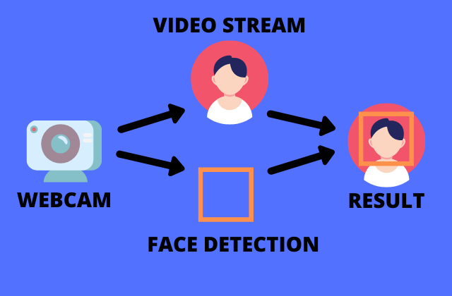
Web Cam Videos
Running code on webcam video is a little more complex than images. We need to start a video stream using our webcam as input. Then we run each frame through our and create an overlay image that contains bounding box of detection(s).
We then overlay the bounding box image back onto the next frame of our video stream.

Slide 12
Reference
colab_webcam.ipynb - Colaboratory (google.com)

Slide 13
what will do by whom next week
감정놀이방 web page ui 프로토타입 (front)
감정놀이방 아동 얼굴 표정 인식 및 성공/실패 구현 (ai)

Slide 14
Thank You!

