Slide 1

Randomized SVD
Eduardo Vital Brasil – HPC-AI Mines Paristech - 03/12/2021

Slide 2
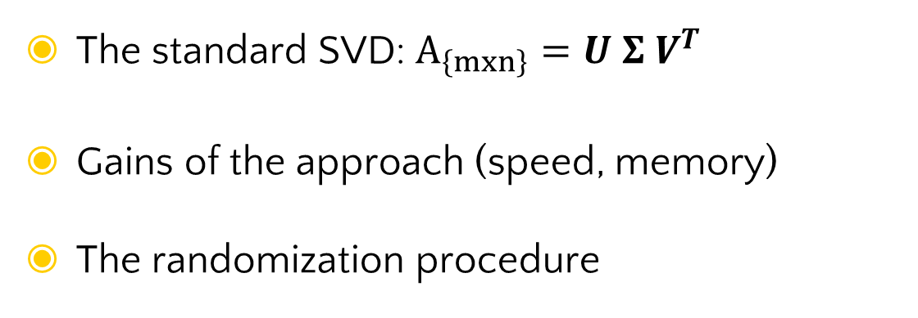
Motivation
{mxr}
{rxr}
{rxn}
The standard SVD: $A_{\left\{mxn\right\}}=U Σ V^{T}$
Gains of the approach (speed, memory)
The randomization procedure

Slide 3
Trade-off
Speed
Using a smaller matrix coasts a lot less if the initial Matrix A is really big.
Precision
The approximation infers in losses of information. We can make this loss neglectable.

Slide 4

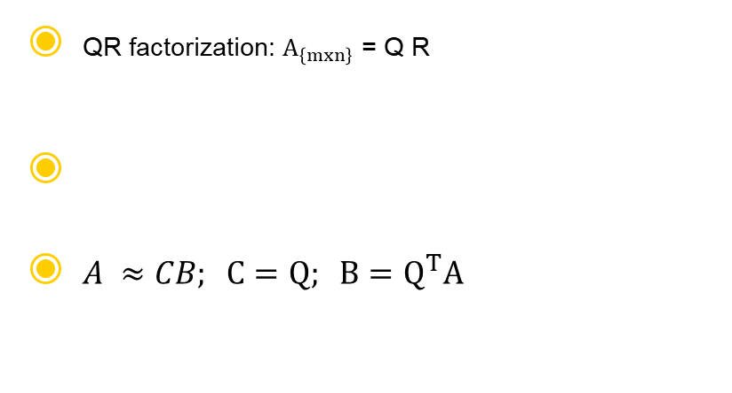
Base equations
Orthogonal
QR factorization: $A_{\left\{mxn\right\}}$ = Q R
$A ≈CB; C=Q; B=Q^{T}A$
Upper triangular

Slide 5
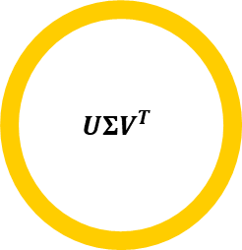
Overview
Input matrix A
Part I
Part II
$$UΣV^{T}$$
Computing Ω
Finding Y
Decomposing to Q
Form small matrix B
Compute the SVD of B
Approximate the SVD of A

Slide 6










Part I – Compute Q with fixed rank problem
* l = r+p = r+5
1
2
3
Improve performance in slow decaying singular values:
Subspation iteration
*Compute $Ω_{\text{\{}\text{nxl}\text{\}}}$:
Gaussian or sampling matrix
$$Y_{\text{\{}\text{m}\text{xl}\text{\}}}= A Ω$$
$$Y_{\text{\{}\text{m}\text{xl}\text{\}}}=QR$$
1
2
3
4
5
6
Singular vectors stay the same
Singular values decay exponnentialy
$$Y_{\text{0}}= A Ω$$
$$Y_{\text{0}}=Q_{0}R_{0}$$
$$Y_{\text{j}}= A^{T}Q_{j−1}$$
$$Y_{\text{j}}=Q_{j}R_{j}$$
$$Y_{\text{j}}={AQ}_{j}$$
$$Y_{\text{j}}=Q_{j}R_{j}$$
$$loop j=1, 2…, q$$

Slide 7
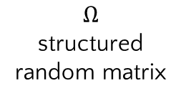

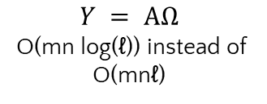
Part I – Compute Q with accelerated tecnique
D: diagonal matrix whose entries are independent random variables uniformly distributed on the complex unit circle
F: unitary discrete Fourier transform
R: Sampling matrix
$$Ω$$
structured random matrix
{nxn}
{nxn}
{nxl}
$$Ω =\sqrt{\frac{n}{l}} D F R$$
Or other structured matrix, including sequences of Givens Rotations for example
$$Y = AΩ$$
O(mn log(ℓ)) instead of O(mnℓ)

Slide 8

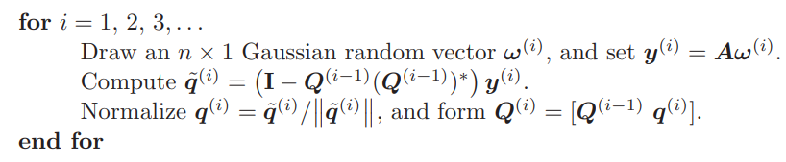
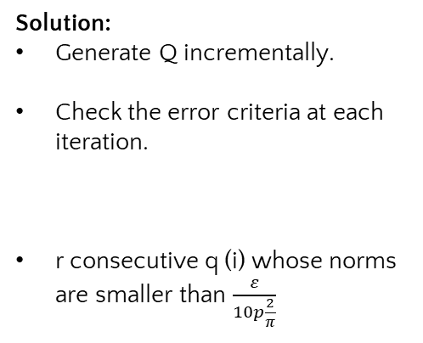
Part I – Compute Q fixed precision problem
Problem:
Solution:
Generate Q incrementally.
Check the error criteria at each iteration.
r consecutive q (i) whose norms are smaller than $\frac{ε}{10p\frac{2}{π}}$

Slide 9
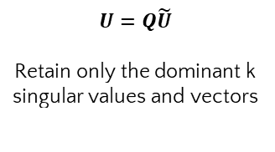
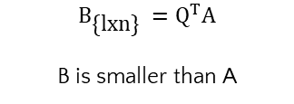

Part II – Compute SVD - standard
Reminder
$$A ≈CB; C=Q; B=Q^{T}A=Q^{T}UΣV^{T}$$
1
2
3
$$B_{\text{\{}\text{l}\text{x}\text{n}\text{\}}} =Q^{T}A$$
B is smaller than A
$$B=\tilde{U} Σ V^{T}$$
$$U=Q\tilde{U}$$
Retain only the dominant k singular values and vectors
$$\tilde{A}=U Σ V^{T}$$

Slide 10
Part II – Compute SVD – special cases
Post-processing via row extraction: fast, but low precision, use Interpolative Decomposition
Postprocessing an Hermitian matrix – use of Direct Eigenvalue Decomposition
Postprocessing a positive semidefinite matrix – use of Eigenvalue Decomposition via Nystrom Method
Single-pass algorithms – To large matrix to be stored

Slide 11
Thanks!
Any questions ?
Reference
Halko, N., Martinsson, P.-G., & Tropp, J. A. (2011). Finding structure with randomness: Probabilistic algorithms for constructing approximate matrix decompositions. SIAM Review, 53(2), 217–288.

