Slide 1
Simulation of BNE
Brazil Nut Effect Simulation Guideline
Notes:
Are your classroom colors different than what you see in this template? That’s OK! Click on Design -> Variants (the down arrow) -> Pick the color scheme that works for you!
Feel free to change any “You will…” and “I will…” statements to ensure they align with your classroom procedures and rules!

Slide 2
Research Pipeline
Data Generation
Feature Preparation
Model Comparison & Testing
Model
Development
& Training

Slide 3
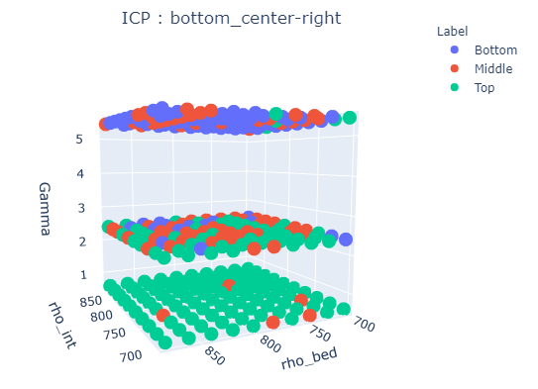
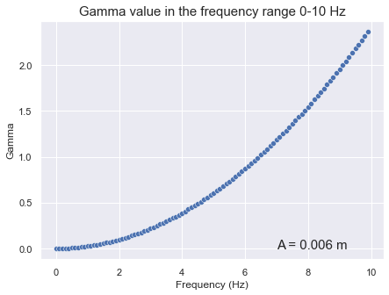
Data Generation
Randomly generated variables:
The initial horizontal position of the intruder, will result in a different system configuration before the vibration begins.
Contactopy will be calculated.
Density of intruder and bed, each will be generated randomly with a range 700-1400. The diameter will be fixed in a ratio of 0.02:0.006.
The frequency will be chosen randomly with a range of 0-10 Hz. The amplitude is fixed so that the Gamma value will range between: 0-2.5.
Model
Development
& Training

Slide 4
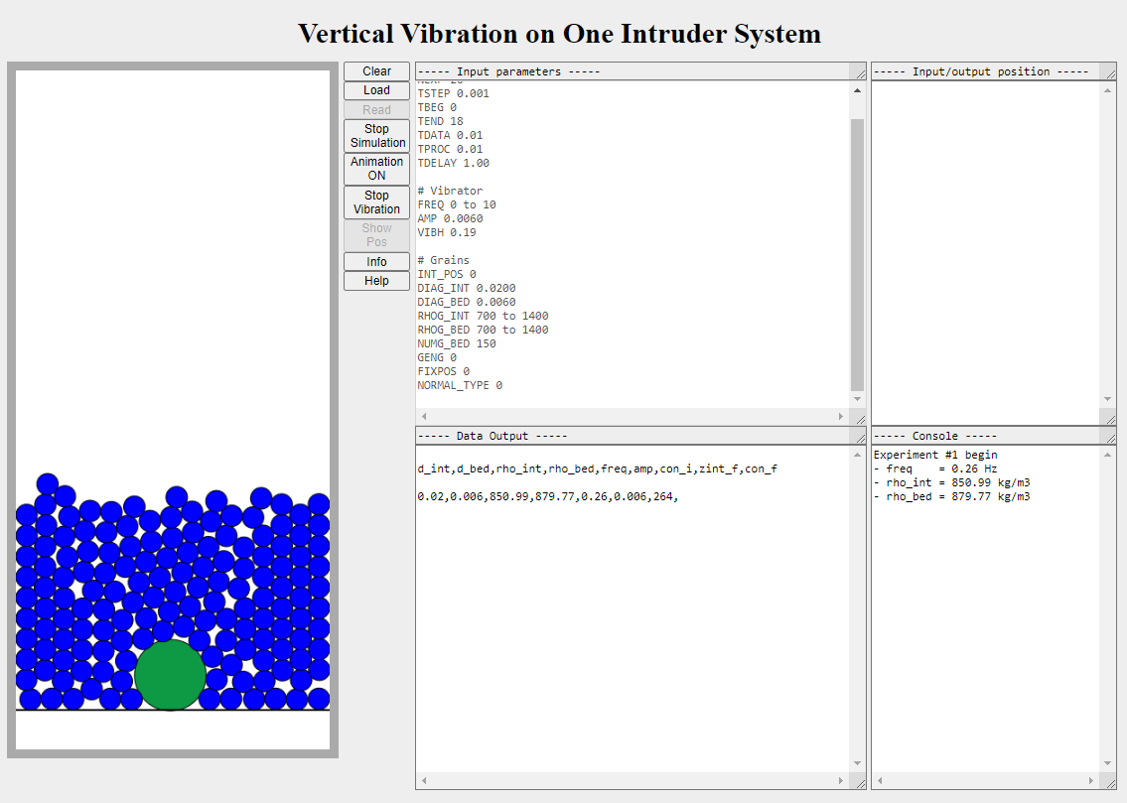
Simulation Layout
Model
Development
& Training

Slide 5
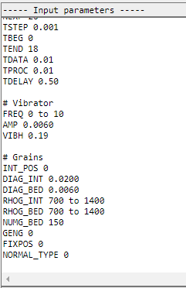
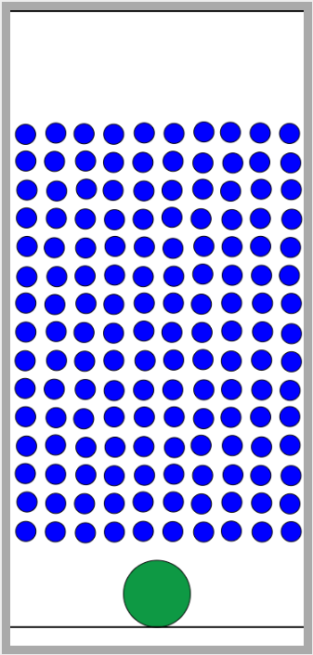
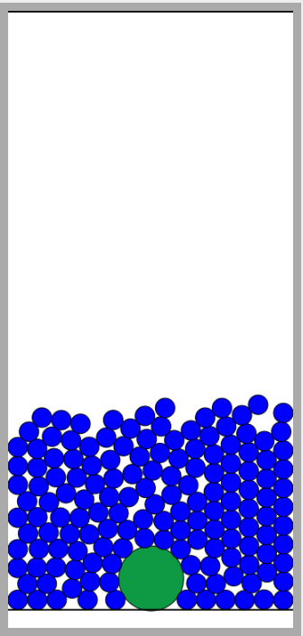
Intruder Initial Position
Users need to set the initial position in INT_POS parameters.
The value is in range of 0 – 8 (negative value will give the opposite direction)
After users click the READ button, The intruder will be in the specified position while the beds will be in the hover position (with a random factor).
By clicking of the Start Simulation button, the floating bed will experience free fall and settle to the bottom during the delay time before the vibration starts.

Slide 6
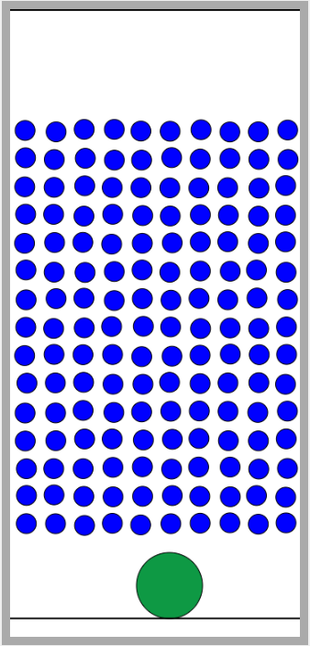
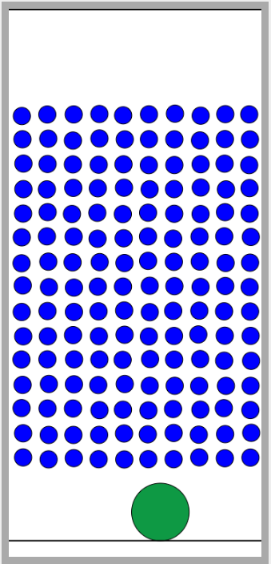
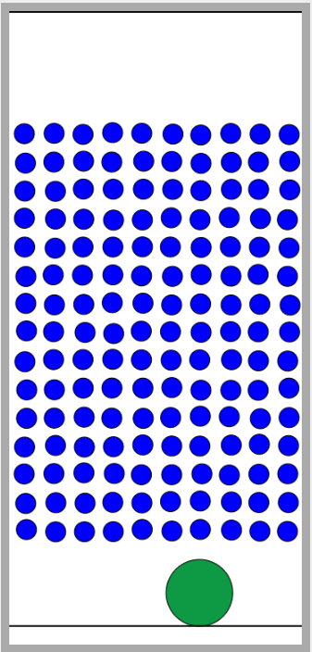
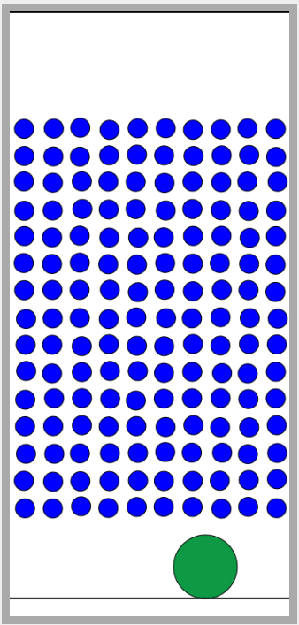
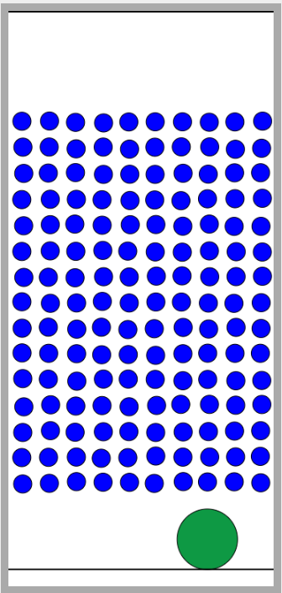
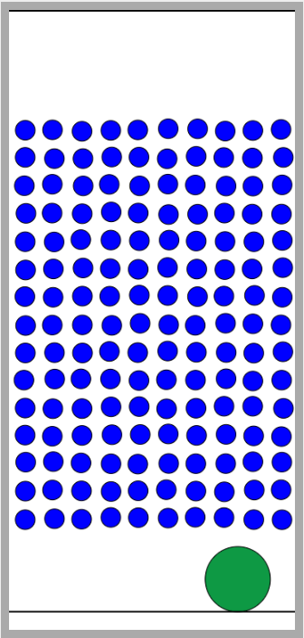
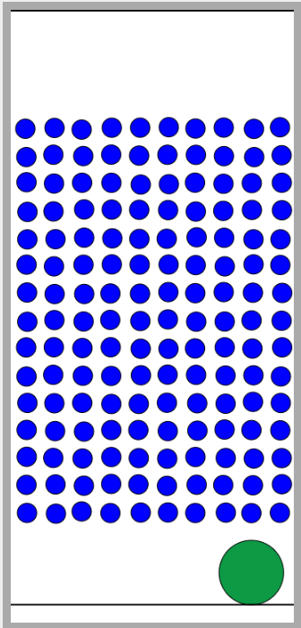
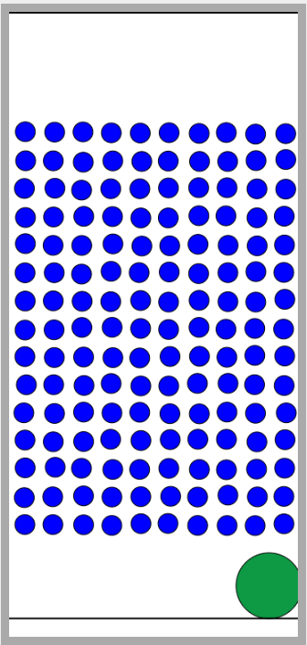
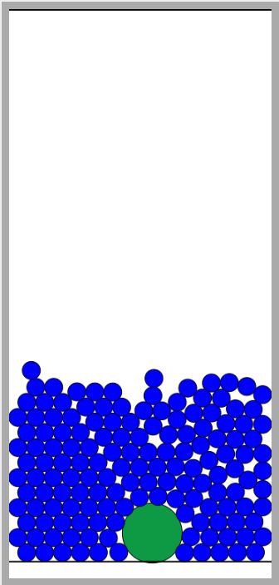
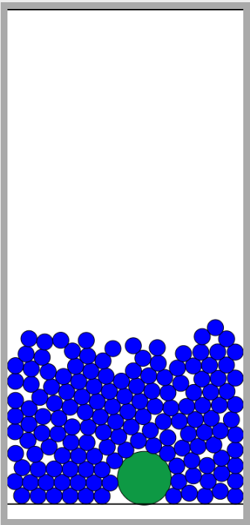
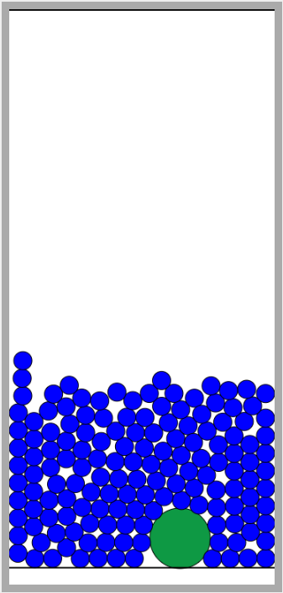
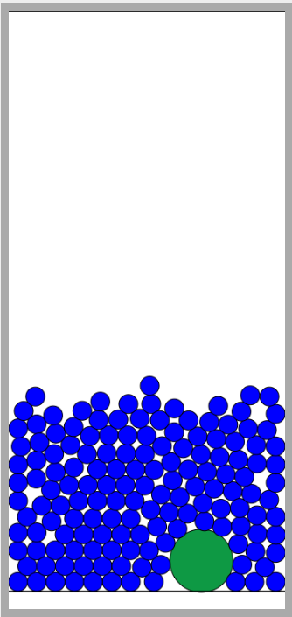

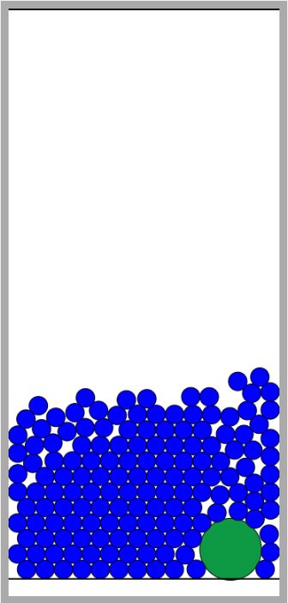
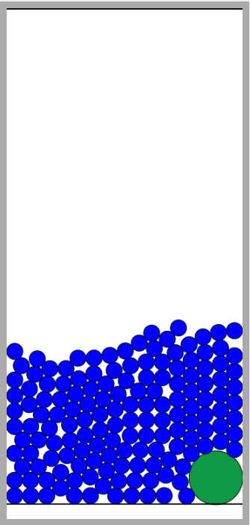
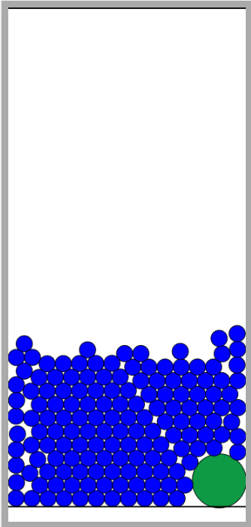
Initial Configuration
INT_POS = 0
INT_POS = 1
INT_POS = 2
INT_POS = 3
INT_POS = 4
INT_POS = 5
INT_POS = 6
INT_POS = 7
INT_POS = 8

Slide 7
Concactopy Calculation
function getContactopy() {
var Contactopy = 0;
for (var i=1; i<numg-1; i++) {
for (var j=i+1; j<numg; j++) {
var deuclid = Math.sqrt(
(r[i].y-r[j].y)*(r[i].y-r[j].y)
+(r[i].z-r[j].z)*(r[i].z-r[j].z));
if (deuclid < (0.5*(D[i]+D[j]))) {
Contactopy = Contactopy + 1;
}
}
}
return Contactopy;
}

Slide 8
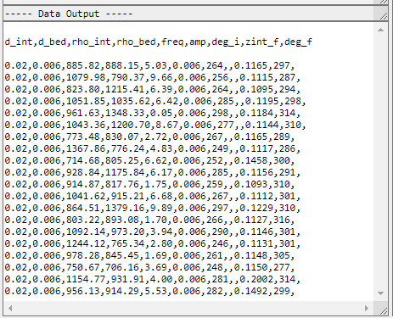
Get the Result
Copy all the result and paste into the plain text (ex: notepad).
Save as CSV
Filename: “int_pos_5.CSV” (for intruder position 5)

Slide 9
Thank you

