Slide 1
Pemodelan dan simulasi Bioinformatics Student Symposium
.
Sparisoma Viridi
Master Program in Computational Science, Nuclear Physics and Biophysics Research Division,
Department of Physics, Faculty of Mathematics and Natural Sciences, Institut Teknologi Bandung,
Bandung 40132, Indonesia
20230522_v2| https://doi.org/10.5281/zenodo.

Slide 2
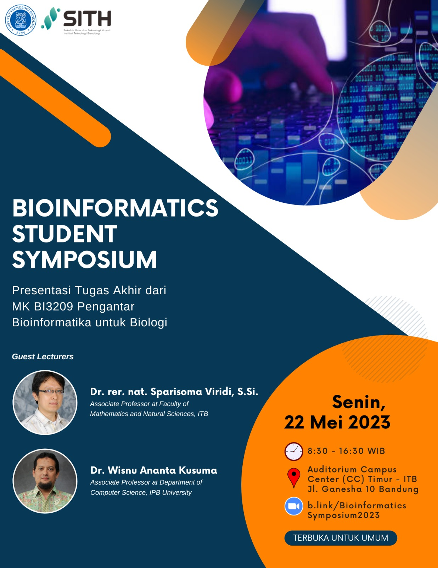

Slide 3
Silakan berdiskusi asinkron setelah simposium ini di https://github.com/dudung/bi3209-00-2022-2/issues/1

Slide 4
Keterangan (disclaimer)
Apa yang akan disampaikan tidak terkait langsung dengan bidang bioinformatika, akan tetapi lebih merupakan sharing pengalaman penelitian selama ini.
Rujukan, yang telah dipilih, mengenai suatu hal dituliskan di bagian bawah slide terkait untuk dapat ditelusuri lebih lanjut.
Hal-hal yang disampaikan tidak dapat terlepas dari pendapat pribadi dan pengalaman penyaji, sehingga belum tentu meru-pakan informasi yang paling tepat.

Slide 5
Kerangka
Model dan simulasi 6
Akurasi dan keseder- hanaan ..

Slide 6
Model dan simulasi

Slide 7
Model
A model is a product (physical or digital) that represents a system of interest.
A model is similar to but simpler than the system it represents, while approximating most of the same salient features of the real system as close as possible.
A good model is a judicious tradeoff between realism and simplicity.
Vinod Kumar Soni, “Answer to What is the difference between simulation and modeling?”, ResearchGate, 21 Feb 2020, url https://www.researchgate.net/post/What_is_the_difference_between_simulation_and_modeling [20230519].

Slide 8
Model (lanj.)
A key feature of a model is manipulability.
A model can be:
a physical model (for example a physical architectural house scale model, a model aircraft, a fashion mannequin, or a model organism in biology research); or
a conceptual model (for example a computer model, a statistical or mathematical model, a business model).

Slide 9
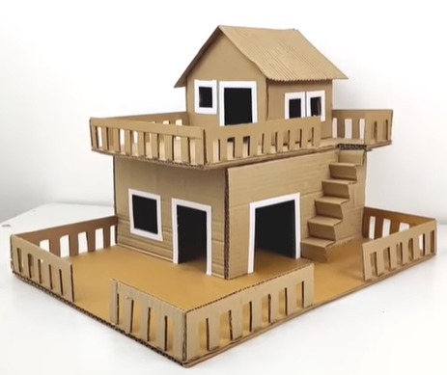
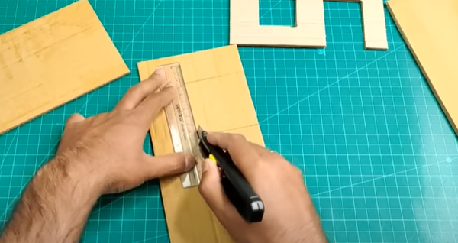
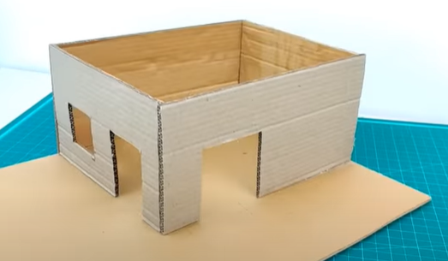
Aman Crafts, “Cardboard House Model Making | How To Make Miniature House From Cardboard | Cardboard House Project”, YouTube, 10.04.2022, url https://www.youtube.com/watch?v=_PvjdZIbgVg [20230519].

Slide 10
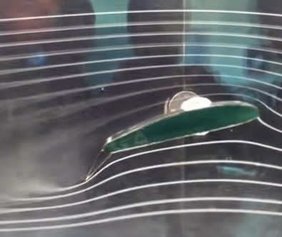
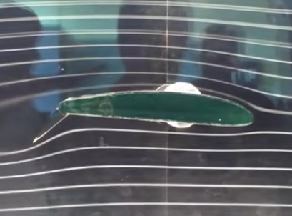
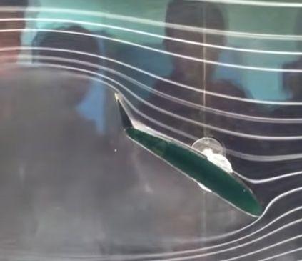

Ruhou Gao, “Cambered Airfoil in Smoke Tunnel”, YouTube, 15.09.2012, url https://www.youtube.com/watch?v=Png0fnG0b_U [20230519].

Slide 11
Simulation
A simulation is the process of using a model to study the behavior and performance of an actual or theoretical system.
In a simulation, models can be used to study existing or proposed characteristics of a system.
The purpose of a simulation is to study the characteristics of a real-life or fictional system by manipulating variables that cannot be controlled in a real system.
Vinod Kumar Soni, “Answer to What is the difference between simulation and modeling?”, ResearchGate, 21 Feb 2020, url https://www.researchgate.net/post/What_is_the_difference_between_simulation_and_modeling [20230519].

Slide 12
Simulation (lanj.)
Simulations allow evaluating a model to optimize system performance or to make predictions about a real system.
Simulations are useful to study properties of a model of a real-life system that would otherwise be too complex, too large/small, too fast/slow, not accessible, too dangerous or unacceptable to engage.
While a model aims to be true to the system it represents, a simulation can use a model to explore states that would not be possible in the original system.

Slide 13
Akurasi dan kesederhanaan

Slide 14
Accuracy vs simplicity
Accuracy vs. Simplicity: A Complex Trade-Off (E. Aragones, I. Gilboa, A. Postlewatite, D. Schmeidler, 2002).
Simplicity and Accuracy Trade-Off in Science: Simple metric for model selection (P. Niinen, 2013).
An Analysis of Accuracy and Simplicity in Relation to Knowledge (Kibin, 2023).
Simplicity vs Complexity in Machine Learning — Finding the Right Balance (Tayo, 2019).
pdf
pdf
html
html

Slide 15
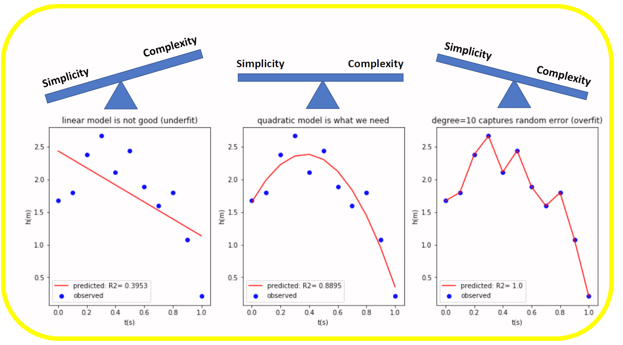
Benjamin Obi Tayo, “Simplicity vs Complexity in Machine Learning — Finding the Right Balance”, Towards Data Science, 11 Nov 2019, url https://towardsdatascience.com/p-c9000d1726fb [20230519].

Slide 16
Simple model is preferred over a complex one
Prevents Overfitting: A high-dimensional dataset having too many features can sometimes lead to overfitting (model captures both real and random effects).
Interpretability: An over-complex model having too many features can be hard to interpret especially when features are correlated with each other.
Computational Efficiency: A model trained on a lower-dimensional dataset is computationally efficient (execution of algorithm requires less computational time).

Slide 17
Terima kasih

