Slide 1
Simulasi sistem biologi Bioinformatics Student Symposium
.
Sparisoma Viridi
Master Program in Computational Science, Nuclear Physics and Biophysics Research Division,
Department of Physics, Faculty of Mathematics and Natural Sciences, Institut Teknologi Bandung,
Bandung 40132, Indonesia
20230522-v0| https://doi.org/10.5281/zenodo.

Slide 2
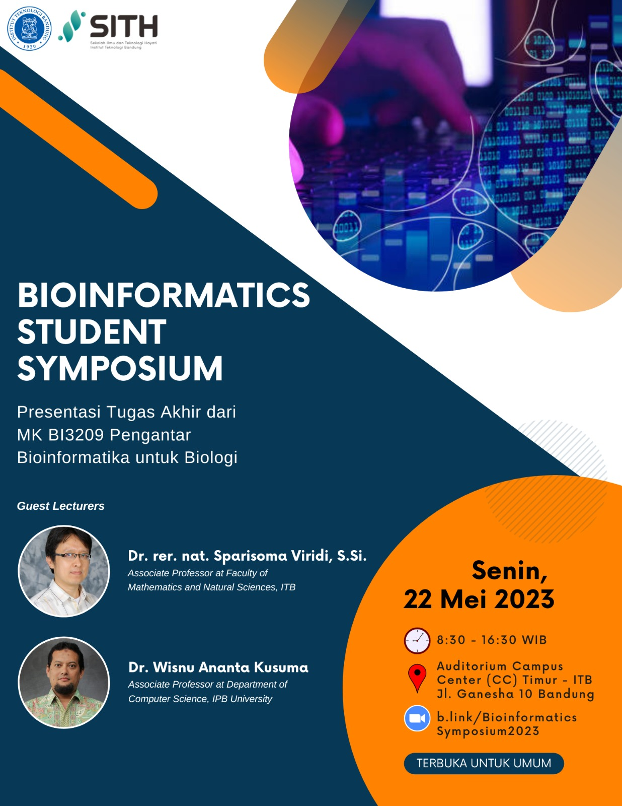

Slide 3
Silakan berdiskusi setelah simposium ini di https://github.com/dudung/bi3209-00-2022-2/issues/1

Slide 4
Kerangka

Slide 5
..

Slide 7
Terima kasih
-

