Slide 1
Pengenalan Ringan dan Singkat Konsep 3S (Safety, Security, Safeguards)
Sidik Permana, Sparisoma Viridi
Nuclear Physics and Biophysics Research Division
Department of Physics, Institut Teknologi Bandung, Bandung 40132, Indonesia
20221117-v2 | https://doi.org/10.5281/zenodo.7328962

Slide 2
Kerangka
Satuan acara perkuliahan 3
Referensi 5
Istilah dan artinya 8
Security, Safety, Safeguards 10
Good practices and challanges 19
Mathematical models and assessment methodologies 26

Slide 3
Satuan acara perkuliahan

Slide 4
Minggu ke-13 | 15 November 2022*
Topik Konsep 3S safety, security dan safeguard
Subtopik Implementasi dari konsep perpaduan safety, security dan safeguard pada fasilitas nukir
*Sebagaimana tercantum dalam SAP di SIX.

Slide 5
Referensi

Slide 6
Referensi utama
Donald Kovacic, “Organisational culture for safety, security and safeguards in new nuclear power countries”, chapter 4 in Verification & Implementation, A biennial collection of analysis on international agreements for security and development, VERTIC, 2015, pp 65-86. url http://www.vertic.org/media/assets/VI%202015/VI%20 Chapter%204.pdf

Slide 7
Catatan kaki
Referensi lain akan disertakan pada catatan kaki dengan tautan yang dapat diakses.
Bila terdapat rangkaian slide menggunakan catatan kaki yang sama, catatan kaki disertakan hanya pada slide pertama pada rangkaian tersebut.

Slide 8
Istilah dan artinya

Slide 9
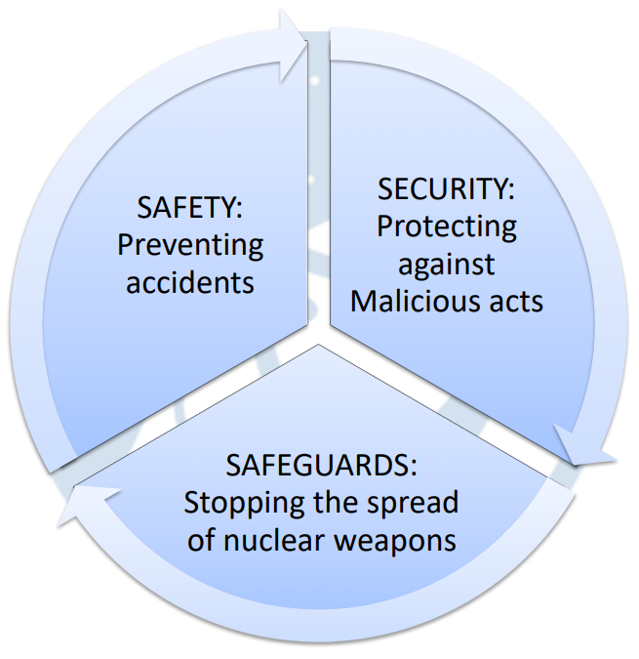
Istilah dan arti
Alberto Muti, “Nuclear Safety, Security and Safeguards", VERTIC, 2019, url https://www.vertic.org/wp-content/uploads/2019/10/AM-Nuclear-3S_UK-PONI-Presentation.pdf [20221117].

Slide 10
Security, Safety, Safeguards

Slide 11
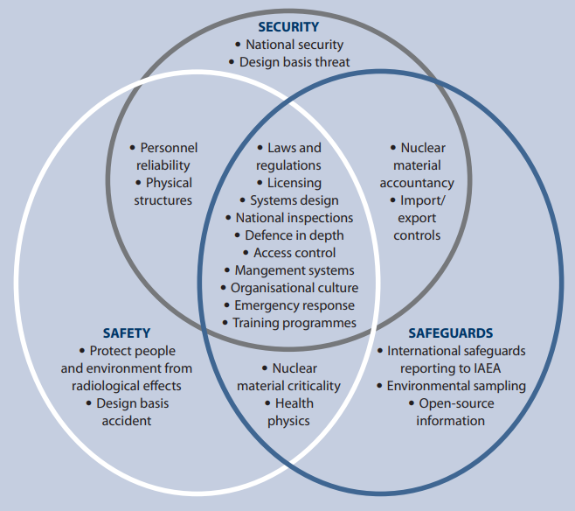
Relasi 3S
(Kovacic, 2015)

Slide 12
Termasuk di semua komponen 3S
Laws and regulations
System design
National inspections
Defence in depth
Access control
Management systems
Organisational culture
Emergency response
Training programmes

Slide 13
Hanya di Security
National security
Design basis threat

Slide 14
Hanya di safety
Protect people and environment from radiological effects
Design basis accident

Slide 15
Hanya di Safeguard
International safeguards reporting to IAEA
Environmental sampling
Open-source information

Slide 16
Irisan antara Security and Safety
Personnel reability
Physical structures

Slide 17
Irisan antara Security and Safeguards
Nuclear material accountancy
Import/export controls

Slide 18
Irisan antara Safety and Safeguards
Nuclear material criticality
Health physics

Slide 19
Good practices and challanges

Slide 20
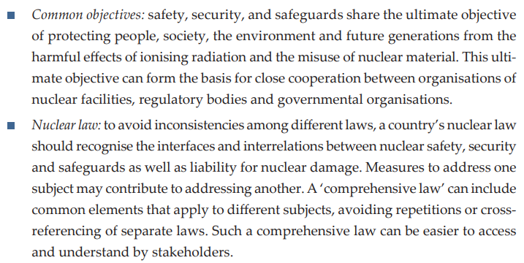
Good practices

Slide 21
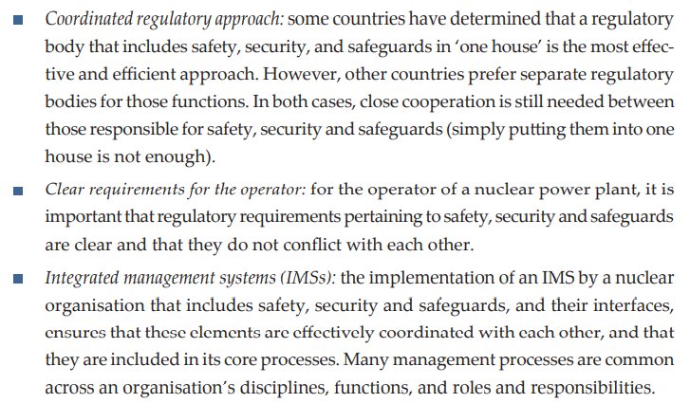

Slide 22
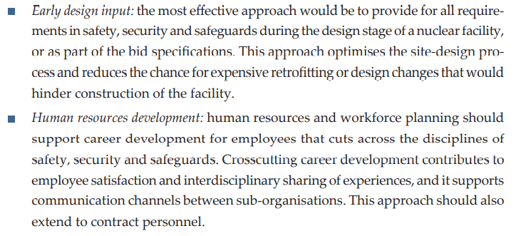

Slide 23
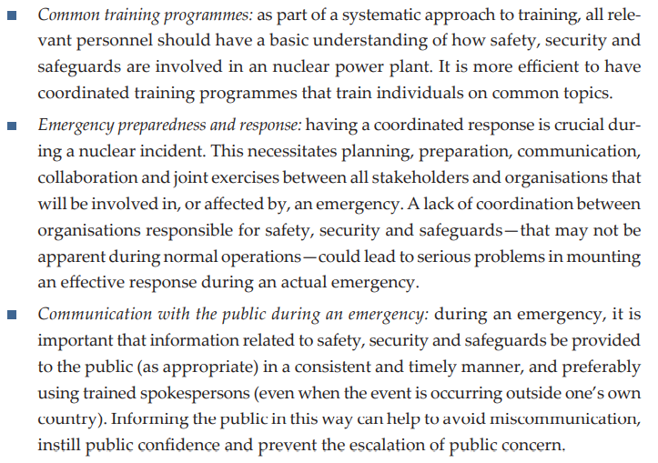

Slide 24
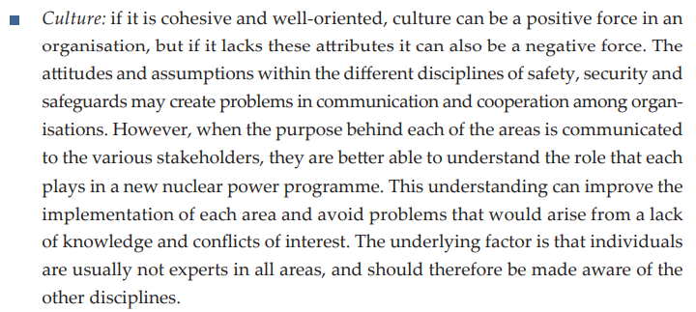
Challanges

Slide 25
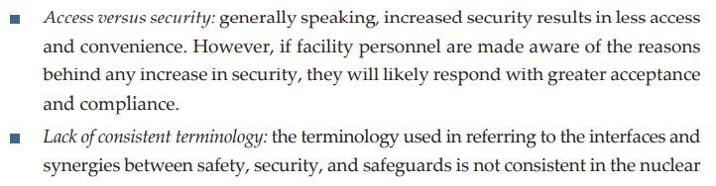

Slide 26
Mathematical models and assessment methodologies

Slide 27
Law – frequency space
Horizontal axis: Frequency
Vertial axis: Law
Statistics: Reported event (+ natural disasters)
Bayes: Events depend on other events
Game/Markov: Particles/agents interactions (+ environment)
Mitsutoshi Suzuki, Norichika Terao, “Solution Monitoring Evaluated by Proliferation Risk Assessment and Fuzzy Optimization Analysis for Safeguards in a Reprocessing Process", Science and Technology of Nuclear Installations, vol 2013, id 590684, Feb 2013, url https://doi.org/10.1155/2013/590684.

Slide 28
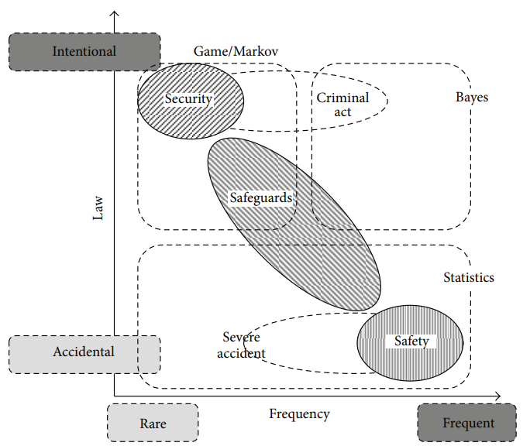

Slide 29
Consistency
The overlaps between Safety, Security, and Safeguards seem not accomated to the model
Inconsistency or implicit already considered? Any idea?

Slide 30
Terima kasih
-, “", url https:// [20220830].

