Slide 1
Human Factor in Nuclear Security Dr. Igor Khripunov Nonresident Fellow Stimson Center USA at the Annual Meeting of the International Nuclear Security Education Network 13-18 July, 2020, Vienna, Austria

Slide 2
Summary
Definitions
Human Factor as a Security Asset and Liability
Nuclear Security Concerns
Human Factor in a New Risk and Technologial Environment
National Culture and its Impact
Human Fallibility.
Security Culture as a Cross-Cutting Element

Slide 3
Human Factor as a Supporting and Enhancing Element
Nuclear Security
The prevention and detection of, and response to, theft, sabotage, unauthorized access, illegal transfer or other malicious acts involving nuclear or other radioactive substances in their associated facilities.
Nuclear Security Culture
The assembly of characteristics, attitudes and behavior of individuals, organizations and institutions which serves as a means to support and enhance nuclear security.

Slide 4
Human Factor as an Asset and Liability
A human factor works both ways: to strengthen and support nuclear security or contribute to nuclear security related incidents as well as system malfunctions
The latter includes:
Deliberate and malicious acts
Unintentional inadvertent personnel errors
Ergonomic issues (design and layout of software and hardware)
Inadequate organizational procedure and processes
Management miscalculations and failures
The human-machine interface is the part of a system through which personnel interact with the security regime to perform their functions and tasks including procedures, communication, alarms, and controls
How efficiently and professionally the workforce accomplishes this mission is contingent on the management and status of nuclear security culture

Slide 5
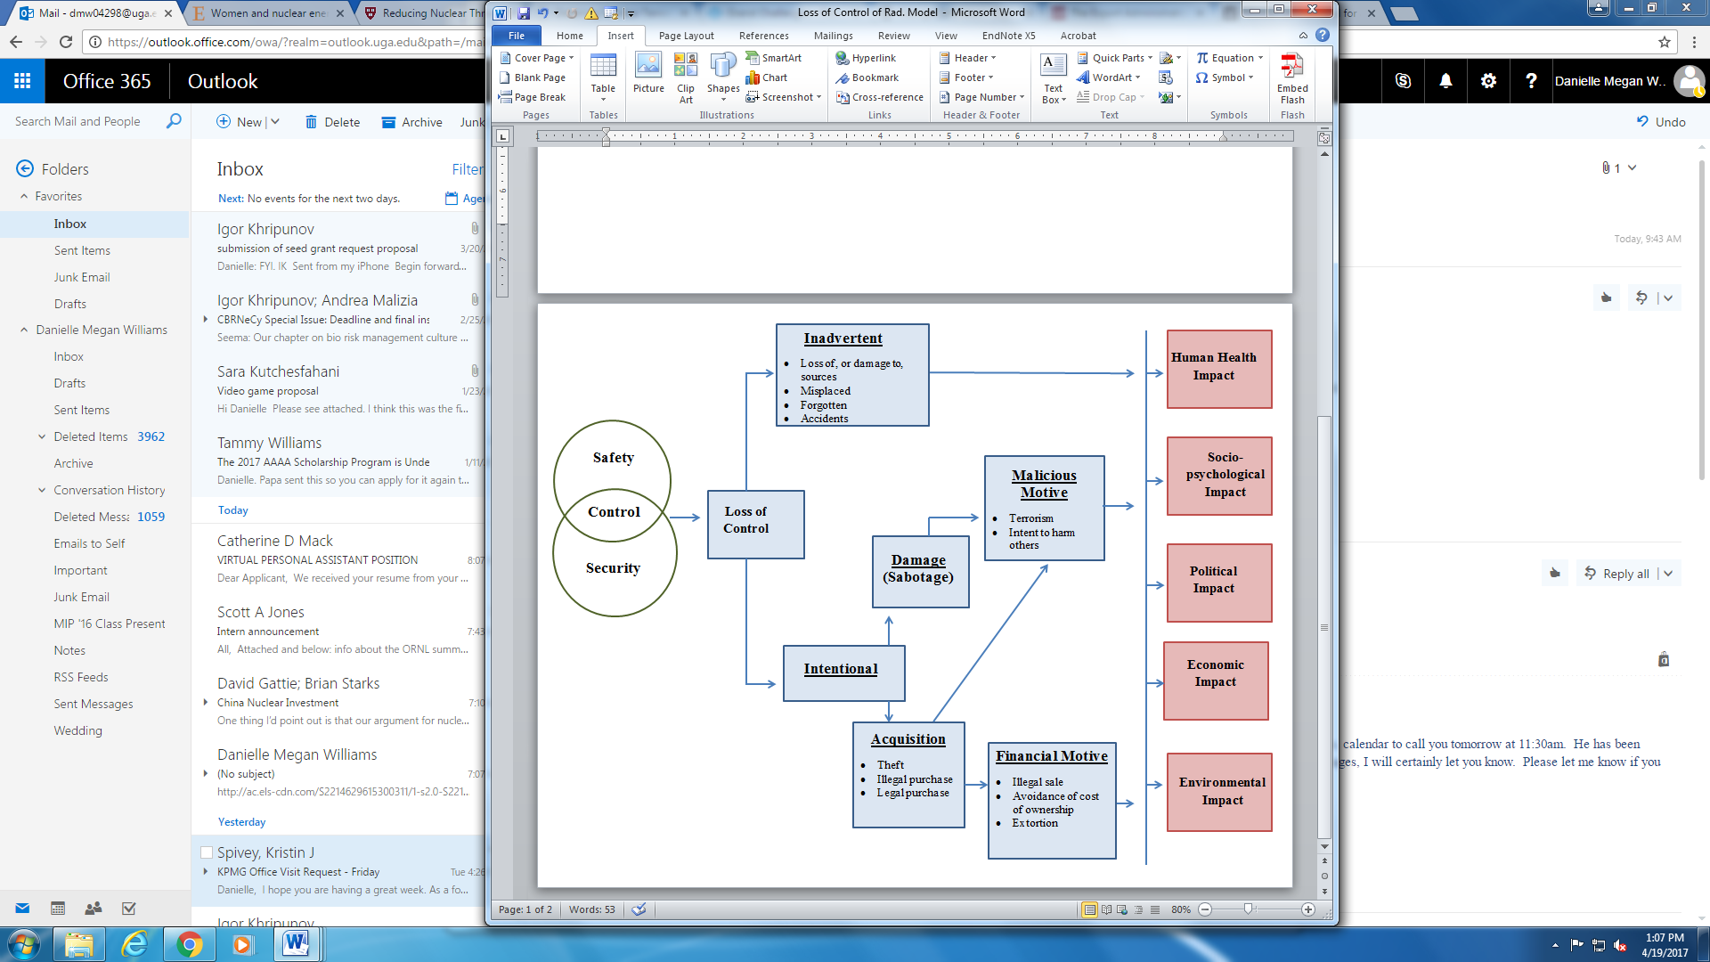
Loss of Control of Radioactive Sources and Possible Consequences
Unintentional (Inadvertent)
This chart illustrates how unintentional (inadvertent) and intentional loss of control may lead to serious consequences
Based on IAEA, “Strengthening Control over Radioactive Sources in Authorized Source use and Regaining Control over Orphan Sources”, IAEA-TECDOC-1388, February 2004, pg.9.

Slide 6
The Case of an Orphan Source and Radiological Event in Goiania, Brazil (1985)
A private radiotherapy institute moved to new premises leaving in place a caesium-137 teletherapy unit without notifying the licensing authorities
Two persons removed the source assembly and ruptured the capsule
The caesium chloride salt spread throughout the city of Goiania
Impact on Goiania City:
260 persons contaminated including 124 with internal and/or external contamination
4 persons died within four weeks
About 125,000 persons monitored until February 1988 over an area of 67km²
4 hospitals, 42 residences, numerous public buses and private cars heavily contaminated
Over 3500m³ of accumulated radioactive waste
Long-term consequences for the economy, employment, and living standard
Long lasting severe psychological trauma and national stigma
Is the event in Goiania a result of oversight, complacency, negligence, or…?

Slide 7

Pelindaba Break-In, South Africa
Pelindaba nuclear facility, 18 miles west of Pretoria, the capital of South Africa

Slide 8
Pelindaba Break-In
In November 2007, a group of armed men broke into the Pelindaba Nuclear Facility, a site at which hundreds of kilograms of weapons-grade uranium are stored – enough for 25 bombs.
Perpetrators deactivated several layers of security, including a 10,000-volt electrical fence, suggesting insider knowledge of the system. Though their images were captured on closed-circuit television, they were not detected by security officers because no one was monitoring the cameras at the time.
The intruders broke into the emergency control center in the middle of the facility. After running into an off-duty emergency services officer who was there by chance, the intruders had to retreat, leaving the facility via the same route used for their entry. They were never apprehended.
This dangerous lapse in security at the nation’s most sensitive nuclear facility did not stem from inadequate physical protection equipment, but rather a breakdown of the human factor within the security force and beyond and deficient security culture.

Slide 9
Complacency as a Root Cause of Weak Security Culture
Complacency
The absence of security-related crises
Failure of senior management to act as role models
Low priority of security in operational activity
Too much smoothing talk from senior management
A lack of sufficient security performance feedback from external sources
Human nature, with its capacity for denial and skepticism
Organizational structures that focus employees on narrow functional goals
A kill-the-messenger-of-bad-news, low-candor, low-confrontation attitudes
Scarcity of resources

Slide 10
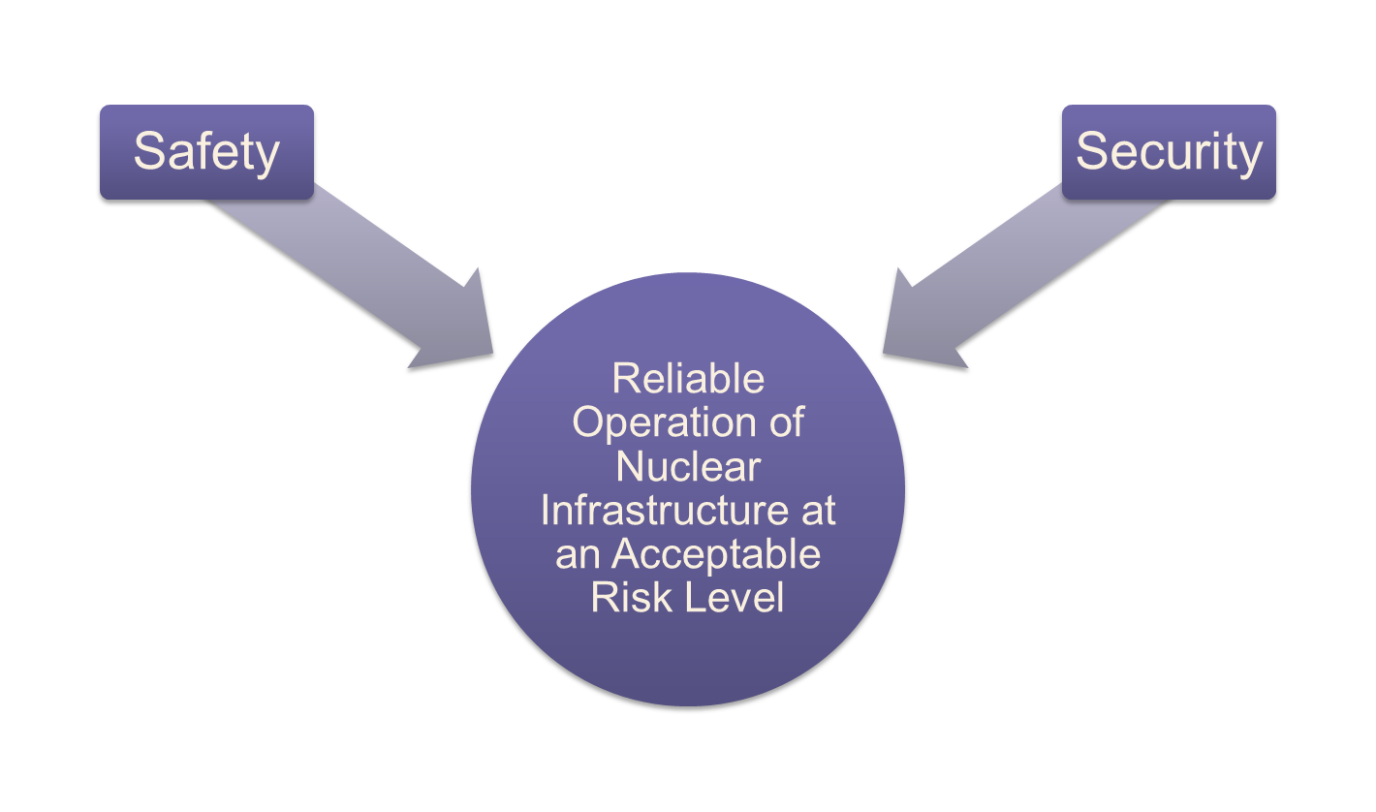
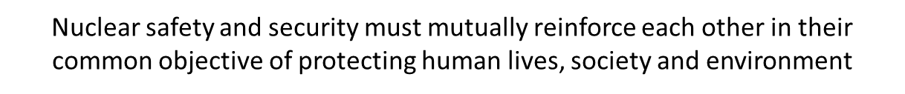
Safety Culture and Security Culture: Shared Objectives
Security Culture
Safety Culture

Slide 11
Need for Integrated Safety and Security for Multiple and Diverse Risks
Natural and Man-Made Unintentional Events
Drought
Combined Effects
Hazardous material release
Man-Made and Intentional (Malicious) Events
Terrorism, sabotage, insider threat (nuclear, radiological, chemical, biological, ecological, agricultural, cyber, conventional)
Wildfire
Avalanche
Winter storms
Tsunami
Hurricane
Pandemic
Heat wave
Extreme cold
Flood
Earthquake
Volcanic eruption
Tornado
Landslide
Lightning storm
Meteorite
Equipment and hardware failure/human error
Explosion or fire
Transportation accident
Building or structure collapse
Power or utility failure
Extreme air pollution
Industrial accidents
Dam or levee failure
Fuel, resource, medication and other shortages
Industrial collapse
Communication and supply line disruption
Hostage taking
Civil unrest and riots
Crime and violence
Arson
Mass casualty events
Hijacking
War
Security
Safety

Slide 12
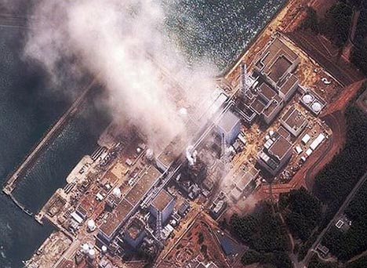
Avoiding “Security Fukushima”
Report of Japanese Government to the IAEA Ministerial Conference on Nuclear Safety (June 2011): 28 lessons to be learned from the accident with perceptions, attitudes, and patterns of behavior as cross cutting elements for most of them.
Report of Diet Independent Investigation Commission (July 5, 2012):
It is a “profoundly man-made disaster”.
Its fundamental causes are to be found in the ingrained conventions of Japanese culture: reflective obedience; reluctance to question authority; devotion to sticking with the program; groupism; and insularity.
A terrorist version of Fukushima is plausible, with all the human displacement, economic disturbance, and national humiliation the March 2011 cataclysm entailed.

Slide 13
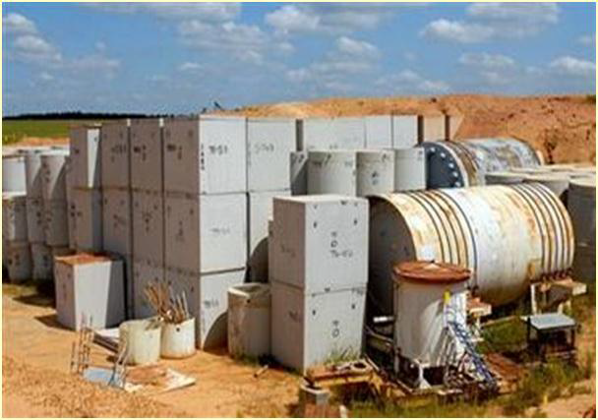
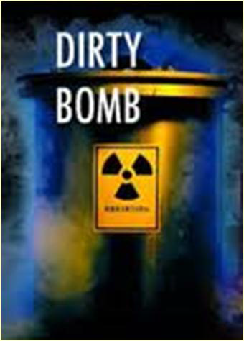
Nuclear Security Concerns
• Nuclear and other radioactive material that is not properly secured
• Possible malicious acts involving such material
What is the Risk?
• Theft of nuclear material (NM) to make improvised nuclear devices (IND)
• Theft of radioactive material (RM) to make radiological dispersal devices (RDD) or radiological emission devices (RED)
• Sabotage of facility or transport

Slide 14
Scenarios of Nuclear and Other Radiological Events
Options | Probability | Effect
 |  | Physiological | Environmental/ Economic | Psychological
Nuclear Weapons | very low to low | high | catastrophic | overwhelming
Improvised Nuclear Device (IND) | Low | medium to high | high to catastrophic | shocking to overwhelming
RDD | medium to high | limited | medium | highly traumatic
RED | high | limited | low to medium | medium
Significant damage to NPP | low | medium to high | high to catastrophic | shocking and overwhelming
Significant damage to radioactive waste and spent fuel site | medium | medium to high | high to catastrophic | shocking and overwhelming

Slide 15
The Human Factor: Asset or Liability?
Most security systems are human-designed, -managed, and –operated, which means that the human factor is very important for effective security systems.
The best equipment is not enough. It is the operator with strong nuclear security culture who can make best use of this equipment.
Nuclear security culture makes the human factor an asset by preventing complacency and apathy.
Security culture is a multidisciplinary approach to counter outside and inside threat by reinforcing willingness and motivation to follow established procedures, comply with regulations and show vigilance.

Slide 16
Human Factor and Security Technologies
Technical solutions without human intervention are unlikely to prevent security breaches
There is ample evidence that the more complicated this human-technology interaction grows, both technologically and procedurally, the more important the role of dedicated security-conscious personnel becomes.
The flexibility and intelligence of people are the critical ingredients in protection nuclear sites and material as well as managing unforeseen circumstances.
Values, orientations, definitions, and goals should be in line with new technologies and procedures in response to new risks. Otherwise, people may lack the commitment and motivation to use them efficiently and strive for new goals.

Slide 17
Challenge of Unforeseen Circumstances and the Role of Culture
A
4. Unexpected, culture and knowledge based improvisation are required
3. Unexpected, but rule recognition and interpretation skills are helpful
Reliance on culture-based response
2. Expected, but only partially covered by instructions
1. Expected, covered by instructions
0
Uncertainty
B

Slide 18
Human Factor and Automation
Automated systems are designed to perform as instructed without major problems of human fallibility and unpredictability but are more complex and introduce more latent errors and accidents.
With a high amount of automation, the human has different tasks to perform, i.e. deal with unforeseen circumstances or perform tasks that the designer cannot automate.
Generally, it may produce a situation when during normal operation security personnel has much less workload leading to reduced attention, deteriorated skills, loss of situational awareness and in some cases to overreliance on machines and eventually complacent attitudes.
Adjustments in the prevailing culture, modifications in management practices and new approaches toward training are needed to address such situations.

Slide 19

Diverse Attitudes Towards Security: From Negative to Positive
Subversion: Some staff members deliberately and willfully try to breach the security program. (Insider threats):
People who may steal material and classified information, tamper with safety systems, weaken security arrangements, pass sensitive information to outsiders, and are ready to act in collusion with them.
People who think security requirements are irrelevant will deliberately ignore them even if their noncompliance puts the organization at risk.
People who are disgruntled and want to satisfy a grudge by committing malicious acts.
People who think they are too important to bother with security rules and go as far as breaking them.

Slide 20
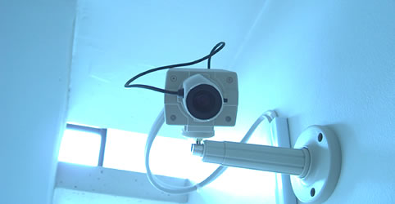
Diverse Attitudes Toward Security: From Negative to Positive
Avoidance:
Some staff members view security as inherently dangerous and do everything they can to keep from getting involved and turn a blind eye to the need to address security weakness or report cases of noncompliance.
If these people see a situation that puts assets at risk they ignore it and discourage others from getting involved or addressing it.
They go out of their way to avoid any sort of contact or collaboration with security staff.

Slide 21

Diverse Attitudes Towards Security: From Negative to Positive
Apathy:
Some staff members don’t care one way or the other about security. They may not believe the threat exists or think security programs are a worthwhile countermeasure to the threat.
They may follow security regulations if noncompliance gets them in trouble but don’t go one fraction of an inch beyond that.
They are reluctant to discuss issues and stay away from any efforts to support or improve security systems.

Slide 22

Diverse Attitudes Towards Security: From Negative to Positive
Compliance:
Staff members with this attitude do exactly what they are told to do in the security program, but if something is not specifically covered by the rules they act as if it is not their problem.
If they are criticized for this approach, they get defensive. They claim to be very careful about following the rules but cannot be expected to act as security experts and handle situations not specifically covered by the security rules.

Slide 23

Diverse Attitudes Towards Security: From Negative to Positive
Participation:
Some staff members believe that the security program and its specific requirements make sense and make a useful contribution to help the organization operate at an acceptable risk level.
They are willing to cooperate and follow the rules going a step beyond the requirements, if necessary.
They may provide specific suggestions to make the organization safe and secure as well as improve the security program.

Slide 24
Diverse Attitudes Towards Security: From Negative to Positive
Ownership:
Some staff members assume responsibility for the security program and don’t view the security staff as the sole actors responsible for the security program.
They take partial credit and ownership for the program and the role of the security staff is to advise and assist them in making it work.
They are willing to devote whatever time, attention, and resources are necessary to make security work well because it is an integral part of their professional ethics.
They are willing to invest in the security program because they have a stake in it and may act as role models for others.

Slide 25
Diverse Attitude Toward Security: From Negative to Positive
SUBVERSION
 | APATHY
 |  | PARTICIPATION
 |  | OWNERSHIP
AVOIDANCE
COMPLIANCE

Slide 26
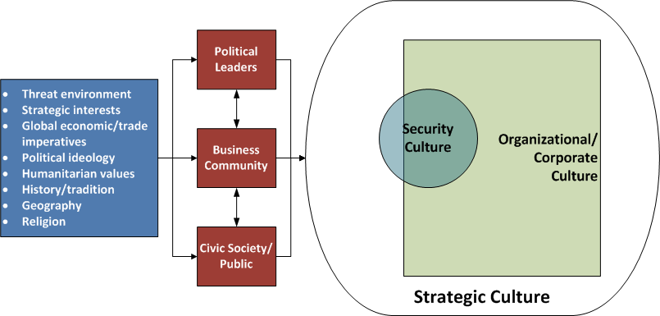
Security Culture as a Subset of Organizational Culture
Organizational
Culture
National Culture

Slide 27
Geert Hofstede’s Model of National Culture and Implications for Security Culture
Power Distance Index (PDI) | Individualism vs. Collectivism (IDV) | Masculinity vs. Femininity (MAS) | Uncertainty Avoidance Index (UAI) | Long-Term vs. Short-Term Orientation (LTO)
The extent to which the less powerful members accept and expect that power is distributed unequally. Such inequality is defined from below, not from above. It is endorsed by the followers as much as by the leaders. leadership and management role in promoting security culture may vary depending on national culture | The degree to which individuals are integrated into groups. Individualist societies have loose ties between their members. In collectivist societies, people are integrated into cohesive groups and enjoy protection in exchange for loyalty. The driving force for culture change: charismatic individuals or groups. | In masculine cultures, people (male or female) value competitiveness, assertiveness, ambition and accumulation of wealth. In feminine cultures people (male or female) value relationships and quality of life. Different types of rewards and encouragement for contributing to security culture development | In cultures with strong uncertainty avoidance, people prefer explicit rules and formally structured activities, and employees tend to remain longer with their employer. In cultures with weak uncertainty avoidance, people prefer implicit or flexible rules or guidelines and informal activities. Preference for detailed guidance versus general principles and rules | A society’s “time horizon,” or the importance attached to the future vs. present. In long-term oriented societies, people value actions and attitudes that affect the future: persistence, perseverance, thrift, reputation. In short-term oriented societies, people value immediate results. Long-term outreach and planning for culture improvement

Slide 28
Addressing Human Fallibility
At-risk behaviors are actions that involve short-cuts, errors, violations, slips, lapses, mistakes or other actions intended to improve performance of a task, usually at some expense of safety and security or, on the other hand, intentionally subvert security regime:
Error is a human action that unintentionally departs from expected behavior. Human errors are provoked by a mismatch between human limitations and work conditions at the job site, including inappropriate management, leadership practices, and organizational weaknesses.
Mistakes occur when a person uses an inadequate plan to achieve the intended outcome. They usually involve misinterpretations, miscalculation, or lack of knowledge.

Slide 29
Addressing Human Fallibility
Violations (or breaches) are often characterized as the intentional circumvention of known rules and policy or a deliberate departure from an expected behavior or procedure. Some violations are well intentioned, arising from a genuine desire to get a job done. Others may be acts of sabotage or material diversion driven by diverse considerations.
Slips occur when physical action fails to achieve the immediate objective.
Lapses involve a failure of one’s memory or recall.
Short cuts are attempts to simplify the process of following procedures in order to save time and effort.
In most cases, the dividing line between these categories is vague and such acts constitute a combination of them. It often makes an investigation and follow-up action challenging and controversial. A robust security culture is an effective tool to address their root causes.

Slide 30
Sources of At-Risk Behavior
Unfamiliarity: a situation is important but occurs infrequently or is novel,
Time shortage: not enough time is available for error detection and correction,
Understanding: no means available to convey information such that it is easy to understand,
Information overload: simultaneous presentation of information goes beyond a person’s capacity to understand,
New techniques: the need to learn new techniques which may follow philosophies opposing those that have been used previously.

Slide 31
Sources of At-Risk Behavior
Perceived risk: the actual risks present are greater than the person involved realizes,
Physical ability: the person does not have the physical ability to perform the required tasks,
Mental stimulation: the person is required to spend a lot of time either inactive or involved in highly repetitive, menial tasks,
Disruption: work patterns cause disruption to normal sleep and rest cycles,
Pacing: other people influence the pace at which tasks can be performed.

Slide 32
Performance Modes and Security Culture
There are four basic culture driven elements of human performance which can contribute to efficient nuclear security:
Skill-based performance involves highly practical, largely physical actions in very familiar situations in which there is little conscious monitoring. Culture helps to avoid confusion.
Rule-based performance requires people to apply memorized or written rules. It is mostly a rule recognition exercise by matching the signs of the problem to the stored information. Culture serves as a guidance.
Knowledge-based performance is a response to a totally unfamiliar situation where no skill or no rule is recognizable. Nuclear security culture is a significant enabler.
Work experience is an assembly of skills, rule recognition and accumulated knowledge on a solid basis of security culture.

Slide 33
TEAM Model: Training, Education, Awareness, Motivation, Culture
People will not do… | So we do:
What they don’t know they should do or don’t know how to do | Training
What they don’t think makes sense | Education
What they never think of doing | Awareness
What they think they have no reason to do | Motivation
Security culture

Slide 34

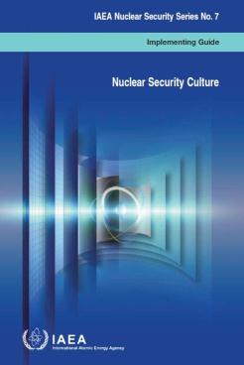
Nuclear Security Culture: Where Are We Now?
IAEA
Over 25 international, regional, and national training workshops
3 pilot self-assessment projects (Indonesia, Bulgaria, Malaysia)
Fundamentals
Recommendations
Nuclear Security Series (NSS) No. 7
Implementing Guides
Technical Guidance
NSS No. 28-T
“SELF‐ASSESSMENT of Nuclear Security Culture in Facilities and Activities
NST027
(Still under Development)
“ENHANCEMENT of Nuclear Security Culture in Facilities and Activities
Notes:
TALKING POINTS
Without being able to measure up we cannot build anything.
This is the reason why the IAEA is currently developing 2 technical guidance documents; one to assess NSC and the other to enhance NSC.
Explain the development two technical documents on going
NST026 ;“SELF‐ASSESSMENT Methodology
NST027; “How to Enhance Nuclear Security Culture”
The two document will provide more detailed and practical way for member states.
(Background)
These planned two documents will directly interface with the Implementing Guide “Nuclear Security Culture” published in September 2008.
NST026
“SELF‐ASSESSMENT of Nuclear Security Culture in facilities and activities that use nuclear and/or radioactive material”
NST027
“ENHANCING Nuclear Security Culture in facilities and activities that use nuclear and/or radioactive material”

Slide 35
Nuclear Security Culture: Where Are We Now?
2. Legal Framework and Enhancement Practice
NSC is Fundamental Principle F in the Amendment of the Convention on Physical Protection of Nuclear Material which came into force in May 2016
NSC is a cross-cutting element of NS as evidenced by IAEA publications in which numerous references are made to the key role of culture applicable to diverse aspects of NS.
NSC integrates relevant elements of national culture, tradition, and indigenous good practice to make culture sustainable
NSC is treated as a continuously evolving educational and training discipline which requires effective communication and interaction between educators and practitioners

Slide 36
NSC as a Cross-Cutting Element of Nuclear Security Culture

Slide 37
NSC as a Cross-Cutting Element Nuclear Security Culture

Slide 38
Nuclear Security Culture: Global Outreach
3. Nuclear Security Summits
Communiqués, work plans, gift baskets, joint statements at Washington NSS (2010), Seoul NSS (2012), the Hague NSS (2014), and Washington NSS (2016)
Five Action Plans at Washington NSS
Global Initiative to Combat Nuclear Terrorism
Five Action Plans at Washington NSS (2016)
International Criminal Police Organization
United Nations
Global Partnership Against the Spread of Weapons and Materials of Mass Destruction
International Atomic Energy Agency
“provide assistance to improve NSC”
“1. Enhance the practice of NSC such that it is infused into all elements of national NS regimes
2. Advocate for the IAEA to increase its assistance to states to develop and foster NSC, including through published guidance and related self-assessment and training materials”
“Provide assistance to and coordinate programs and activities on the development of NSC and PRP”

Slide 39
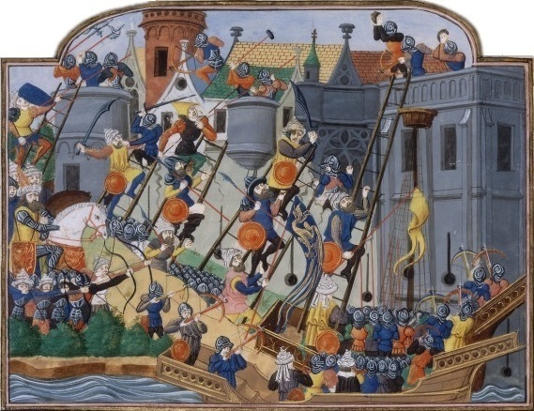
Culture and Security: A Vision from the Past
“The thickness of a wall is less important than the will to defend it”
- Thucydides, Greek historian from the 5th Century B.C.

Slide 40

Thank you for your attention!
Questions?

