Slide 1
Machine Learning Discussing some diagrams and terms
to Adi Pancoro¹ and Udjianna Sekteria Pasaribu² from Sparisoma Viridi³
¹Genetics and Molecular Biotechnology Expertise Group, School of Life Sciences & Technology
²Statistics Research Group, Faculty of Mathematics and Natural Sciences
³Nuclear Physics and Biophysics Research Division, Faculty of Mathematics and Natural Sciences
¹⁻³Institut Teknologi Bandung, Bandung 40132, Indonesia
20230410-v1| https://doi.org/10.5281/zenodo.

Slide 2
Outline
Diagrams and terms 3
Algorithms 12
Subcategories ..

Slide 3
Diagrams and terms

Slide 4
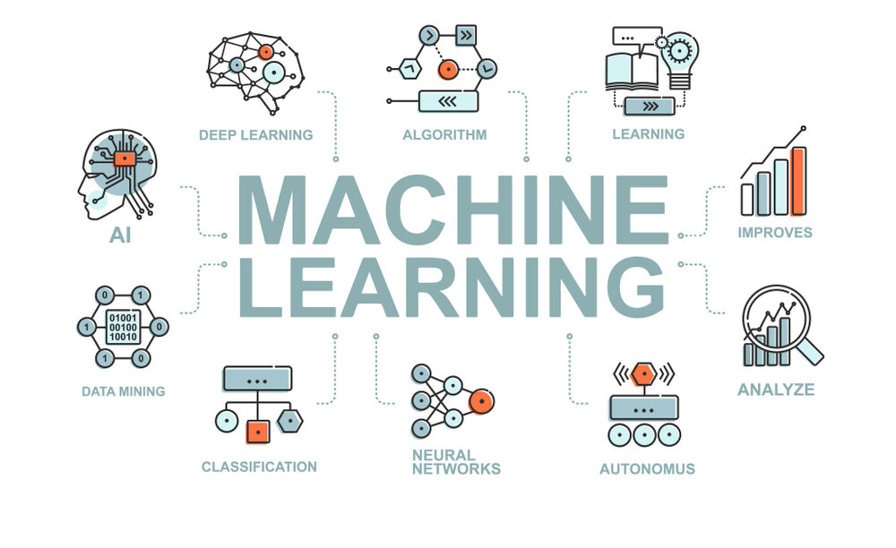
CCR, “An Introduction to Machine Learning, Its Importance, Types, and Applications”, FORE School of Management, New Delhi, 31 Aug 2022, url https://www.fsm.ac.in/blog/an-introduction-to-machine-learning-its-importance-types-and-applications/ [20230410].

Slide 5
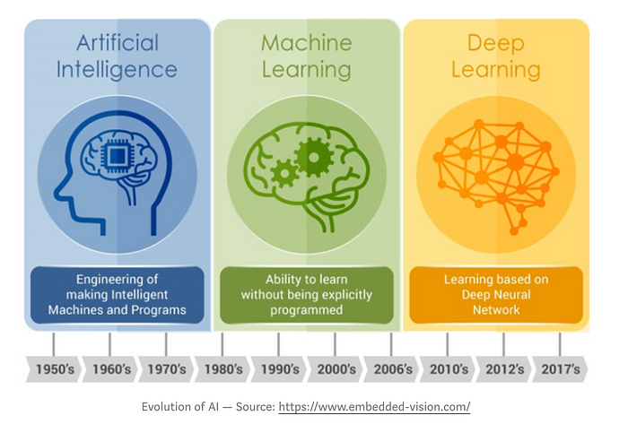
Vikita Padaliya, “Difference between AI, ML and DL”, Medium, 25 Sep 2019, url https://medium.com/decoding-artificial-intelligence/p-f5274d8db2 [20230411].

Slide 6
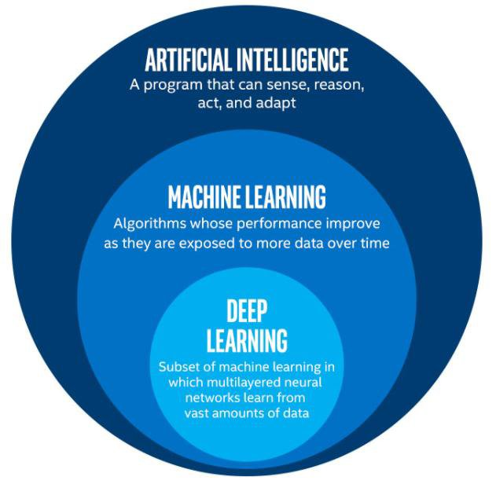
Rohini G. Khalkar, Adarsh Singh Dikhit, Anirudh Goel, Manisha Gupta, “Handwritten Text Recognition using Deep Learning (CNN & RNN)”, IARJSET 8(6):870-881, Jun 2021, url http://dx.doi.org/10.17148/IARJSET.2021.86148.

Slide 7
AI – ML
Artificial Intelligence systems are used to perform complex tasks in a way that is similar to how humans solve problems.
Machine learning is a subfield of artificial intelligence, which is broadly defined as the capability of a machine to imitate intelligent human behavior.
Sara Brown, “Machine learning, explained”, MIT Management Sloan School, 21 Apr 2021, url https://mitsloan.mit.edu/ideas-made-to-matter/machine-learning-explained [20230410].

Slide 8
ML – AI
Machine learning (ML) is a type of artificial intelligence (AI) that allows software applications to become more accurate at predicting outcomes without being explicitly programmed to do so.
Machine learning algorithms use historical data as input to predict new output values.
Ed Burns, “Machine learning”, TechTarget, Mar 2021, url https://www.techtarget.com/searchenterpriseai/definition/machine-learning-ML [20230410].

Slide 9
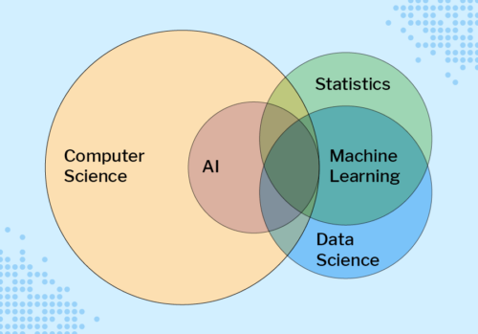
Sue Sentance, “Educating Young People in AI, Machine Learning, and Data Science: New Seminar Series”, Noise, 27 Jul 2021, url https://noise.getoto.net/2021/07/29/educating-young-people-in-ai-machine-learning-and-data-science-new-seminar-series/ [20230410].

Slide 10
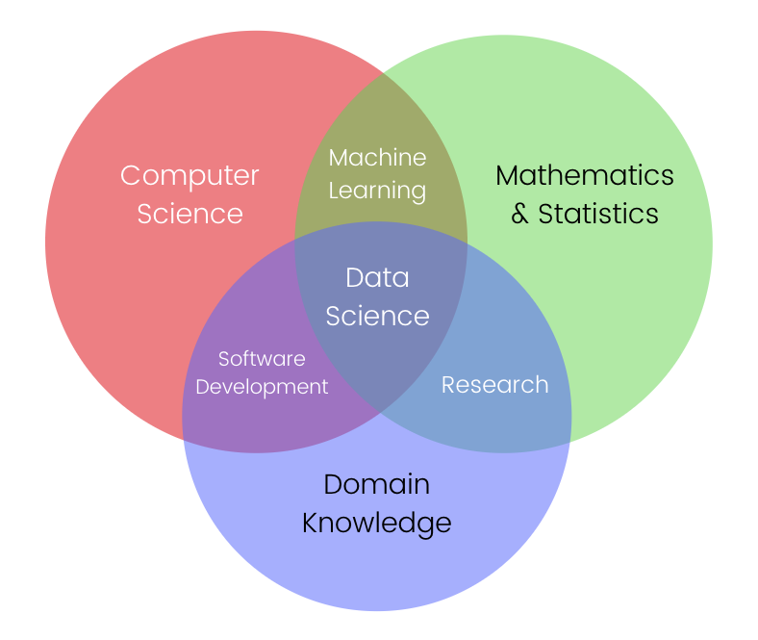
Jon-Ting, Coursera, GitHub, url https://www.meal2home.top/ProductDetail.aspx?iid=380751683&pr=39.88 [20230410].

Slide 11
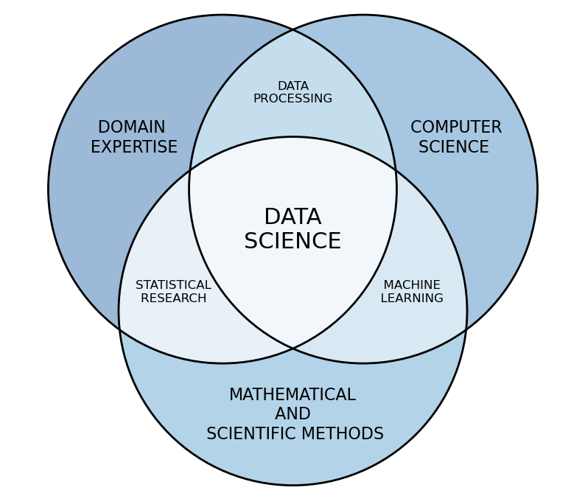
Rob Pascoe, “Data science”, Data Cymru, url https://www.data.cymru/data-science [20230410].

Slide 12
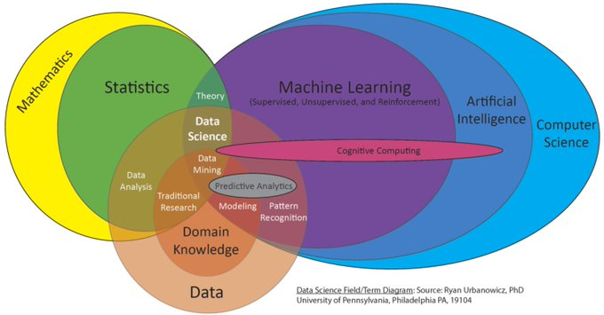
Ryan Urbanowicz, “New proposed field/term Venn diagram for an upcoming talk”, Twitter, 15 Jun 2018, url https://twitter.com/DocUrbs/status/1007375834347376642 [20230410].

Slide 13
Algorithms

Slide 14
Types
Machine learning algorithms are classified into 4 types:
Supervised learning,
Unsupervised learning,
Semi-supervised learning,
Reinforcement learning.
There are (at least) 10 popular algorithms.
Simon Tavasoli, “Top 10 Machine Learning Algorithms For Beginners: Supervised, and More”, Simplilearn, 30 Mar 2023, url https://www.simplilearn.com/10-algorithms-machine-learning-engineers-need-to-know-article [20230410].

Slide 15
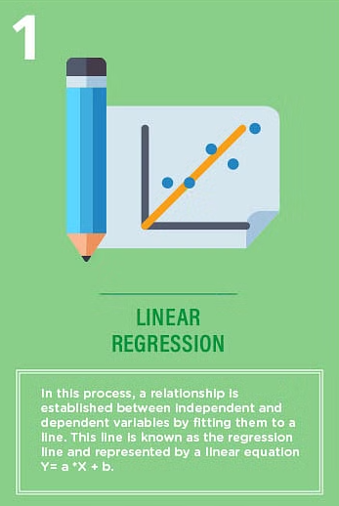
Simon Tavasoli, “Top 10 Machine Learning Algorithms For Beginners: Supervised, and More”, Simplilearn, 30 Mar 2023, url https://www.simplilearn.com/10-algorithms-machine-learning-engineers-need-to-know-article [20230410].

Slide 16
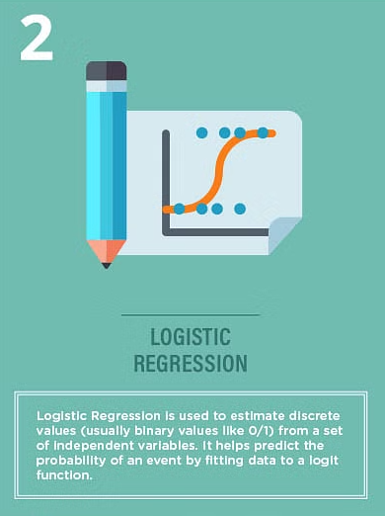
Simon Tavasoli, “Top 10 Machine Learning Algorithms For Beginners: Supervised, and More”, Simplilearn, 30 Mar 2023, url https://www.simplilearn.com/10-algorithms-machine-learning-engineers-need-to-know-article [20230410].

Slide 17
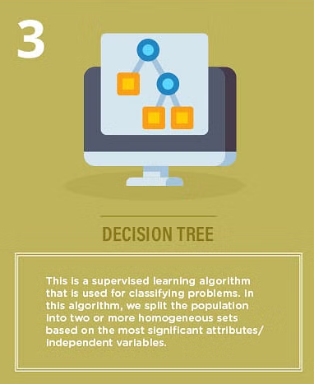
Simon Tavasoli, “Top 10 Machine Learning Algorithms For Beginners: Supervised, and More”, Simplilearn, 30 Mar 2023, url https://www.simplilearn.com/10-algorithms-machine-learning-engineers-need-to-know-article [20230410].

Slide 18
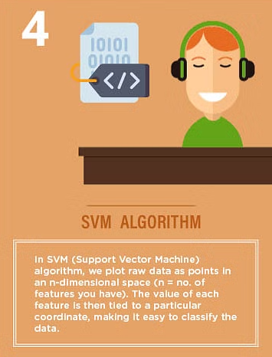
Simon Tavasoli, “Top 10 Machine Learning Algorithms For Beginners: Supervised, and More”, Simplilearn, 30 Mar 2023, url https://www.simplilearn.com/10-algorithms-machine-learning-engineers-need-to-know-article [20230410].

Slide 19
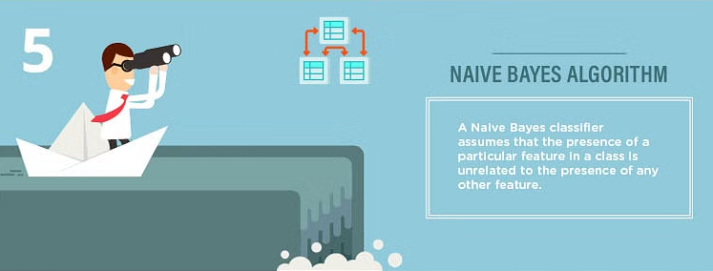
Simon Tavasoli, “Top 10 Machine Learning Algorithms For Beginners: Supervised, and More”, Simplilearn, 30 Mar 2023, url https://www.simplilearn.com/10-algorithms-machine-learning-engineers-need-to-know-article [20230410].

Slide 20
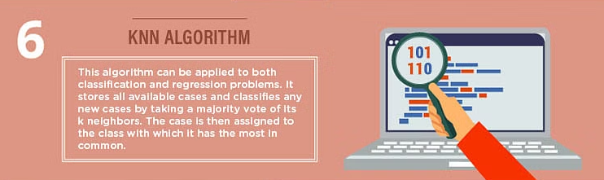
Simon Tavasoli, “Top 10 Machine Learning Algorithms For Beginners: Supervised, and More”, Simplilearn, 30 Mar 2023, url https://www.simplilearn.com/10-algorithms-machine-learning-engineers-need-to-know-article [20230410].

Slide 21
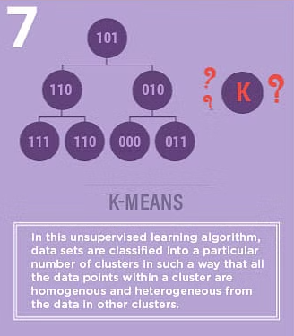
Simon Tavasoli, “Top 10 Machine Learning Algorithms For Beginners: Supervised, and More”, Simplilearn, 30 Mar 2023, url https://www.simplilearn.com/10-algorithms-machine-learning-engineers-need-to-know-article [20230410].

Slide 22
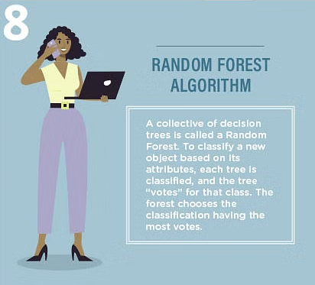
Simon Tavasoli, “Top 10 Machine Learning Algorithms For Beginners: Supervised, and More”, Simplilearn, 30 Mar 2023, url https://www.simplilearn.com/10-algorithms-machine-learning-engineers-need-to-know-article [20230410].

Slide 23
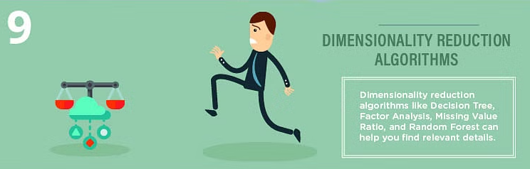
Simon Tavasoli, “Top 10 Machine Learning Algorithms For Beginners: Supervised, and More”, Simplilearn, 30 Mar 2023, url https://www.simplilearn.com/10-algorithms-machine-learning-engineers-need-to-know-article [20230410].

Slide 24
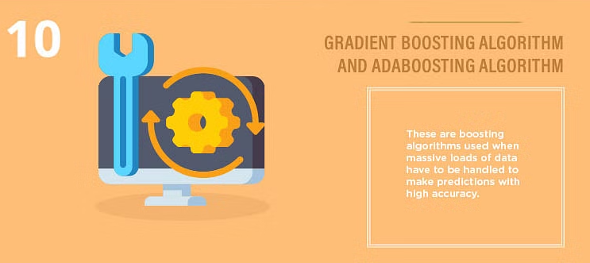
Simon Tavasoli, “Top 10 Machine Learning Algorithms For Beginners: Supervised, and More”, Simplilearn, 30 Mar 2023, url https://www.simplilearn.com/10-algorithms-machine-learning-engineers-need-to-know-article [20230410].

Slide 25
Applications

Slide 26
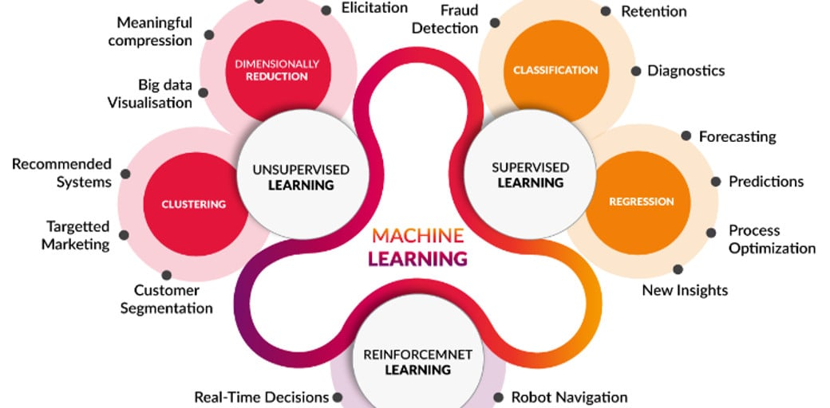
Mohaiminul Islam, “Machine Learning”, Kaggle, 6 Nov 2020, url https://www.kaggle.com/getting-started/195629 [20230411].

Slide 27
Types

Slide 28
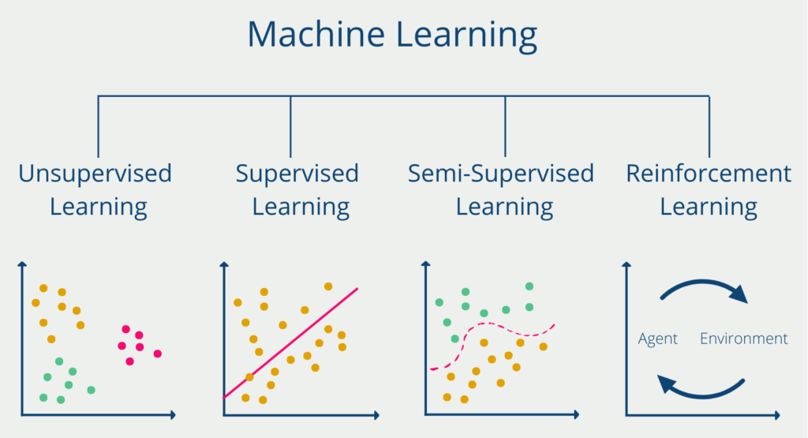
-, “Reinforcement Learning: Bestärkendes Lernen erklärt!”, Data Base Camp, 26 Jan 2022, url https://databasecamp.de/ki/reinforcement-learning [20230411].

Slide 29
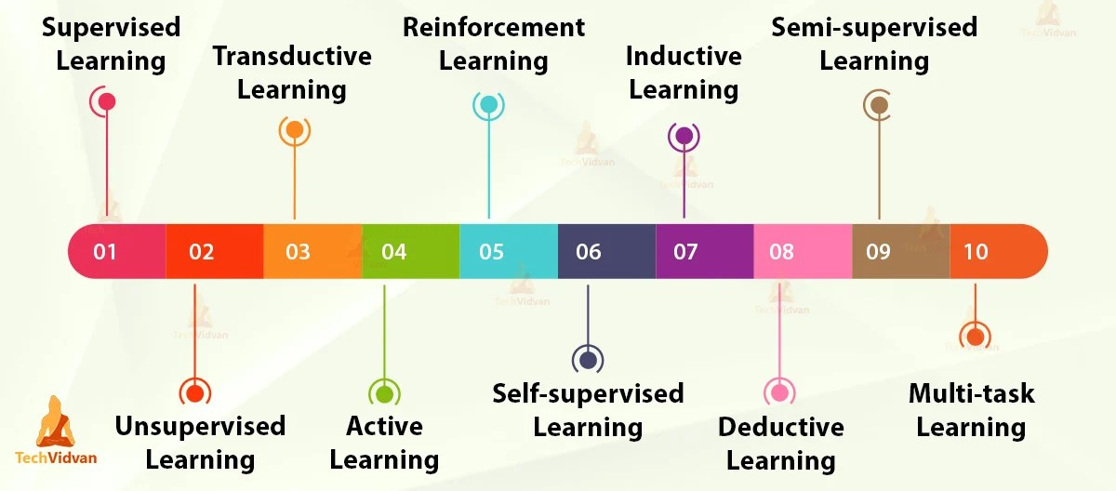
There is also another way for types of ML
TechVidvan Team, “Types of Machine Learning – Supervised, Unsupervised, Reinforcement”, Simplilearn, 10 Mar 2021, url https://techvidvan.com/tutorials/types-of-machine-learning/ [20230411].

Slide 30
Architectures

Slide 31
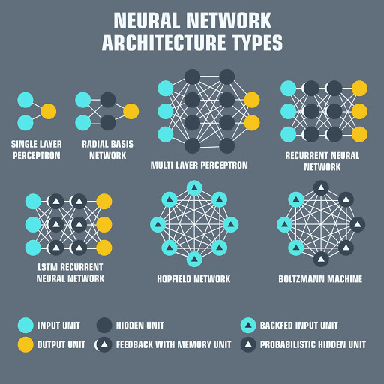
Mohaiminul Islam, “Machine Learning”, Kaggle, 6 Nov 2020, url https://www.kaggle.com/getting-started/195629 [20230411].

Slide 32
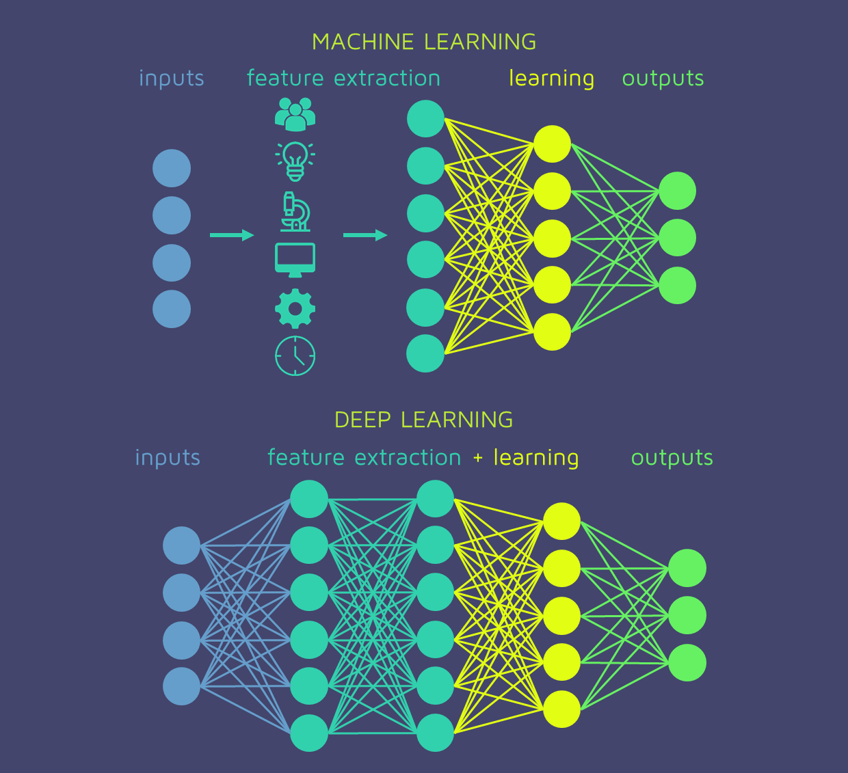
Mohaiminul Islam, “Machine Learning”, Kaggle, 6 Nov 2020, url https://www.kaggle.com/getting-started/195629 [20230411].

Slide 33
Mohaiminul Islam, “Machine Learning”, Kaggle, 6 Nov 2020, url https://www.kaggle.com/getting-started/195629 [20230411].

Slide 34
Thank you
-

