Slide 1
Python: Import, Function, Class https://github.com/dudung/sk5003-02-2022-2
Sparisoma Viridi
Master Program in Computational Science, Nuclear Physics and Biophysics Research Division,
Department of Physics, Faculty of Mathematics and Natural Sciences, Institut Teknologi Bandung,
Bandung 40132, Indonesia
20230401-v6| https://doi.org/10.5281/zenodo.7809397

Slide 2
Silakan berdiskusi untuk kuliah hari ini di https://github.com/dudung/sk5003-02-2022-2/issues/6

Slide 3
Kerangka
SAP dan referensi 4
Object orientation 8
Object-oriented programs 23
Diskusi dan latihan 32

Slide 4
SAP dan referensi

Slide 5
Minggu 5
Minggu | Topik | Subtopik | Capaian Belajar
5 | Struktur data, orientasi objek, rekursi dalam Python | Orientasi objek dan program berorientasi objek | Kemampuan untuk memahami dan menguasai orientasi objek dan program berorientasi objek dengan Python

Slide 6
Referensi
Jose M. Garrido, "Introduction to Computational Models with Python", Routledge, 1st edition, 2020,
url https://isbnsearch.org/isbn/9780367575533.

Slide 7
R1
C8
Object in problem domain
Defining class
Describing objects
Interaction between objects
Design with classes
C9
Introduction and programs
Classes definition in Python
Create / manipulate objects
Program with classes
Scope of variables
Class hierarchy with inheritance
Overloading / overriding methods

Slide 8
Object orientation

Slide 9
Object orientation
Object in problem domain
Defining class
Describing objects
Interaction between objects
Design with classes

Slide 10
Object in problem domain
Real-world entities (RWEs) or objects are fundamental components of a real-worl system.
Identifying and modeling RWEs in the problem domain are central focus of the object-oriented approach.
A RWE has responsibility of carrying out a specific taks.
A RWE entity is modeled as an object.

Slide 11
Abstraction
A RWE has a lot of characteristics.
A process called abstraction is used to modeled RWE in problem domain.
The process also involves elimination of unessential characteristics, or parameters that are considered not important (include only relevant aspects of real-word system).
Several levels of detail are required to define completely objects and collections of objects in a model.

Slide 12
Object-oriented modeling
It consists of
identifying the relevant objects for the model,
describing these objects using abstraction,
defining collection of similar objects.
Objects with similar characteristics are grouped into collections, and these are modeled as classes, where UML (Unified Modeling Language) is a standard notation to describe object and classes in a problem domain.

Slide 13
Defining class
All similar objects are group into a collection of objects.
The collection of objects have same structure and behavior.
A class is an abstract description of a collection of objects.
A class defines attributes and behavior for all objects of the class.
Software implementation of class consists of
Some data definitions represent attributes of the class,
Some methods (or operations) represent behaviors of the class.

Slide 14
Illustration in defining classes
Class A
Class B
Class C
Class D
Problem domain
Model
Notes:
Problem domain

Slide 15
Describing objects
A state Represented by set of properties (or attributes) and their associated values.
Behavior Represented by the operations, also known as methods, of the objects.
Identity An implicit or explicit property that can uniquely identify an object.

Slide 16
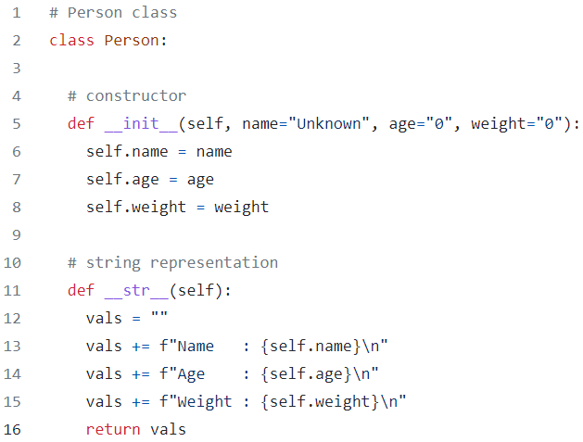
behavior
state
Notes:
state

Slide 17
Interaction between objects
Owner of an operation do something.
The operation can change state of owner.
The operation, when apply to other object, can also change state of the other object.

Slide 18
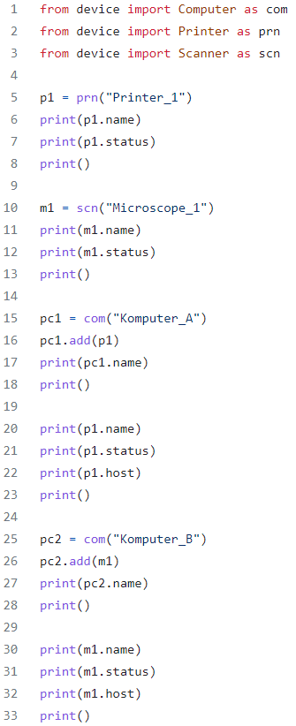
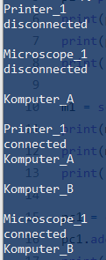

Slide 19
Design with classes
Encapsulation This principle describes integration of object attributes and behavior as a single unit, which can be considered as a protection mechanism. Only certain objects can have access to other objects attributes and behaviors → private ones.
Data (or information) hiding It hides implementation details, so there two views:
External view: List of services (or operations) an object can invoke.
Internal view: Details of implementation of data and operations.

Slide 20
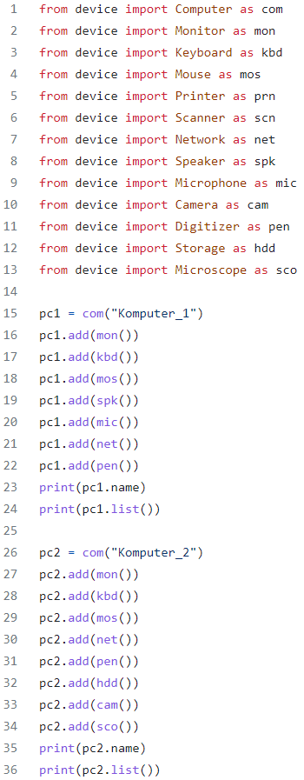

Slide 21
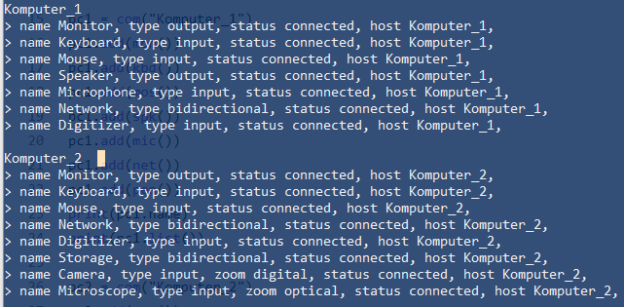

Slide 22
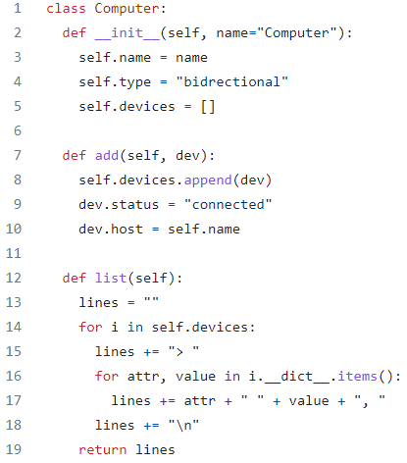
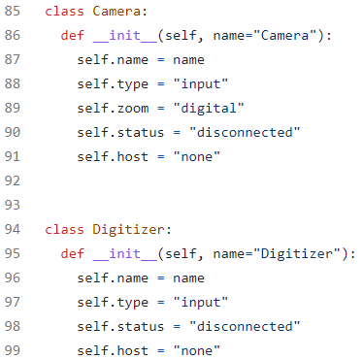


Slide 23
Object-oriented programs

Slide 24
Object-oriented programs
Programs
Classes definition in Python
Create / manipulate objects
Program with classes
Scope of variables
Class hierarchy with inheritance
Overloading / overriding methods

Slide 25
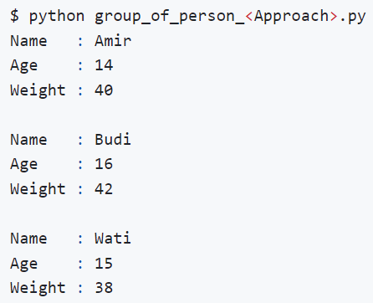
Desired output

Slide 26
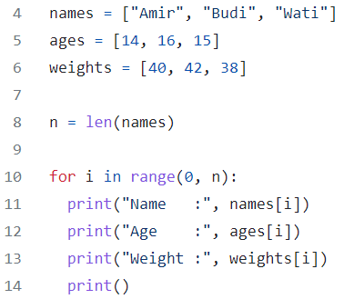
Without class

Slide 27
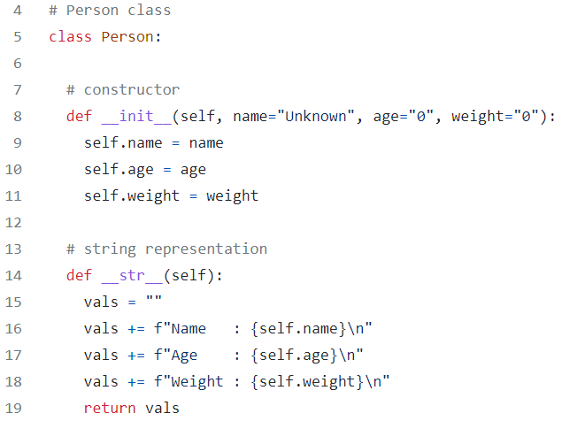
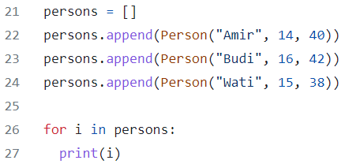
With class

Slide 28
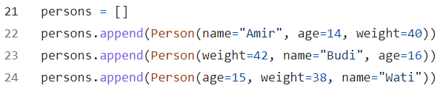
Class using keywords
It is clearer but more to type.
Order of arguments depend on the given keywords.

Slide 29
Defining class in module

Slide 30
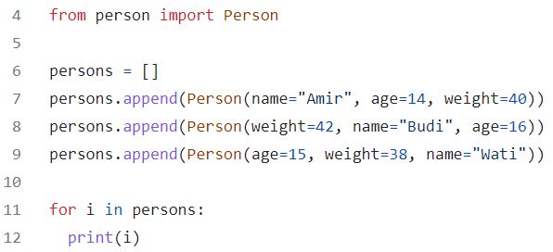
Using class with import
It hides all complex implementation in imported module.
Main program is more simple.

Slide 31
Comparison
Approach | Size (bytes) | Lines | Time (s)
multiple_lists | 227 | 12 | 0.010093
list_of_class | 552 | 25 | 0.006331
list_of_class_kwargs | 600 | 25 | 0.005884
import | 224 | 10 | 0.007803
(person module) | 383 | 17 | -

Slide 32
Diskusi dan latihan

Slide 33
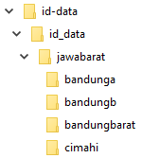
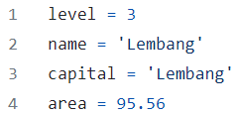
Latihan dengan package id-data
Package id_data
bandungbarat
lembang

Slide 34
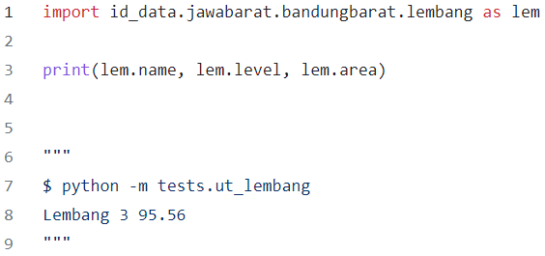
use module lembang

Slide 35

id-data
Package id_data
cimahi

Slide 36
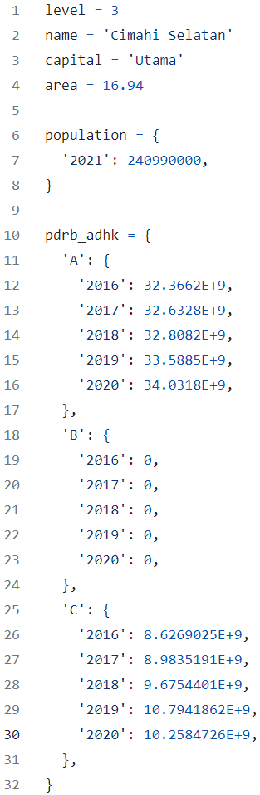
cimahiselatan

Slide 37
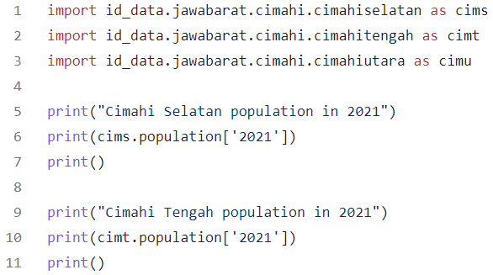
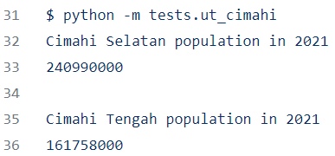
use module cimahiselatan, cimahitengah

Slide 38
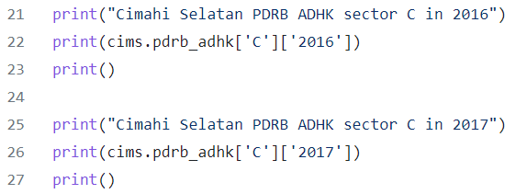
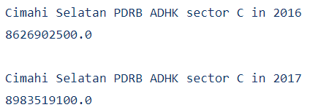
.. module cimahiselatan, cimahitengah

Slide 39
Diskusi
Silakan bila ada pertanyaan.
Setelah kuliah pertanyaan dapat diajukan secara asinkron di url https://github.com/dudung/sk5003-02-2022-2/issues/6

Slide 40
Terima kasih
-

