Slide 1
Sekilas linked list & Python . https://github.com/dudung/sk5003-02-2022-2
+ blockchain
Sparisoma Viridi
Master Program in Computational Science, Nuclear Physics and Biophysics Research Division,
Department of Physics, Faculty of Mathematics and Natural Sciences, Institut Teknologi Bandung,
Bandung 40132, Indonesia
20230414-v2| https://doi.org/10.5281/zenodo.

Slide 2
Silakan berdiskusi untuk kuliah hari ini di https://github.com/dudung/sk5003-02-2022-2/issues/7

Slide 3
Kerangka
SAP dan referensi 4
Array & linked list 10
Linked list & blockchain 15
Sekilas list Python 22
Linked list 24
Diskusi dan latihan 26

Slide 4
SAP dan referensi

Slide 5
Minggu 6
Minggu | Topik | Subtopik | Capaian Belajar
6 | Struktur data, orientasi objek, rekursi dalam Python | List yang terhubung (linked list) | Kemampuan untuk memahami dan menguasai list yang terhubung (linked list) dalam Python

Slide 6
Referensi utama
Jose M. Garrido, "Introduction to Computational Models with Python", Routledge, 1st edition, 2020,
url https://isbnsearch.org/isbn/9780367575533.

Slide 7
R1
C10
Nodes
Class for linked lists
Create a linked list
Manipulate a linked list
Linked lists with two ends
Double-linked lists
Stacks and queues data stractures

Slide 8
Refs from internet
url https://www.geeksforgeeks.org/linked-list-vs-array/ [20230414]
url https://builtin.com/data-science/python-linked-list [20230414]
url https://machinelearningmastery.com/setup-python-environment-machine-learning-deep-learning-anaconda/ [20230414]

Slide 9
Refs from internet (cont.)
url https://www.educative.io/answers/how-to-create-a-linked-list-in-python [20230415]
url https://stackabuse.com/python-linked-lists/ [20230415]

Slide 10
Array & linked list

Slide 11
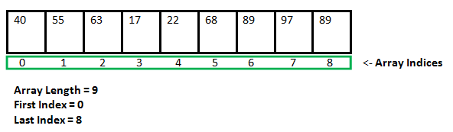
Array
Arrays store elements in contiguous memory locations, resul-ting in easily calculable addresses for the elements stored and this allows faster access to an element at a specific index.
GeeksforGeeks, “Linked List vs Array”, GeeksforGeeks, 29 Mar 2023, url https://www.geeksforgeeks.org/linked-list-vs-array/ [20230414].

Slide 12
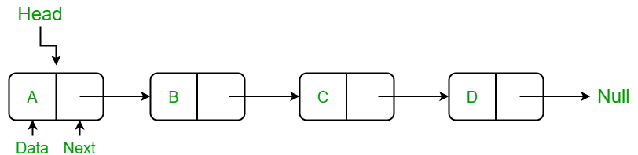
Linked-list
Linked lists are less rigid in their storage structure and ele-ments are usually not stored in contiguous locations, hence they need to be stored with additional tags giving a reference to the next element.
GeeksforGeeks, “Linked List vs Array”, GeeksforGeeks, 29 Mar 2023, url https://www.geeksforgeeks.org/linked-list-vs-array/ [20230414].

Slide 13
Array and linked list comparison
Parameters | Array | Linked list
Storing location | Arrays are stored in contiguous location. | Linked lists are not stored in contiguous location.
Size | Fixed in size. | Dynamic in size.
Memory | Allocated at compile time. | Allocated at run time.
Memory use | Less memory than linked lists. | More memory than array because it stores both data and address of next node.
GeeksforGeeks, “Linked List vs Array”, GeeksforGeeks, 29 Mar 2023, url https://www.geeksforgeeks.org/linked-list-vs-array/ [20230414].

Slide 14
Array and linked list (cont.)
Parameters | Array | Linked list
Access to element | Element can be accessed easily. | Element accessing requires the traversal of whole linked list.
Operation time | Insertion and deletion operations take time. | Insertion and deletion operations are faster.
GeeksforGeeks, “Linked List vs Array”, GeeksforGeeks, 29 Mar 2023, url https://www.geeksforgeeks.org/linked-list-vs-array/ [20230414].

Slide 15
Linked list & blockchain

Slide 16
Blockchain
A blockchain is a Distributed Ledger Technology (DLT) meaning it can store records of transactions that are not editable any further. It is always online as it is distributed among a vast network of computers in the world that are called nodes.
A blockchain is a reliable store of data as it is decentralized and chronological, making any malicious changes at any single or few nodes easily detectable since their timestamps and hash codes will change while the other nodes’ will not.
Sandeep Bhandari, “Difference Between Blockchain and Linked List”, Ask Any Difference, 11 Apr 2023, url https://askanydifference.com/difference-between-blockchain-and-linked-list/ [20230415].

Slide 17
Linked list and blockchain comparison
Parameters | Blockchain | Linked list
Formation | Every block in a blockchain contains a hash address for the previous block. | A linked list has a pointer carrying the address of the next element in the list.
Complexity | It is a very complex data structure that has Merkle roots to store transaction data. | It is the simplest data structure storing only integer values.
GeeksforGeeks, “Linked List vs Array”, GeeksforGeeks, 29 Mar 2023, url https://www.geeksforgeeks.org/linked-list-vs-array/ [20230414].

Slide 18
Linked list and blockchain (cont.)
Parameter | Blockchain | Linked list
Type of bond | The bond between blocks is permanent and cannot be broken or changed. | A linked list is easily editable and elements can be edited, added, and deleted.
Nature | It is by rule, decentralized, and chronological in nature. | It is not decentralized and may or may not be chronological.
Data | Information once entered into a block is transformed using cryptography to protect it from leaking. | Data is stored in its simple form as it was entered into the elements.
GeeksforGeeks, “Linked List vs Array”, GeeksforGeeks, 29 Mar 2023, url https://www.geeksforgeeks.org/linked-list-vs-array/ [20230414].

Slide 19
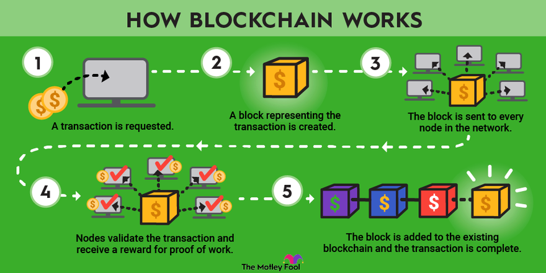
Anders Bylund, “What Is Blockchain?”, The Motley Fool, 8 Jun 2022, url https://www.fool.com/investing/stock-market/market-sectors/financials/blockchain-stocks/what-is-blockchain/ [20230415].

Slide 20
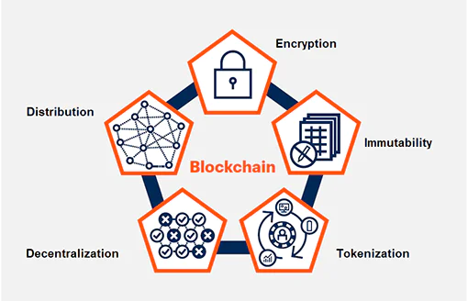

Remsha, “How Blockchain Technology Is Transforming The Cybersecurity”, MMC Global, 22 Mar 2022, url https://mmcgbl.com/how-blockchain-technology-is-transforming-the-cybersecurity/ [20230415].

Slide 21
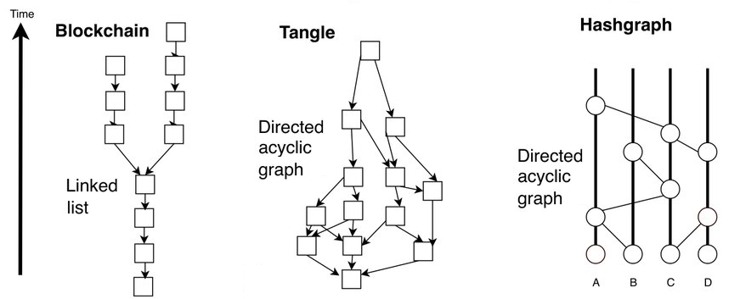
Existing Distributed Ledger Technology
Antonio Lopez Vivar, Alberto Turégano Castedo, Ana Lucila Sandoval Orozco, Ana Lucila Sandoval Orozco, Luis Javier García Villalba, “An Analysis of Smart Contracts Security Threats Alongside Existing Solutions”, Entropy, vol 22, no 2, 203, Feb 2020, url http://dx.doi.org/10.3390/e22020203.

Slide 22
Sekilas list Python

Slide 23
List di Python
url https://github.com/dudung/python/blob/main/src/stepin/intermediate/list/README.md

Slide 24
Linked list

Slide 25
Linked list dengan Python
url https://github.com/dudung/python/blob/main/src/stepin/intermediate/linked_list/README.md

Slide 26
Diskusi dan latihan

Slide 27
Tugas sebelum kuliah
Isi kehadiran di SIX.
Baca contoh-contoh di - list (10), - linkedlist (5).
Ajukan satu pertanyaan terkait contoh-contoh di atas (satu poin untuk tugas).
Informasi lebih jauh tersedia di Issue 7.

Slide 28
Diskusi
Silakan bila ada pertanyaan.
Setelah kuliah pertanyaan dapat diajukan secara asinkron di url https://github.com/dudung/sk5003-02-2022-2/issues/7

Slide 29
Terima kasih
-

