Slide 1
Machine Learning Discussing some diagrams and terms
to Adi Pancoro¹ and Udjianna Sekteria Pasaribu² from Sparisoma Viridi³
¹Genetics and Molecular Biotechnology Expertise Group, School of Life Sciences & Technology
²Statistics Research Group, Faculty of Mathematics and Natural Sciences
³Nuclear Physics and Biophysics Research Division, Faculty of Mathematics and Natural Sciences
¹⁻³Institut Teknologi Bandung, Bandung 40132, Indonesia
20230410-v0| https://doi.org/10.5281/zenodo.

Slide 2
Kerangka
Diagrams and terms 3
Subcategories 10

Slide 3
Diagrams and terms

Slide 4
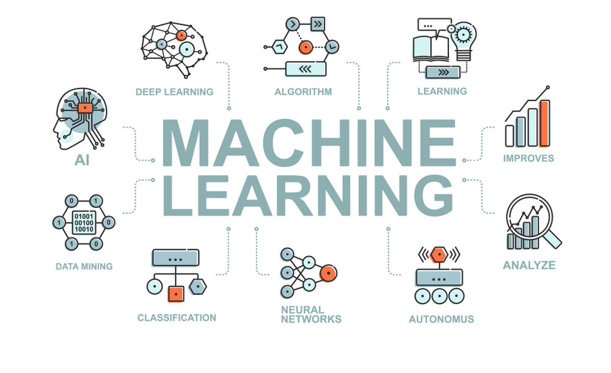
CCR, “An Introduction to Machine Learning, Its Importance, Types, and Applications”, FORE School of Management, New Delhi, 31 Aug 2022, url https://www.fsm.ac.in/blog/an-introduction-to-machine-learning-its-importance-types-and-applications/ [20230410].

Slide 5
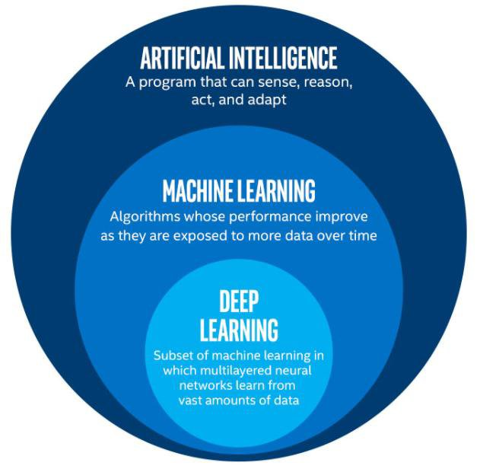
Rohini G. Khalkar, Adarsh Singh Dikhit, Anirudh Goel, Manisha Gupta, “Handwritten Text Recognition using Deep Learning (CNN & RNN)”, IARJSET 8(6):870-881, Jun 2021, url http://dx.doi.org/10.17148/IARJSET.2021.86148.

Slide 6
AI – ML
Artificial Intelligence systems are used to perform complex tasks in a way that is similar to how humans solve problems.
Machine learning is a subfield of artificial intelligence, which is broadly defined as the capability of a machine to imitate intelligent human behavior.
Sara Brown, “Machine learning, explained”, MIT Management Sloan School, 21 Apr 2021, url https://mitsloan.mit.edu/ideas-made-to-matter/machine-learning-explained [20230410].

Slide 7
ML – AI
Machine learning (ML) is a type of artificial intelligence (AI) that allows software applications to become more accurate at predicting outcomes without being explicitly programmed to do so.
Machine learning algorithms use historical data as input to predict new output values.
Ed Burns, “Machine learning”, TechTarget, Mar 2021, url https://www.techtarget.com/searchenterpriseai/definition/machine-learning-ML [20230410].

Slide 8
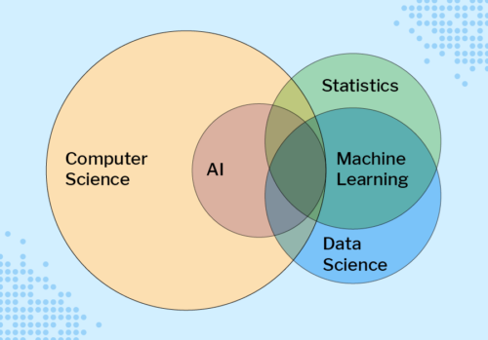
Sue Sentance, “Educating Young People in AI, Machine Learning, and Data Science: New Seminar Series”, Noise, 27 Jul 2021, url https://noise.getoto.net/2021/07/29/educating-young-people-in-ai-machine-learning-and-data-science-new-seminar-series/ [20230410].

Slide 9
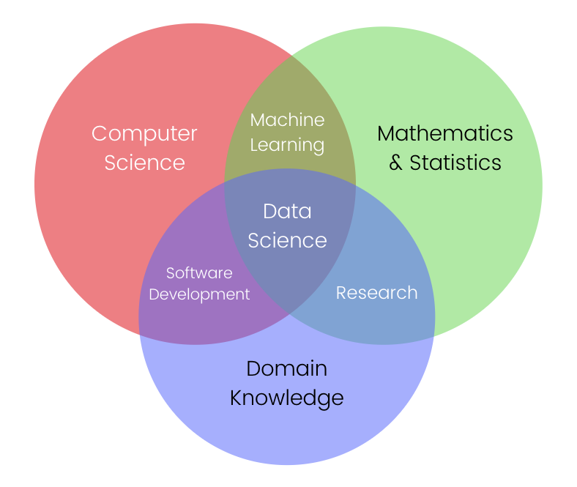
Jon-Ting, Coursera, GitHub, url https://www.meal2home.top/ProductDetail.aspx?iid=380751683&pr=39.88 [20230410].

Slide 10
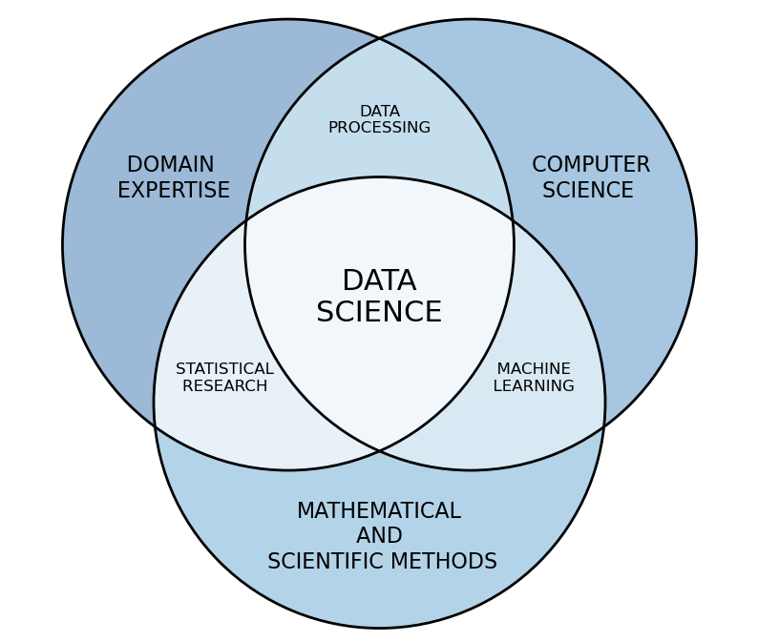
Rob Pascoe, “Data science”, Data Cymru, url https://www.data.cymru/data-science [20230410].

Slide 11
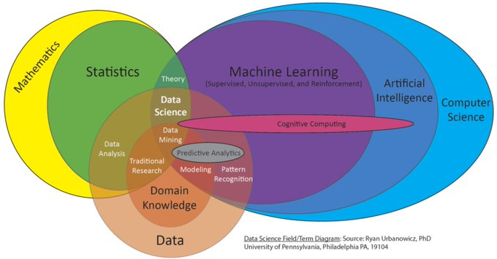
Ryan Urbanowicz, “New proposed field/term Venn diagram for an upcoming talk”, Twitter, 15 Jun 2018, url https://twitter.com/DocUrbs/status/1007375834347376642 [20230410].

Slide 12
Terima kasih
-

