Slide 1

Heart Stroke Prediction
Sai Sumanth Dudyala
Arpita Perugu
Amulya Geereddy
Satya Mounica Kalidindi

Slide 2
Heart Stroke
Stroke is a medical condition that can lead to the death of a person. It’s a severe condition and if treated on time we can save one’s life and treat them well.
A stroke occurs when a blood vessel that carries oxygen and nutrients to the brain is either blocked by a clot or bursts (or ruptures). When that happens, part of the brain cannot get the blood (and oxygen) it needs, so it and brain cells die.
The dataset consists of 30,000 records which can be used for analysis. Cases constitute a cross-section of all key diagnostic categories in heart stroke

Slide 3
Why is it necessary to predict heart stroke?
Predicting the probability of Heart stroke in early stages for a person will help us to identify the risk of getting a Cardiac attack.
This helps us to lower the death rates from Heart stroke.

Slide 4
Problem Definition and Significance
To build a heart stroke prediction engine using pyspark.
By implementing it using various algorithms such as Decision Tree, Logistic Regression, Random Forest and Gradient Decent.

Slide 5
How does heart stroke prediction help?
Early identification helps the doctor to give lifesaving and ‘brain-saving’ treatments .
Inculcating Good health habits and Proper Medications will help us to prevent heart stroke.
From the data we can observe that with the increase in age the risk of heart stroke is increasing periodically.

Slide 6
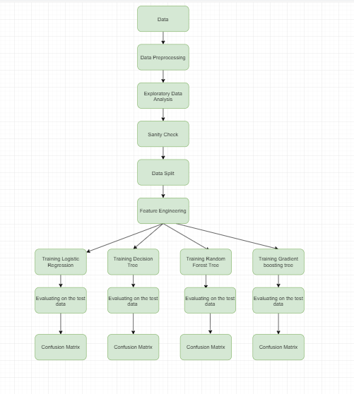
Flow Chart

Slide 7

Data Collection
The Data is obtained from Kaggle website.
https://www.kaggle.com/lirilkumaramal/heart-stroke

Slide 8
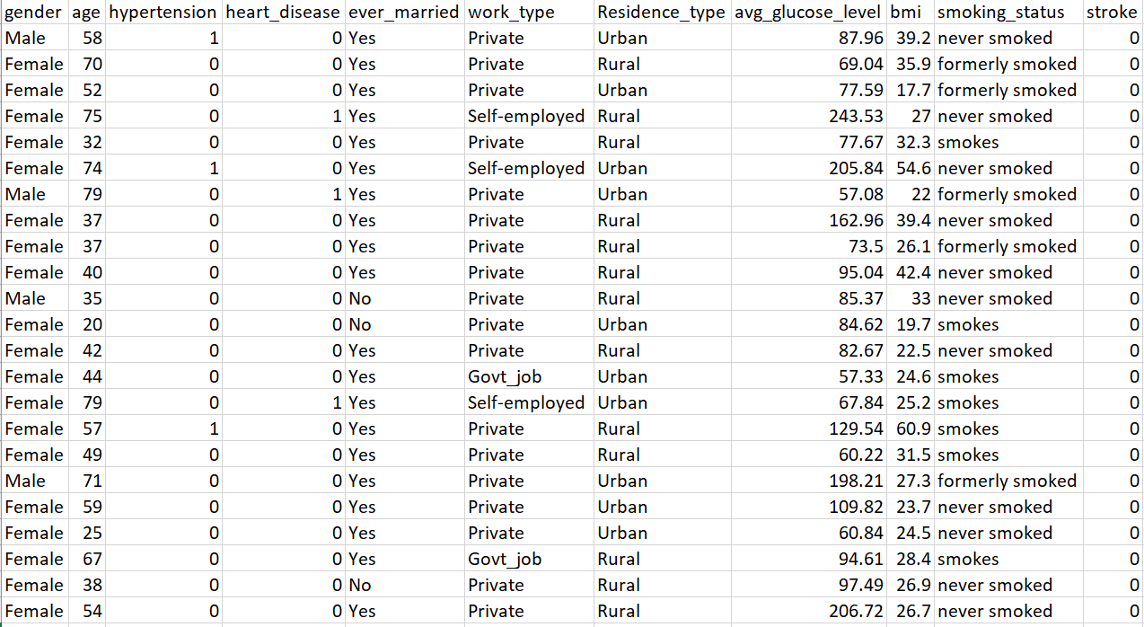
Variable Selection

Slide 9
Data Preprocessing
Encoded Categorical columns.
Standardized numerical values.
Calculated bmi category from the available bmi column.
Imputed numeric and categorical columns

Slide 10
Data Imbalance
After analyzing our dataset, we found it to be imbalanced.
Our target class(Stroke) has uneven distribution of observations.
To overcome this imbalance in the data we have performed Oversampling with the existing records(Train dataset).
By implementing Oversampling, we have generated an unbiased dataset.

Slide 11
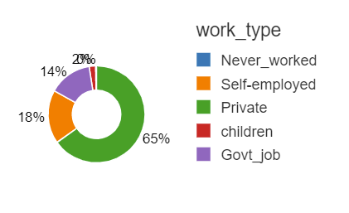
Exploratory Data Analysis
Here we can see that private work_type employees are more prone to heart attacks maybe because of job tension or severity of work.

Slide 12
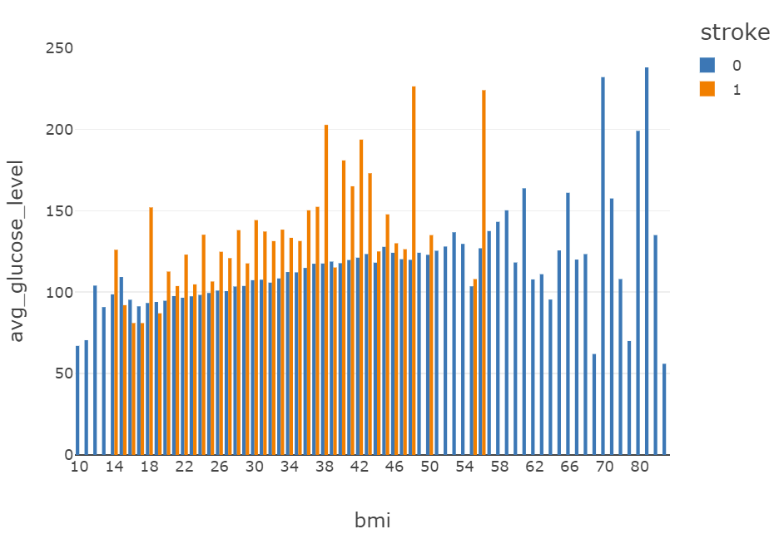
Exploratory Data Analysis
From the other graph we can see that people whose bmis are less than 58 are more towards heart attacks than others.

Slide 13
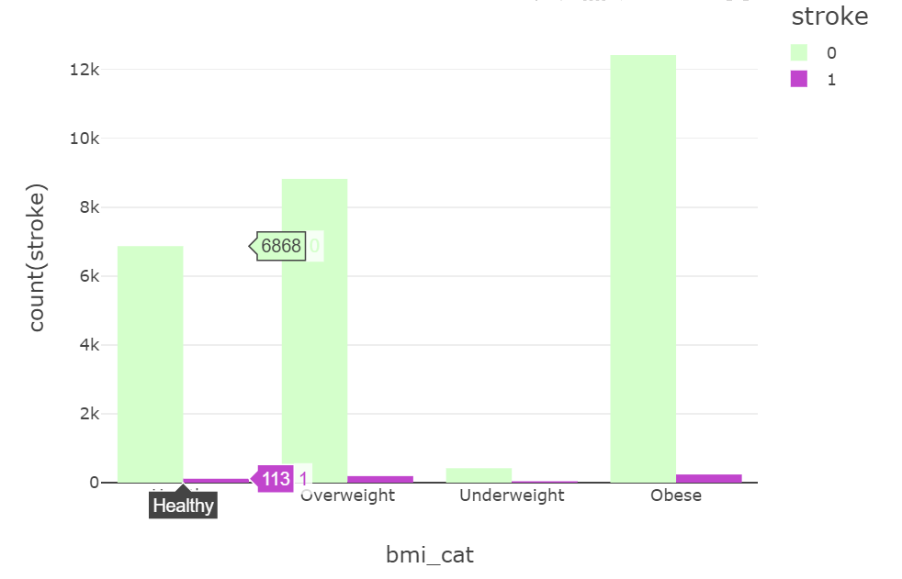
Exploratory Data Analysis
From the data we can see that Obese and overweight people are more towards heart stroke.

Slide 14
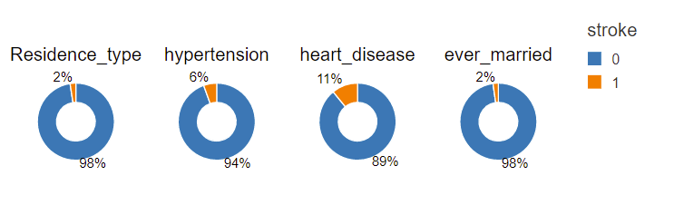
Exploratory Data Analysis
From the below Pie charts we can see that people with prior heart disease are more likely to get Heart stroke.

Slide 15
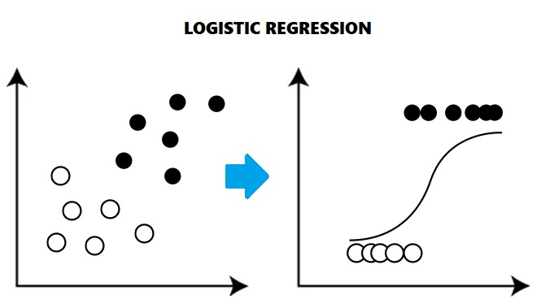
Model Building: Logistic Regression
Logistic regression is a statistical method that in its basic form uses a logistic function to model a binary dependent variable.
The accuracy was 74.29%

Slide 16
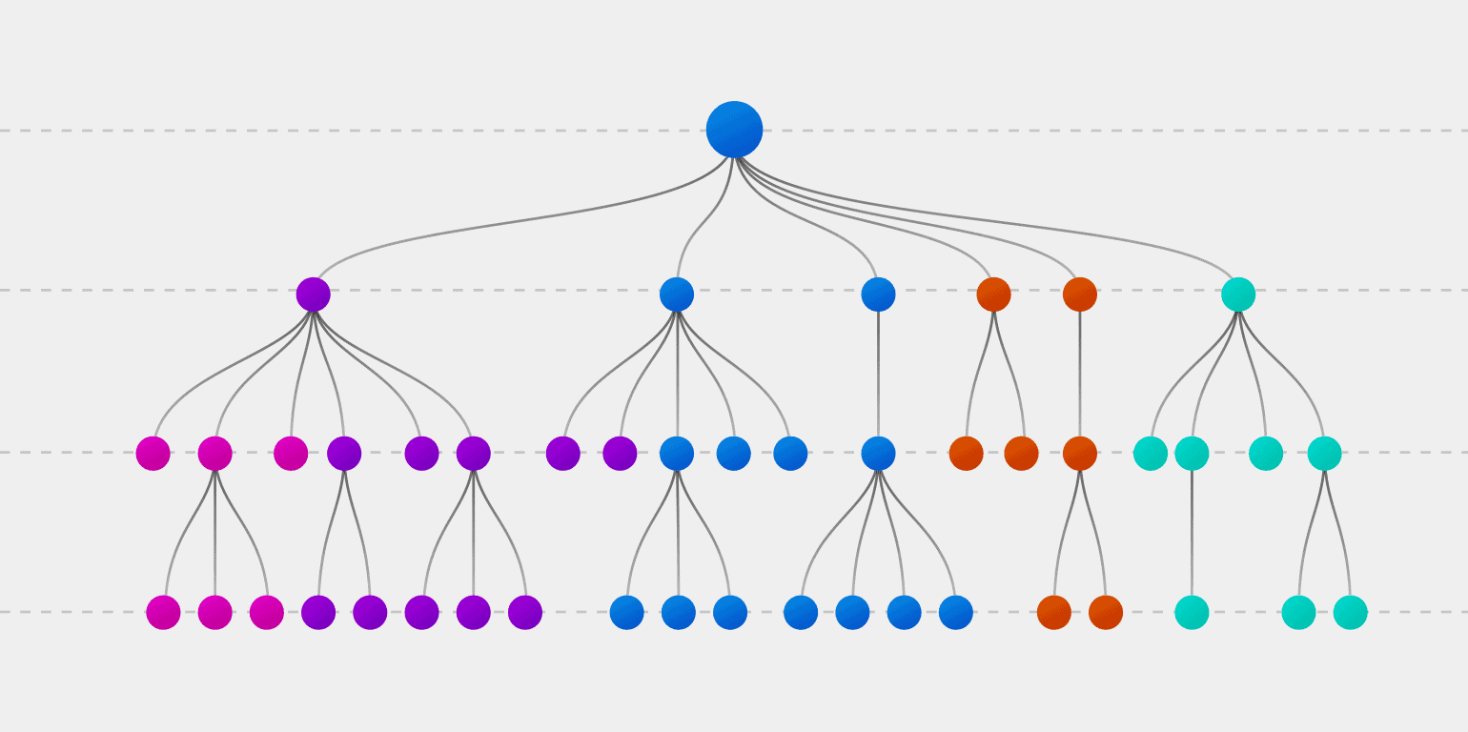
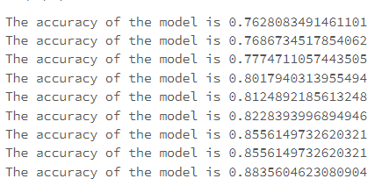
Model Building: Decision Tree
A decision tree is a graphical representation of possible solutions to a decision based on certain conditions.
It's called a decision tree because it starts with a single root, which then branches off into several solutions, just like a tree.

Slide 17
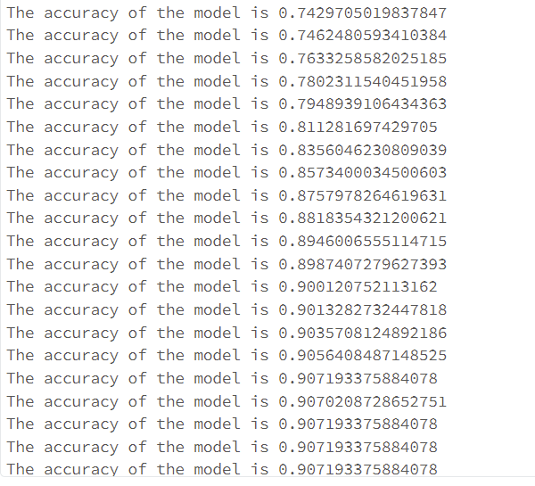
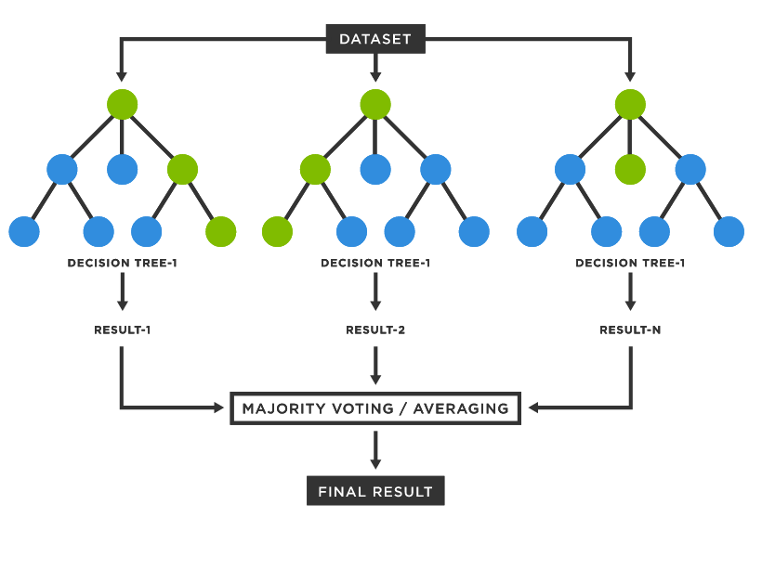
Model Building: Random Forest Tree
Random forests or random decision forests are an ensemble learning method for classification that operates by constructing several decision trees at training time.
For classification tasks, the output of the random forest is the class selected by most trees.

Slide 18
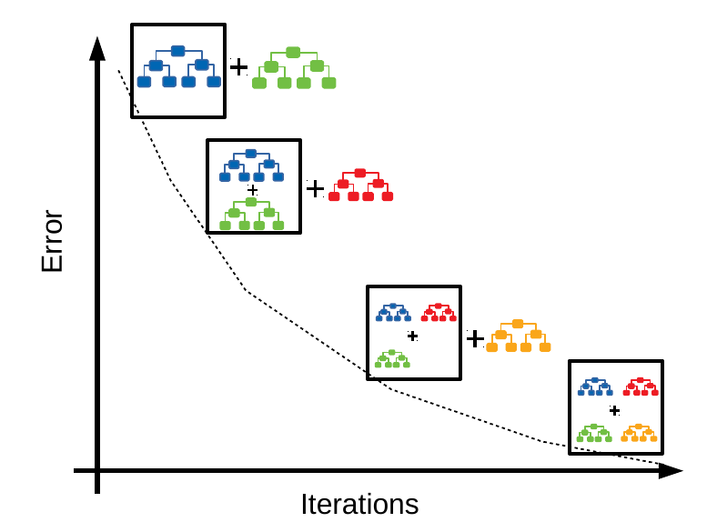
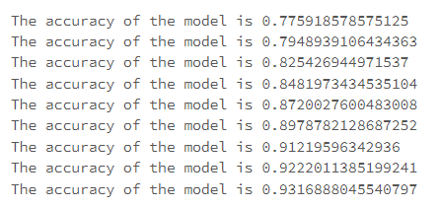
Model Building: Gradient Boosting Tree
Gradient boosting tree is a machine learning technique used in classification tasks.
It gives a prediction model in the form of an ensemble of weak prediction models, which are typically decision trees.

Slide 19
Models and Accuracy
Baseline Accuracy : 50.1%
Model | Accuracy
Logistic Regression | 73.2%
Decision Tree | 88.3%
Random Forest | 90%
Gradient Boosting Tree | 93%

Slide 20
Insights from the model
From our model we can see that people above 60 years of age are more prone to have a heart stroke
People with a smoking habit are more susceptible to heart stroke.
Our model suggests that people with prior heart complications are more prone to stroke.

Slide 21
Future Work
Extracting demographic features would help us in improving the model performance.
Based on the health habits we can predict if a person has probability of getting a heart stroke.
We can create a survey to collect data from people based on their food habits and lifestyle. Using which we can provide a chart as a guide to avoid heart stroke.
Using this model, we can create a dashboard for doctors which helps them to identify the risk of heart stroke for patients.

Slide 22
References
https://www.youtube.com/watch?v=JnlM4yLFNuo&t=1134s
https://spark.apache.org/docs/3.1.1/api/python/reference/api/pyspark.ml.classification.RandomForestClassifier.html
https://spark.apache.org/docs/latest/api/python/reference/api/pyspark.ml.classification.GBTClassifier.html
https://spark.apache.org/docs/latest/api/python/reference/api/pyspark.ml.classification.DecisionTreeClassifier.html
https://www.healthline.com/health/high-cholesterol/levels-by-age#children
https://www.webmd.com/heart-disease/guide/heart-disease-lower-cholesterol-risk
https://www.medicinenet.com/blood_pressure_chart_reading_by_age/article.htm
https://my.clevelandclinic.org/health/diagnostics/17402-pulse--heart-rate
https://spark.apache.org/docs/latest/api/python/reference/api/pyspark.ml.classification.LogisticRegression.html

