Slide 1

Heart Stroke prediction
Sai Sumanth Dudyala
Arpita Perugu
Amulya Geereddy
Satya Mounica Kalidindi

Slide 2
Heart Stroke
Stroke is a medical condition that can lead to the death of a person. It’s a severe condition and if treated on time we can save one’s life and treat them well.
A stroke occurs when a blood vessel that carries oxygen and nutrients to the brain is either blocked by a clot or bursts (or ruptures). When that happens, part of the brain cannot get the blood (and oxygen) it needs, so it and brain cells die.
The dataset consists of 30,000 records which can be used for analysis. Cases constitute a cross-section of all key diagnostic categories in heart stroke

Slide 3
Why is it necessary to predict heart stroke?
Predicting the probability of Heart stroke in early stages for a person will help us to identify the risk of getting a Cardiac attack.
This helps us to lower the death rates from Heart stroke.

Slide 4
Problem Definition and Significance
To build a heart stroke prediction engine using pyspark.
By implementing it using various algorithams such as decision tree, Logistic regression and clustering.

Slide 5
How does heart stroke prediction help?
Early identification helps the doctor to give lifesaving and ‘brain-saving’ treatments .
Inculcating Good health habits and Proper Medications will help us to prevent heart stroke.
From the data we can observe that with the increase in age the risk of heart stroke is increasing periodically.

Slide 6

Data Collection
The Data is obtained from Kaggle website.
https://www.kaggle.com/lirilkumaramal/heart-stroke

Slide 7
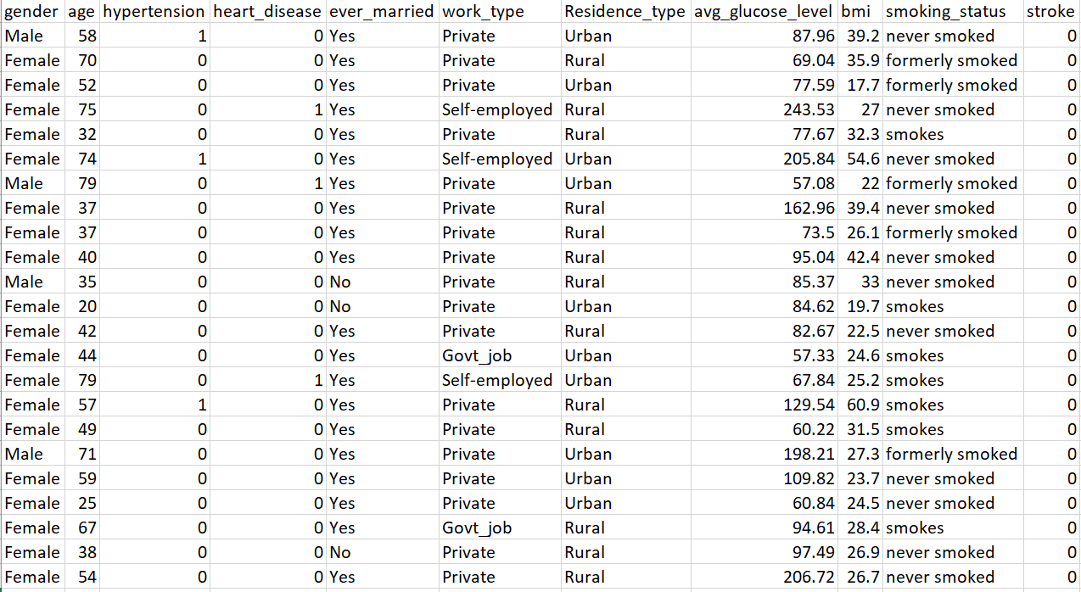
Variable Selection

Slide 8
Data Preprocessing
Encoded Categorical columns.
Standardized numerical values.
Calculated bmi category from the available bmi column.
Imputed numeric and categorical columns

Slide 9
Data Imbalance
After analyzing our dataset, we found it to be imbalanced.
Our target class(Stroke) has uneven distribution of observations.
To overcome this imbalance in the data we have performed Oversampling with the existing records(Train dataset).
By implementing Oversampling, we have generated an unbiased dataset.

Slide 10
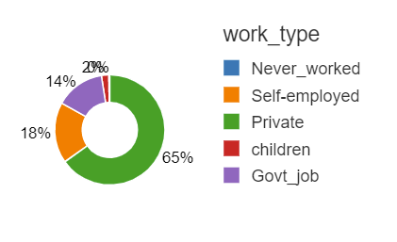
Exploratory Data Analysis
Here we can see that private work_type employees are more prone to heart attacks maybe because of job tension or severity of work.

Slide 11
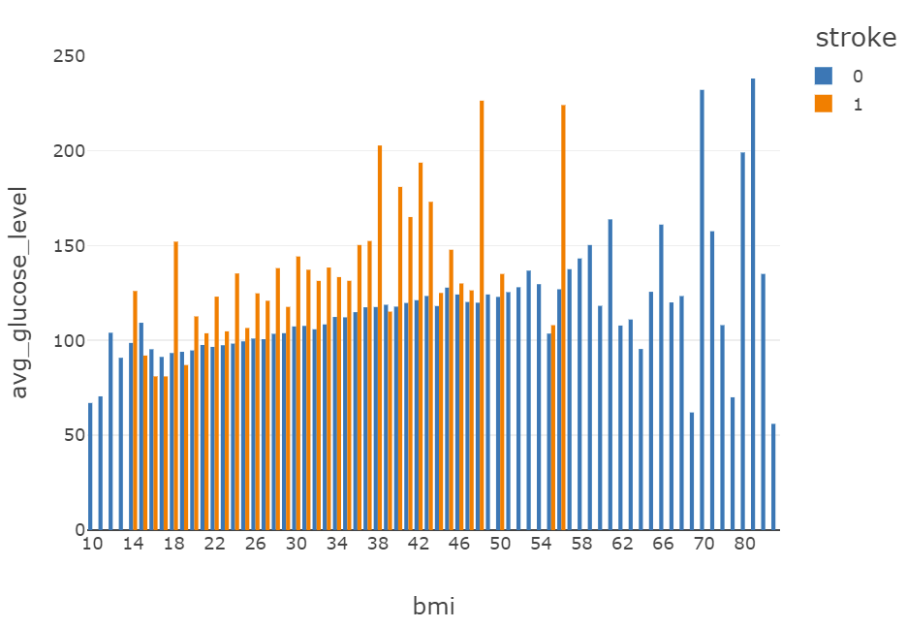
Exploratory Data Analysis
From this graph we can see that people whose bmis are less than 58 are more towards heart attacks than others.

Slide 12
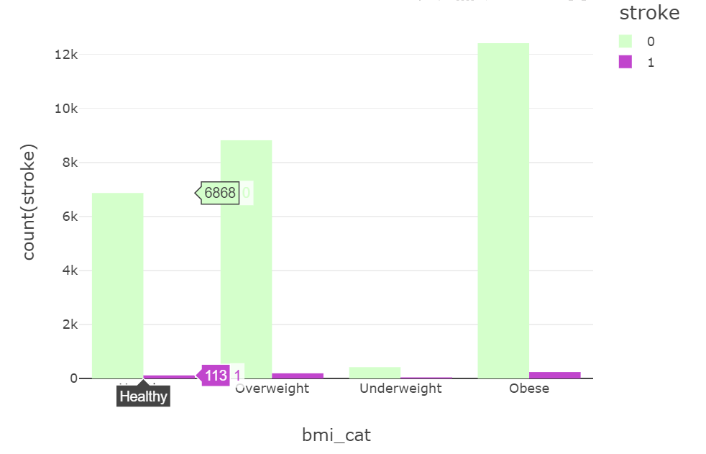
Exploratory Data Analysis
From the data we can see that Obese and over weight people are more towards heart stroke.

Slide 13
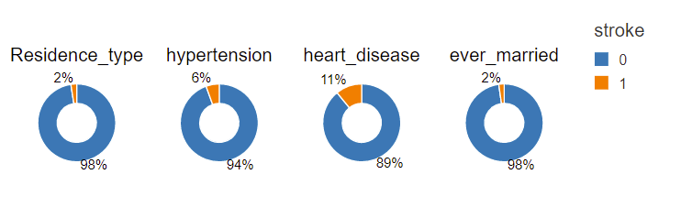
Exploratory Data Analysis
From the below Pie charts we can see that people with prior heart disease are more likely to get Heart stroke.

Slide 14
Models and accuracy performed
Baseline Accuracy : 50.1%
Model | Accuracy
Logistic | 73.2%
Random Forest | 90%
Gradient Boosting Tree | 93%

Slide 15
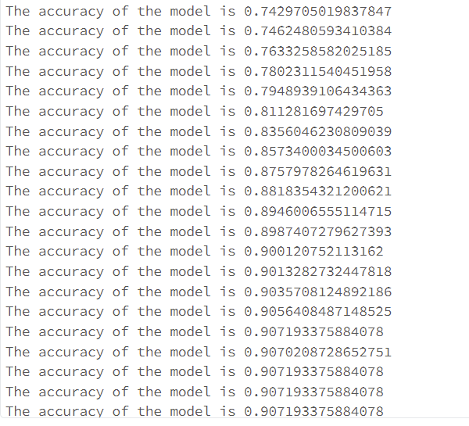
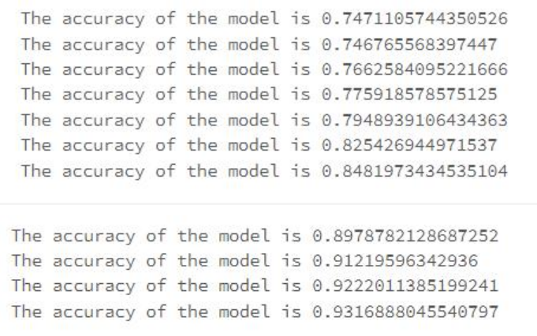
Insights from the model
Gradient Boosting Tree:
Random Forest

Slide 16
Recommendations

Slide 17
Future Work
Extracting demographic features would help us in improving the model performance.
Based on the health habits we can predict if a person has probability of getting a heart stroke.
We can create a survey to collect data from people based on their food habits and lifestyle. Using which we can provide a chart as a guide to avoid heart stroke.
Using this model, we can create a dashboard for doctors which helps them to identify the risk of heart stroke for patients.

Slide 18
References
https://www.youtube.com/watch?v=JnlM4yLFNuo&t=1134s
https://spark.apache.org/docs/3.1.1/api/python/reference/api/pyspark.ml.classification.RandomForestClassifier.html
https://spark.apache.org/docs/latest/api/python/reference/api/pyspark.ml.classification.GBTClassifier.html
https://www.healthline.com/health/high-cholesterol/levels-by-age#children
https://www.webmd.com/heart-disease/guide/heart-disease-lower-cholesterol-risk
https://www.medicinenet.com/blood_pressure_chart_reading_by_age/article.htm
https://my.clevelandclinic.org/health/diagnostics/17402-pulse--heart-rate

