Slide 1

Heart Stroke prediction
Sai Sumanth Dudyala
Arpita Perugu
Amulya Geereddy
Mounika Kalidindi

Slide 2
Why is it necessary to predict heart stroke?
Predicting heart stroke for specific person will help us to identify the person.
Which can save life by acting early.

Slide 3
Problem Definition and Significance
To build a heart stroke prediction engine using pyspark.
By implementing it using various algorithams such as decision tree, Logistic regression and clustering.

Slide 4
How does heart stroke prediction help?
It will help doctors and patients to save the lifes early.
By following proper food and medication they will be able to avoid heart stroke.
As from the data we can see that higher age people are more towards heart stroke so we can monitor their vitals periodically.
Recommend proper diet to avoid heart stroke.

Slide 5

Data Collection
The Data is obtained from Kaggle website.

Slide 6
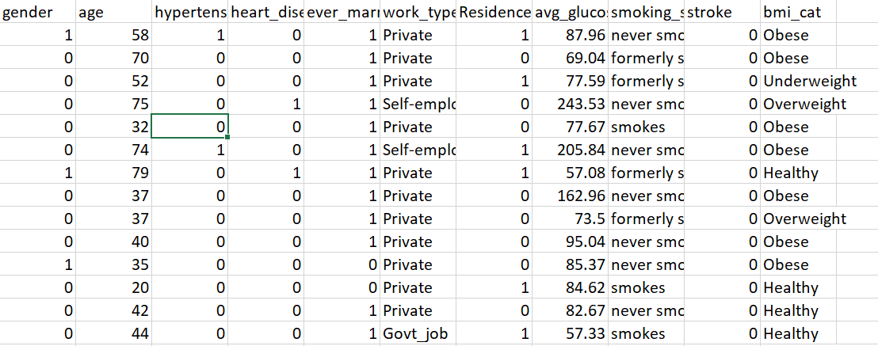
Variable Selection

Slide 7
Data Preprocessing
Encoded Categorical columns.
Standardized numerical values.
Calculated bmi category from the available bmi column.
Imputed numeric and categorical columns

Slide 8
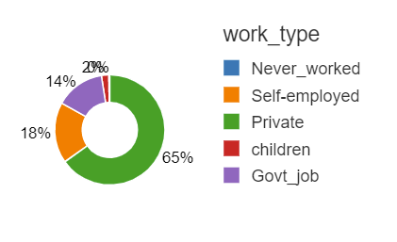
Exploratory Data Analysis
Here we can see that private work_type employees are more prone to heart attacks maybe because of job tension or severity of work.

Slide 9
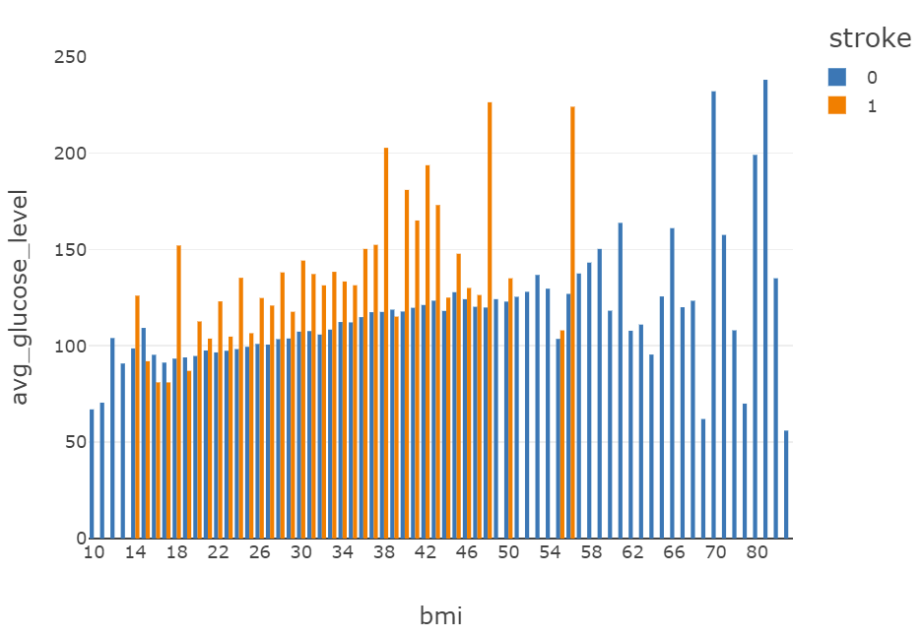
Exploratory Data Analysis
From the other graph we can see that people whose bmis are less than 58 are more towards heart attacks than others.

Slide 10
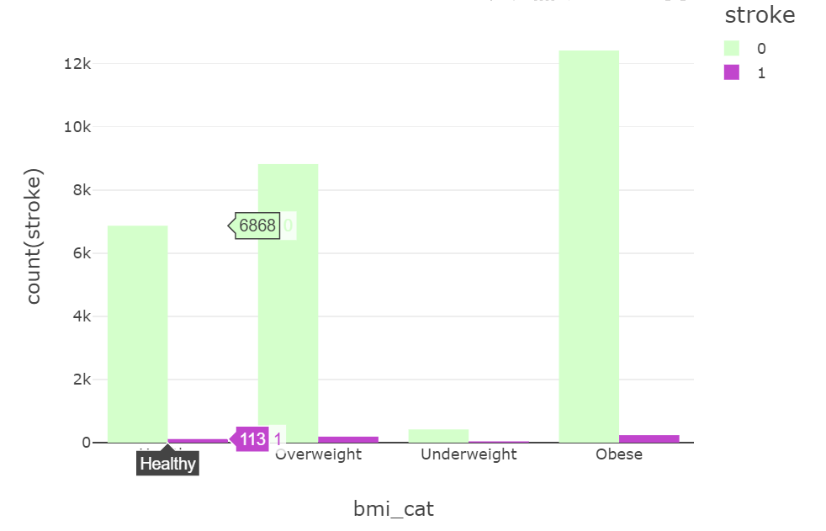
Exploratory Data Analysis
From the data we can see that Obese and over weight people are more towards heart stroke.

Slide 11
Models and accuracy performed
Model | Accuracy
Logistic
Random Forest
Gradient Boosting Tree

Slide 12
Insights from the model

Slide 13
Future Work

Slide 14
References

