Slide 1
SmartCoffee
Marcin Dobosz s8622
Andrzej Górz s8383
INN@PJATK
29.01.2016

Slide 2
Thesis Description
Adjustment of caffeine and sugar level
Predict how strong his coffee should be
Coffee beans have different level of caffeine
Saves time on putting necessary data into the system
Blood pressure and risk of using gas/electricity supply with water
Coffee making is boring for non-Italian users
Analysis of user health and machine input
No additional input from user

Slide 3
Objective/Approach
Obtain data for health and mood analysis
Determine how strong coffee user needs and should drink
Determine kind of beans
Prepare right coffee with desired level of caffeine
Camera determines mood and health of user
Test bean tautness and size to determine how strong coffee should be
Embed good equality pressure coffee machine

Slide 4
Resources/Schedule
01/02 - Research on video analysis
30/04 - Research on coffee beans
01/05 - Research on caffeine input on human health
01/08 -Testing preferences of coffee in various moods
30/09 - Creating algorithm which will determine right coffee output
01/12 - Developing machine prototype
01/02 - Testing prototype
30/04 - Making necessary adjustments

Slide 5
Requirements
Control employee energy
No overdose caffeine
Save money on coffee supplies
Smart saves time
Workplace is safe and clean
Easier maintenance - supplies rationing

Slide 6
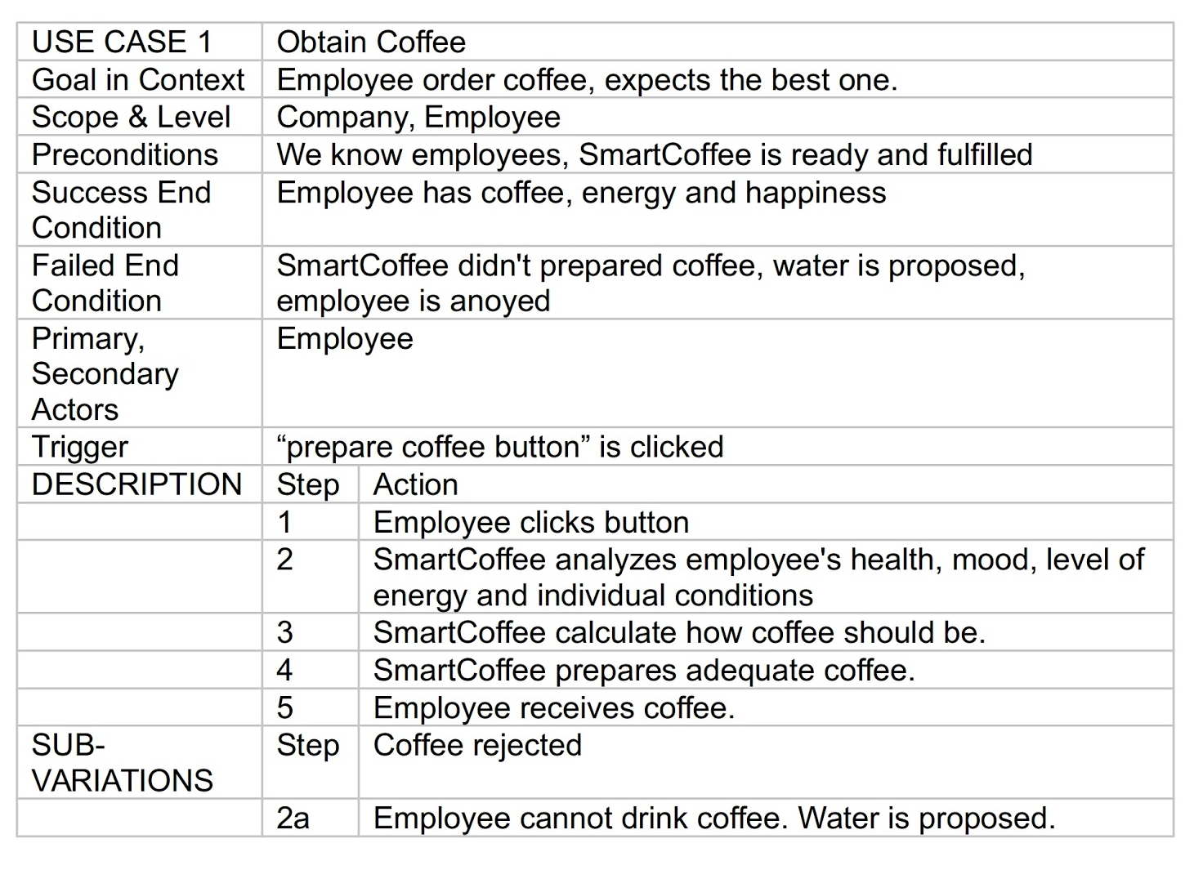
USE CASE 1

Slide 7
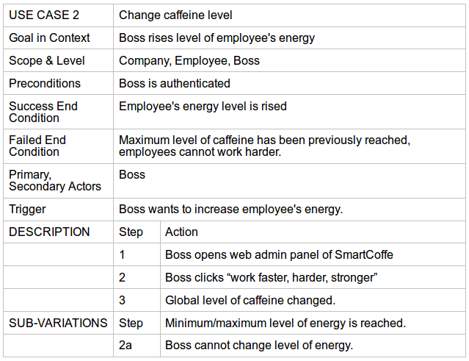
USE CASE 2

Slide 8
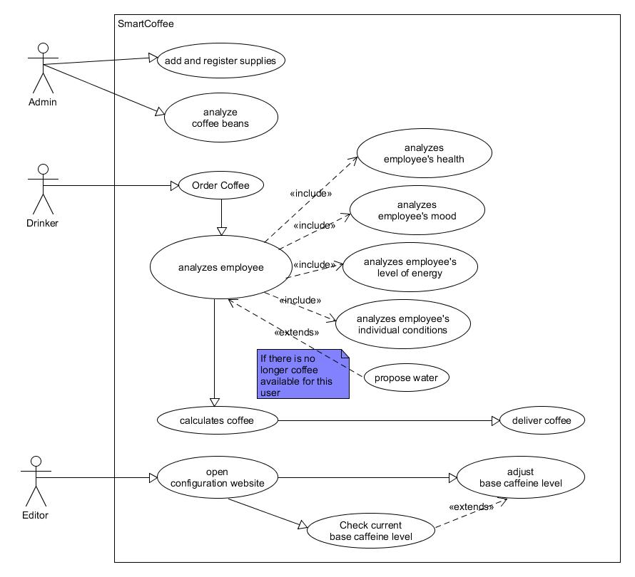
SMART COFFEEMAKER

Slide 9
Dzięki za your attention.
Marcin Dobosz s8622
Andrzej Górz s8383
INN@PJATK
29.01.2016

