Slide 1

Automatic Number Plate Recognition for Indian vehicles
Presented By: Under Group no-11 Dr. V.K. RAO.
Dheeraj Kumar Maurya (20195032)
Kuldeep (20195031)
Devendra Kumar Atoliya (20195138)
DEPARTMENT OF ELECTRONICS AND COMMUNICATION ENGINEERING
MOTILAL NEHRU NATIONAL INSTITUTE OF TECHNOLOGY ALLAHABAD PRAYAGRAJ,

Slide 2
Content
Introduction
Platform details
Technique Used
Flow chart
Image Processing & Plate Localization
Character Segmentation
Character Recognition
Important MATLAB Functions and Formula Used
Application/Problem
References

Slide 3


Independent Project: Number Plate Detection
Introduction :-
Number plates are used for identification of vehicles all over nation.
Recognizing and Detecting Number Plate is a very important task for a camera surveillance-based security system.
This method of detection and identification helps in detection of number plates of authorized and unauthorized vehicle.

Slide 4

2. Platform Details :-
We are using MATLAB for this project.
It solves technical computational problems faster than languages like C, C++ etc.
3. Technique Used :-
We are using Image Processing technique in which captured image of vehicle number plate is processed through multiple algorithms to convert the alpha numeric conversion of image into text format and displayed.
4. Working Procedure :-

Slide 5
Input Car Image
Image Pre Processing
Character Recognition
Output Image
Plate Localization
Character Segmentation

Slide 6
5. Image Processing & Plate Localization :-
Image is pre-processed through different algorithms and location of number plate is extracted. Major stages are :-
RGB to Gray scale conversion
Detection of Plate Size
Dilation of BGM (Binary Gradient Masking)
Media Filtering
Eroding of Image
Multiplication of segmented image with gray scale image.
Number Plate Image of Vehicle.

Slide 7
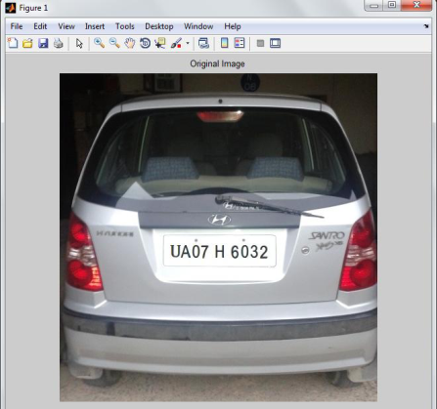
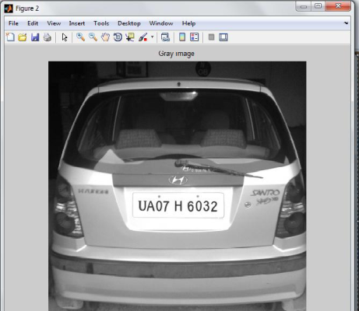
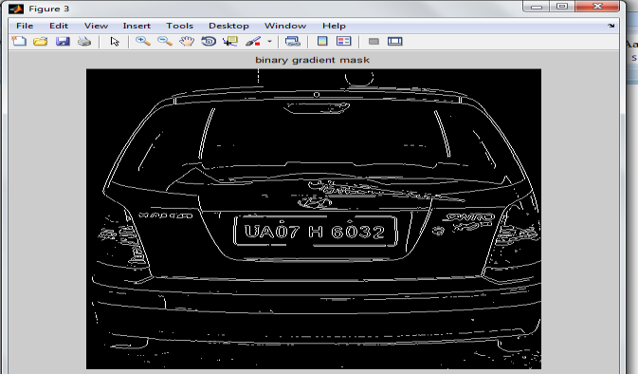
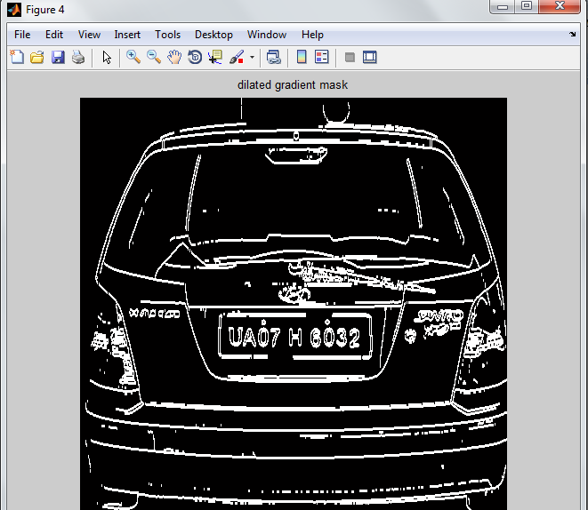
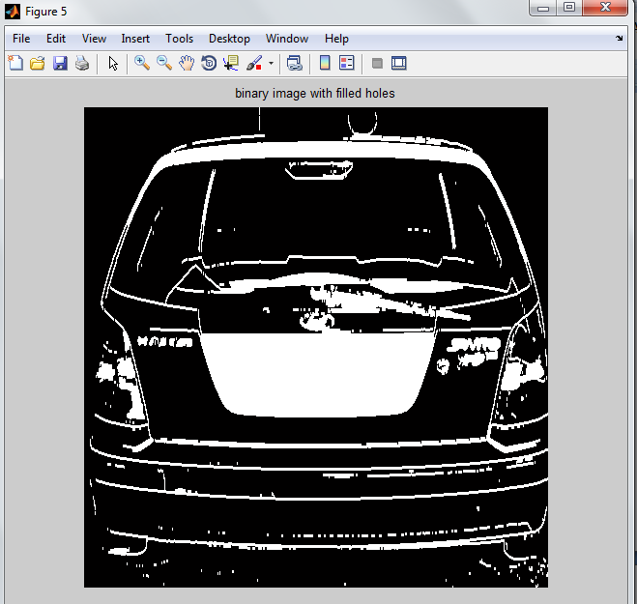
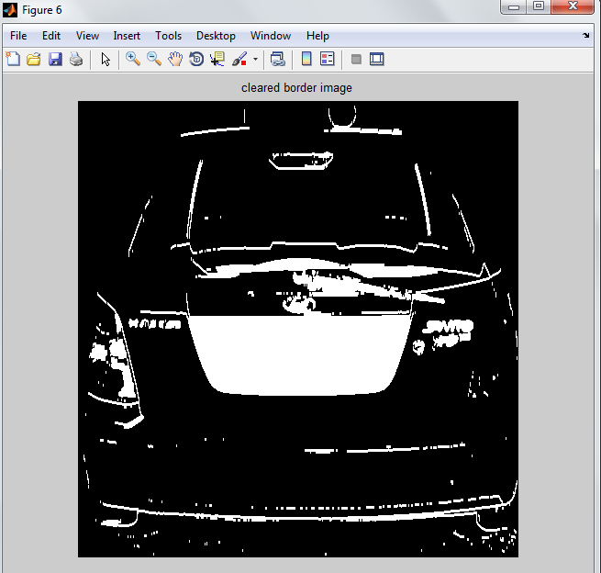

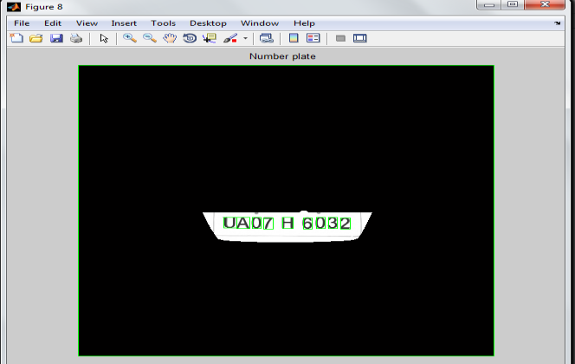
Pictorial Understanding
(Image Processing)

Slide 8

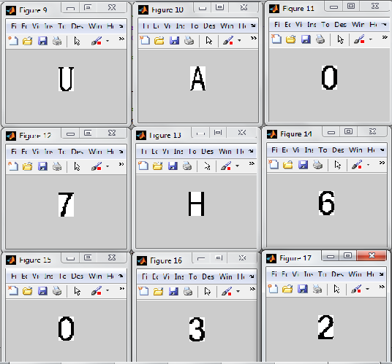

6. Character Segmentation :-
Segmentation is one of the most important processes in the number plate recognition, because all further steps rely on it.
Bounding Box Technique: It is used to measure properties of image region.
Once a bounding box created over each character and
numbers presented on number plate, each character
& number is separate out for recognition of the
number plate.

Slide 9

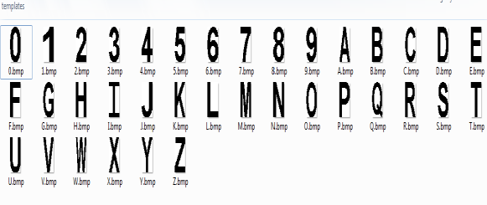
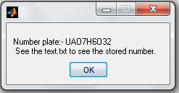
7. Character Recognition :-
Number plate recognition is now used to compare the each individual character against the complete alphanumeric database using template matching.
After successful and accurate template matching, text file of output image is displayed.

Slide 10

8. Important MATLAB Functions and Formula Used :-
1 gray=0.114*R+0.587*G+0.299*B
I = rgb2gray(RGB) converts the true color image RGB to the grayscale intensity image I.
BW2 = imfill(BW, 'holes') fills holes in the input binary image BW.
imclearborder(I): It suppresses structures in image I that are lighter than their surroundings and that are connected to the image border.
imread(filename): It reads the image from the file specified by filename.

Slide 11

Applications
Problems
Parking: Allow to enter prepaid members.
Tolling: Calculate travel fee in toll road and used to double check ticket.
Border Security: Monitors inter as well as intra crossing of vehicles.
Traffic Control: Directed to different lanes acc. to their entry permits.
Airport Parking: Reduce ticket frauds and captures image of car and number plate.
1. Broken number plate.
2. Blurry images.
3. Number plate not within the legal specification.
4. Low resolution of the characters.
5. Poor maintenance of the vehicle plate. Like similarity b/w certain characters.
(Ex: O & D)

Slide 12
References
References Referred: www.mathworks.com .
Research Paper : INTERNATIONAL JOURNAL OF INNOVATIVE RESEARCH IN ELECTRICAL, ELECTRONICS, INSTRUMENTATION AND CONTROL ENGINEERING

Slide 13
THANK YOU

