Slide 1
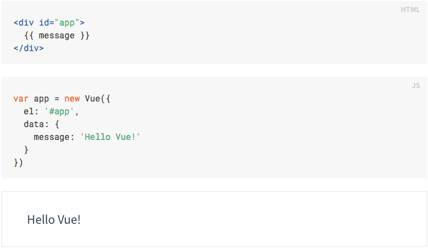
Hello world!

Slide 2




Slide 3
Directive
V-bind:(attribute)
  V-bind:title, v-bind:style
V-on:(event)
  V-on:click
V-if, v-else
v-for
V-model

Slide 4
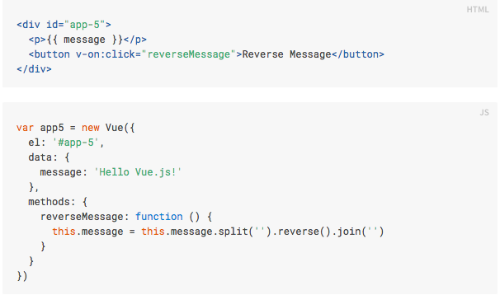
v-on

Slide 5
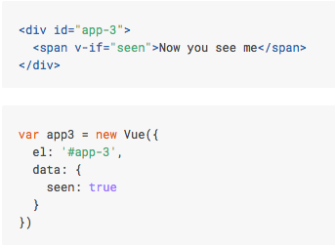

Slide 6
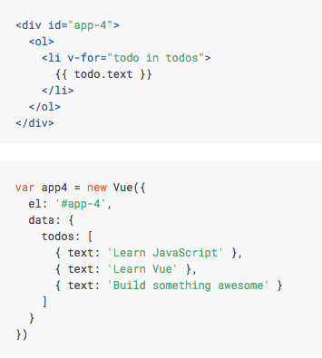

Slide 7
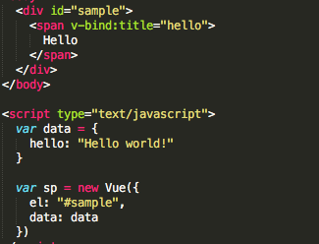
Vue instance – reactivity sys

Slide 8
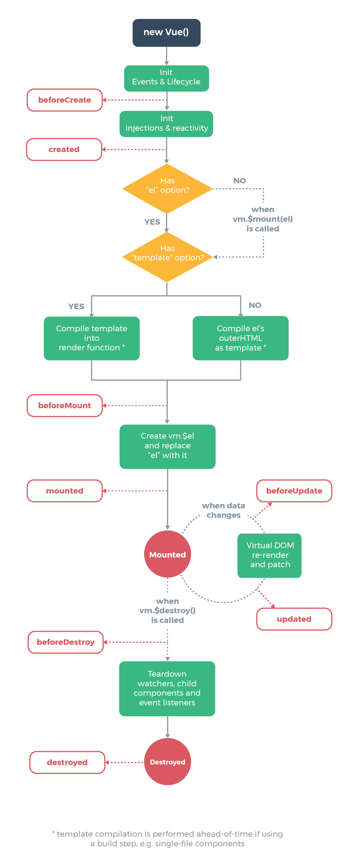
Lifecycle

Slide 9
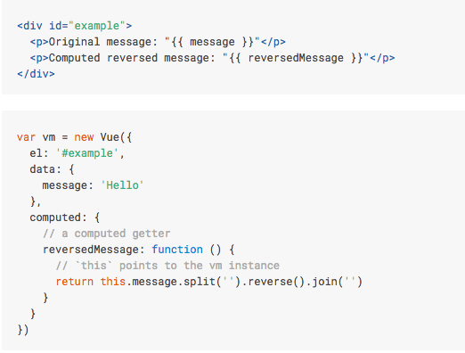
Computed Properties

Slide 10
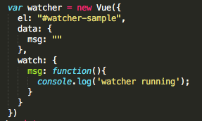
Watcher

Slide 11


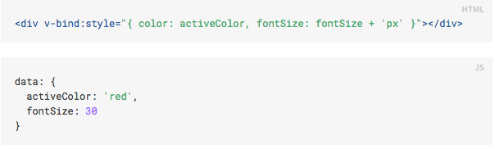
Class and Style Bindings
Object Syntax

Slide 12
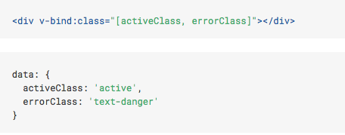
Class and Style Bindings
Array Syntax

Slide 13
Form Input Bindings

Slide 14
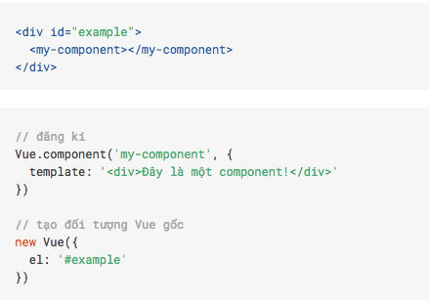
Component

Slide 15
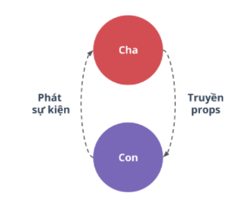
Props vs Event

