Slide 1
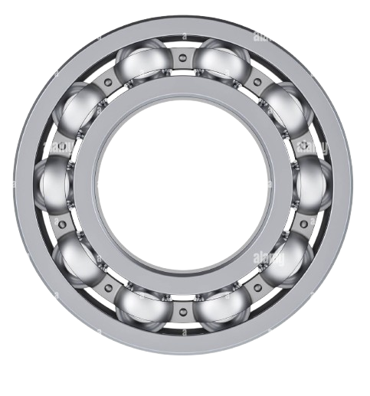
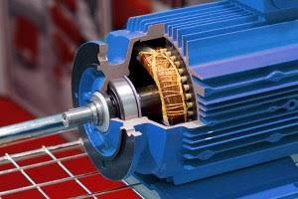
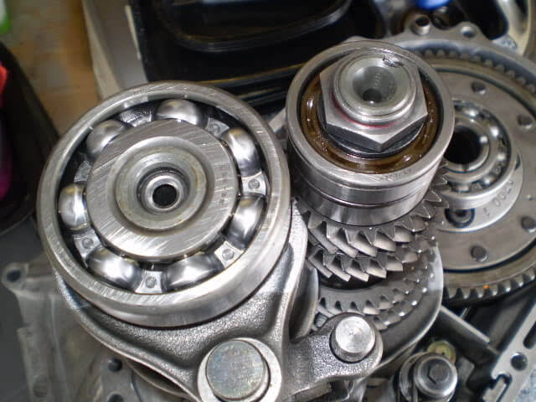
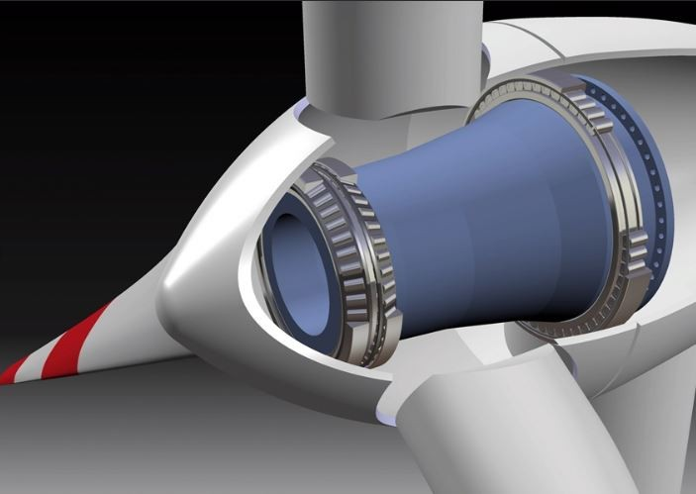
Improving Cross-Domain Generalization in Leakage-Safe Bearing Fault Diagnosis
WHY THIS common PROBLEM?
ME G545
BIGGEST ISSUE YET TO BE SOLVED…
Critical fact checking and development of an honest deep learning model to cover the gaps in this field that are left open by recent research.
Affected 294 papers across 17 fields.
Within this problem, >90% papers show splitting problems.
Splitting and cross-domain generalization is the way to go.
DATA LEAKAGE

Slide 2
WHY THIS common PROBLEM?
BIGGEST ISSUE YET TO BE SOLVED…
Affected 294 papers across 17 fields.
Within this problem, >90% papers show splitting problems.
Splitting and cross-domain generalization is the way to go.
DATA LEAKAGE
CWRU – Vibration signals at multiple defect sizes, recorded at 12 kHz/48kHz under four load levels (0-3 HP) – Most ‘leaked’
PU – Vibration signals from multiple operating conditions (speed, torque, radial force) – Harder dataset for leakage-safe models
DATASETS
Knap, Jachymczyk & Lalik (PHM Society Europe, 2026) built a leakage-safe cross-domain benchmark on CWRU + PU.
Their model showed an F1 score (harmonic mean of precision and recall) of 0.326 whereas a simple logistic regression performed better with a score of 0.355.
BENCHMARKS & GAP

Slide 3
CWRU – Vibration signals at multiple defect sizes, recorded at 12 kHz/48kHz under four load levels (0-3 HP) – Most ‘leaked’
PU – Vibration signals from multiple operating conditions (speed, torque, radial force) – Harder dataset for leakage-safe models
DATASETS
Knap, Jachymczyk & Lalik (PHM Society Europe, 2026) built a leakage-safe cross-domain benchmark on CWRU + PU.
Their model showed an F1 score (harmonic mean of precision and recall) of 0.326 whereas a simple logistic regression performed better with a score of 0.355.
BENCHMARKS & GAP
How I aim on the g a p
bridging
Reproduce results.
Reproduce the 0.326 leakage-safe baseline exactly — same split, same metric, same seeds.
Adapt.
Apply domain-adaptation training — adversarial and/or contrastive pretraining — so features stop encoding bearing identity.
Experiment.
Examine the architecture and find out exactly what caused the improvement changing things one at a time.

Slide 4
How I aim on the g a p
bridging
Reproduce results.
Reproduce the 0.326 leakage-safe baseline exactly — same split, same metric, same seeds.
Adapt.
Apply domain-adaptation training — adversarial and/or contrastive pretraining — so features stop encoding bearing identity.
Experiment.
Examine the architecture and find out exactly what caused the improvement changing things one at a time.
REFERENCES
Vieira, Bauler, Rosa & Silva
"Towards a more realistic evaluation of ML models for bearing fault diagnosis"
Mechanical Systems and Signal Processing (MSSP)
2026
Knap, Jachymczyk & Lalik
“Leakage-Safe, Reproducible Benchmarking for Vibration-Based Fault Diagnosis"
PHM Society European Conference
2026
Chen, Yang, Xue, Huang, Ferrero & Wang
"Deep Transfer Learning for Bearing Fault Diagnosis: A Systematic Review Since 2016"
IEEE Transactions on Instrumentation and Measurement
2023
Ganin & Lempitsky
"Unsupervised Domain Adaptation by Backpropagation" (origin of DANN)
ICML (International Conference on Machine Learning)
2015

Slide 5
REFERENCES
Vieira, Bauler, Rosa & Silva
"Towards a more realistic evaluation of ML models for bearing fault diagnosis"
Mechanical Systems and Signal Processing (MSSP)
2026
Knap, Jachymczyk & Lalik
“Leakage-Safe, Reproducible Benchmarking for Vibration-Based Fault Diagnosis"
PHM Society European Conference
2026
Chen, Yang, Xue, Huang, Ferrero & Wang
"Deep Transfer Learning for Bearing Fault Diagnosis: A Systematic Review Since 2016"
IEEE Transactions on Instrumentation and Measurement
2023
Ganin & Lempitsky
"Unsupervised Domain Adaptation by Backpropagation" (origin of DANN)
ICML (International Conference on Machine Learning)
2015

Slide 6
THANK Y U

