Slide 1
Progress meeting
2022. 07. 27.
Yousang Nam

Slide 2
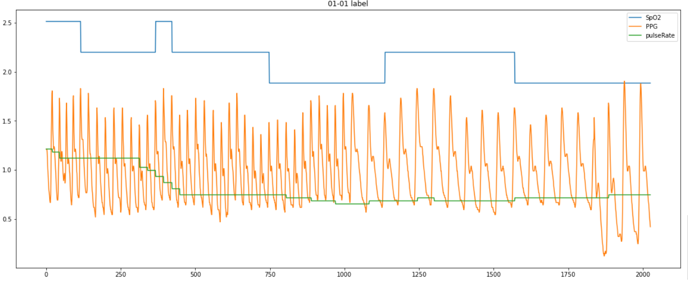
Progress
Done
Change the QrPPGNet in multimodal
method : Adding output branchs pi ( b - x) / (b - a)
output : SpO2, pulseRate, PPG, and scalar 0 ( 0 : Temporary value to match the number of the output to 4 )
PURE dataset pre-processing ( labels )

Slide 3
Progress
Progress
PURE dataset pre-processing ( images )
Results of preprocessing performed on colab are not stored on actual Google drives
To do
Pre-Processing PURE dataset on a lab server
Try the other pre-processing files i received from Younghoon

