Slide 1
Progress meeting
2022. 08. 03.
Yousang Nam

Slide 2
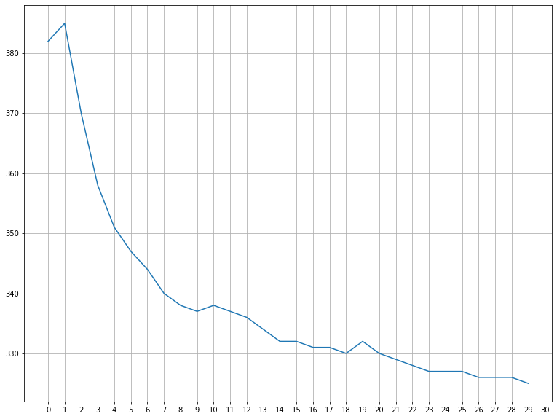
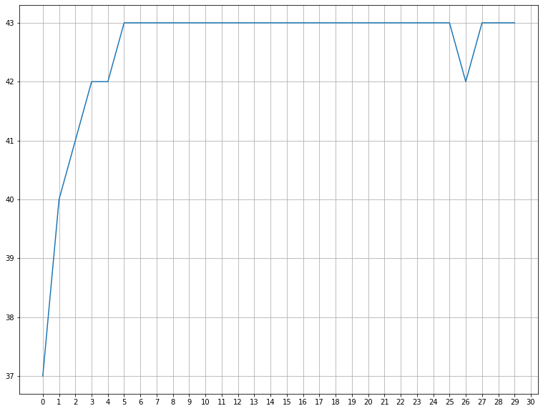
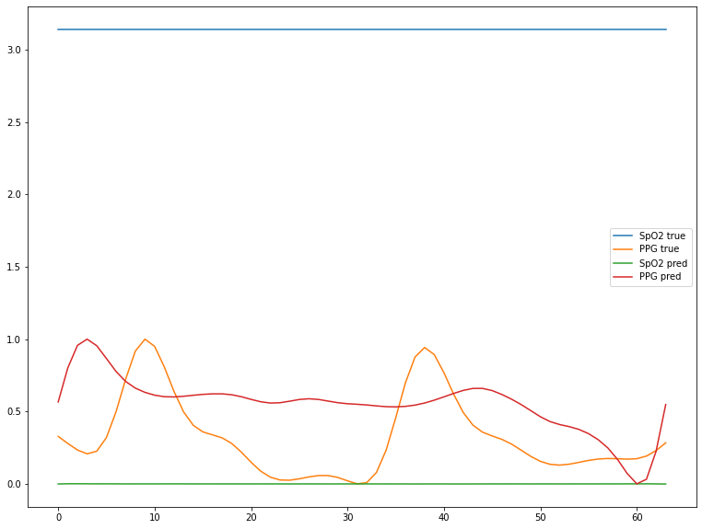
Progress
Done
Multi-task learning with QrPPGNet
inputs : All PURE dataset; training loss, validation loss, test result

Slide 3
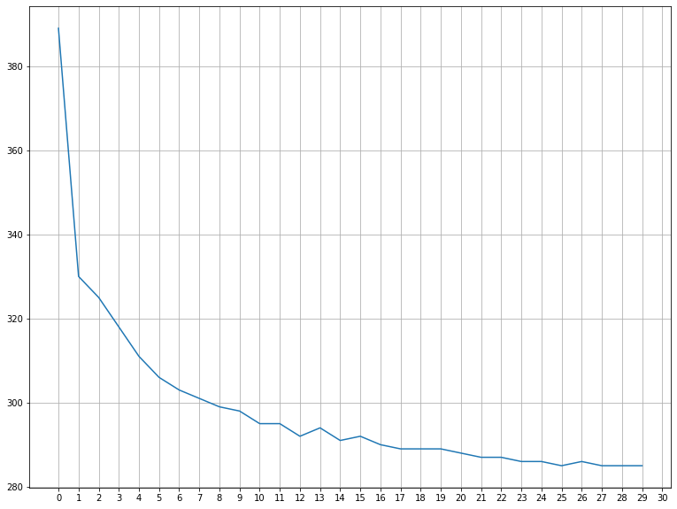
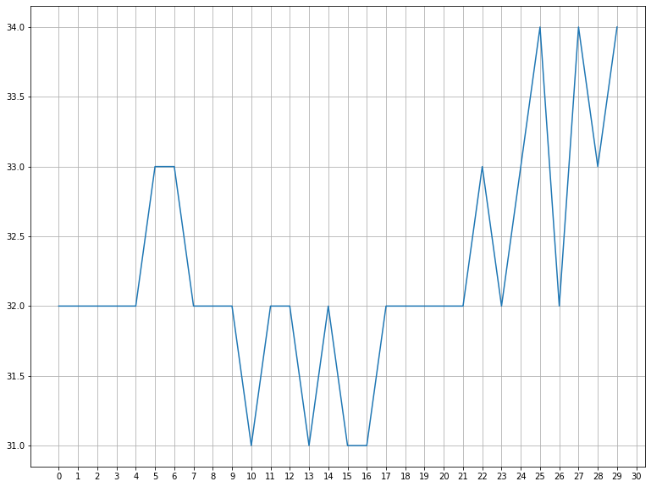
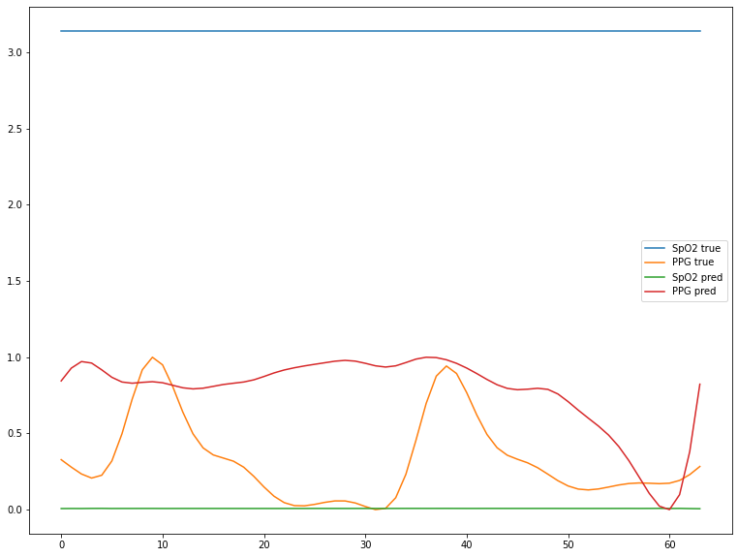
Progress
Done
Multi-task learning with QrPPGNet
inputs : PURE dataset without “OO-06” ; training loss, validation loss, test result “OO-06” -> shake the head, best validation result

Slide 4
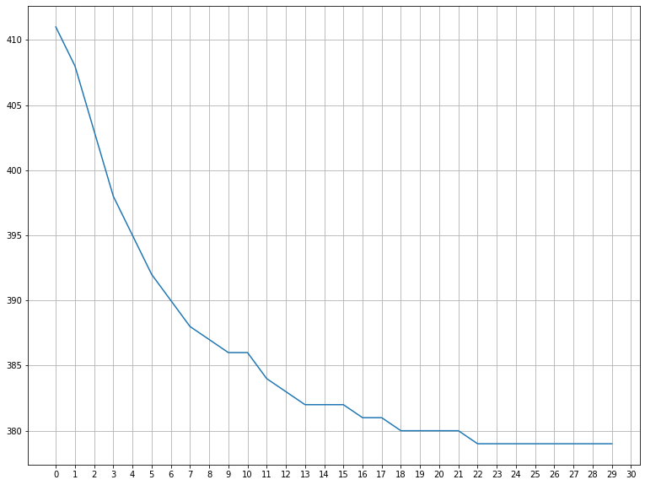
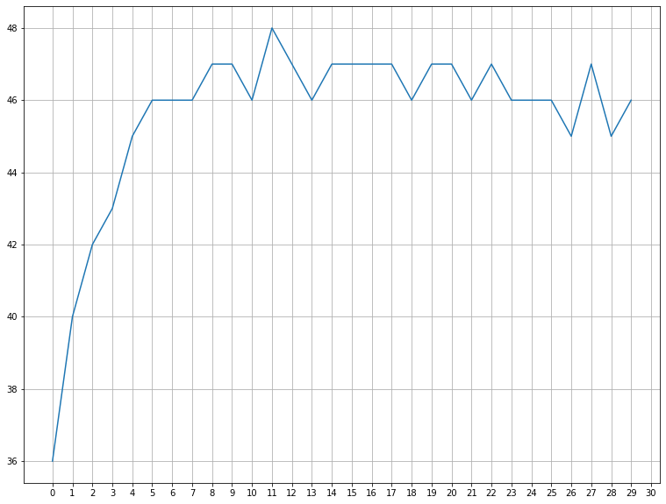
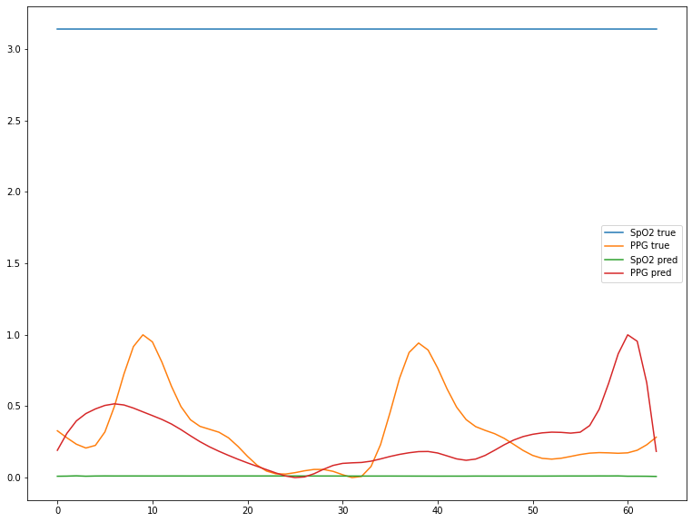
Progress
Done
Multi-task learning with QrPPGNet
inputs : PURE dataset without “OO-04” and “OO-06”; training loss, validation loss, test result “OO-04” -> move the head

Slide 5
Progress
To Do
Results of multimodal learning are bad. So i’m going to change the structure of the QrPPGNet
Change the kernel shape
Add some branch
Add some loss
I’m considering adding inception module or applying residual-learning (resnet)
I think these will improve the performance of the model

