Slide 1
Progress meeting
2022. 08. 31.
Yousang Nam

Slide 2
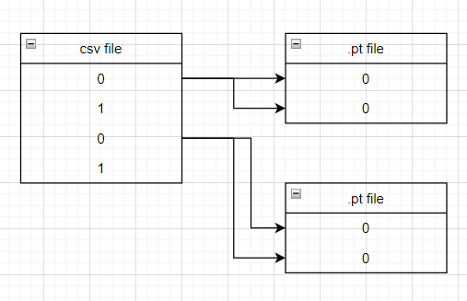
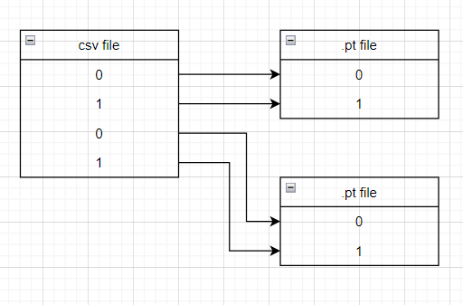
Progress
Done
To correct pre-processing error
labels : Same data is repeated
before after

Slide 3
Progress
Done
Insert Inception module to QrPPGNet
some Q-Convolution layers have been replaced with inception modules

Slide 4
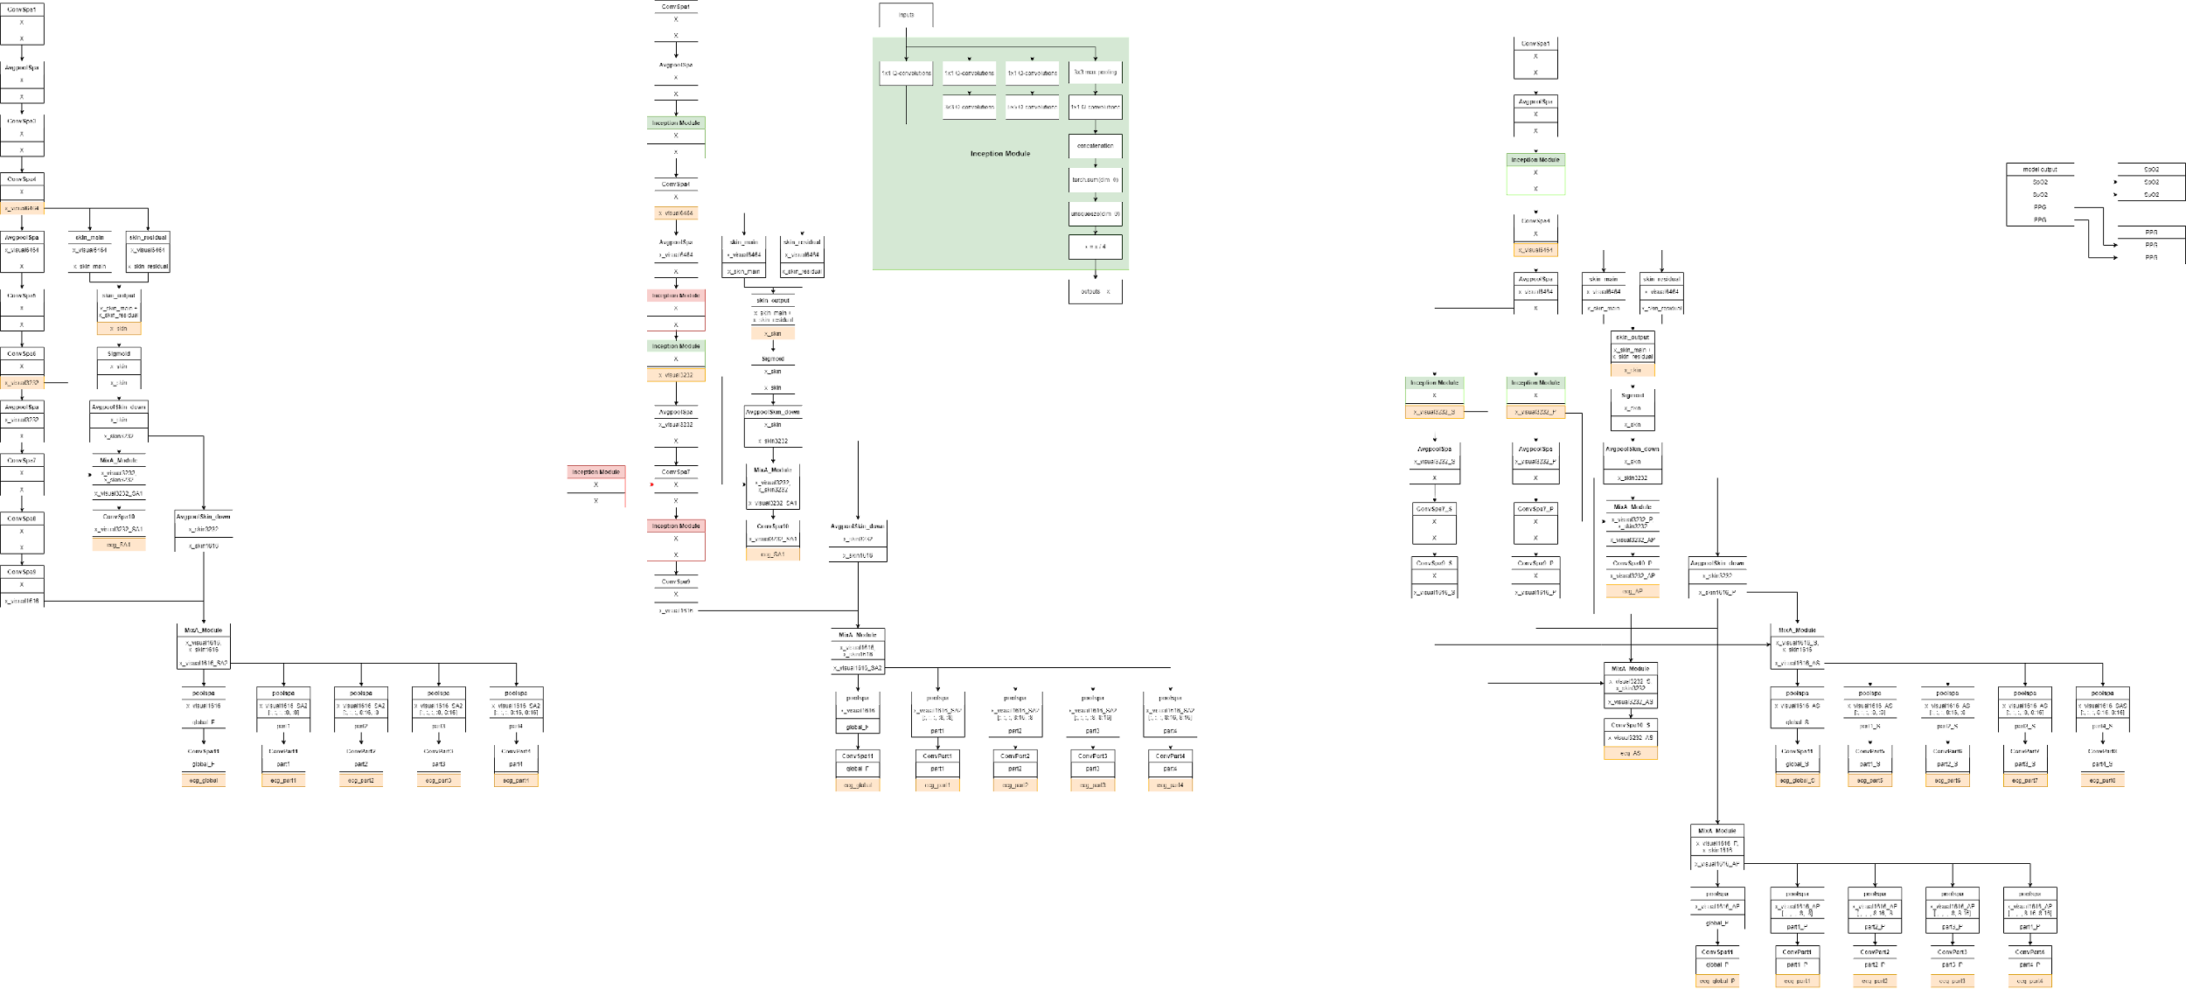
Progress
Done
only for 1 batch input
Yellow block
: model output
Red block
: Removed Inception
module(cuda memory)
Green block
: Exist Inception
module
This model takes too long to learn

Slide 5
Progress
Progress
Solving some device-side assert error with multi-batch inputs
Inception module has 4 branches.
Dimensions of output > Dimensions of input
The process of reducing dimensions causes errors

Slide 6
Progress
To Do
Compare the results of the original model with the results of the modified model with the modified dataset

