Slide 1
Progress meeting
2022. 08. 31.
Yousang Nam

Slide 2
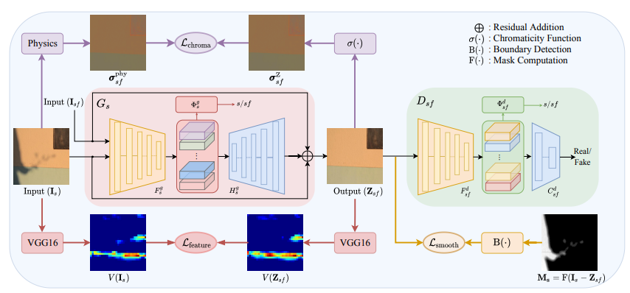
Progress
Done
Shadow removal using DC-shadownet

Slide 3
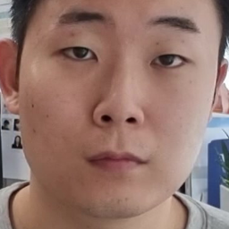
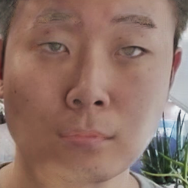
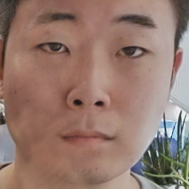
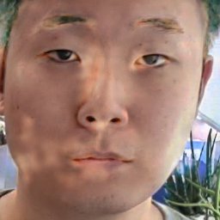
Progress
Done
BCML dataset, Shadow removal using pretrained DC-shadownet
Ground Truth
ISTD
AISTD
SRD

Slide 4
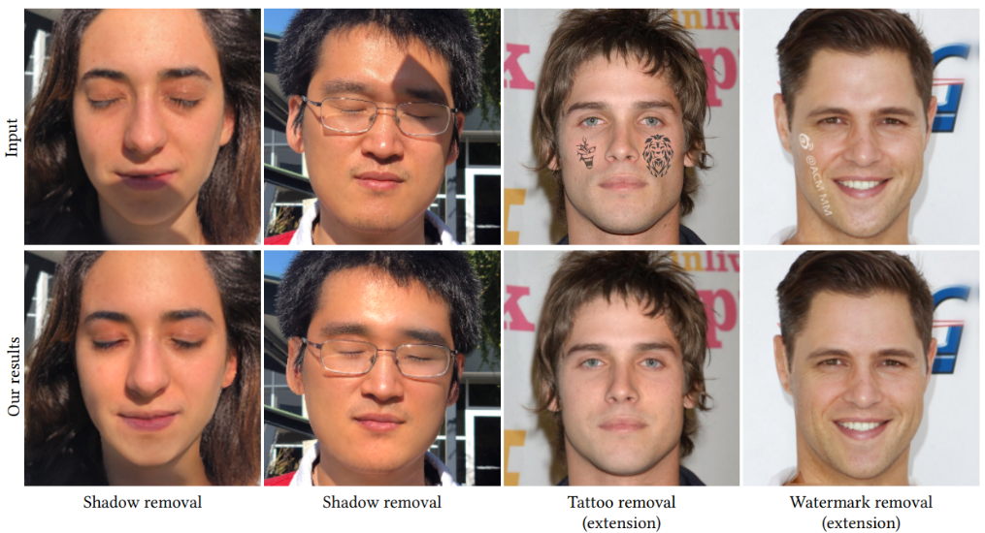
Progress
Doing
Unsupervised Portrait Shadow removal via Generative prirors – pretrained with only face images
samples

