Slide 1
Progress meeting
2023. 01. 18.
Yousang Nam

Slide 2
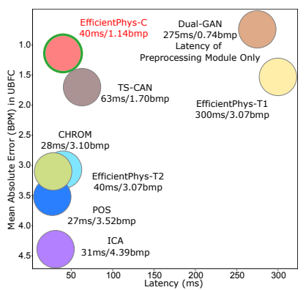
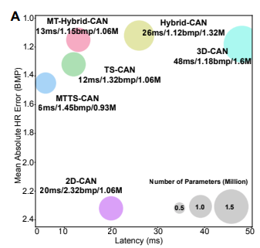
Progress
Doing
QrPPGNet
I read two papers : EfficientPhys. Xin Liu et al. 2021. citation : 5, MTTS-CAN, Xin Liu et al. 2020. citation : 64
I will use these models as the baseline for QrPPGNet’s performance evaluation after testing with BCML dataset
figure from EfficientPhys
figure from MTTS-CAN

Slide 3
Progress
To do
QrPPGNet
To test with BCML dataset, pick some of the best models and change them to use Quaternion CNN
SNN
To participate in the SNN study

