Slide 1
Progress meeting
2023. 02. 01.
Yousang Nam

Slide 2
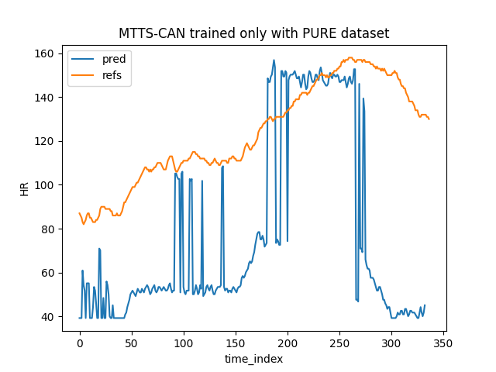
Progress
Done & To Do
QrPPGNet
MTTS-CAN result figure : tested with BCML dataset
To train with BCML dataset for better result

Slide 3
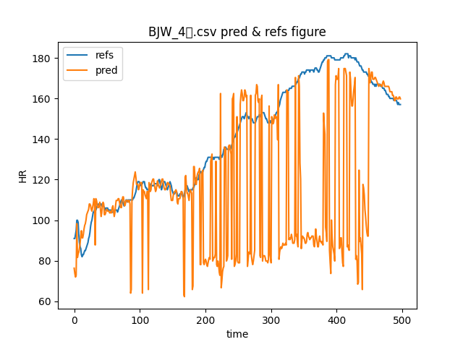
Progress
Done & To Do
QrPPGNet
LGI : Using pyVHR (inherited from DRAX project)
I’m still in studying post-processing

