Slide 1
Progress meeting
2023. 02. 08.
Yousang Nam

Slide 2
Progress
Done
Drax project proposal
I sent the mail to the DRAX officials
Desktop setting
I received the desktop and installed win10, anaconda… etc

Slide 3
Progress
On going
IITP proposal
The deadline is today

Slide 4
Progress
To do
QrPPG
I will compare the quaternion based model and the real number based model in the PPG single task

Slide 5
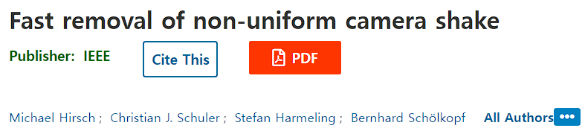
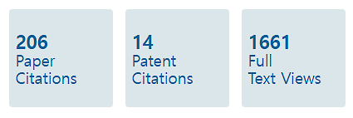
Progress
Done & To do
DRAX
I read the paper :
This paper describes how to remove camera shaking
I think this algorithm will be helpful when the user moves faster in treadmil
I’m going to implement the algorithm of this paper for the drax project

Slide 6
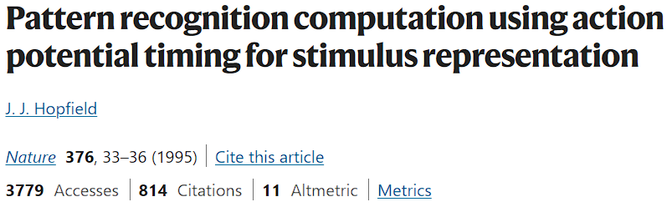
Progress
Done & To do
SNN
I read paper :
This paper presents a method for temporal coding of SNN
The author of this paper argues that the coincidence of spikes is important in recognizing patterns of stimuli
I’m going to find other paper about temporal coding or encoder of snn and implement them

