Slide 1
Progress meeting
2023. 02. 15.
Yousang Nam

Slide 2
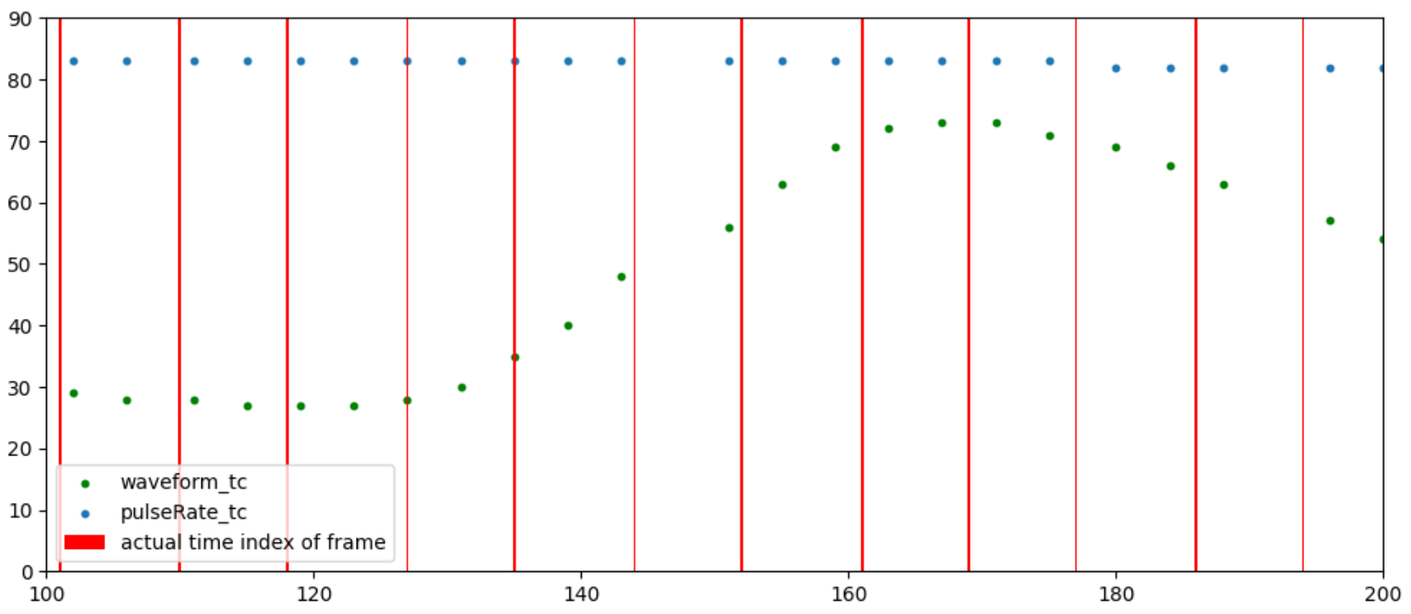
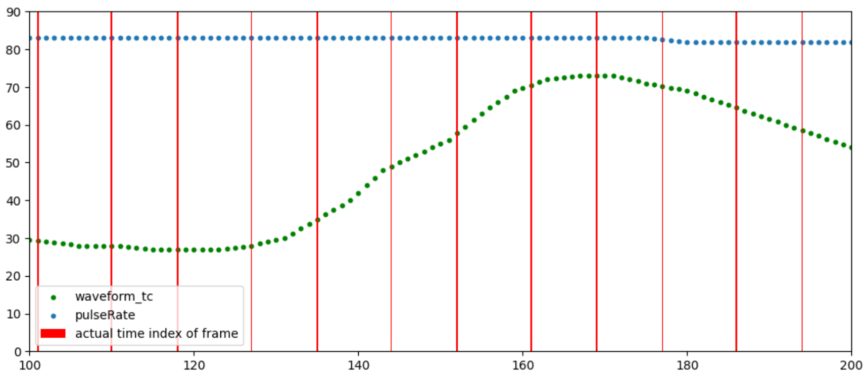
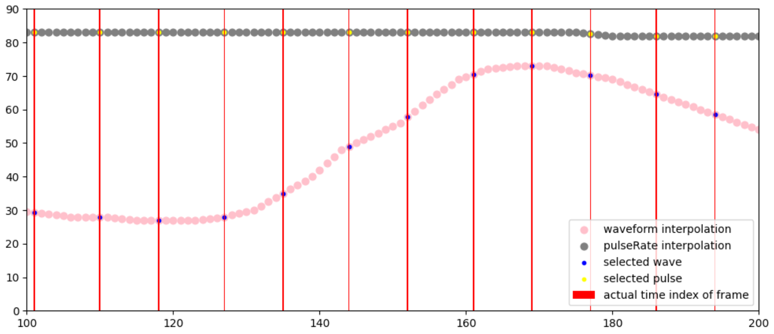
Progress
The Original state
Done
QrPPG
rPPG dataset preprocessing
After interpolation
(Linear)
After sampling

Slide 3
Progress
On going
QrPPG
Model training
C/C++
I started studying C and C++
Journal meeting
I'm preparing for the journal meeting
DRAX
Reading papers about Deblurring algorithm based on conventional signal processing

