Slide 1
Progress meeting
2023. 02. 22.
Yousang Nam

Slide 2
Progress
Done
DRAX
COEX fitness equipment exhibition
Journal meeting
Quaternion-convolutional neural networks
ps. At the journal meeting, I presented the paper about QCNN

Slide 3
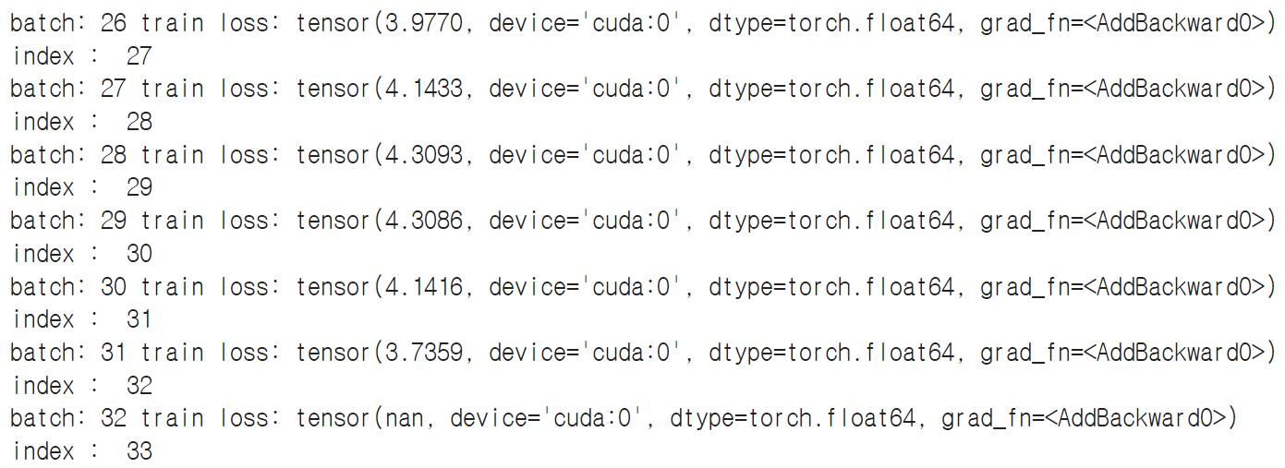
Progress
On going
QrPPG
Model training
Model loss : NaN
ps. I got NaN loss,
so now i’m trying to
figure out what’s wrong
C / C++
Reviewing pointer, structure
EMMA
Realtime GUI without frame drop
ps. EMMA 황재영 send the document about request
GUI frame drop is the one of the list

Slide 4
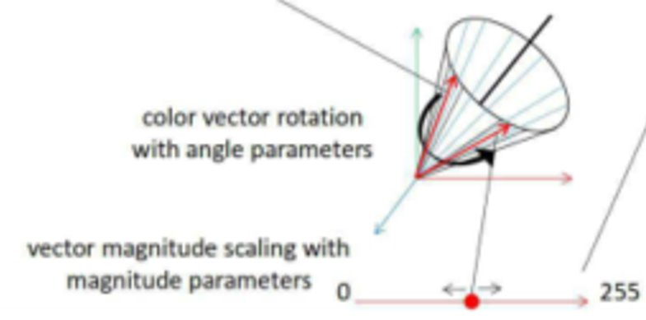
Progress
To do
QrPPG
Inserting gray scale image into 0th dimension of dataset and run model training again
ps. For now, first dimension of dataset consists zero-matrix( filled with only float 0 )
Quaternion vector restriction research (refer to QCNN paper)
ps. I’m going to find best Quaternion-vector restriction in angle and norm
Quaternion vector visualizing for analysis

