Slide 1
Progress meeting
2023. 02. 22.
Yousang Nam

Slide 2
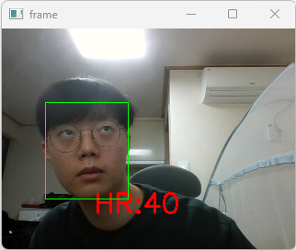
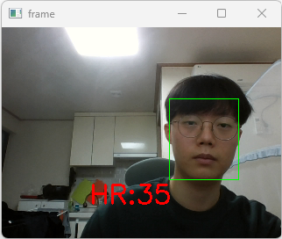
Progress
Done
EMMA
Frame drop: no problem
User Face ROI display in GUI program
The deadline is today

Slide 3
Progress
On going
QrPPG
Trying to find cuase of NaN loss until now

Slide 4
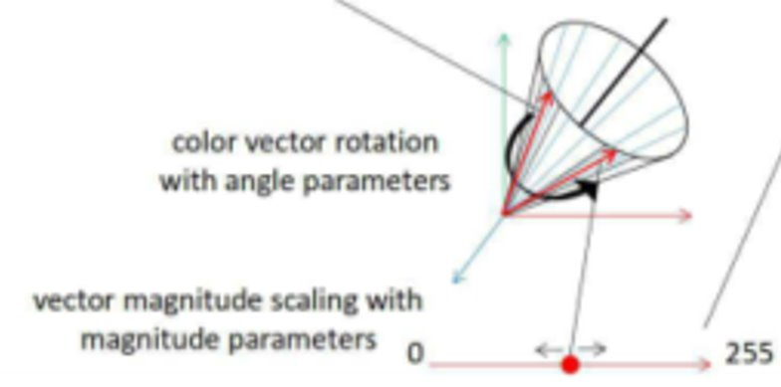
Progress
To do
QrPPG
Inserting gray scale image into 0th dimension of dataset
Quaternion vector restriction research (refer to QCNN paper)
Quaternion vector visualizing for analysis

