Slide 1
Progress meeting
2023. 03. 16.
Yousang Nam

Slide 2
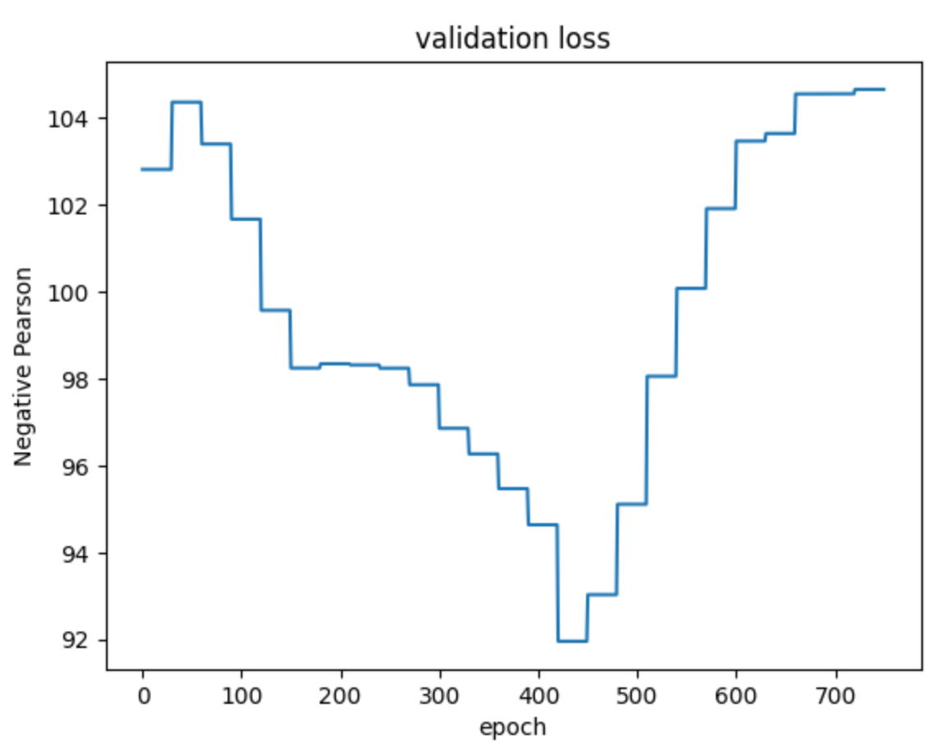
Progress
Done & To do
QrPPG
Actual epoch : 24, Validation times at each epoch : 33
Best model epoch : 17
Final training loss : 0.2 (negative pearson; same with validation)
Using NAS
2. Gray scale image on 0 dimension
(first dimension of dimension scale 4)

Slide 3
Progress
Name | CPU | GPU | RAM | NN processor
Rock 5B | Quad core Cortex-A76 Quad core Cortex-A55 | Mali-G610 MP4 3D GPU | LPDDR 4,8,16GB (dual) | None
Tinker Board 2S | Dual core Cortex-A72 Quad core Cortex-A53 | Mali-T860 | LPDDR4 2,4GB (dual) | None
Done & To do
DRAX
Kick off meeting
신산업 융합형 재료비 : Tinker Board 2S
Other card : Jetson Nano, Tinkder Board S,
ODROID N2L

