Slide 1
Progress meeting
2023. 03. 30.
Yousang Nam

Slide 2
Progress
Done & On going
DRAX
Preparing meeting PPT
HR estimation performance experiment using single board computers
HR estimation code conversion : To use GPU(ARM) - Not CUDA, ARM GPU uses opencl or opengl
Reference, Single board system prediction preprocessing: Using Unix-time (time.time()) - Polar – H10 support record Unix time during measure the HR
Tinker board 2S (borrowed from EMMA) realtime Performance: 6sec ( Average time spent per 1 estimation )
Rock 5b (borrowed from DRAX) realtime Performance: 2sec ( Average time spent per 1 estimation )

Slide 3
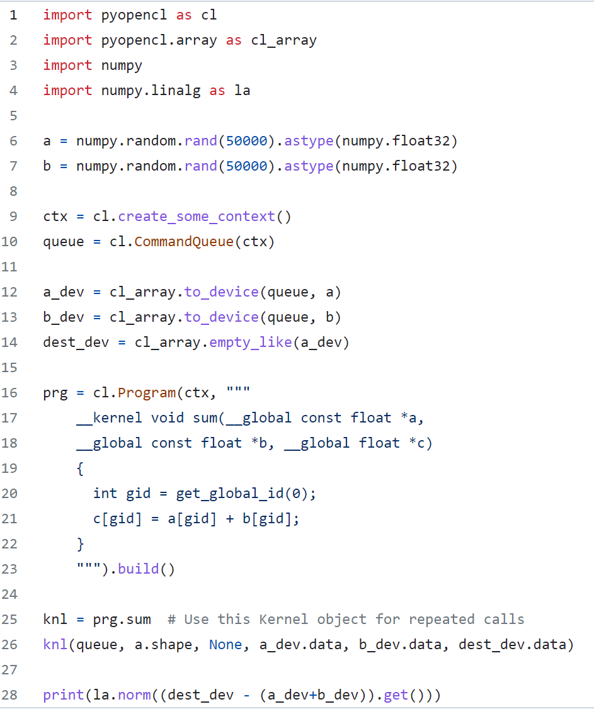
Progress
On going
DRAX
Opencl example: simple element-wise array addition
The main code needs to be re-write in C++

