Slide 1
Progress meeting
2023. 04. 06.
Yousang Nam

Slide 2
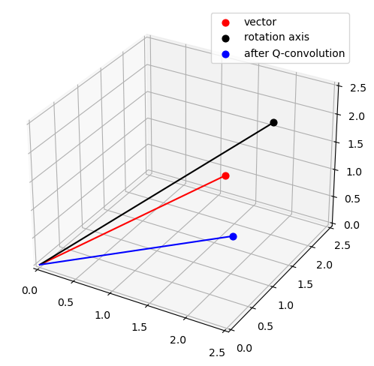
Progress
Done
DRAX
2nd meeting
QrPPG
Quaternion Convolution Experiment
Already implemented and I was mistaken

