Slide 1
Progress meeting
2023. 04. 13.
Yousang Nam

Slide 2
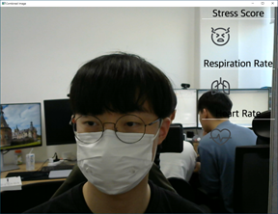
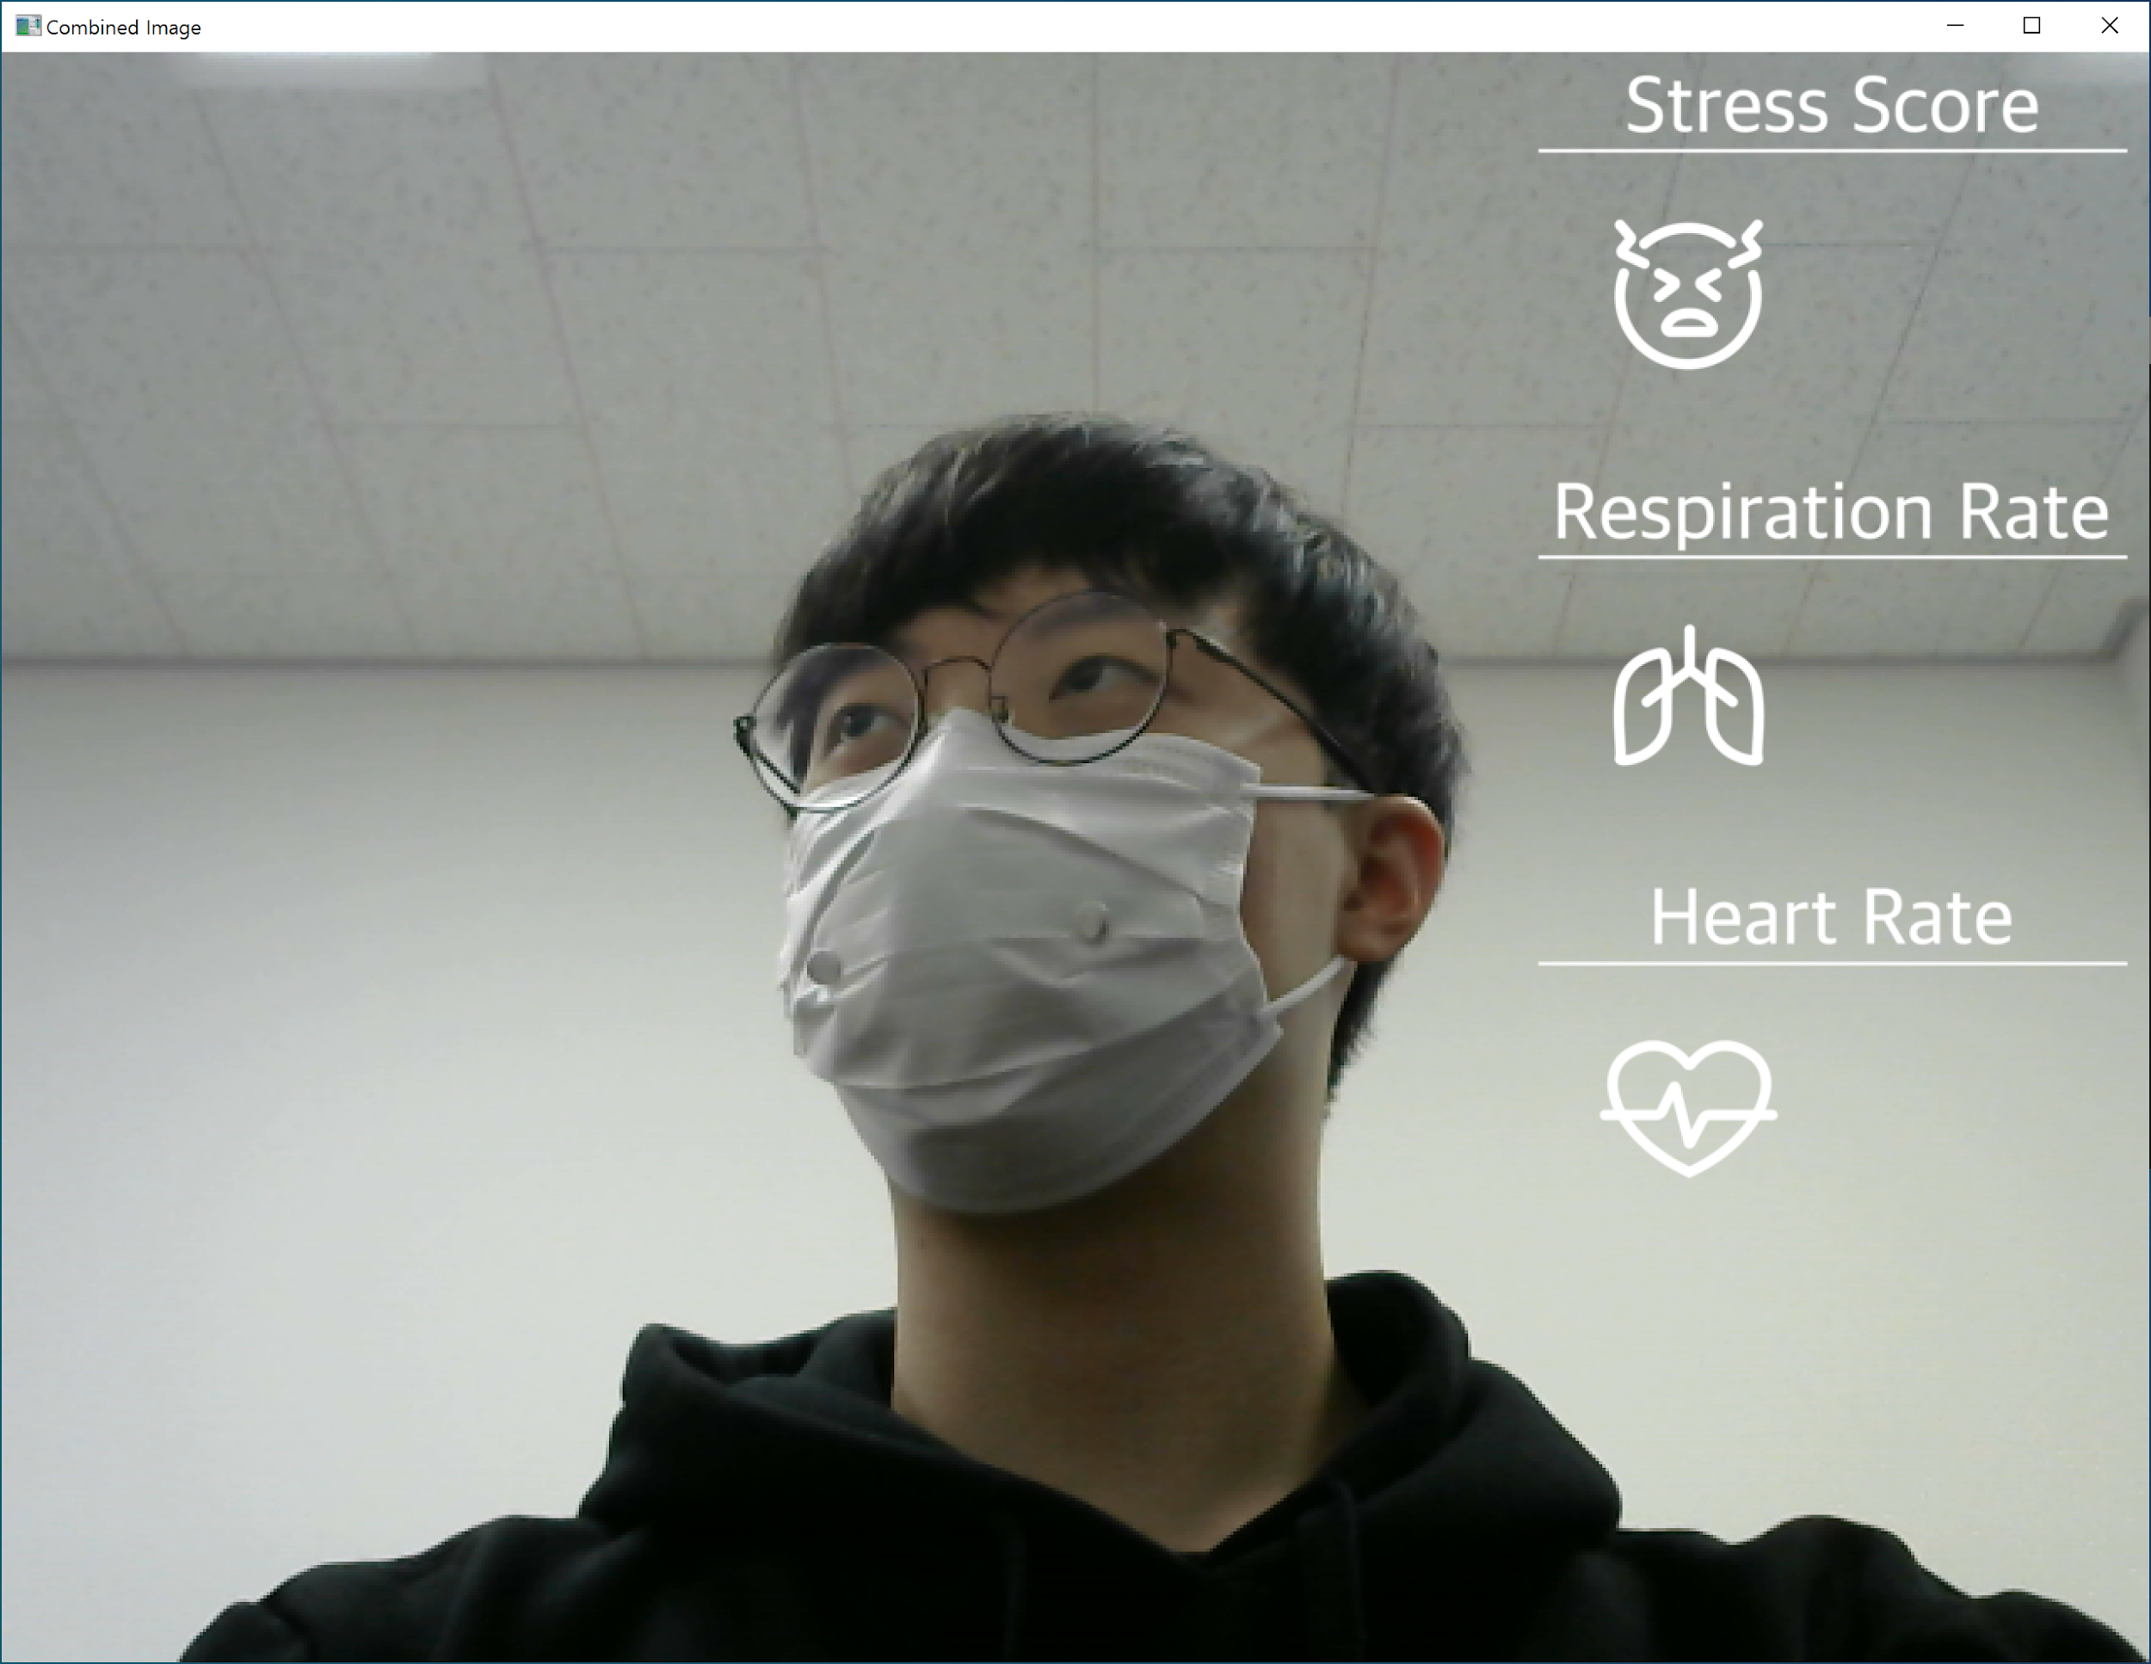
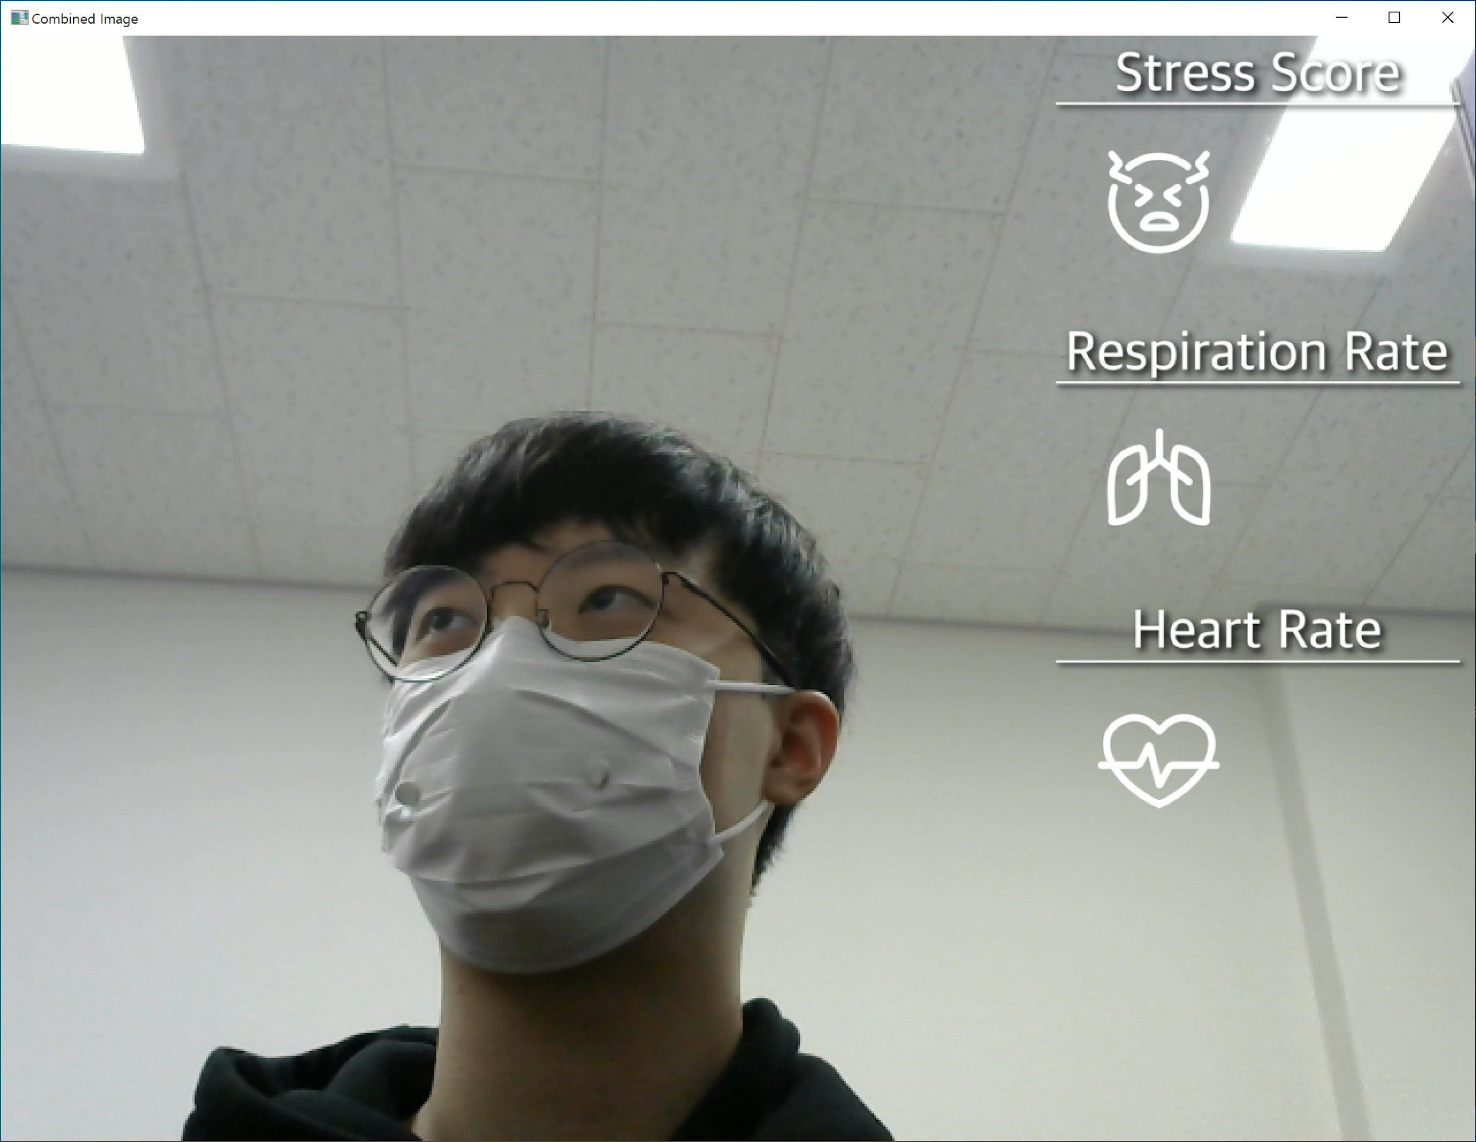
Done & On going : EMMA
Overlaying the Image (GUI task) - Done
Combine with HR estimation code (got error) - On going
Black
White
White with Shadow

Slide 3
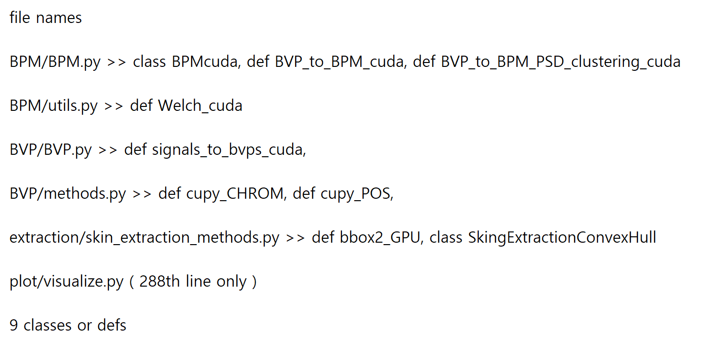
On going : DRAX & EMMA
Using Single Board GPU by PyOpencl API
Info

Slide 4
To do : QCNN
NAS : Model Search
It is not supported now
The theoretical background paper :
Imporving Keyword Spotting and Language Identification via Neural Architecture Search at Scale 2019, Hanna Mazzawi et al
I'm gonna explain this paper on my journal meeting

