Slide 1
Progress meeting
2023. 04. 21.
Yousang Nam

Slide 2
DRAX
Done
Pyopencl Implementation
Modifying codes using cuda to the codes using pyopencl
On going
PC –> Single board computer Video Transmission using USB to TTL module
Experiment is currently in progress

Slide 3
DRAX
To do
3rd DRAX meeting PPT
I'm going to upload the draft with the experiment results by next monday

Slide 4
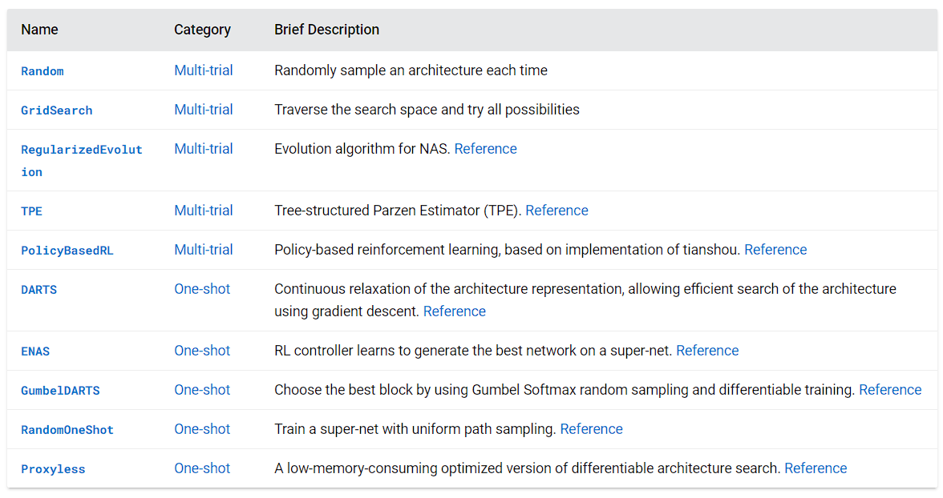
QCNN
On going
Using NNI Library
A set of several AutoML techniques :
Hyperparameter Tuning, Model pruing, Quantization, NAS, Feature Engineering
In NAS, It provides various search strategy : ENAS is one of them.
The list of search strategies

Slide 5
END

