Slide 1
Progress meeting
2023. 05. 04.
Yousang Nam

Slide 2
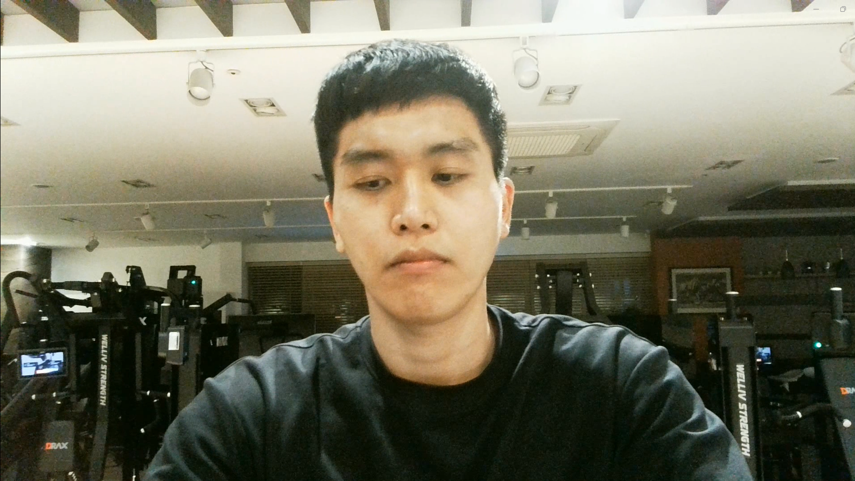
DRAX
Done
Video streaming from PC to SBC(Single Board Computer)
Original method : UART communication (0.5 ~ 2 fps)
Present method : Socket communication (30 fps)
FPS increase : 2 fps -> 30 fps
Experiment Setting – Done
On going
Experiments
With the method explained above
Dataset from DRAX

Slide 3
END

