Slide 1
Progress meeting
2023. 06. 01.
Yousang Nam

Slide 2
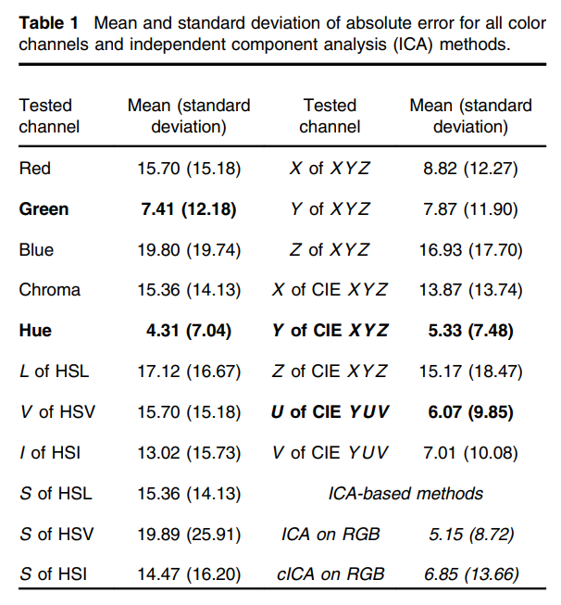
Progress
On going
Making C-programing’s 3rd assignment
To fix the bugs of DRAX HR estimation server version code
To review papers on domain adaptation in the context of quaternion color correction
To review papers on color spaces in related to Quaternion - rPPG inputs
DRAX experiments – using rock 5b (me), using Tinker board 2S (정환)
To do
Making DRAX PPT draft
Tsouri, Gill R., and Zheng Li.
"On the benefits of alternative color spaces for noncontact heart rate measurements using standard red-green-blue cameras.“
Journal of biomedical optics 20.4 (2015): 048002-048002.
Notes:
Continuing the explanation on the color space of rPPG inputs, as you can see in this illustration
Such color space transformations are performed by applying relevant formulas.
They conducted experiments using various color spaces and two ICA-based methods. As shown in the table, there are multiple rows representing different color spaces and two columns indicating the mean of standard deviation. Their findings suggest that the Y channel of the CIE XYZ color space yield the most accurate results.
Based on these experimental results, I plan to conduct experiments on quaternion and DRAX projects.

