Slide 1
Progress meeting
2023. 07. 13.
Yousang Nam

Slide 2
Done
SNN study
Presentation on Encoding methods
DRAX
Preprocessing pipeline
Raw video
Extract
Face Landmarks
(mediapipe)
Kalman
Filter
Notes:
I have constructed a preprocessing pipeline, as depicted in this figure.
I opted to utilize the Mediapipe library for extracting facial landmarks because it provides more accurate results compared to the previously used model.

Slide 3
In Progress
DRAX
Building the model refers to the process described in the smart shoe paper
HR
Attention module
DensNet-1D
Bidirectional-GRU
Global Average Pooling
EE
Notes:
Currently, I am in the process of building the model based on the smart shoe paper.

Slide 4
In Progress
DRAX
Building the model refers to the process described in the smart shoe paper
HR
Filtered
Face Landmarks
DensNet-1D
Bidirectional-GRU
Global Average Pooling
EE
Notes:
In the smart shoe paper, the attention module was used to determine the importance ranking of almost 20 time series data.
However, since I will only be utilizing one specific point on the face, the attention module has been detached from the model.

Slide 5
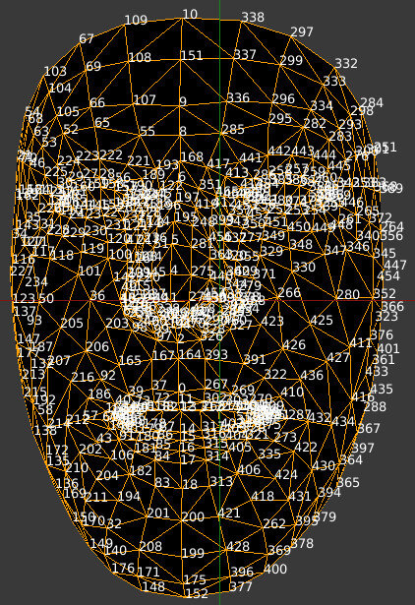
In Progress
DRAX
Nose point : number 4
Notes:
In the smart shoe paper, the attention module was used to determine the importance ranking of 20 different types of time series data.
However, since I will only be utilizing one specific point on the face, the attention module has been detached from the model.

