Slide 1
Journal meeting
2023. 02. 16.
Yousang Nam

Slide 2
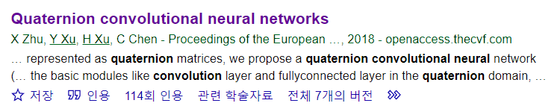
Quaternion convolutional neural networks

Slide 3
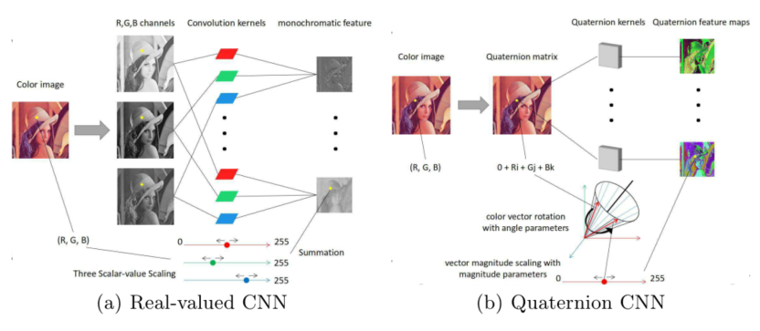
Quaternion convolutional neural networks
Color image representation: | Three independent real-valued matrices | Quaternion matrix
:

Slide 4
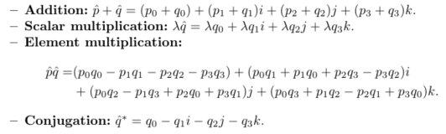
Operation in Quaternion domain
:
Operation definition in quaternion domain

Slide 5

Operation in Quaternion domain
w = rotation axis
Rotate q to get p
Operation definition in quaternion domain

Slide 6

Operation in Quaternion domain
w = rotation axis
Rotate q to get p
Operation definition in quaternion domain

Slide 7


Quaternion convolution definition
N by N size RGB Image
L by L size Kernel
Quaternion convolution operation symbol
µ = gray axis with unit length, definition:
= scale factor (magnitude of )
= angle around gray axis
Gray axis
Vector angle

Slide 8



Quaternion convolution definition
Quaternion convolution
Rotation in quaternion domain
: Image pixel expressed in quaternion domain
: To remove redundant scaling factor
Representing each image pixel as a 3D vector
Quaternion convolution - rewrite
= vectorized representation of quaternion
The detailed derivation : skip

Slide 9

Quaternion convolution fully-connected layers
Fully-connected layers
Convolution layers
1D application of quaternion convolution layer

Slide 10

Quaternion convolution Weight initialization
: scaling factor of j-th layer
: rotation factor of j-th layer
: uniform distribution
: dimension of j-th layer's input
Scaling factor is independent of rotation factor
Keep variance of the gradients same during training

Slide 11


Quaternion convolution Backpropagation
L : The real-valued loss function
p,q : pure quaternion variables
Summary : Rotate transformation with the same axis and a reverse angle

Slide 12
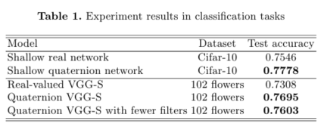
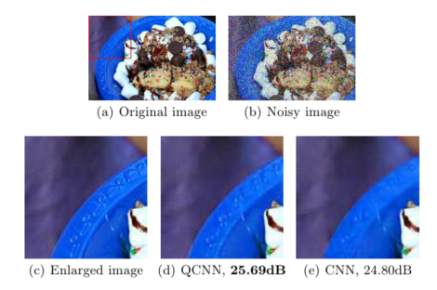
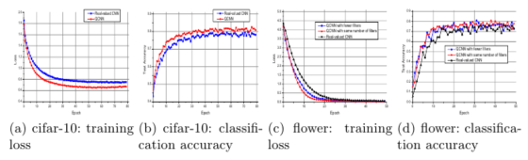
Quaternion convolution neural networks Performance
Classification Task
Image denoising Task

Slide 13
The End

