Slide 1


Concurrent and Asynchronous Programming

Slide 2
Some Definitions
Concurrent
more than one task logically proceeding within a given time interval
Parallel
more than one task executing at the same instant
Can be concurrent without being parallel
single CPU, multi-tasking OS
Parallelism implies concurrency

Slide 3
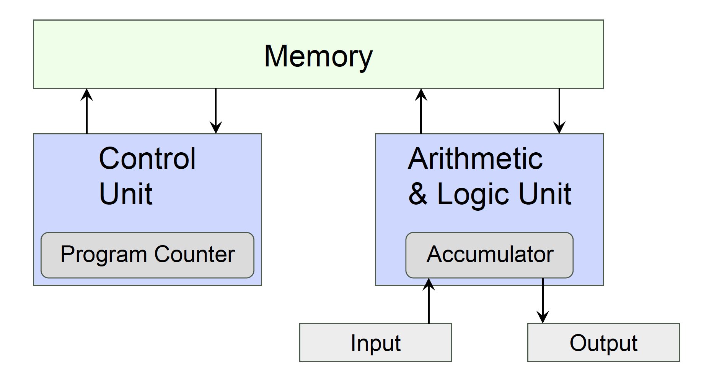
The Von Neumann Architecture
Stored Program execution
Program stored in memory
Memory shared between program and data
Execution follows a sequential model

Slide 4
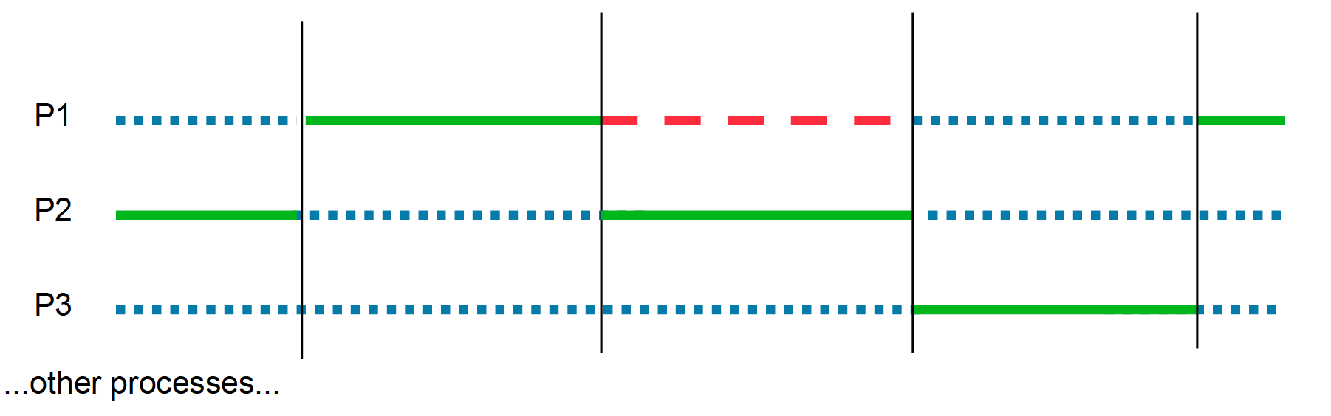
Process Based Concurrency
Operating system schedules processes
concurrency achieved by sharing work across processes
can operate on single cpu core – no parallelism

Slide 5
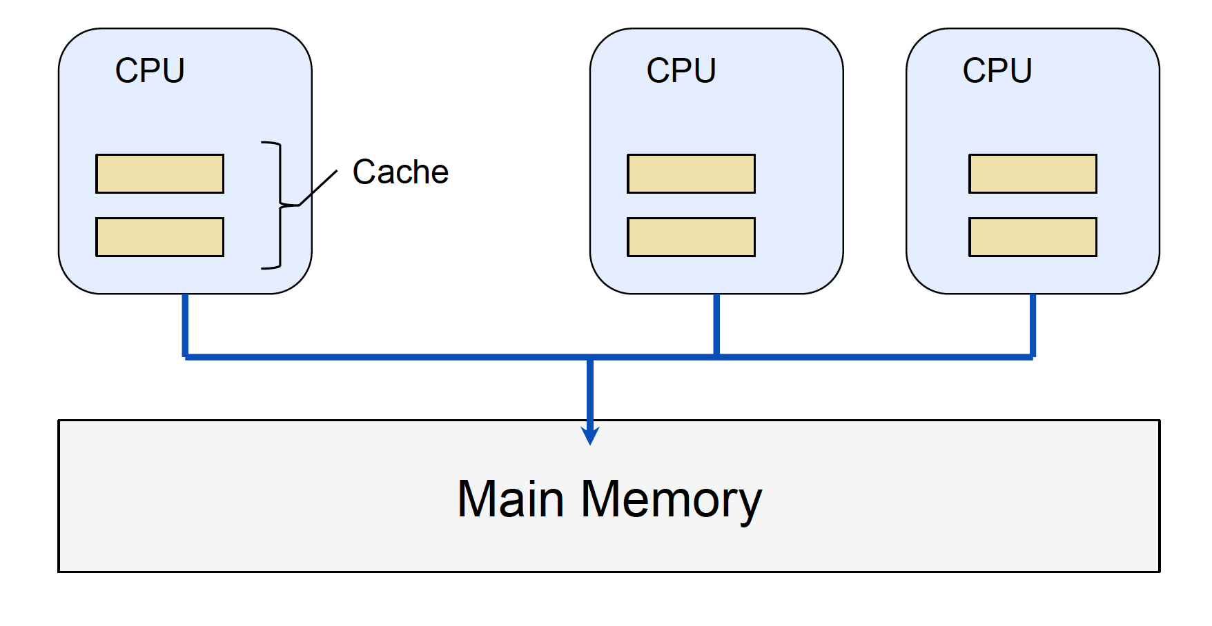
Multiprocessor/Multicore
Multiple CPUs (cores) sharing memory

Slide 6
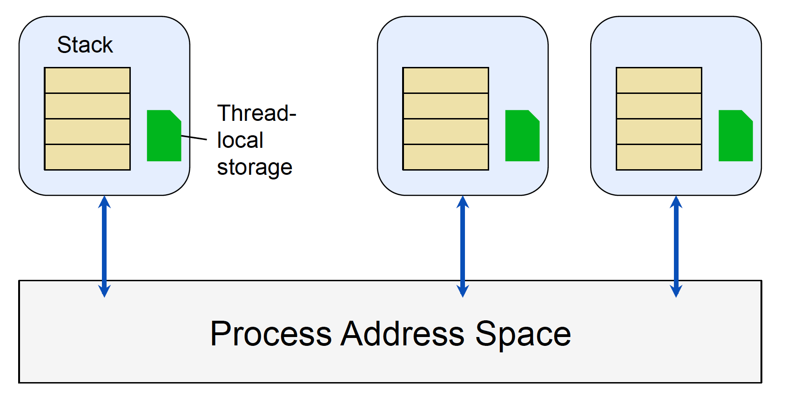
Traditional Threading Model
Aim is to provide more lightweight concurrency model
Multiple threads share the same address space

Slide 7
Threads and Processes
Thread
a sequence of instructions that can execute independently (of other threads)
on multi-core CPUs threads can execute in parallel
on single-core CPUs threads are time-sliced
Process
provides resources needed to execute a program
eE.g. address space, security context, environment
a process will contain at least one thread

Slide 8
JVM Threading: Threads and Runnable Objects
Thread encapsulates a schedulable entity
Runnable interface used to represent work for thread to do
Thread
Thread
Thread
Runnable
public void run()
Runnable
public void run()
Notes:
The designers of Java understood the benefits of multithreading, and designed threads into the language from the very beginning. The key elements of multithreading include the Thread class and the Runnable interface, which are inherently part of any Java execution environment. Since Scala is a JVM language, it will have access to these basic features through the JVM and the basic classes from the core Java library.

Slide 9
Creating a Thread
Instantiate Thread class
Associate with Runnable object
Start execution of thread
start() method invokes run() on the Runnable object
…
Runnable r = new RunnableImpl();
Thread t1 = new Thread( r );
Thread t2 = new Thread( r );
t1.start();
t2.start();
…
…
Thread t1 = new Thread( () -> { … } );
t1.start();
…
Notes:
The most flexible way to create new threads is to first create the Runnable object that represents the work they will be doing. Then pass a reference to the Runnable object to the Thread class constructor. This establishes the association.
When the threads' start() methods are called, the run() method is invoked on the Runnable object.
In the slide, the two threads will be using the same Runnable object.
We can also create a thread using a lambda to define the Runnable object.
@tag intro;

Slide 10
Creating a Thread
Thread class implements Runnable
empty run() method
Define subclass of Thread
override run() method with required action
Create Thread object via subclass
public class SubThread extends Thread
{
@Override
public void run()
{
doSomething();
}
}
…
SubThread s = new SubThread();
s.start();
Notes:
Interestingly, the Thread class itself implements the Runnable interface, with an empty implementation of the run() method.
This means that it is possible to extend the Thread class and override the method, to provide required behaviour. The Thread is then created automatically when an instance of the subclass is created
This method of creating a thread is preferred when the requirement is to keep thread and action tightly bound together.
@tag intro;

Slide 11
Creating a Thread
Creating Thread object doesn’t create a thread
The start() method creates the thread
Calls out to the operating system to create and register the thread
Runnable r = () -> doSomething();
(new Thread(r)).start();
Notes:
Interestingly, the Thread class itself implements the Runnable interface, with an empty implementation of the run() method.
This means that it is possible to extend the Thread class and override the method, to provide required behaviour. The Thread is then created automatically when an instance of the subclass is created
This method of creating a thread is preferred when the requirement is to keep thread and action tightly bound together, although in Java 8, the lambda expression form is an alternative way of expressing the tight binding.

Slide 12
Thread Example
public class TickTock implements Runnable {
private String word;
private int delay;
public TickTock(String w, int d) {
word = w;
delay = d;
}
public void run() {
while (!Thread.interrupted()) { // More later
try {
System.out.print(word + " ");
Thread.sleep(delay);
} catch (InterruptedException ie) {
Thread.currentThread().interrupt();
}
}
}
}
public static void main(String[] args) {
Thread t1 = new Thread(new TickTock("tick", 50));
Thread t2 = new Thread(new TickTock("tock", 100));
t1.start(); t2.start();
Thread.sleep(5000); t1.interrupt(); t2.interrupt();
}
Notes:
The example code demonstrates the use of the interface Runnable to implement multithreading.
The run() method will display the required word and then wait for the specified period of time. This continues until the thread is interrupted (more later), at which point the run() method returns and the thread terminates. Notice that to test if the current thread has been interrupted, we use the static method interrupted() of the Thread class.
@flow;
@tag intro;

Slide 13
Thread Example
public class TickTock2 extends Thread {
private String word;
private int delay;
public TickTock2(String w, int d) {
word = w;
delay = d;
}
public void run() {
while (!Thread.interrupted()) {
try {
System.out.print(word + " ");
Thread.sleep(delay);
} catch (InterruptedException ie) {
Thread.currentThread().interrupt();
}
}
}
}
public static void main(String[] args) {
TickTock2 tt1 = new TickTock2("tick", 50);
TickTock2 tt2 = new TickTock2("tock", 100);
tt1.start(); tt2.start();
Thread.sleep(5000); tt1.interrupt(); tt2.interrupt();
}
Notes:
The same example can be implemented by extending the Thread class rather than using a separate Runnable object.
Notice that in the while loop, we can call the interrupted() method directly as the current object is a subclass of Thread.
@tag intro;

Slide 14
Thread Example
public class TickTock implements Runnable {
private String word;
private int delay;
public TickTock(String w, int d) {
word = w;
delay = d;
}
public void run() {
while (!Thread.interrupted()) { // More later
try {
System.out.print(word + " ");
Thread.sleep(delay);
} catch (InterruptedException ie) {
Thread.currentThread().interrupt();
}
}
}
}
import java.util.concurrent._;
…
public static void main(String[] args) {
Runnable r1 = new TickTock("tick", 50);
Runnable r2 = new TickTock("tock", 100);
Executor engine = Executors.newFixedThreadPool(2);
engine.execute(r1);
engine.execute(r2);
Thread.sleep(5000);
engine.shutdownNow();
}
Notes:
The example code demonstrates the use of the interface Runnable to implement multithreading.
The run() method will display the required word and then wait for the specified period of time. This continues until the thread is interrupted (more later), at which point the run() method returns and the thread terminates. Notice that to test if the current thread has been interrupted, we use the static method interrupted() of the Thread class.
@flow;
@tag intro;

Slide 15

Problems
Limited capabilities
run method returns void
Scalability is limited
threads relatively heavyweight objects
limited number can be supported in VM
Shared state difficult to protect
locks/synchronized blocks
introduces complexity to code
difficult to debug or reason about
blocking threads wastes resources
Notes:
There are many problems connected with writing code using the low level threading primitives, making it prone to errors that are often related to timing and extremely hard to diagnose.

Slide 16

Problems
Notes:
There are many problems connected with writing code using the low level threading primitives, making it prone to errors that are often related to timing and extremely hard to diagnose.

Slide 17
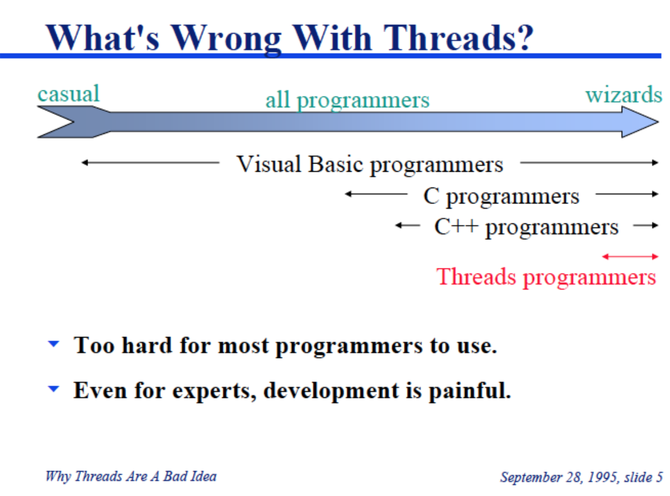
Problems
Notes:
There are many problems connected with writing code using the low level threading primitives, making it prone to errors that are often related to timing and extremely hard to diagnose.

Slide 18
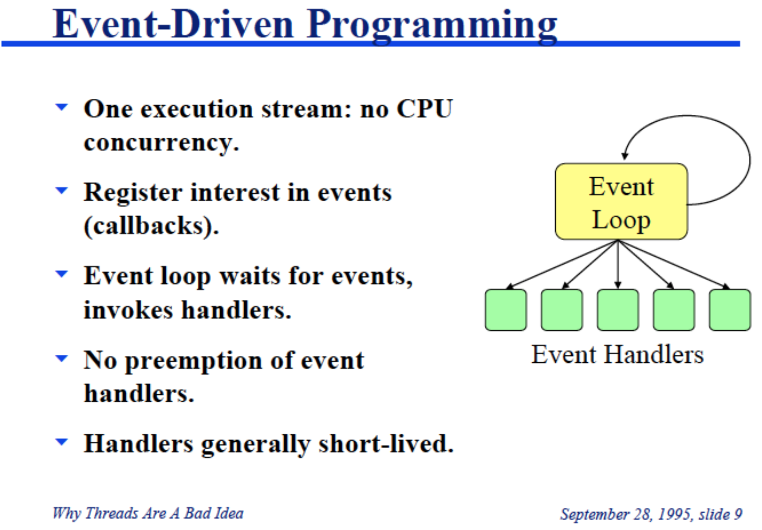
Problems
Notes:
There are many problems connected with writing code using the low level threading primitives, making it prone to errors that are often related to timing and extremely hard to diagnose.

Slide 19
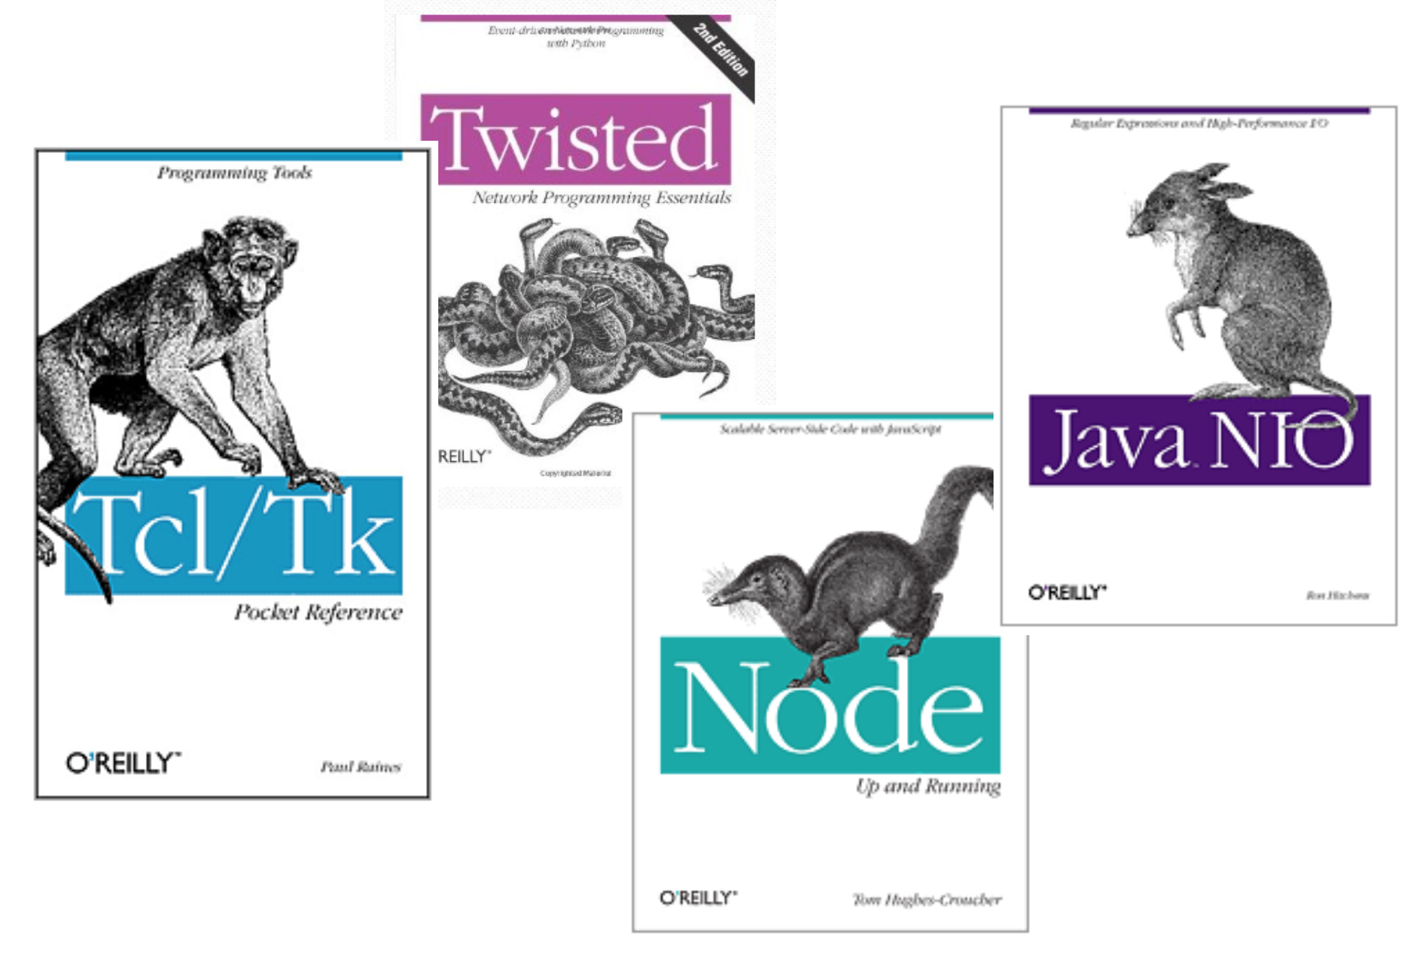
Moving to a different model

Slide 20

Moving to a different model
Conventional program pulls data from its sources
Active polling or blocking can cause issues
Event based programming is a solution
Reactive Programming refines the approach further

Slide 21
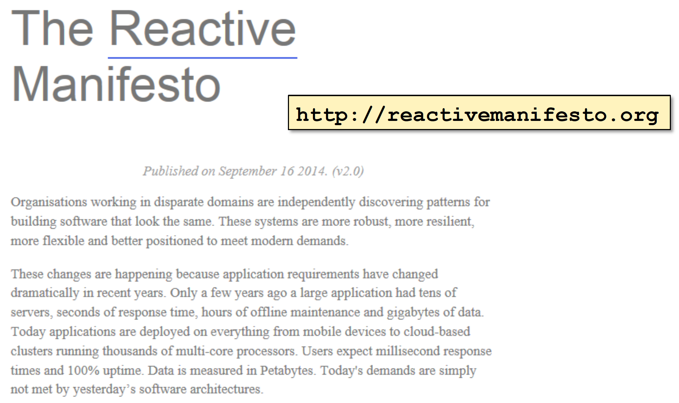
Reactive?
A developing "movement" in software architecture
programming and architecture

Slide 22
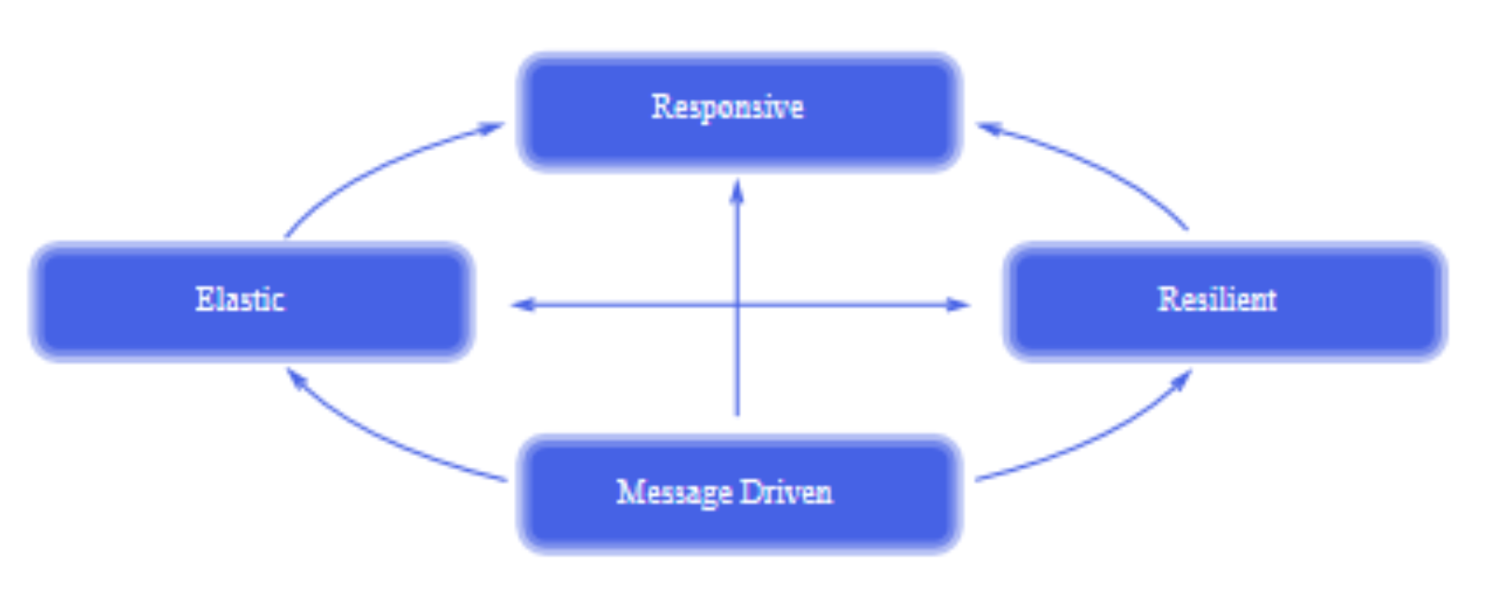
Reactive?
Reactive systems are
Responsive
Resilient
Elastic
Message driven (event driven)

Slide 23



Functional?
Reactive ideas often combined with functional programming
Emphasis on immutable state
reduces the need for data synchronisation
Declarative style abstracts away from implementation specifics
allows concurrency to be deployed where possible, without modifying application code

Slide 24
Asynchronous Programming
A different approach
"do something" while calling thread continues
hand back a result when finished
Higher level of abstraction
int theNumber = NumberService.fetchNum(…)
Number Service
Notes:
A better approach would be to carry out the request in a way that does not necessarily block the calling thread – perhaps issue the request in a separate thread that can block without affecting the main thread. Once the result is obtained it is passed back into the calling thread using some form of callback mechanism.
This leaves the possibility for the main thread to continue executing for at least part of the time, until it reaches a point where it absolutely requires the value to be available.
The thread (or threads) that provide the mechanism to execute the request is called the ExecutionContext. The calling thread uses a construct called a Future to represent the result.
@exhibit;

Slide 25
Asynchronous Programming
A different approach
"do something" while calling thread continues
hand back a result when finished
Higher level of abstraction
int theNumber = NumberService.fetchNum(…)
Future
Number Service
ExecutionContext
Notes:
A better approach would be to carry out the request in a way that does not necessarily block the calling thread – perhaps issue the request in a separate thread that can block without affecting the main thread. Once the result is obtained it is passed back into the calling thread using some form of callback mechanism.
This leaves the possibility for the main thread to continue executing for at least part of the time, until it reaches a point where it absolutely requires the value to be available.
The thread (or threads) that provide the mechanism to execute the request is called the ExecutionContext. The calling thread uses a construct called a Future to represent the result.
@exhibit;

Slide 26
Fetching a Value
Often a task is required to return a value
asynchronous calculation
public class NumberService {
…
public static int getNumber ( ) {
delay();
int theNum = random.nextInt() % 100;
return theNum;
}
}
Callable<Integer> fetchNum = new Callable<Integer> () {
@Override
public Integer call() {
return NumberService.getNumber();
}
};
Callable<Integer> fetchNum = () -> NumberService.getNumber();
Notes:
As mentioned already, not allowing a task to return anything to its "caller" is very limiting. Fortunately there is a mechanism supported within the Java concurrency library that allows this to happen.
It is based on a different interface, java.util.concurrent.Callable<T>, which allows us to define a task that returns a value of type T.
@tag async;

Slide 27
Returning a Value
Task submitted to ExecutorService using submit()
returns Future<T> to represent result
…
ExecutorService engine = Executors.newFixedThreadPool(2);
Future<Integer> numF = engine.submit(fetchNum);
…
…
Future<Integer> numF = engine.submit( () -> NumberService.getNumber()
);
…
Notes:
The task is passed to an ExecutorService (not a simple Executor) using the submit() method rather than the execute() method. Since we are expecting a value to be returned from this task, we need to provide a mechanism to pass this value back to the caller. This is the purpose of the Future<T> type used as the return value of the submit() method.
@tag async;

Slide 28

Working with Future<T>
Operations:
fetch value, block thread if task not complete
check if task complete or cancelled
cancel task execution
Operations throw exceptions to indicate failures
ExecutionException if task throws an exception
CancellationException if task was cancelled
InterruptedException if waiting thread is interrupted
TimeoutException if optional fetch timeout expires
The answer is …
The answer is
42
Notes:
As we have seen before, a Future is a placeholder that will contain the result of an expression or task that is being executed asynchronously. The Java implementation of Futures is relatively limited in the operations that can be performed on it:
Fetch the value from the Future, blocking the thread if the task has not yet completed and placed the value into the Future.
Check if the task has completed, without blocking the thread.
Cancel the task.
Check if the task has been cancelled, without blocking
These operations can throw exceptions, see the API definitions for the specific exceptions from each call.
@tag async;

Slide 29
Working with Future<T>
ExecutorService engine = Executors.newFixedThreadPool(2);
Future<Integer> numF = engine.submit(
() -> NumberService.getNumber() );
…
int theNum = 0;
try {
while ( !numF.isDone() ) {
System.out.print(".");
Thread.sleep(200);
}
theNum = numF.get();
} catch ( InterruptedException ieIgnore ) {
} catch ( ExecutionException exIgnore ) {
} catch ( CancellationException ccIgnore ) {
}
System.out.println("Returned number: " + theNum);
Main thread id: 1
..........Returned number: -95
Notes:
Once the task has been submitted for execution, the calling thread checks every 200ms to see if it has completed. If not, then it prints a '.' and waits before checking again.
Once successfully completed, the future's value is fetched and displayed. If there were any problems that prevented successful completion, these are made visible to the caller as exceptions.
@tag async;

Slide 30
Limitations of Java Futures
Not simple to trigger behavior once future completes
Difficulty in combining results from futures
it is necessary to wait for the future value
Slow operations may never return
which may cause the application to hang
Futures can actually represent bottlenecks
where it is necessary to wait on a future operation
for example while waiting for a group of futures to complete
Notes:
Although Futures are a very useful construct in java; they are not without their own limitations. For example, it is not that easy to combine results from multiple futures together. Similarly it is not that straight forward to define behavior that will only be invoked once the future has completed. Another problem is that slow operations may never return.

Slide 31
Completable Futures
Promotes asynchronous, event-driven model
with asynchronous callback support
Support for lambda expressions
for functional style
Settable features
allowing any thread to set the value of the CompleteableFuture
Ability to chain operations
allowing several asynchronous operations to be combined
see CompletionStage interface
Notes:
In Java 8, a new approach to Futures was introduced. It enhances the capabilities of Futures substantially, making them more similar to futures implemented in languages such as Scala. The CompletableFuture<T> type is a concrete type that implements the Future<T> interface, but provides additional functionality that can be used at both the "client" and "server" side.

Slide 32
CompletableFuture<T>
Concrete implementation of Future<T>
Created using static factory methods
supplyAsync(Supplier<U> supplier)
supplyAsync(Supplier<U> supplier, Executor executor)
runAsync(Runnable runnable)
runAsync(Runnable runnable, Executor executor)
Supplier<T> interface
represents a supplier of results
functional interface
defines a single method T get()
CompletableFuture<String> future =
CompletableFuture.supplyAsync(() -> {
//...long running...
return "Hello World";
}, executor);
Notes:
The task to be performed can be wrapped inside a CompletableFuture. The task can be a Runnable, a Supplier or a Function lambda expression. A Supplier represents a task that will return a value. A Runnable returns void. Instances of the CompletableFuture are created using one of the static factory methods defined on the CompletableFuture class.

Slide 33
Using a CompletableFuture
Create a Supplier and check for completion
ExecutorService executor = Executors.newFixedThreadPool(2);
System.out.println("Setting up Future");
CompletableFuture<String> future =
CompletableFuture.supplyAsync(new Supplier<String>() {
public String get() {
try {
Thread.sleep(500);
} catch (InterruptedException e)){
e.printStackTrace();
}
return "Hello Completable World!";
}
}, executor);
Notes:
In this example, an anonymous class is derived from the Supplier<T> interface. This anonymous class implements the get method returning a String. It sleeps to simulate some time consuming process. The supplyAsync factory method is used to create the new CompletableFuture object. Note that an executor is being passed in to run the future.

Slide 34
Using a CompletableFuture
Create a Supplier and check for completion
System.out.println("Get value from CompletableFuture");
try {
while (!future.isDone()) {
System.out.println("Waiting ...");
Thread.sleep(250);
}
String msg = future.get();
System.out.println("Obtained result: " + msg);
} catch (Exception exp) {
exp.printStackTrace();
}
Setting up Future
Get value form CompletableFuture
Waiting ...
Waiting ...
Obtained result: Hello Completable World!
Notes:
The client side code for the future here checks to see if the future has completed its processing. If it has not then it will loop until a result is available. Once the result is available it is obtained using the get() method. Note that while this works there are better solutions to this.

Slide 35
Using a CompletableFuture
Create a Supplier and check for completion
can supply a lambda expression
which can simplify the code
...
CompletableFuture<String> future =
CompletableFuture.supplyAsync(() -> {
try {
Thread.sleep(500);
} catch (InterruptedException e) {
e.printStackTrace();
}
return "Hello Completable World!";
}, executor);
Notes:
The example of defining a CompletableFuture shown here illustrates how to use a function lambda to define the task to be performed (rather than creating a class that implements the Supplier or Runnable interfaces). This leads to more concise code.

Slide 36
Acting on Completion
Can register a callback
to be invoked once future is completed
thenRun/thenRunAsync executes a Runnable
thenAccept/thenAcceptAsync invokes a Consumer passing in a value
typically the final stage in processing
System.out.println("Setting up Future");
CompletableFuture<String> future =
CompletableFuture.supplyAsync(() -> {
try {
Thread.sleep(50);
} catch (InterruptedException e) {
e.printStackTrace();
}
return "Hello Completable World!";
}, executor);
future.thenAccept(System.out::println);
Setting up Future
Hello Completable World!
Notes:
It is common to need to perform some action following the completion of a Future. The CompletableFuture explicitly supports this via the thenAccept and thenRun (and their asynchronous alternative) methods. This avoids the need to check to see if the future isDone and then calling the get() method (if it is a Supplier).

Slide 37
Combining Operations
Can combine operations together
chain of operations to be invoked once future completes
thenApply/thenApplyAsync execute a Function
supports both synchronous and asynchronous invocations
42
CompletableFuture<Integer> f1 =
CompletableFuture.supplyAsync(() -> {
try {
Thread.sleep(50);
} catch (InterruptedException e) {
e.printStackTrace();
}
return 6;
}, executor);
// Combine operations together
CompletableFuture<Integer> f2 = f1.thenApply(v -> v * 7);
CompletableFuture<String> f3 =
f2.thenApply(v -> Integer.toString(v));
// Finally print result
f3.thenAccept(System.out::println);
Notes:
It is also possible to chain a series of operations to be executed once the future completes.
This is done using the thenApply or thenApplyAsync methods.In this case first the f1 CompletableFutrue will be executed, then f2, before f3.

Slide 38
Composing CompletableFutures
CompletableFutures are composable
allows chaining of operations on the Future
thenCompose / thenComposeAsync
public static Future<Integer> compose() {
CompletableFuture<Integer> cf1 =
NumberService.getIntegerAsync();
CompletableFuture<Integer> cf2 = cf1.thenCompose(
v -> CompletableFuture.supplyAsync(
() -> NumberService.squareIt(v)));
CompletableFuture<Integer> cf3 = cf2.thenCompose(
v -> CompletableFuture.supplyAsync(
() -> NumberService.cubeIt(v)));
return cf3;
}
Notes:
One of the more powerful features of CompletableFuture<T> is the capability to compose operations on the Future<T>. This allows us to set up a "processing path" for data, before the data itself is available.
In the example, we are fetching asynchronously a number from the NumberService. Once this number is returned, we wish to multiply it by 2 using the doubleIt method. The result of this operation is then squared, and the result of that is cubed. These last two operations are actually performed asynchronously.
@fold;
The result of this composition is returned from the method compose(), so that the caller of this method is unaware of the intermediate processing path that is used to calculate the final value – only that this value will be made available through a Future<Integer>.
Methods that compose CompletableFutures are:
thenApply for functions that return standard types,
thenCompose used with functions that return a CompletableFuture,
thenAccept for functions that return void.
thenRun for use with runnables
whenComplete for functions that take a value and a Throwable and return void.
@tag async

Slide 39
Combining CompletableFutures together
Can combine two independent futures
thenCombine / thenCombineAsync
results from two CompletableFutures combined
ExecutorService executor =
Executors.newFixedThreadPool(3);
CompletableFuture<String> f1 =
CompletableFuture.supplyAsync(() -> {
return "Hello";
} , executor);
CompletableFuture<String> f2 =
CompletableFuture.supplyAsync(() -> {
return "World";
} , executor);
CompletableFuture<String> f3 =
f1.thenCombine(f2, (x, y) -> x + " " + y);
f3.thenAccept(System.out::println);
Hello World
Notes:
As well as being able to chain operations / futures together, it is possible to combine two independent futures when they are both completed.
In this example, f1 returns the String "Hello" while f2 returns the String "World" The results from both futures are combined in f3 to create the String "Hello World".

Slide 40
Waiting for CompletableFutures to complete
Can wait for two CompletableFutures to complete
thenAcceptBoth / runAfterBoth (and async versions)
Can wait for first to finish
acceptEtiher / runAfterEither (and async versions)
applyToEither / applyToEitherAsync returns a future
anyOf / anyOfAync handles any number of futures
Combining multiple CompletableFutures futures
can wait for arbitrary number of futures
allOf / allOfAsync
Notes:
There are various options available to support trigger actions after two or more futures complete.

Slide 41
Error handling
Can also handle exceptions asynchronously
exceptionally takes a function
invoked asynchronously when future throws an error
System.out.println("Setting up Future");
CompletableFuture<String> future =
CompletableFuture.supplyAsync(..., executor);
CompletableFuture<String> safe =
future.exceptionally(
ex -> "We have a problem: " + ex.getMessage());
safe.thenAccept(System.out::println);
Notes:
In some situations it may be necessary to trigger some behavior if an exception is thrown by a CompletableFuture. This is supported by the exceptionally() method. This method takes a function that is executed asynchronously if the future throws an exception.
exceptionally() takes a function that will be invoked when the original future throws an exception. It is then possible to recover by transforming this exception into some value compatible with Future's type.

Slide 42
Error handling
Can handle exceptions when complete
whenComplete methods can all take an exception
can handle exception from anywhere in chain
CompletableFuture<String> f1 =
CompletableFuture.supplyAsync(() -> {
return "Hello";
} , executor);
CompletableFuture<String> f2 = f1.thenApply(
v -> {throw new RuntimeException("Noooo - " + v);});
f2.whenComplete((v, err) -> {
if (v != null) {
System.out.println(v);
} else {
System.err.println("Handling exception: " +
err.getMessage());
}
});
Handling exception: java.lang.RuntimeException: Noooo - Hello
Notes:
It also possible to also handle the exception when the processing chain is completed (or when it exceptionally completes). This allows the exception to be passed to the function invoked when the chain is completed and appropriate action taken at that point.

Slide 43
Explicit Completion
CompletableFuture supports explicit completion
Success or failure
Allows for greater control over how tasks are executed
…
public static Future<Integer> fetchIntCF ( ) {
CompletableFuture<Integer> numF = new CompletableFuture<>();
new Thread( () -> {
int num = NumberService.getNumber();
numF.complete(num);
} ).start();
return numF;
}
public static Future<Integer> fetchIntAsync ( ) {
return CompletableFuture.supplyAsync( () -> fetchInt() );
}
…
Notes:
In Java 8, a new approach to Futures was introduced. It enhances the capabilities of Futures substantially, making them more similar to futures implemented in languages such as Scala. The CompletableFuture<T> type is a concrete type that implements the Future<T> interface, but provides additional functionality that can be used at both the "client" and "server" side.
At the server side, we have considerably more control over the execution and completion of the future. In the example, the method fetchIntCF() creates an "empty" CompletableFuture, and returns this to its caller. The method evaluates the call to the service in a separate thread. When the method returns, we complete the future explicitly (this completes the protocol with the get() and isDone() methods at the caller).
A slightly more concise way to achieve the same effect is to use the CompletableFuture.supplyAsync() method, passing a Callable<T> object representing the task to be executed. This call makes use of an application wide thread pool that is managed by the concurrency library.
@tag completeablefuture;

Slide 44
Explicit Completion
Task can complete but not successfully
boolean completeExceptionally(Throwable ex)
if not already completed, causes invocation of get and related methods to throw the given exception
return result indicates if future is now in completed state
boolean res = future.completeExceptionally(
new RuntimeException("Opps"));
Notes:
It is also possible to force a futrue to complete exception. If this is done then any get invocations (or associated methods) will throw the provided exception.

