Slide 1


Streams in Java 8

Slide 2
Java8 Streams
Provide a stream processing model for Java
can work sequentially or in parallel
Allow output of one stream to become input to another
stream methods can return next stream in chain
but one method does not need to complete
before output can be used by the next
data source
stream()
stream
filter()
stream
sorted()
stream
Notes:
The Streams API allows developers to connect multiple methods together such that the output from one method serves as the input to the next method. Furthermore, one method does not have to complete before its output can be used by the next method in the stream.
For example, consider how streams work on a simple Linux command line:
ls –l | grep txt
ls –l retrieves a list of filenames in the current directory, and then grep txt only shows files that have the string “txt” in their name. ls –l returns filenames one at a time, so if the first file is “file1.txt” then the grep command will process that filename potentially before ls –l returns the second filename.
@fold;
Streams work in a similar manner and just as multiple pipes can be connected together multiple streams can be connected together by different operations (such as stream, filter and sorted).

Slide 3
About Streams
Functional in nature
no storage
don’t modify the source
Can chain streams
can produce an intermediate stream
terminal operations produce output
Aim to be Lazy / Possibly infinite
can be operated on using findFirst() or limit(n)
Consumable
a new stream must be generated to revisit items
Can execute in parallel
Notes:
Streams provide an alternative way of working with (possibly infinite) collections of data.
Streams are functional in nature, and they differ from collections in many ways.
It is wrong to think of a stream as storing data elements. A stream is essentially built up of multiple operations and only when a terminal operation is encountered are values lazily pulled through the stream.
Streams aim to be lazy only processing values when they have to.
Streams can be infinite, giving developers the possibility to now work on infinite data sets. Developers can use operations such as findFirst and limit to cease execution once a result or desired value has been found.
Finally streams are consumables, thus once a stream is used it cannot be used again.
Note here streams have nothing to do with the IO oriented Input and Output Streams.

Slide 4
Streams on Collections
Collections common structure in Java applications
streams extensions to collection classes
two key methods added to collections
stream()
creates a stream object that operates on collection
allows for sequential process of contents, filtering, sorting etc.
parallelStream()
creates a stream that works in parallel on data
collection must be treated as immutable
take a copy if required
Operations are pipelined together and lazily evaluated
Notes:
Java applications frequently operate on collections of data, Streams are intimately connected to Collection classes. Two new methods have been added to the Collection APIs:
stream(): Creates a Stream object that can be used to operate on the collection.
parallelStream(): Creates a Stream object that can be used to operate on the collection in parallel.
Often when dealing with a business problem we want to express the solution as an operation on the data that is held inside the collection. In Java we are often forced to consider the iterations and management over a collection rather than what we are trying to solve. This leads to extensive boiler plate to manage iteration and in complicated operations can often hide the intent of the business calculation or transformation. Streams allow us to express an operation without considering the holding collection.

Slide 5
Example
Generate Stream from simple array
Print out all elements
…
import java.util.List;
…
List<String> theList = Arrays.asList("one", "two", "three");
…
theList.stream() .forEach(System.out::println);
…
one
two
three

Slide 6
Not only collections
It is not necessary to have a collection to use streams
Can use Stream.of method to create a stream
takes a group of object references
Special types of streams for primitive types
e.g. IntStream, LongStream and DoubleStream
a1
a2
a3
Stream.of("a1", "a2", "a3").forEach(System.out::println);
1
2
3
IntStream.range(1, 4).forEach(System.out::println);
IntStream.generate(
()->{return (int)(Math.random()*100)
.limit(10).forEach(System.out::println);
Notes:
It is not necessary to have to use a collection type in order to work with streams as can be seen here.
Just use Stream.of() to create a stream from a bunch of object references.
There are also special kinds of streams for working with the primitive data types int, long and double. As might be expected there are IntStream, LongStream and DoubleStream.
IntStreams can replace the regular for-loop utilizing IntStream.range.

Slide 7
Generating Infinite Streams
Stream need not have a finite length
generate() function allows arbitrary function to be called to provide next element
e.g. for random values
1
2
3
4
5
IntStream.iterate (1, i -> i + 1 )
.limit(5) // or else we go on forever…
.forEach ( System.out::println);
92
61
88
68
11
IntStream.generate( ()->{return (int)(Math.random()*100 )
.limit(5)
.forEach(System.out::println);
Notes:
It is not necessary to have to use a collection type in order to work with streams as can be seen here.
Just use Stream.of() to create a stream from a bunch of object references.
There are also special kinds of streams for working with the primitive data types int, long and double. As might be expected there are IntStream, LongStream and DoubleStream.
IntStreams can replace the regular for-loop utilizing IntStream.range.

Slide 8
Streams Methods
Can use functional operations on the stream
map() applies a function to each element in stream and returns a new stream
filter() filters contents of stream and returns a new stream
flatMap() apply a map() function and flatten the nested stream that results
reduce() combine elements in stream to a single value
forEach() applies operation to element element in stream. Does not return a stream
collect() ends the stream process and transforms stream data (e.g. into a List)
Other supported methods
count() number of elements in stream
limit() only pass first n elements to the next stream
sorted() – sorts the items in the stream
max() / min() returns the maximum or minimum element in the stream
distinct() ensures all values in the stream are distinct
Notes:
There are many common functions defined for streams. These include many common functional operations that are gaining popularity from languages such as Scala, Python and others. It is also possible to lazily evaluate and process operations and we will see how this can be taken further to actually process elements within the stream in parallel. Similar to LINQ in C# we also start to be able to consider SQL like operations within code to start to make SELECT and WHERE like statements upon a collection as well as other operations such as ORDER BY, GROUP BY, SUM etc.

Slide 9
Example
Print out the entry in the stream (list) that has the longest length
…
import java.util.List;
…
List<String> theList = Arrays.asList("one", "two", "three");
…
theList.stream()
.map ( s -> s.toUpperCase())
.max ( Comparator.comparing(s -> s.length()) )
.ifPresent(s -> System.out.println(s));
…
THREE
max() returns Optional<String>

Slide 10
Example
Print out the entry in the stream (list) that has the longest length
Use method handles as more concise notation
…
import java.util.List;
…
List<String> theList = Arrays.asList("one", "two", "three");
…
theList.stream()
.map( String::toUpperCase )
.max( Comparator.comparing( String::length ) )
.ifPresent( System.out::println );
…
THREE
max() returns Optional<String>

Slide 11
Terminal and Non Terminal Operations
Stream operations are either terminal or intermediate
Terminal operations
return a void or a non stream object
examples include collect and forEach
Intermediate (or non terminal operations)
return another stream of a specific type
type inferred
allows for chaining of operations
Notes:
Stream operators are either terminal or intermediate operations.
Terminal operations return void or a non stream object (such as collecting the elements from a stream into a List).
Intermediate operations return another stream from some operation (such as filter).

Slide 12
Example
Person is a simple class with a name and age
public class Person {
private String name;
private int age;
public Person ( String n, int a ) {
this.name = n;
this.age = a;
}
public int getAge() {
return this.age;
}
public String getName() {
return this.name;
}
}
Person people[] = {
new Person("George", 21),
new Person("John", 32),
new Person("Jane", 21),
new Person("Fred", 40)
};
List<Person> thePeople Arrays.asList(people);
Notes:
The example that we will look at throughout the rest of this section is based on a Collection of trades. The way that most Java developers will interact with lambdas and functional programming in Java will be via the streams API. You can think of the streams API as a keyword to switch you into functional mode. From there everything that you now operate on until the stream is finished you should be thinking about the data rather than the underlying collection.

Slide 13
Internal and External Iteration
Historically in Java, iteration over a collection controlled via Iterators
Loops make it difficult to sub divide problems
Large amount of boiler plate code
Application Code
Build Operation
Application Code
Receive Result
Collection
Controls Iteration
Notes:
External iteration is more flexible, allowing the client to control the iteration of the loop from outside the collection. However, it means that allowing the API to subdivide the iteration on your behalf into parallel is practically impossible. Java has previously always had external iteration controlled via the iterator and objects within the collection were effectively mutable. We can now allow the collection/holder to perform the iteration via performing actions on the stream. The stream itself does not modify the existing elements.
@fold;
You can think of the application or calling code as now building up an operation that it wishes to perform upon the collection. Once it as built up this sequence of instructions the actions are carried out by pulling elements through the stream and the application code returns the result. This leads to the application code now expressing the intent of the call upon the collection closer to the business logic than possible before. We can actually now begin to remove a significant amount of boiler plate from our code.
@index iteration, internal iteration;

Slide 14
Map
Applies a function to transform each element
non terminal operation
example transforms a Person object to the corresponding name
List<String> names = new ArrayList<>();
for ( Person p: thePeople ) {
names.add(p.getName());
}
List<String> names = thePeople.stream()
.map(Person::getName)
.collect(Collectors.toList());
Notes:
Map is the one of the most common operations in Java 8 Streams.
The best way to think of the map function is it takes an Object from the stream and transforms it into something else. The map operation is an intermediate operation, so in our example here we would take a stream of trades and using the lambda to return the symbol of the trades transform it into a stream of String. We then collect all the values returned from the map into a List. As the map returned a stream of strings the List holding the collected values would be List<String>
@fold;
As a comparison the orihin (pre Java 8) style of code is presented in the first box.
This is a simple example so there isn’t much difference – however consider a more complicated transformation and how this would result in the semantics of the mapping you were trying to perform getting lost in the detail of the iteration.
@index map;

Slide 15
Collectors
collect operation is a terminal operation
Used to transform stream elements into
lists, sets, maps etc.
Accepts a Collector
object that handles transformation into result
can build your own - implement java.util.stream.Collector
Various built-in collector classes available
Collectors.toSet()
Collectors.toList()
Collectors.groupingBy(func) provides Map<key, List>
Collectors.averagingInt(func)
Notes:
The collect operation is an extremely useful terminal operation to transform the elements of the stream into a different kind of result, e.g. a List, Set or Map. Collect accepts a Collector which consists of four different operations: a supplier, an accumulator, a combiner and a finisher. This sounds complicated at first, but the good part is Java 8 supports various built-in collectors via the Collectors class. So for the most common operations developers don't have to implement a collector themselves.

Slide 16
Collectors
Can transform into a Map
Basic statistics can be retrieved
using summarizingInt,
summarizingLong and
summarizingDouble
Map<Integer, List<Person>> agesMap =
thePeople.stream()
.collect( Collectors.groupingBy(
Person::getAge,
Collectors.toList()
)
);
for ( Integer i : agesMap.keySet() ) {
System.out.println(i + ": " + agesMap.get(i));
}
32: [John[32]]
21: [George[21], Jane[21]]
40: [Fred[40]]
Notes:
Collectors consume the stream and so far we have seen that we can use a collector to collect values into a List. There are many useful methods on the Collectors class that will fit the majority of use cases we are looking for. It is also possible to collect into basic counts, sums and averages and you can also write your own collection function if you need it. There are also mechanisms to collect into summarizing classes. This allows a basic set of metrics or data to be retrieved from the stream.
@fold;
In this example, the Collectors.toMap function used takes a key mapper, a value mapper and a merge function to allow existing values in the map to be merged with new values to be added.
@index collectors, collector, summarizingInt, summarizingLong, summarizingDouble;

Slide 17
forEach
Located on Iterable interface and on Stream
in place operation on collection
terminal operation to work on each items on a stream
Expects a Consumer argument
void return
side effect may cause modification of underlying data
thePeople.stream().forEach( System.out::println );
thePeople.stream().forEach(
p -> p.setName( p.getName()
.toUpperCase() )
);
System.out.println("-");
thePeople.stream().forEach( System.out::println );
George[21]
John[32]
Jane[21]
Fred[40]
-
GEORGE[21]
JOHN[32]
JANE[21]
FRED[40]
Notes:
For Each allows us a very quick in place operation to perform an action on each and ever element within a given collection. In the example shown above we are looking to increment all the quantities by 1 (perhaps there was a 0 based bug in production!). We can see that the result code executing is the desired increment.
@index forEach;

Slide 18
Filter
Applies a predicate to remove false elements
Items where predicate is true are passed as output stream
Item shoppingList [] = {
new Item("Tin Beans", 0.50, 4),
new Item("Milk", 0.60, 1),
new Item("Sausages", 2.75, 1),
new Item("Potatoes", 0.45, 2)
};
List<Item> myList = Arrays.asList(shoppingList);
List<Item> bulkItems = myList.stream()
.filter( i -> i.getAmount() > 3 )
.collect( Collectors.toList() );
System.out.println(bulkItems);
[4 of Tin Beans @ 0.5]
Notes:
Filter is another common operation, and most existing for loops in enterprise code can probably be easily performed by a simple filter-map pipeline. Filter allows us to specify a predicate using a lambda that will determine whether the object is kept in or removed from the stream. In the example here we are looking to only retrieve the trades that have a quantity of greater than 20, the return type of this operation would be List<Trade>.
@index filter;

Slide 19
Pipelining
Create a pipeline of operations and apply to the stream
Find names of all Items where quantity greater than 1
Item
Multiples List
filter amnt > 1
map – t.getName
List<String> multiples = myList.stream()
.filter( i -> i.getAmount() > 1 )
.map(Item::getName)
.collect(Collectors.toList());
Notes:
Quite often it is necessary to use multiple stream operations.
It is possible to just chain these methods together remembering that filter and map are both intermediate operations so return the intermediate stream.
Remember also that because streams are lazy no actual work will be done by those operations until we encounter the terminal collect method. At this point the values contained in the stream of trades will each be pulled through and filtered out if they don’t match the predicate, otherwise they will be mapped and collected into the list.
@fold;
Again the type checker works in overdrive here and is able to infer the types of the lambda based on the type of the stream after each operation and the final type of the variable combined based on the final operation and the collector that is used.
@index filter, map, collect, pipeline;

Slide 20
Pipelining
Create a pipeline of operations and apply to the stream
Find names of all Items where quantity greater than 1
Item
Multiples List
filter amnt > 1
map – t.getName
List<String> multiples = myList.stream()
.filter( i -> i.getAmount() > 1 )
.map(Item::getName)
.collect(Collectors.toList());
[Tin Beans, Potatoes]
Notes:
Quite often it is necessary to use multiple stream operations.
It is possible to just chain these methods together remembering that filter and map are both intermediate operations so return the intermediate stream.
Remember also that because streams are lazy no actual work will be done by those operations until we encounter the terminal collect method. At this point the values contained in the stream of trades will each be pulled through and filtered out if they don’t match the predicate, otherwise they will be mapped and collected into the list.
@fold;
Again the type checker works in overdrive here and is able to infer the types of the lambda based on the type of the stream after each operation and the final type of the variable combined based on the final operation and the collector that is used.
@index filter, map, collect, pipeline;

Slide 21
Pipelining
Can generate as complex a pipeline as required
List<String> processedList =
myList.stream()
.filter(t -> t.getAmount() > 1)
.map(t -> t.getName())
.map(String::toLowerCase)
.sorted()
.collect(Collectors.toList());
System.out.println(processedList);
[potatoes, tin beans]
Notes:
You can combine these operations together in as complex a manner as required. Not that each operation returns a stream of the appropriate type this the next element in the chain must provide an appropriate operation.

Slide 22
FlatMap
flatmap applies map operation and "flattens" results
useful for dealing with nested streams
Consider contents of a text file read into a collection
We are interested in the individual words in each line
String [] lines = {
"Here is the first line of the file",
"Here is the second line",
"And here is the third line"
};
List<String> contents = Arrays.asList(lines);
Notes:
FlatMap is a useful operation when you have a list of lists, or some container that has a hierarchy and you want to consider each object within the sublists also. In this example we create a list containing our trades list twice. Using flatMap in this example will encounter each of the lists and effectively return the stream of that list. These are then all combined and the result here would be the trades list appended with the trades list.
@index flatMap;

Slide 23
FlatMap
String::split can be used to split line into words
returns array of String
can be turned into a stream of String
Use flatMap to combine into a single stream
then a single List
List<String> allWords =
contents.stream()
.flatMap( l -> Arrays.asList(l.split(" "))
.stream() )
.collect(Collectors.toList());
System.out.println(allWords);
[Here, is, the, first, line, of, the, file, Here, is, the, second, line, And, here, is, the, third, line]
Notes:
FlatMap is a useful operation when you have a list of lists, or some container that has a hierarchy and you want to consider each object within the sublists also. In this example we create a list containing our trades list twice. Using flatMap in this example will encounter each of the lists and effectively return the stream of that list. These are then all combined and the result here would be the trades list appended with the trades list.
@index flatMap;

Slide 24
Count
It is also possible to get a count of elements in the stream
Another useful option is .distinct()
uses .equals(Object o) to determine distinct members of the stream
long numWords = contents.stream()
.flatMap( l -> Arrays.asList(l.split(" ")).stream())
.count();
long numDistinct = contents.stream()
.flatMap( l -> Arrays.asList(l.split(" ")).stream())
.distinct()
.count();
System.out.println( numWords + " words (" + numDistinct + " distinct)");
19 words (11 distinct)
Notes:
Count is a very quick operation to just see the number of items within the stream. If we were to run the code above knowing that we have 4 items in the trades object the result would be 8. Another useful operation is distinct, and this relies on the .equals method being implemented. If we were to run distinct().count() then we would have 4 if Trade correctly implemented the equality method. Notice once again how this is starting to look a SQL like operation.
@index count, distinct;

Slide 25
Sorting a Stream
Streams are easily sorted
default is to use natural ordering of sort key type
List<String> sortedWords = contents.stream()
.flatMap( l -> Arrays.asList(l.split(" ")).stream())
.sorted()
.collect(Collectors.toList());
System.out.println(sortedWords);
[And, Here, Here, file, first, here, is, is, is, line, line, line, of, second, the, the, the, the, third]
Notes:
Sorting a stream is quite simple and allows you to use the comparing class to allow a natural ordering comparison. If you remember how complicated writing a comparator could potentially be, this is a very welcome addition.
@index sort, comparator, comparing;

Slide 26
Sorting a Stream
Specify a sort function using the static function
Comparator.comparing
Can also be used outside Streams infrastructure
import static java.util.Comparator.comparing;
List<String> sortedWords2 = contents.stream()
.flatMap( l -> Arrays.asList(l.split(" ")).stream() )
.sorted( comparing(String::toLowerCase) )
.collect( Collectors.toList());
System.out.println(sortedWords2);
[And, file, first, Here, Here, here, is, is, is, line, line, line, of, second, the, the, the, the, third]
Notes:
Sorting a stream is quite simple and allows you to use the comparing class to allow a natural ordering comparison. If you remember how complicated writing a comparator could potentially be, this is a very welcome addition.
@index sort, comparator, comparing;

Slide 27
Map Reduce
Perform a transformation and reduce to a single value
0
Item
amount *
price
2.00
2.00
Item shoppingList [] = {
new Item("Tin Beans", 0.50, 4),
new Item("Milk", 0.60, 1),
new Item("Sausages", 2.75, 1),
};
List<Item> myList = Arrays.asList(shoppingList);
double totalCost = myList.stream()
.map( it -> it.getAmount() * it.getPrice() )
.reduce( 0.0, (a,b) -> a + b );
Notes:
Map-Reduce is a popular technique for converting a large collection of values using a map function and then accumulating those into a single result. In this example we map all the trades to their quantity and then use a very simple lambda to add these together. In the reduce function the first value 0 is the initial value of the accumulator.

Slide 28
Map Reduce
Perform a transformation and reduce to a single value
0
Item
amount *
price
2.00
2.00
Item
amount *
price
0.60
2.60
double totalCost = myList.stream()
.map( it -> it.getAmount() * it.getPrice() )
.reduce(0.0, (a,b) -> a+b);
Notes:
Map-Reduce is a popular technique for converting a large collection of values using a map function and then accumulating those into a single result. In this example we map all the trades to their quantity and then use a very simple lambda to add these together. In the reduce function the first value 0 is the initial value of the accumulator.

Slide 29
Map Reduce
Perform a transformation and reduce to a single value
0
Item
amount *
price
2.00
2.00
Item
amount *
price
0.65
2.65
Item
amount *
price
2.75
5.30
double totalCost = myList.stream()
.map( it -> it.getAmount() * it.getPrice() )
.reduce(0.0, (a,b) -> a+b);
Notes:
Map-Reduce is a popular technique for converting a large collection of values using a map function and then accumulating those into a single result. In this example we map all the trades to their quantity and then use a very simple lambda to add these together. In the reduce function the first value 0 is the initial value of the accumulator.
@exhibit;

Slide 30
Spliterator and parallel streams
Streams make it very easy to execute code in parallel
Utilising app-wide fork-join thread pool
how much work without streams?
Collections should be immutable
for safe parallel processing
either make immutable (Collections.unmodifiableList) or take a copy
The spliterator is used under the hood
to divide the stream up into chunks for processing
trades.parallelStream()
.filter(t -> t.getQuantity() > 20)
.map(t -> t.getSymbol())
.limit( 5 )
.collect( Collectors.toList() );
Notes:
Performing parallel operations in Java is now relatively trivial. Rather than using the stream call we simply call the parallelStream method in place. This will tell Java to effectively take the stream and split it up automatically into chunks for processing. This is done using a spliterator.
@index spliterator, parallel streams;
@tag parallel;

Slide 31
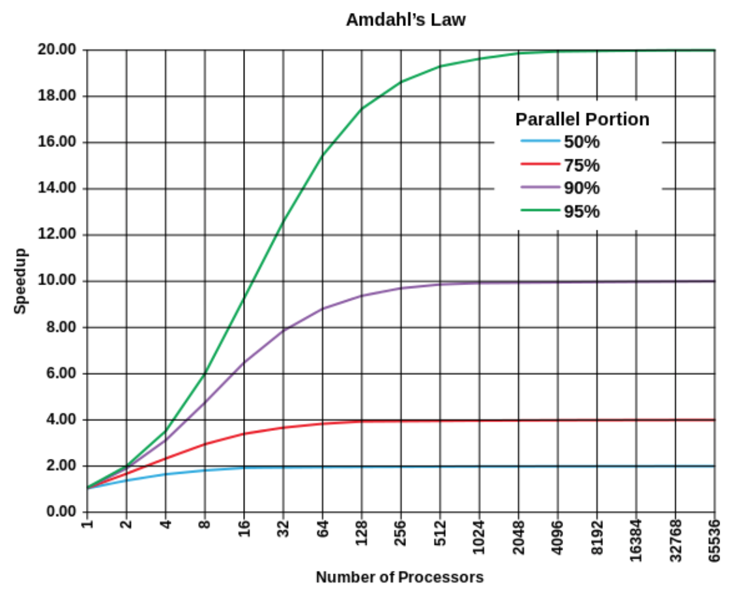
Notes on Parallel Streams
Making a stream parallel may not always result in speedup
Beware Amdahl's Law
Certain stream operations may require serial operation
Stateful (e.g. distinct())
sorted()
findFirst() (use findAny() instead)
Cost of splitting stream may be significant
Arrays easy, linked list very slow

