Slide 1
BlackTeam
Show And Tell 11th JUNE

Slide 2
Progress so far .. 11th June
Spend a lot of time on SW infrastructure (kudos to Neil) – excellent process in place
Using Travis, Circle, Selenium we have continuous deployment to our VM http://csi6220-1-vm2.ucd.ie/ from github
VM is running a django project displaying RSS feed
We’re using Docker VM to ensure we all have the same environment
Meetings via Slack and Google hangouts twice a week – good communication
We’ve broken down the Development into Scrum Epics, and are adding user stories to Trello – to be assigned Thursday for first sprint to 30th June
All learning python + docker + git + django + APIs etc

Slide 3
Objectives
Technology Trending News on web page
Enrich News with Tweets relevant to the news
Web page will allow users to enter their twitter id
Personalize web page by ordering the headlines based on the content of the users tweets and of their followers tweets
Personalize the web page by remembering which news articles the user clicked on and hence what type of technology news they are interesting in
When users clicks on article, show relevant tweets streaming

Slide 4
How is it done today and LIMITS
Technology news has mostly comments and opportunity to share news Via twitter, email etc
Technology news doesn’t have dynamic streaming tweets about the news topic
Most news is not personalized, so if I love iPhones I will still see news about Android phones for example

Slide 5
WHATS new in our approach
Including tweets relevant to the news article – especially showing dynamic streaming tweets
Personalizing the web page based on twitter usage
Personalizing the web page based on what users click on

Slide 6
PROs and Cons
PROS
Giving the user instant feedback, for example a new laptop model, you might see social media information about the product to help you
Personalizing news based on tweets so that it is more relevant to you
Personalizing news based on what you like
CONS
The content of the tweets may not be interesting – also will not be from trusted sources
The content of tweets may be offensive
Personalizing the news may annoy the user if they feel they are being manipulated

Slide 7
WHO CARES ?
People who watch technology closely can get better and faster feedback and see what people really think about technology
WHAT DIFFERENCE WILL IT MAKE
It will make the news more interesting and relevant
RISKS AND PAYOFFS
Main risk is that the contents of tweets is not interesting
Payoffs: if we can make the news relevant through personalization and interesting through relevant tweet content this model could be copied for other news

Slide 8
Midterm and final “exams”
Midterm
Basic UI for Trending Technology
RSS news enriched with tweet relevant to news
Basic Personalization
Final
Online web app, meeting all objectives on slide 2, real time and nice UI

Slide 9
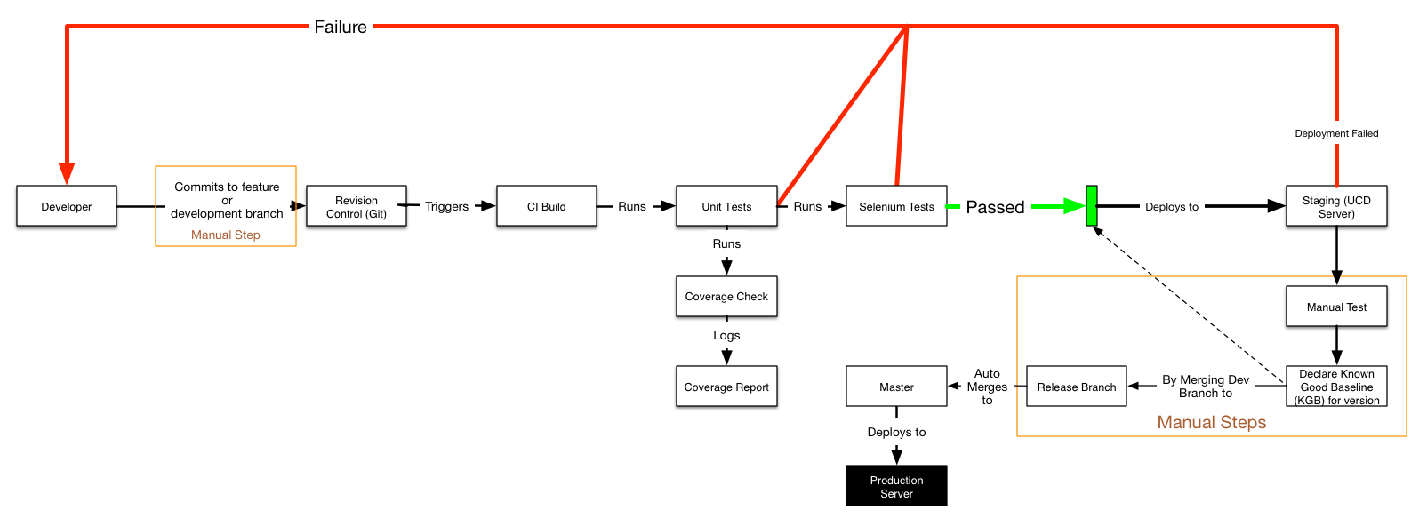
Working SW process

Slide 10
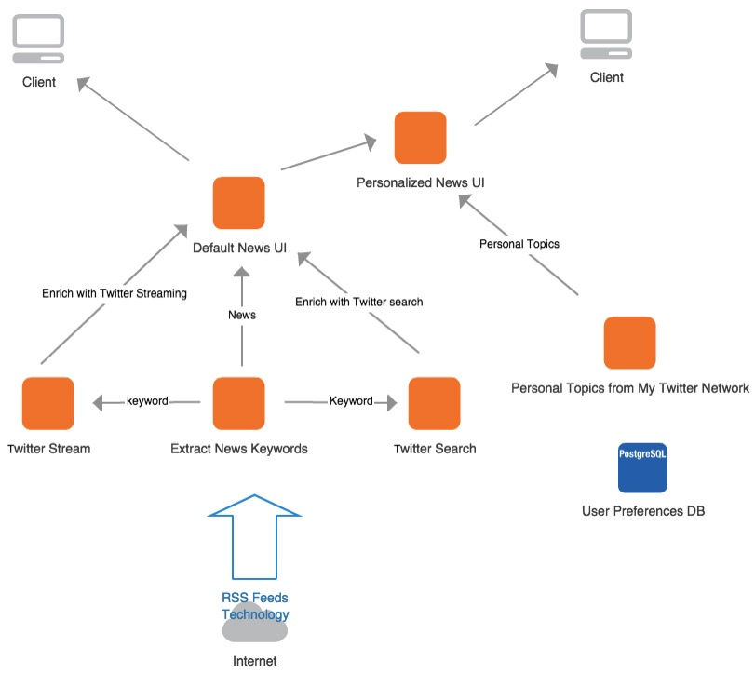
Simple diagram

