Slide 2
Alerts Implemented
2

Slide 3
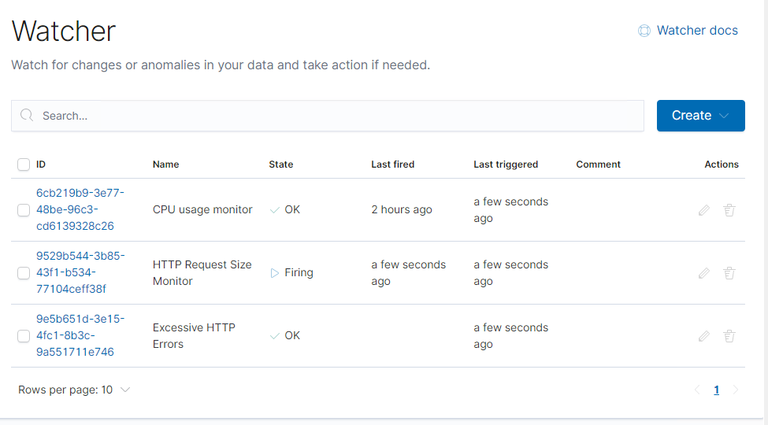
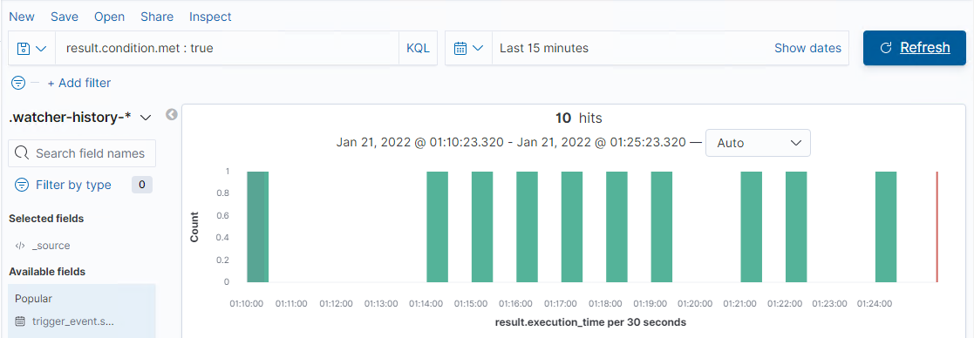
Alerts Overview
Set up 3 Alerts to trigger for various criteria
CPU Usage Monitor
HTTP Request Size Monitor
Excessive HTTP Errors
Below is the .watcher-history-* index visualization
This is a compilation of the 3 alerts we had set up

Slide 4
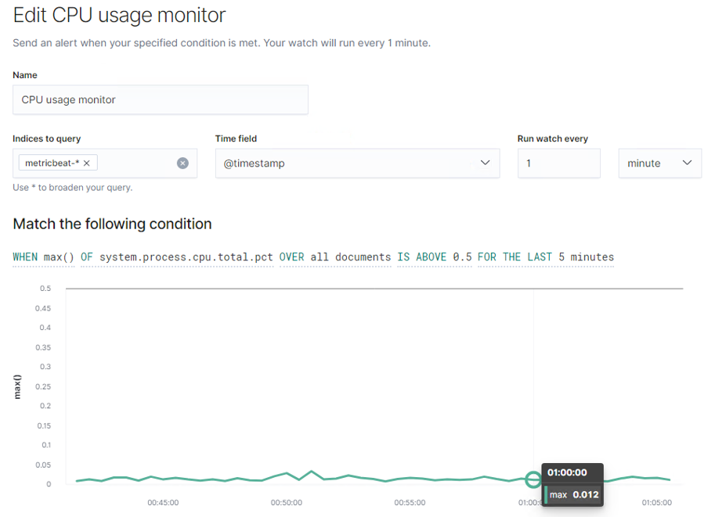
Alert 1: CPU Usage Monitor
This alert monitors metric data from the operating system and from services running on the server
We have set the alert to run every 1 minute and trigger when the total CPU process percentage for all documents is above 0.5 over a 5 minute period.

Slide 5
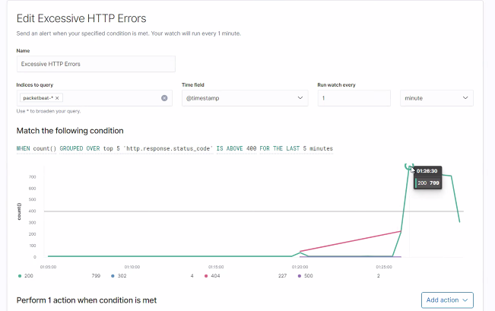
Alert 2: Excessive HTTP Errors
We utilized Packetbeat which sniffs traffic between application processes and parses on the fly protocols like HTTP and MySQL
We have set the alert to run every 1 minute and trigger when HTTP response status codes greater than 400 are generated.
This alert groups the top 5 status codes over a 5 minute period

Slide 6
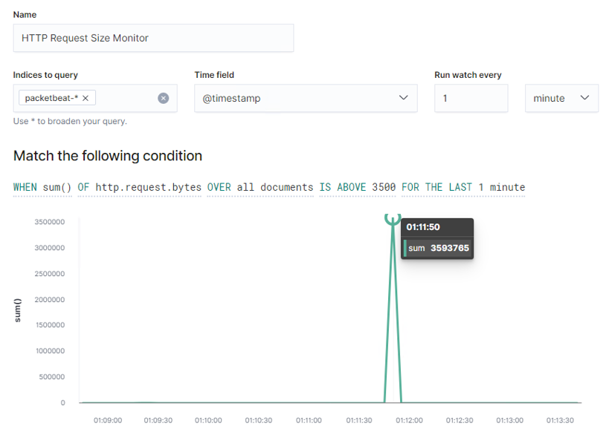
Alert 3: HTTP Request Size Monitor
We also used Packetbeat for this alert as it monitors HTTP traffic
We have set the alert to run every 1 minute and trigger when the sum of HTTP request bytes for all documents is above 3500
This takes the sum of requests every minute

Slide 7

Hardening & Implementing Patches
7

Slide 8
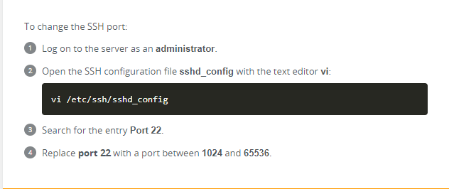
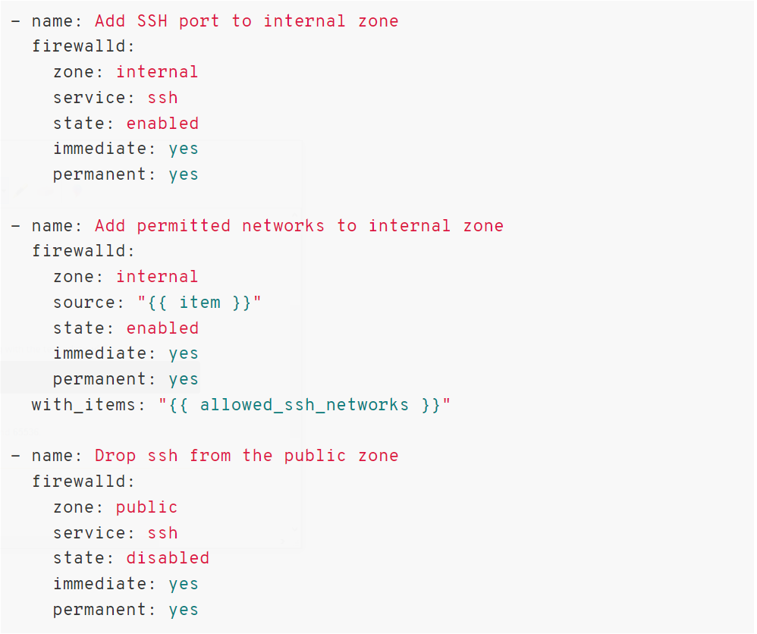
Hardening Against Poorly Secured SSH Port on Target 1
The following configurations can be set on the host to mitigate port scans:
Mitigation: Change port 22 to new custom port number
Why it works: By default, SSH is set to be listening on port 22. Changing the default port 22, for example 5150, offers an additional layer of security by obscurity.
Mitigation: Enable IP allowed list on firewall
Why it works: By creating a specific filter/rule in your firewall, you are opening SSH port only to your whitelisted IP addresses.

Slide 9

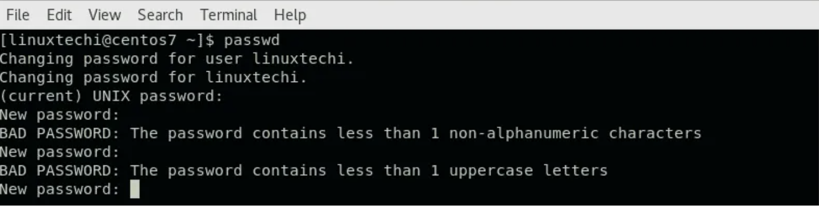
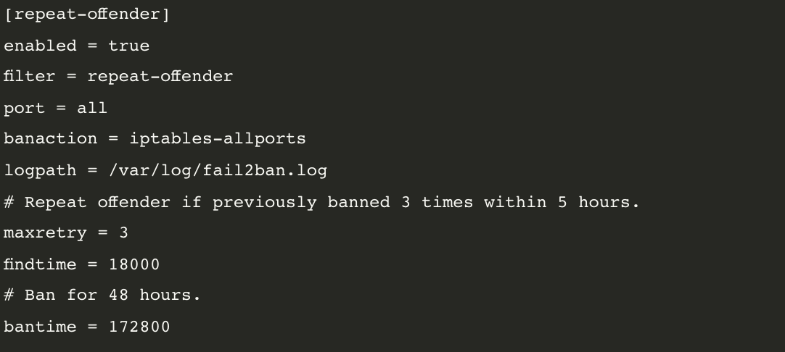
Hardening Against Weak User Password on Target 1
The following mitigation steps can be implemented to counter password attacks:
Implement multi-factor authentication.
Institute strong password policy (one that includes different characters e.g letters, numbers, special characters etc.)
Configure “fail2ban” utility to mitigate brute force attacks.
Notes:
“fail2ban” utility scans logs and bans IPs that show malicious activity. scans log files (e.g. /var/log/apache/error_log) and bans IPs that show the malicious signs -- too many password failures, seeking for exploits, etc.
Generally Fail2Ban is then used to update firewall rules to reject the IP addresses for a specified amount of time, although any arbitrary other action (e.g. sending an email) could also be configured.
Fail2Ban is able to reduce the rate of incorrect authentications attempts however it cannot eliminate the risk that weak authentication presents.
https://www.fail2ban.org/wiki/index.php/Main_Page

Slide 10
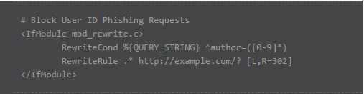
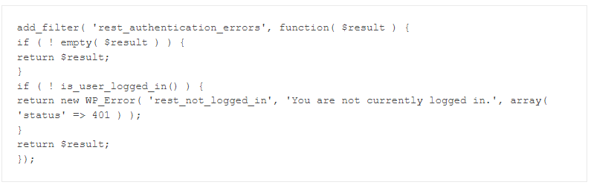
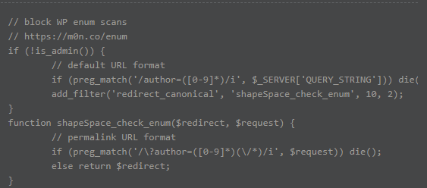
Hardening Against Wordpress Enumeration
The following configurations can be set on the host to mitigate port scans:
Mitigation: Restrict the WordPress Rest API
Why it works: WPScan uses REST API to enumerate users, therefore restricting some functions within it prevents user enumeration among other vulnerabilities.
Add and activate the plugins below on the site which disables the WordPress API for anyone who is not logged in
Mitigation: Disable Scans and Block User Enumeration via .htcaccess
Why it works: This 2 step process will add layers of security by:
adding a code snippet to the theme’s functions.php file:
Adding a code snippet to the site’s root
Notes:
The WordPress API is the modern way for third-party applications to communicate with WordPress. While it is safe to use, it is advisable to restrict some functions within it to prevent user enumeration and other potential vulnerabilities.
Additionally, the WordPress REST API enables JSONP by default. JSONP is an old technique for bypassing the browser’s same origin policy before modern browsers supported CORS (Cross-origin Resource Sharing). Since this could potentially be used as a step in an attack by an attacker, there is no real reason for this to be enabled. It is recommended to disable it using the rest_jsonp_enabled WordPress filter using the following PHP snippet.
https://securityboulevard.com/2021/01/wordpress-security-hardening-the-definitive-guide/

Slide 11
Blue Team References
https://www.redhat.com/sysadmin/harden-new-system-ansible - ansible config
https://www.redhat.com/sysadmin/locking-down-sshd - ansible config
https://www.happycoders.eu/devops/ansible-tutorial-setup-users-ssh-firewall/ - ansible config
https://www.ionos.com/help/server-cloud-infrastructure/getting-started/important-security-information-for-your-server/changing-the-default-ssh-port/ - change port 22
https://medium.com/secjuice/how-to-hide-your-ports-with-port-knocking-cb7f244849e7 - port knocking
https://www.fail2ban.org/wiki/index.php/Main_Page - fail2ban
https://www.lifewire.com/install-fail2ban-on-ubuntu-server-18-04-4179020 - fail2ban walkthrough
https://www.rapid7.com/blog/post/2017/02/13/how-to-protect-ssh-and-apache-using-fail2ban-on-ubuntu-linux/ -fail2ban

