Slide 1
Final Engagement
Attack, Defense & Analysis of a Vulnerable Network
Kathryn Lahr, James Liddell, Mike Monahan, Juddy Otieno, Grant Stanford, and Ian Duff
GWU Cybersecurity Bootcamp - January 22, 2022

Slide 2
Table of Contents
This document contains the following resources:
Network Topology & Critical Vulnerabilities
Exploits Used
Methods Used to Avoiding Detect

Slide 3

Network Topology
& Critical Vulnerabilities
3

Slide 4
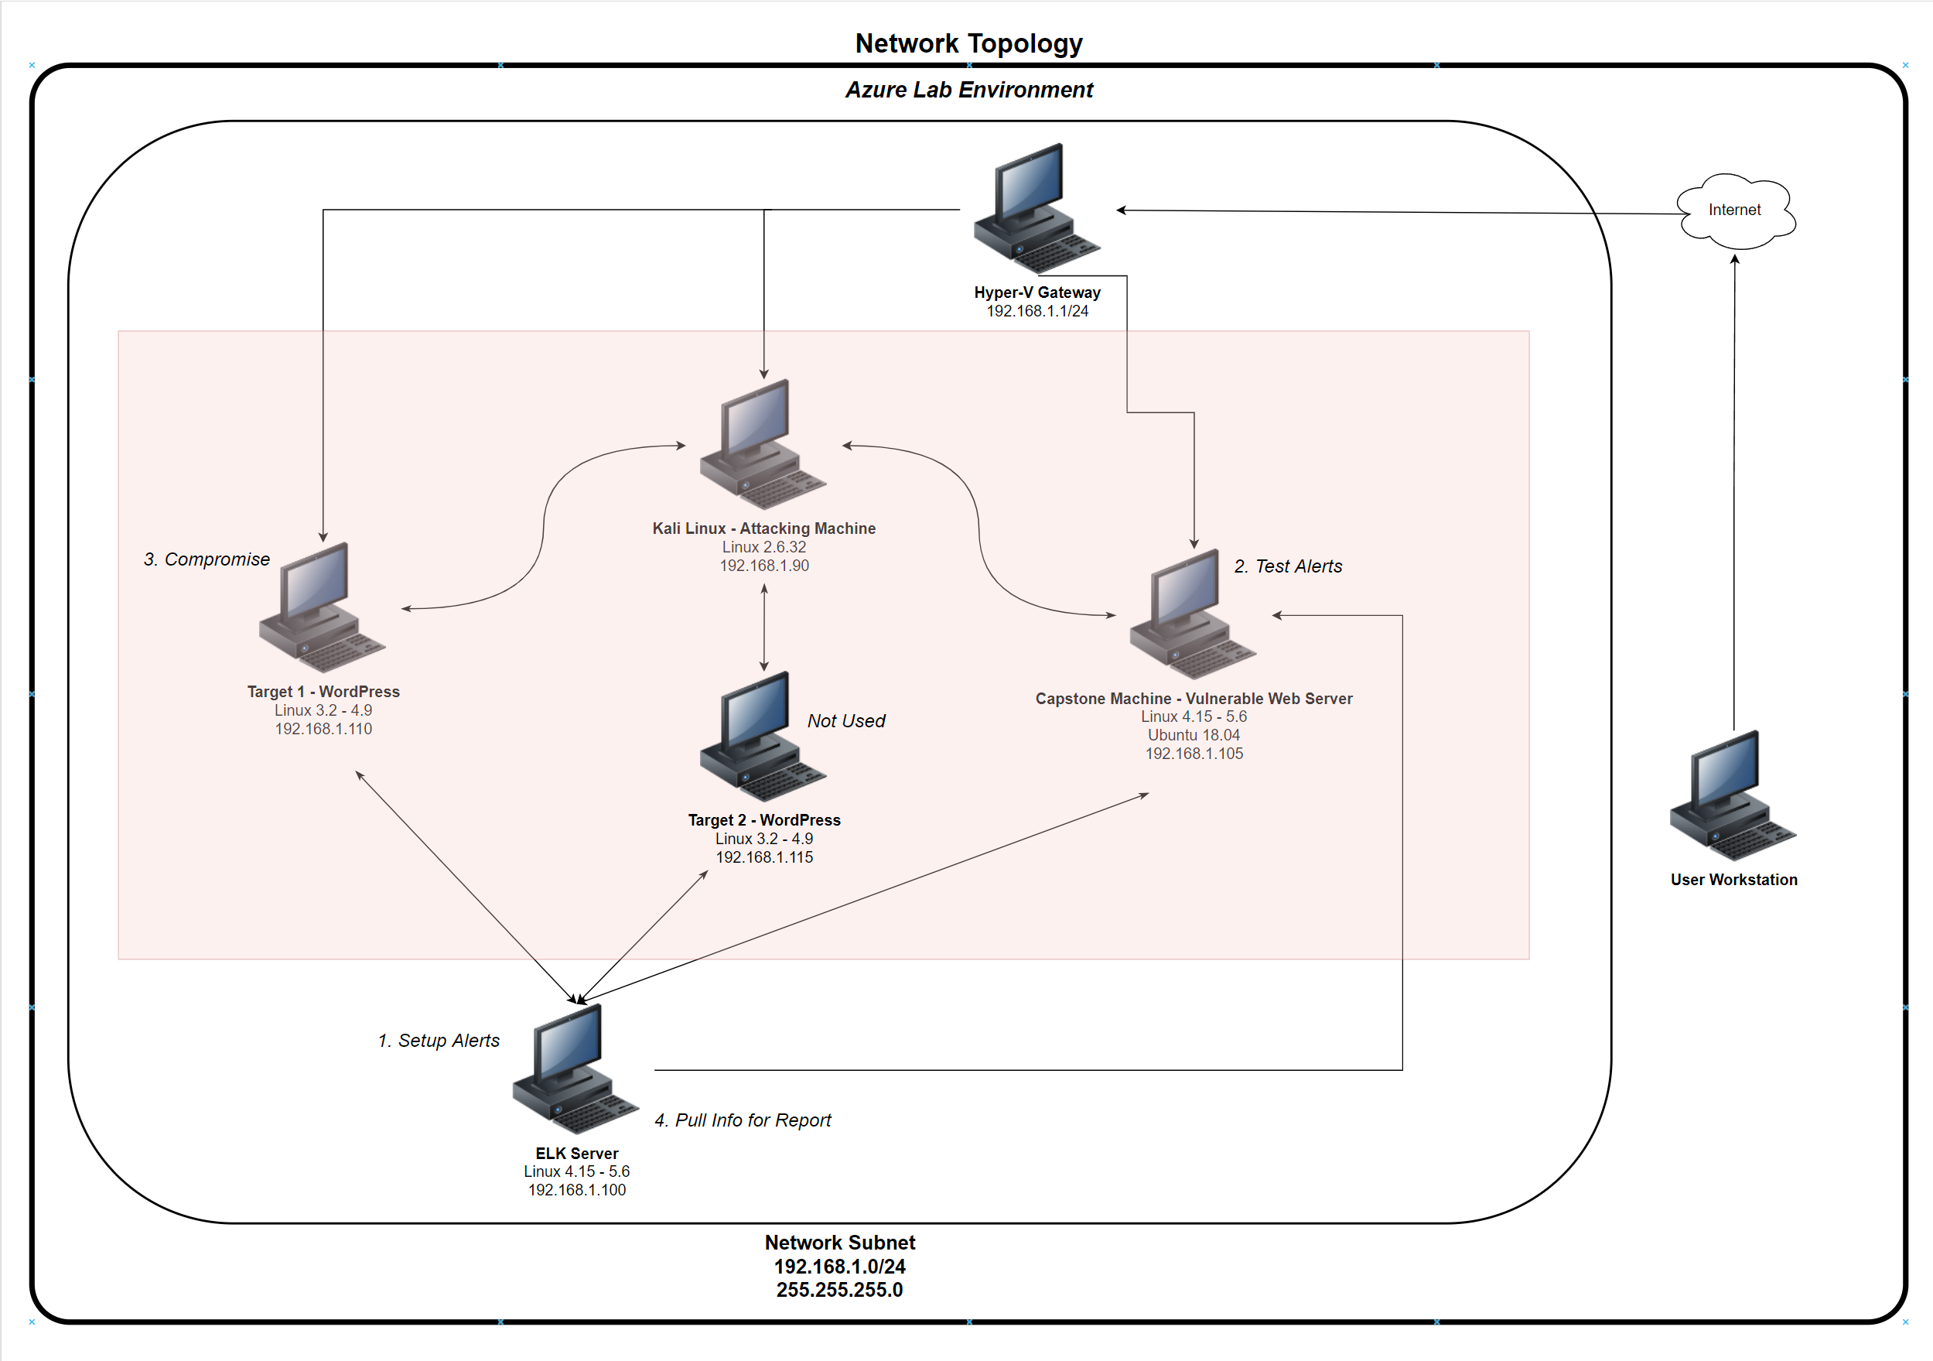
Network Topology
[Insert Here]
Use draw.io to create a diagram of the network.
Add your diagram to this slide and fill out the data in the sidebar.
Network
Address Range: 192.168.1.0/24
Netmask: 255.255.255.0
Gateway: 192.168.1.1
Machines
IPv4: 192.168.1.1
OS: Windows 10
Hostname: Hyper-V Host
IPv4: 192.168.1.90
OS: Linux 2.6.32
Hostname: Kali Linux - Attack
IPv4: 192.168.1.100
OS: Linux 4.15 – 5.6
Hostname: ELK Stack - Monitor
IPv4: 192.168.1.105
OS: Linux 4.15 – 5.6
Hostname: Capstone – Vulnerable Web Server
IPv4: 192.168.1.110
OS: Linux 3.2 – 4.9
Hostname: Target 1 - WordPress
Azure Lab Environment

Slide 5
Critical Vulnerabilities: Target 1
Our assessment uncovered the following critical vulnerabilities in Target 1.
Vulnerability | Description | Impact
Poorly Secured SSH Port | Performed nmap scan of Target 1 Machine | Nmap scan revealed several open ports which we used to access Target 1 Machine
SQL Enumeration | Performed WPscan on Target1 Machine | User name “michael” and “steven” uncovered
Weak User Password | Performing hydra brute force successfully discovered user password | User “michael” password is “michael”
No File Security | Password for root user stored in plaintext in wp-config.php | Using login username “root” and password “R@v3nSecurity” we achieved elevated permissions and access to mysql

