Slide 2
Traffic Profile
2

Slide 3
Traffic Profile
Our analysis identified the following characteristics of the traffic on the network:
Feature | Value | Description
Top Talkers (IP Addresses) | 172.16.4.205 185.243.115.84 10.0.0.201 | Machines that sent the most traffic.
Most Common Protocols | TCP UDP HTTP | Three most common protocols on the network.
# of Unique IP Addresses | 810 | Count of observed IP addresses.
Subnets | 10.6.12.0/24 172.16.4.0/24 10.0.0.0/24 | Observed subnet ranges.
# of Malware Species | 1 (june11.dll) | Number of malware binaries identified in traffic.
Notes:
You may have more than 2 subnets.

Slide 4
Behavioral Analysis
Purpose of Traffic on the Network
Users were observed engaging in the following kinds of activity.
“Normal” Activity
Watching YouTube, Googling Orbike
Suspicious Activity
Downloading suspicious files, high spikes in traffic, torrenting files

Slide 5
Normal Activity
5

Slide 6
Normal Activity: Web Traffic
Summarize the following:
What kind of traffic did you observe? Which protocol(s)? HTTP/web traffic
What, specifically, was the user doing? Which site were they browsing? Etc. Browsing Orbike.com
Include screenshots of packets justifying your conclusions.
Include a description of any interesting files.

Slide 7
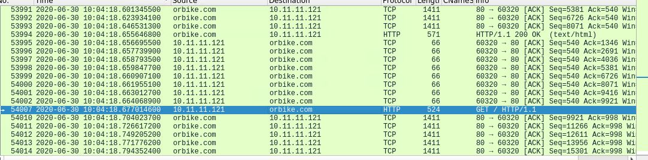
Normal Activity: Web Traffic

Slide 8
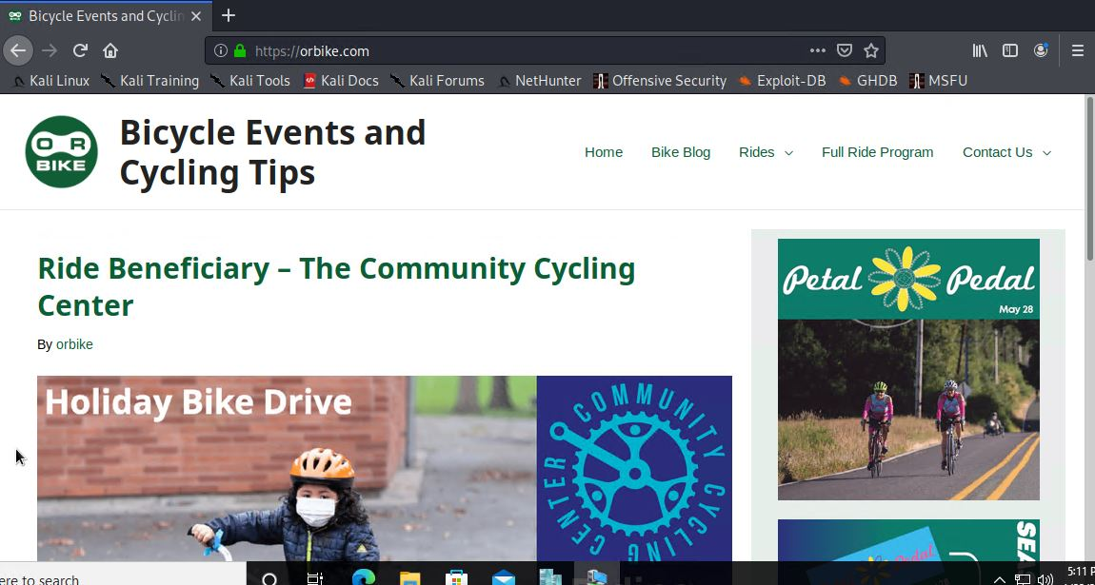
Normal Activity: Web Traffic

Slide 9
Normal Activity: DNS
Summarize the following:
What kind of traffic did you observe? Which protocol(s)? DNS query for Orbike.com - UDP over port 53; 8.8.8.8
What, specifically, was the user doing? Which site were they browsing? Etc. Querying Google DNS Servers for Orbike.com site info.
Include screenshots of packets justifying your conclusions.
Include a description of any interesting files.

Slide 10
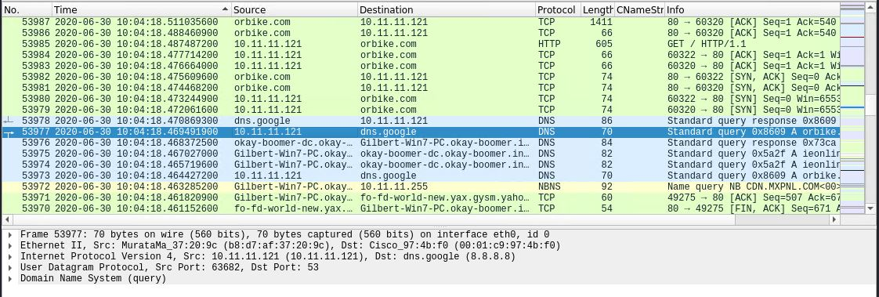
Normal Activity: DNS

Slide 11
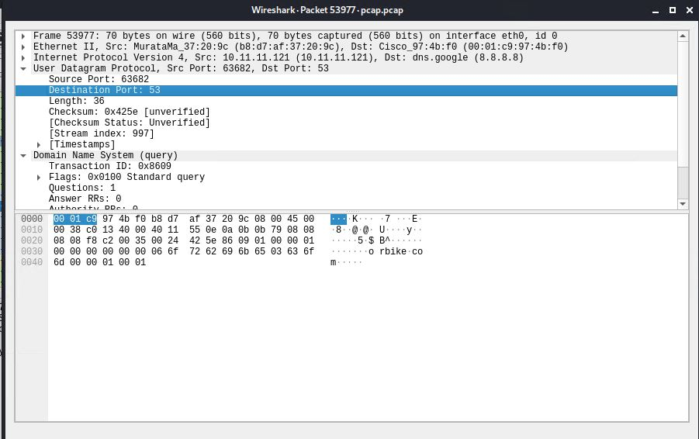
Normal Activity: DNS

Slide 12
Malicious Activity
12

Slide 13
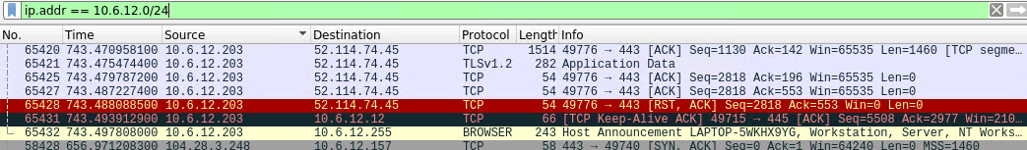
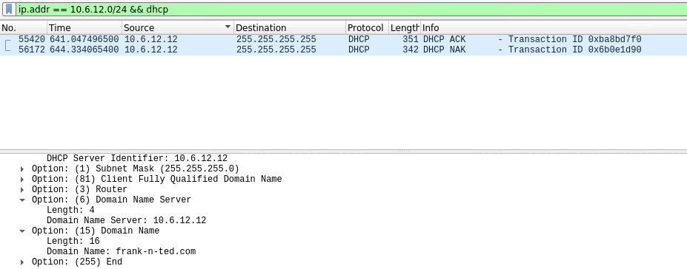
Time Thieves
Users created web server to access YouTube with IP address in the range of 10.6.12.0/24
Filtered for traffic by
ip.addr == 10.6.12.0/24
Discovered web server by filtering traffic
ip.addr == 10.6.12.0/24 && dhcp
IP Address: 10.6.12.12
Domain Name: frank-n-ted.com

Slide 14
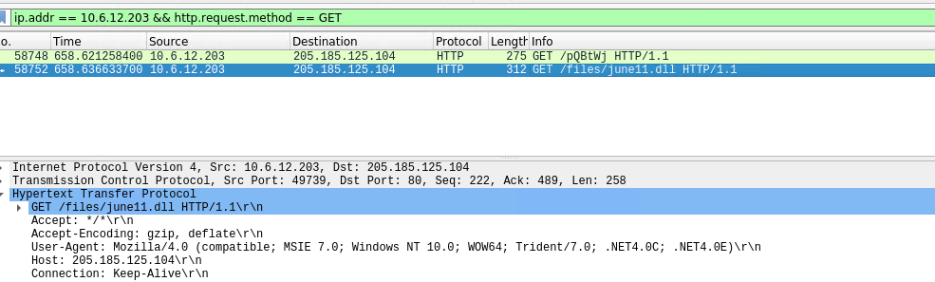
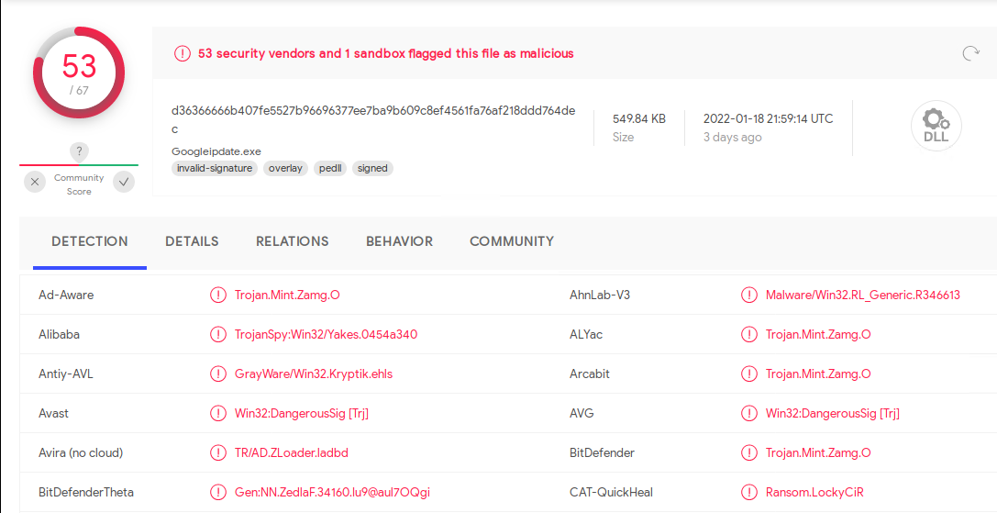
Malicious File Download
Malicious file was downloaded on machine with IP Address 10.6.12.203
Filtered for traffic by
ip.addr == 10.6.12.203 && http.request.method == GET
Identified a downloaded file name june11.dll
The file was downloaded and scanned by VirusTotal
Per the scan, the file was identified as a possible Trojan

Slide 15
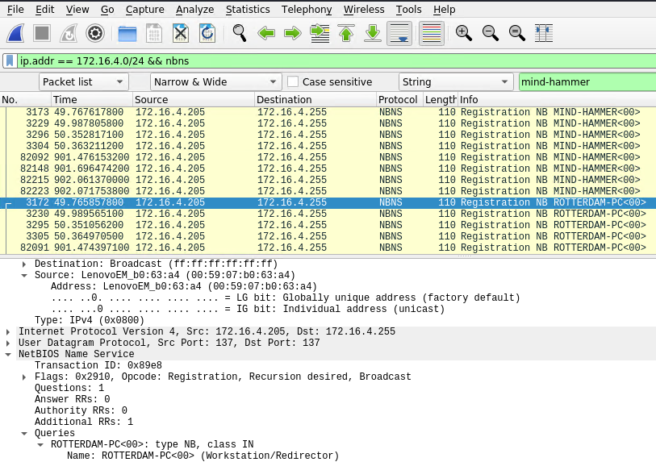
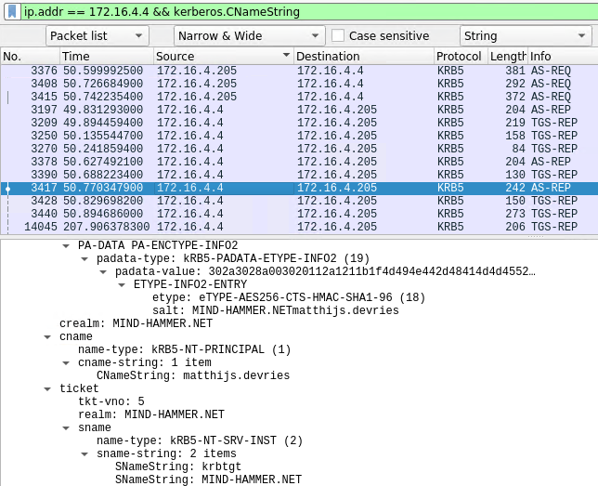
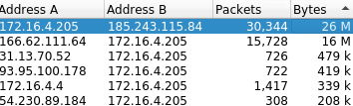
Vulnerable Windows Machines
Infected Windows host machine on network
Filtered traffic by
ip.addr == 172.16.4.0/24 && nbns
Identified infected computer
Host name: ROTTERDAM-PC
IP address: 172.16.4.205
MAC address: 00:59:07:b0:63:a4
Filtered traffic by
ip.addr == 172.16.4.0/24 && kerberos.CNameString
User on infected machine: matthijs.devries
IP Addresses used in infection traffic had substantially higher traffic:
185.243.115.84
166.62.111.64

Slide 16
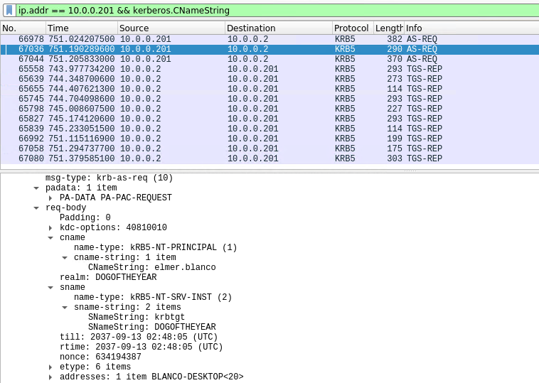
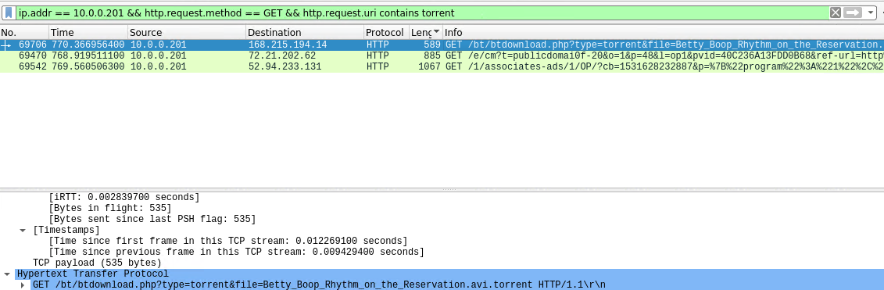
Illegal Downloads
Filtered traffic by
ip.addr == 10.0.0.201 && kerberos.CNameString
Machine information
MAC address: 00:16:17:18:66:c8
Windows Username: elmer.blanco
Desktop Name: BLANCO-DESKTOP
Filtered traffic by
ip.addr == 10.0.0.201 && http.request.method == GET && http.request.uri contains torrent
Identified torrented file:
Betty_Boop_Rhythm_on_the_Reservation.avi.torrent

Slide 17
The End
17

