Slide 1
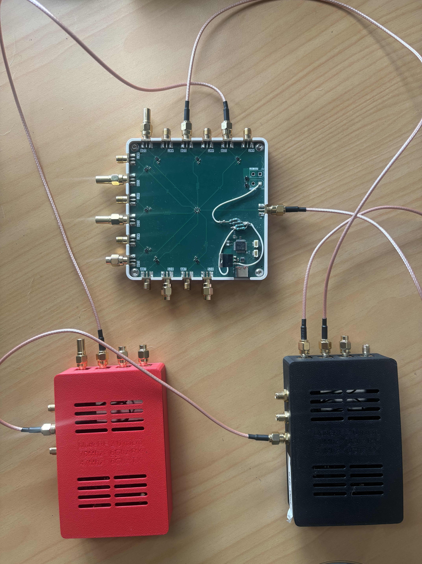
Angle of Arrival Estimation using Two SDRs
Motivation
Rocket localisation: Develop direction-finding capabilities to support rocket tracking.
UC Rocketry: Make use of existing bladeRF hardware to create a system that can be modified and expanded.
Project Aim
Develop and validate a dual-SDR system capable of synchronised, calibrated phase measurements for AoA estimation.
Chanelle Duffy Supervisor: Chris Hann

Slide 2
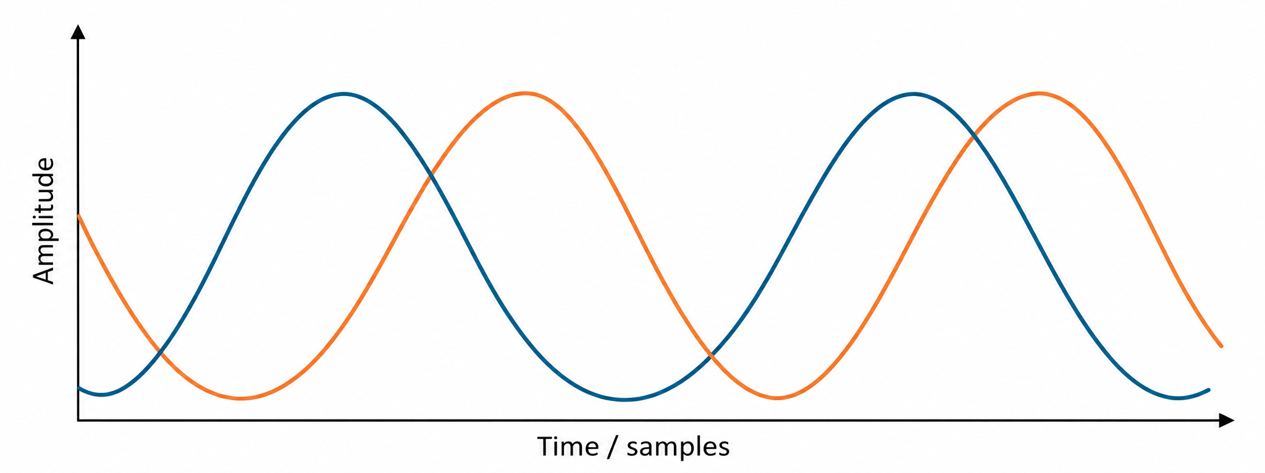


Angle of Arrival Estimation Using Two SDRs
Propagation Direction
RX1
RX2
$$θ$$
Broadside
RX1
RX2
$$Δt$$
Incoming wavefront reaches RX1 first
Received Signals are Phase Shifted

Slide 3
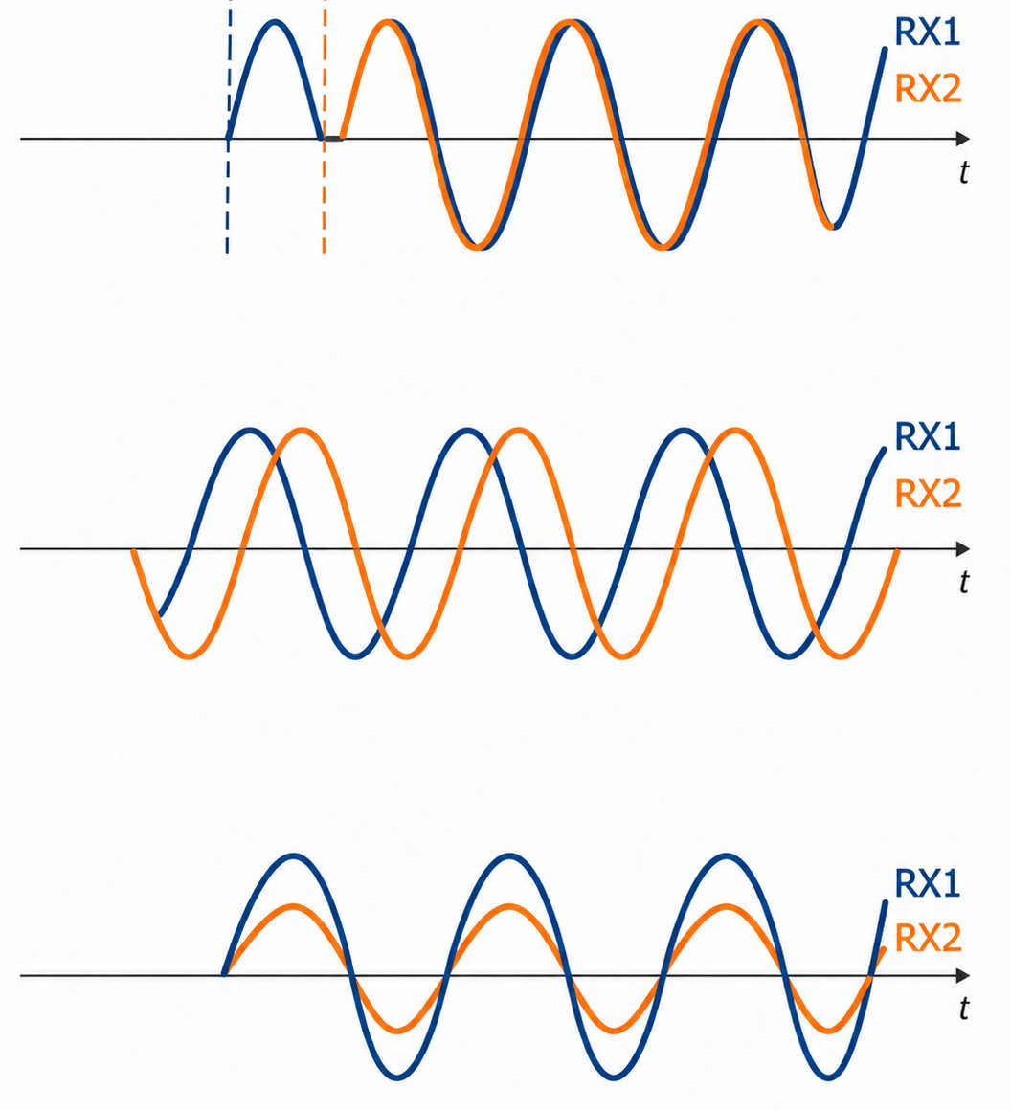
The Challenge of Independent SDRs
Timing
Offset | Primary Cause
Timing | Independent sample acquisition start times
Phase | RF signal paths and independent PLL
Amplitude | Receiver gain and component differences
Phase
Amplitude
$$Δφ_{measured} = {Δφ}_{AoA} + Δφ_{system}$$

Slide 4
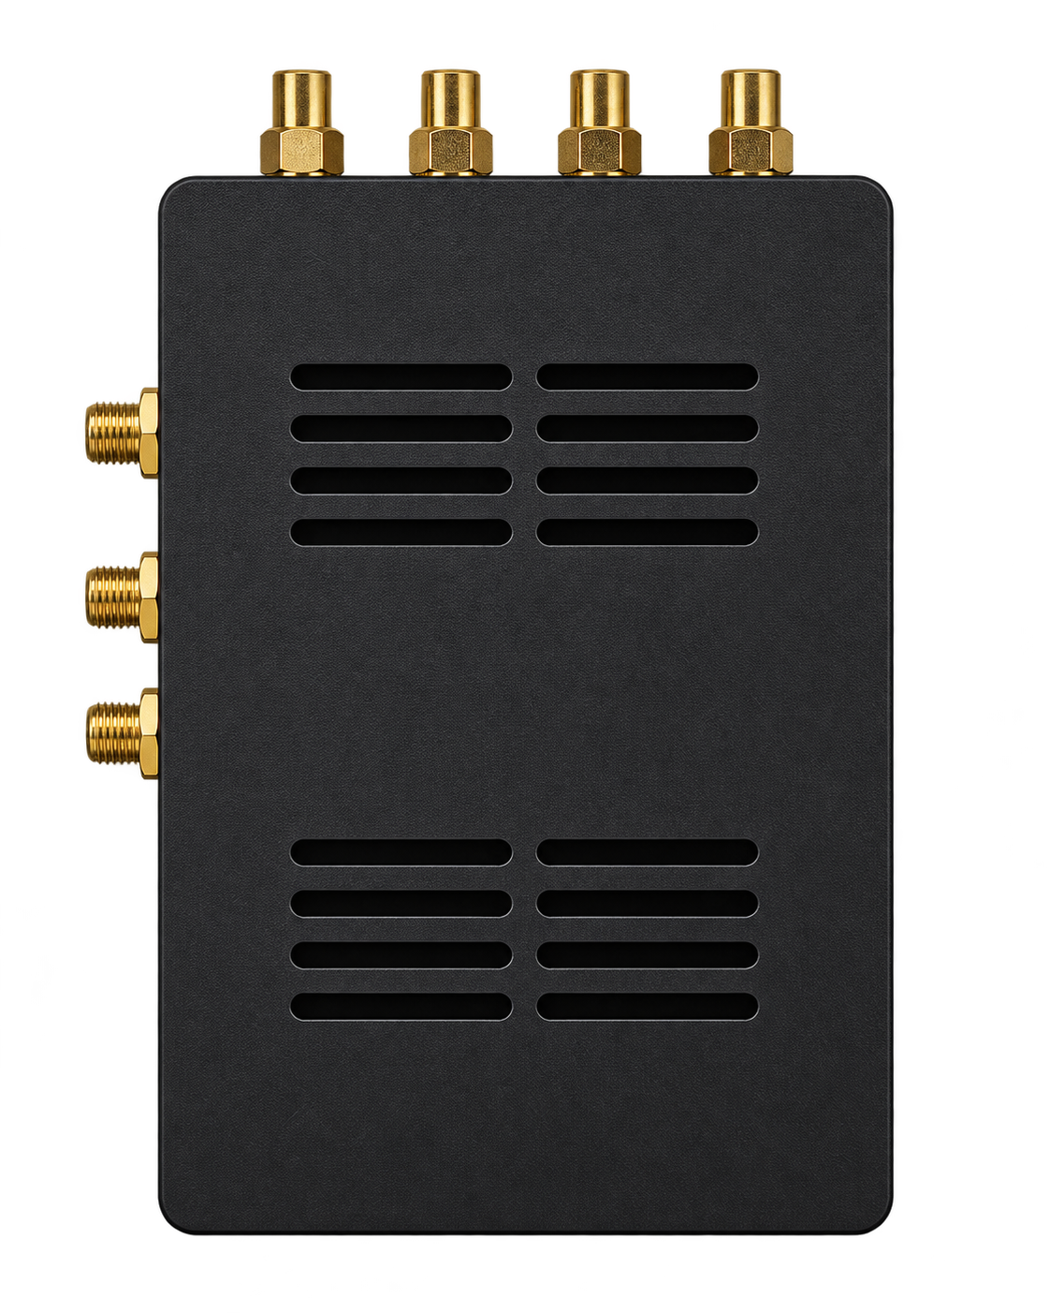
Initial Offset Calibration
Calibration
Dual SDR Synchronisation
RF Switch Board
Angle-of-Arrival (AoA)
Hardware Configuration
Purpose
Establish a method for estimating and correcting relative timing, amplitude, and phase offsets.
RX0
Master SDR
Section Overview
TX0
Calibration algorithm development
Single-SDR hardware testing

Slide 5
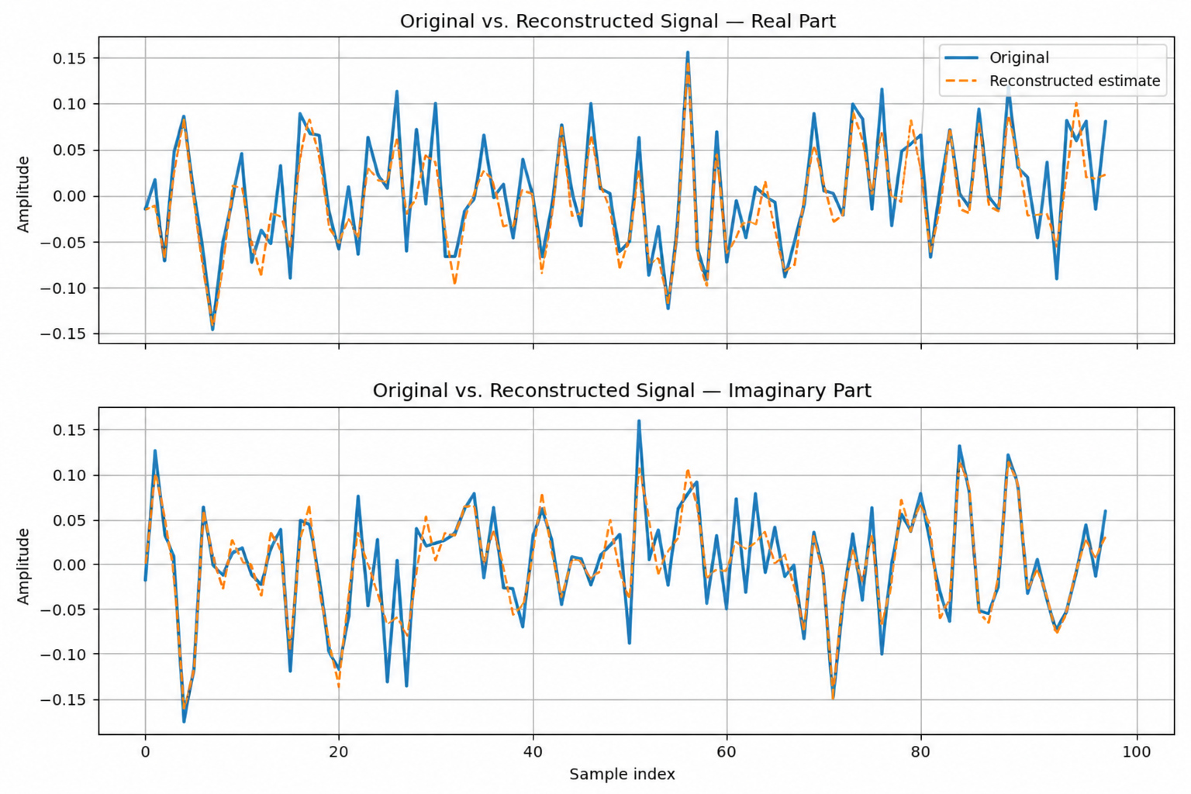
Initial Calibration Development
Cross-Correlation
Estimate the integer sample delay
Phase-Fitting
Estimate the fractional delay
Least-Squares Complex Gain
Estimate relative amplitude and phase
Apply Correction
Align received IQ signal to the reference
Notes:
The initial calibration algorithm was developed using a single bladeRF in loopback, allowing the known transmitted signal to be compared against the received signal.
First, cross-correlation was used to identify the integer-sample delay, taking the highest correlation peak.
The remaining fractional delay was then estimated in the frequency domain. Since time delay produces a linear phase slope, the phase was unwrapped to remove the (2\pi) discontinuities before fitting a straight line across a fixed frequency range.
Once the signals were aligned in time, least-squares complex gain estimation was used to determine the remaining amplitude and phase offsets.
These corrections were then applied to reconstruct the transmitted signal. The hardware results on the right show good agreement between the original and reconstructed waveforms, for both the real and imaginary components, despite the noise introduced by the hardware.

Slide 6
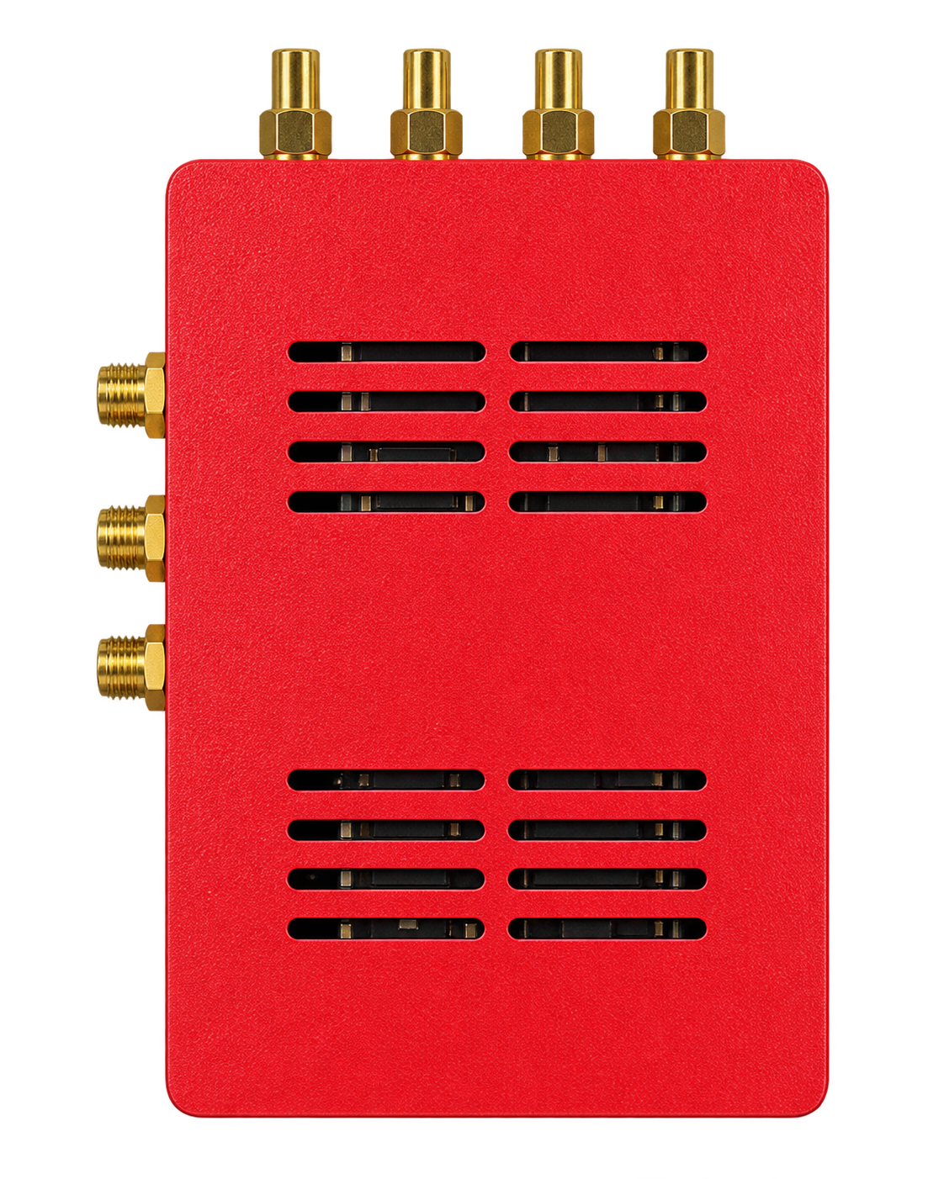
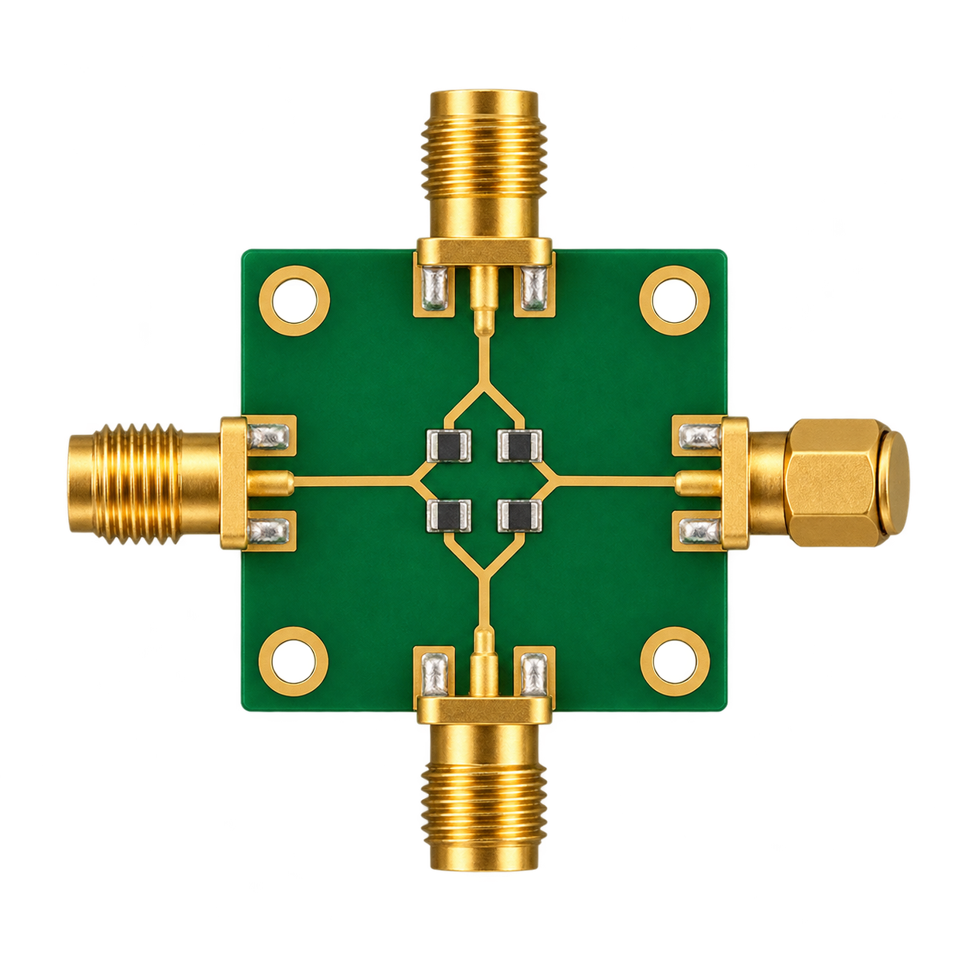
SDR Synchronisation
Calibration
Dual SDR Synchronisation
RF Switch Board
Angle-of-Arrival (AoA)
Hardware Configuration
Purpose
CLOCK
Extend calibration to two independent SDR receivers.
Maintain relative alignment during continuous acquisition.
RX0
Section Overview
Slave SDR
50Ω
Shared Clock Synchronisation
Dual-SDR acquisition and calibration
Continuous correction and stability testing.
NOISE
Master SDR
RX0

Slide 7
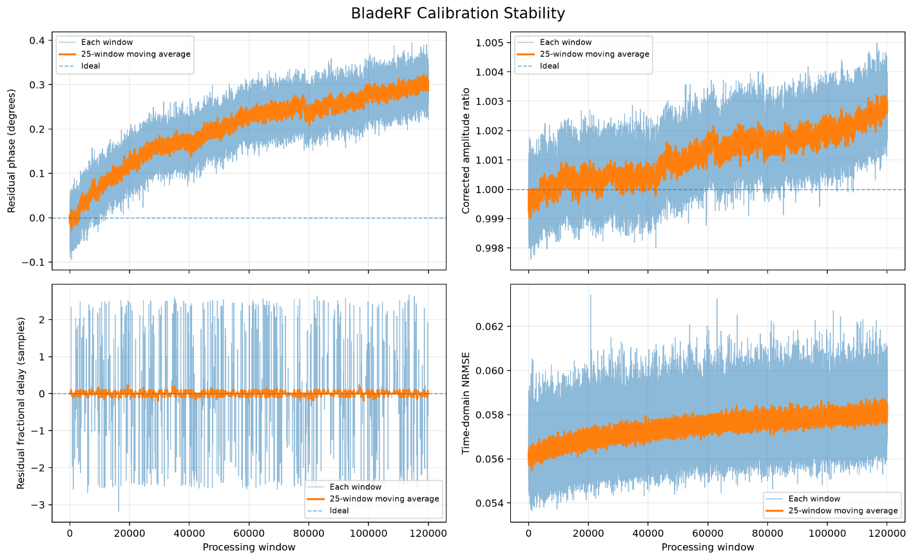
SDR Synchronisation
1. Shared Reference Clock
Master CLKOUT → Slave CLKIN
Common 38.4 MHz frequency ref
2. Initial Sample Alignment
Apply estimated integer delay
3. Continuous Correction
Fractional-delay FIR + complex gain
Notes:
The next step was extending the calibration to two independent bladeRF receivers, both receiving the same signal through an RF splitter.
The master provides a shared 38.4 MHz clock reference to the slave, preventing their frequency references from drifting independently. However, the receivers still start acquiring at different times, so their samples aren't automatically aligned.
The calibration algorithm developed previously estimates this offset. The integer delay is applied to align the streams, while a 65-tap FIR filter corrects the fractional delay. Amplitude and phase corrections are then applied using the estimated complex gain, with the filter state preserved between consecutive processing windows.
Initial testing achieved a corrected correlation of 0.9988 with no residual integer-sample errors. The 20-minute stability test shown here demonstrated that the calibration could be maintained throughout continuous acquisition, although a gradual phase drift of approximately 0.3 degrees was observed.

Slide 8
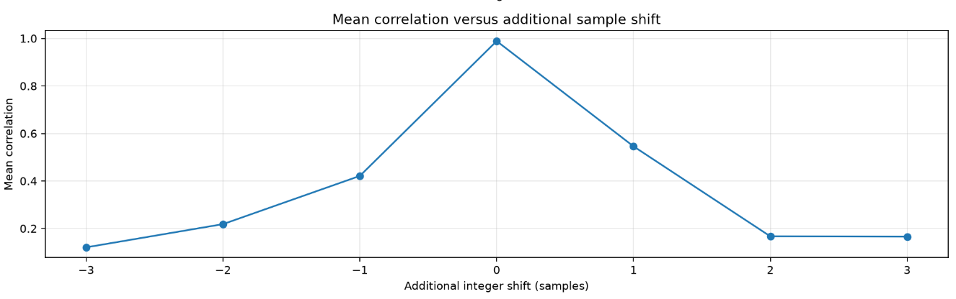
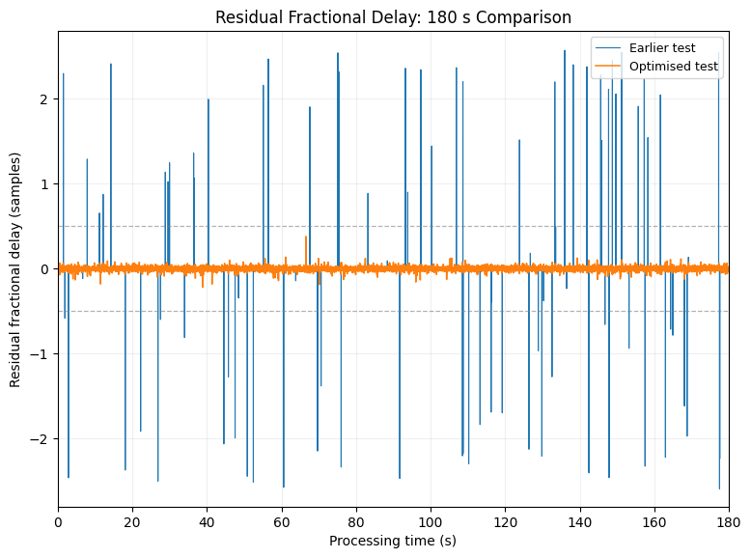
Improving Calibration Reliability
Fractional Delay Estimation
2. Integer Delay Reliability
Original phase-unwrapping method
Original Peak Estimate +/- 2 Samples
0.1307 Sample Standard Deviation
Bounded Correlation Optimisation
0.0170 Sample Standard Deviation
3. Dynamic Frequency Masking
Retains bins with ≥ 6dB above the estimated noise floor.
±250/300/350 kHz Bandwidths validated
0.9906
18,000/18,000
180 s
Mean Correlation
Zero integer delays
Trial time

Slide 9
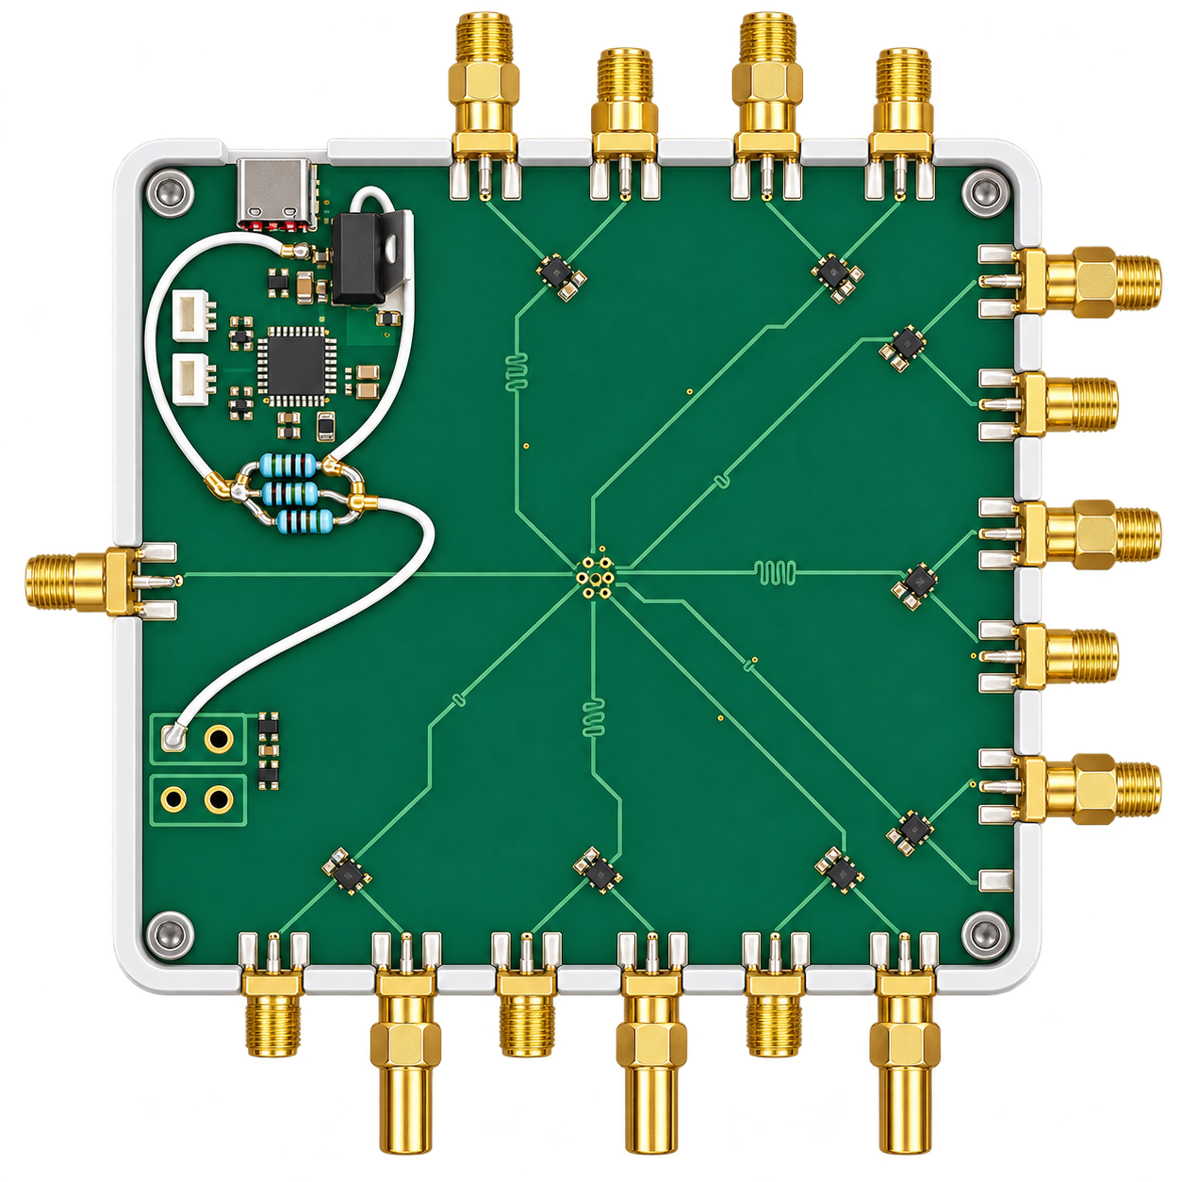
RF Switch Board Integration
Calibration
Dual SDR Synchronisation
RF Switch Board
Angle-of-Arrival (AoA)
Hardware Configuration
Purpose
CLOCK
Validate RF signal paths
Assess whether calibration holds after switching between RF paths.
TX0
RX0
Slave SDR
Section Overview
TX0
Individual RF path validation
Dual-SDR integration and calibration
Switching repeatability and phase stability
Master SDR
RX0

Slide 10
RF Switch Board Integration & Validation
1. Individual Path Validation
Verified NOISE and ANTENNA paths separately
Switching Test Results
 | 10 Switches | No Switch (180s)
Correlation | 0.99893 | 0.99901
Phase Change | +0.310° | +0.202°
2. Dual SDR Integration
Verified calibration through the board
Run-to-Run Phase Repeatability
10 independent starts, NOISE → ANTENNA
15.084°
3. Switching Repeatability
NOISE → ANTENNA → NOISE
Total residual phase offset spread
-11.02
+4.07
Mean correlation: 0.9989
Notes:
After validating the individual RF paths, I integrated the switching board with both SDRs and confirmed that calibration worked through its NOISE path.
I then tested whether the calibration remained effective during switching. Across ten switching cycles, correlation remained approximately 0.999, with a phase change of 0.31 degrees. A separate test without switching showed a similar gradual drift of 0.20 degrees.
However, when I repeated the experiment across ten independent system starts, I found something more concerning. Despite maintaining high correlation, the residual phase offset between the NOISE and ANTENNA paths varied by over 15 degrees between runs.
This suggested that while calibration remained relatively stable within individual runs, its transfer to the antenna paths was not consistently repeatable between starts.

Slide 11
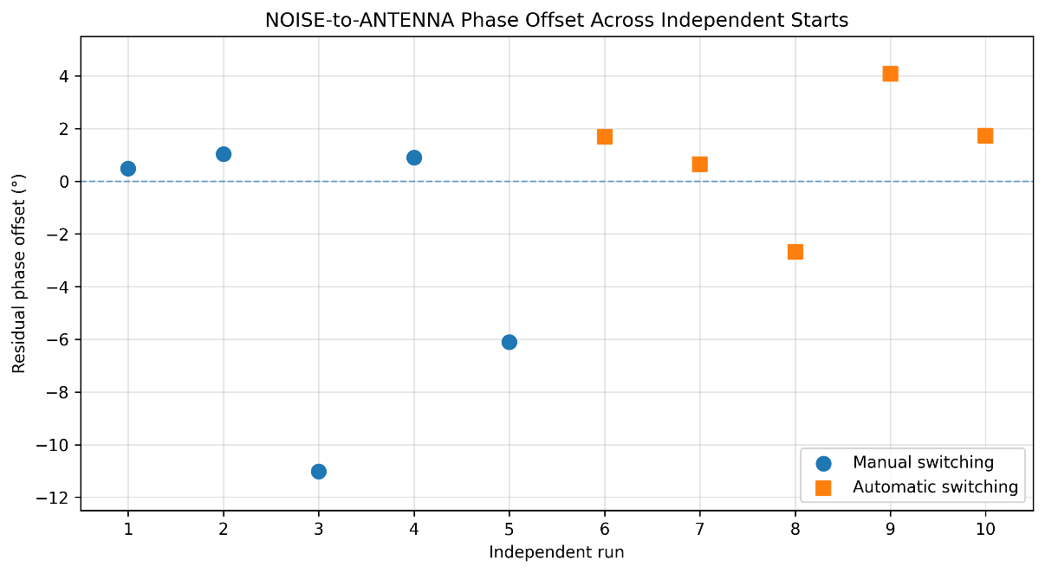
Residual Phase Offset Investigation
Experiment | Result | Finding
1. Independent RF Source Replaced slave TX with an external noise generator. | 8.635° Phase offset spread across 5 starts | Variation persisted without the slave transmitter
2. Master TX Shutdown Disabled master TX while in ANTENNA mode. | +0.2° to +0.3° Difference in phase after stopping TX | A consistent small change – not enough to account for observed offsets
3. Single SDR Dual-Channel Connected both RF switch outputs to RX0 and RX1 of a single bladeRF. | 0.177° Difference | The issue arises within the dual SDR setup.
Conclusion:
The underlying cause of the run-to-run phase offset was not determined.

Slide 12
Angle of Arrival
Calibration
Dual SDR Synchronisation
RF Switch Board
Angle-of-Arrival (AoA)
Recommended Hardware Configuration
Purpose
CLOCK
Antenna
Develop AoA estimation using relative phase
Validate AoA estimation
RX0
Section Overview
Slave SDR
Phase difference AoA algorithm development
Simulation and Monte Carlo
Residual phase-offset effect
TX0
Master SDR
RX0
Antenna

Slide 13
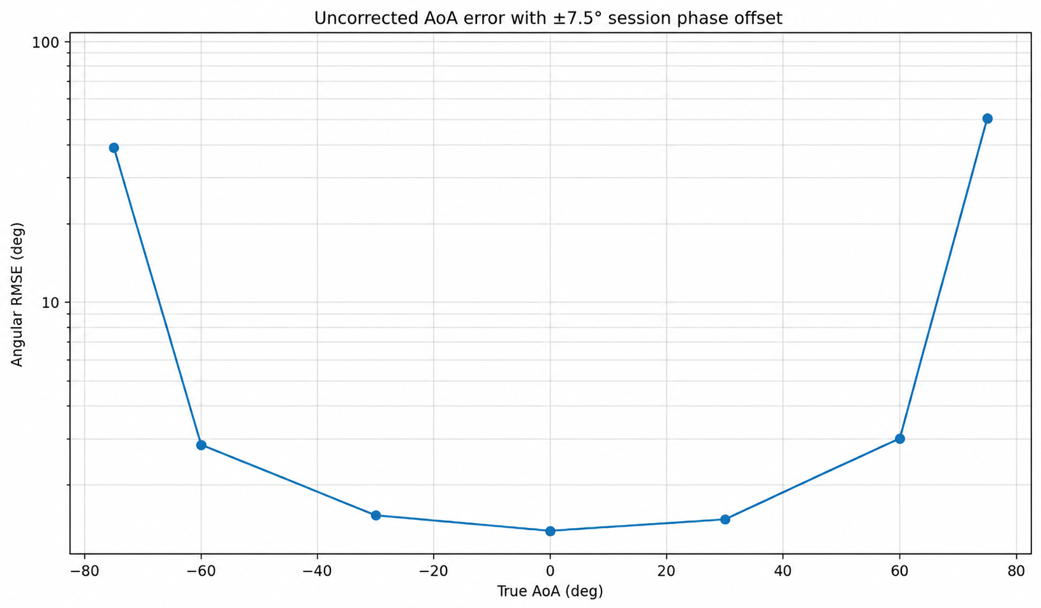
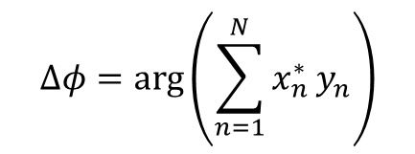
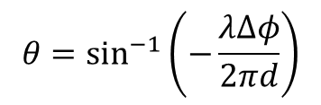
Angle-of-Arrival Estimation and Validation
AoA Estimation Method
1. Estimate relative phase
$$Δφ=\arg\left(\sum_{n=1}^{N}{x_{n}^{∗}}y_{n}\right)$$
2. Convert phase to arrival angle
$$θ=\sin^{−1}\left(−\frac{λΔφ}{2πd}\right)$$
Sim Results in RMSE
Angle = 30°
SNR = 10dB
0.070°
1.477°
0.145°
Ideal conditions:
No calibration error
Uniform ±7.5° phase offset
Uniform ±7.5° phase offset – Post calibrated

Slide 14
Full Pipeline Integration
Calibration
Dual SDR Synchronisation
RF Switch Board
Angle-of-Arrival (AoA)

Slide 15
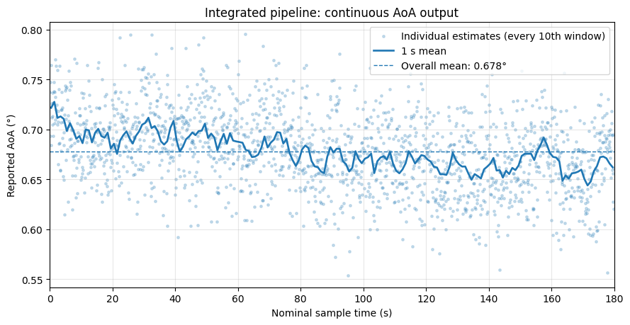
Complete Pipeline Integration and Validation
1. NOISE-Mode Calibration
Estimate and validate receiver offsets
2. RF Path Switching
Disable NOISE TX, switch to ANTENNA
3. Continuous IQ Correction
Apply saved calibration
18,000
0.9740
0.6775°
0.0381°
4. AoA Estimation
Calculate phase difference/angle per window
Mean Correlation
Mean AoA*
AoA Standard Dev
Valid Windows

Slide 16
Conclusion and Project Outcomes
1. Calibration
Developed and validated timing, amplitude and phase correction.
2. Synchronisation
Achieved continuous, calibrated data reception.
v
3. RF Switching
Integrated and validated RF switching between NOISE and ANTENNA.
4. Angle of Arrival Estimation
Validated in simulation, demonstrated complete pipeline.
Remaining Work:
Identify and correct the unknown phase offset, validate AoA accuracy using physical hardware.

