Slide 1



Sustainabili-TREE
By: Kathryn Dufour
Professor: Winnerjit Singh Rathor
Class: Internet Applications (LIB2024 010)

Slide 2

Basic Information
Company Name:
Sustainabili-TREE
Purpose:
Eco-friendly, Christmas tree-rental company
Website URL:
https://dufo0062.github.io/final/
Notes:
So for my assignment, I decided to create a website to promote a fictional company called sustainabili-tree. Sustainable Christmas tree-rental company that grows Christmas trees responsibly, and uproots them and pots them during the Christmas season so that they can be rented out to families. At the end of the Christmas season, the trees are returned to the company and are replanted for continued growth and future rentals, until they get too large for in-house use. This process eliminates the plastic associated with articficial trees, and the pesticides traditionally associated with live-cut trees.

Slide 3
Creative Design
Inspiration: Target Demographic (Environmentalists)
Characteristics
Implications
24-40
Busy
Technology-dependent
Nature-lovers
Minimalists
Zero-waste Supporters
Colours:
Natural
Mature
Green
Content:
Informative
Limited text
Layout:
Minimalistic
Responsive
Images:
Nature-Oriented
Notes:
The creative design for the website was inspired by the primary, target demographic, namely environmentaists. Most environmentalists in todays’ society are between 24 and 40 years of age. They are nature-lovers, and often fall into the minimalist/zero-waste categories as well. This age group is very busy and does not have a lot of time to research and read content; they appreciate when information is sussinct and well-laid out. Individuals in this age group tend to be quite technology-dependent, and thus likely have mobile phones. Thus, a natural, mature, green colour scheme was chosen for the website. The layout is very minimalistic. It is also responsive in order to accommodate mobile viewing.

Slide 4
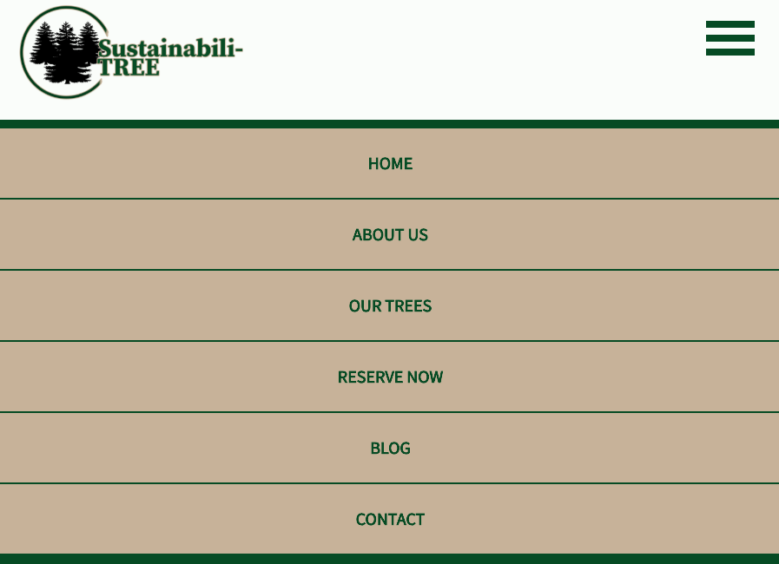
Content
Essential/Beneficial Elements:
Company Information
Purpose
Benefits
Tree Information
Type
Cost
Care
Reservations
Inspiration
Blog
Contact
Notes:
Based on the purpose of the company, I created a list of information that would be beneficial or essential to visitors to the website. I used that list to develop the navigation menu and the different pages on the website.

Slide 5
Content
Essential/Beneficial Elements:
Company Information
Purpose
Benefits
Tree Information
Type
Cost
Care
Reservations
Inspiration
Blog
Contact
Notes:
Based on the purpose of the company, I created a list of information that would be beneficial or essential to visitors to the website. I used that list to develop the navigation menu and the different pages on the website.

Slide 6
Content
Essential/Beneficial Elements:
Company Information
Purpose
Benefits
Tree Information
Type
Cost
Care
Reservations
Inspiration
Blog
Contact
Notes:
Based on the purpose of the company, I created a list of information that would be beneficial or essential to visitors to the website. I used that list to develop the navigation menu and the different pages on the website.

Slide 7
Content
Essential/Beneficial Elements:
Company Information
Purpose
Benefits
Tree Information
Type
Cost
Care
Reservations
Inspiration
Blog
Contact
Notes:
Based on the purpose of the company, I created a list of information that would be beneficial or essential to visitors to the website. I used that list to develop the navigation menu and the different pages on the website.

Slide 8
Content
Essential/Beneficial Elements:
Company Information
Purpose
Benefits
Tree Information
Type
Cost
Care
Reservations
Inspiration
Blog
Contact
Notes:
Based on the purpose of the company, I created a list of information that would be beneficial or essential to visitors to the website. I used that list to develop the navigation menu and the different pages on the website.

Slide 9
Content
Essential/Beneficial Elements:
Company Information
Purpose
Benefits
Tree Information
Type
Cost
Care
Reservations
Inspiration
Blog
Contact
Notes:
Based on the purpose of the company, I created a list of information that would be beneficial or essential to visitors to the website. I used that list to develop the navigation menu and the different pages on the website.

Slide 10
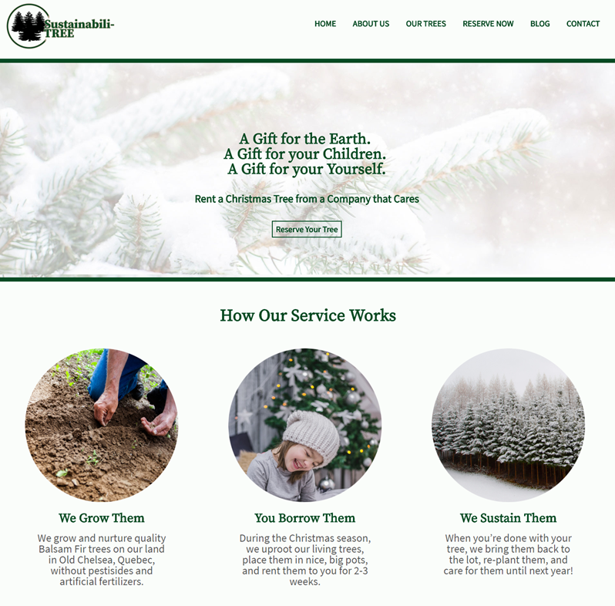
Home Page
Purpose:
Summarize all content
Visually appealing
Emphasize purpose/benefits
Reason:
Novel idea
Quickly catch attention
Quickly Answer questions
Sell idea
Notes:
In terms of the homepage, the purpose is to succinctly summarize all of the information in a visually-appealing fashion, while emphasizing the purpose and benefits of the company. The reason for this is that this is a very novel concept that is not well known. Individuals who visit the website likely don’t know anything about the company. So the website has to quickly catch the attention of users, efficiently answer any questions they might have and thus sell the idea.

Slide 11
Home Page
Results:
Intuitive
Basic
Persuasive
Slogans
Quotes
Clear Titles
Helpful Buttons
Good Overview
Notes:
Soooo, as you can see, the homepage is basic, intuitive, with clear titles, and helpful buttons. You can see for yourselves that the homepage covers information about reserving trees, it conveys information about the company and its benefits, and it provides highlights from the blog. All links are active. Clicking on any link triggers a loading animation. The contact page is fully validated, which ensures that all necessary information is input in the correct format before submitting a form. As you can see, there is a lovely slideshow here, on the about page.
Only three of the pages are completely finished, so there is a friendly message on all other pages. Finally, as you can see the website it fully responsive, with a functional dropdown menu.

Slide 12
Home Page
Results:
Intuitive
Basic
Persuasive
Slogans
Quotes
Clear Titles
Helpful Buttons
Good Overview
Notes:
Soooo, as you can see, the homepage is basic, intuitive, with clear titles, and helpful buttons. You can see for yourselves that the homepage covers information about reserving trees, it conveys information about the company and its benefits, and it provides highlights from the blog. All links are active. Clicking on any link triggers a loading animation. The contact page is fully validated, which ensures that all necessary information is input in the correct format before submitting a form. As you can see, there is a lovely slideshow here, on the about page.
Only three of the pages are completely finished, so there is a friendly message on all other pages. Finally, as you can see the website it fully responsive, with a functional dropdown menu.

Slide 13
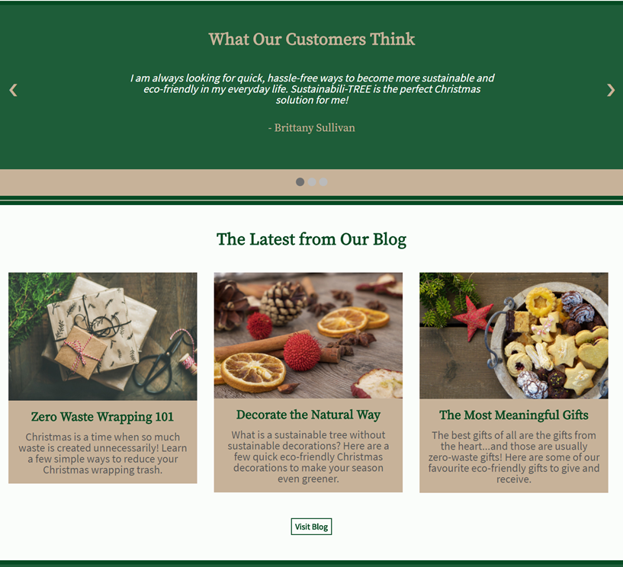
Home Page
Results:
Intuitive
Basic
Persuasive
Slogans
Quotes
Clear Titles
Helpful Buttons
Good Overview
Notes:
Soooo, as you can see, the homepage is basic, intuitive, with clear titles, and helpful buttons. You can see for yourselves that the homepage covers information about reserving trees, it conveys information about the company and its benefits, and it provides highlights from the blog. All links are active. Clicking on any link triggers a loading animation. The contact page is fully validated, which ensures that all necessary information is input in the correct format before submitting a form. As you can see, there is a lovely slideshow here, on the about page.
Only three of the pages are completely finished, so there is a friendly message on all other pages. Finally, as you can see the website it fully responsive, with a functional dropdown menu.

Slide 14
Home Page
Results:
Intuitive
Basic
Persuasive
Slogans
Quotes
Clear Titles
Helpful Buttons
Good Overview
Notes:
Soooo, as you can see, the homepage is basic, intuitive, with clear titles, and helpful buttons. You can see for yourselves that the homepage covers information about reserving trees, it conveys information about the company and its benefits, and it provides highlights from the blog. All links are active. Clicking on any link triggers a loading animation. The contact page is fully validated, which ensures that all necessary information is input in the correct format before submitting a form. As you can see, there is a lovely slideshow here, on the about page.
Only three of the pages are completely finished, so there is a friendly message on all other pages. Finally, as you can see the website it fully responsive, with a functional dropdown menu.

Slide 15
Home Page
Results:
Intuitive
Basic
Persuasive
Slogans
Quotes
Clear Titles
Helpful Buttons
Good Overview
Notes:
Soooo, as you can see, the homepage is basic, intuitive, with clear titles, and helpful buttons. You can see for yourselves that the homepage covers information about reserving trees, it conveys information about the company and its benefits, and it provides highlights from the blog. All links are active. Clicking on any link triggers a loading animation. The contact page is fully validated, which ensures that all necessary information is input in the correct format before submitting a form. As you can see, there is a lovely slideshow here, on the about page.
Only three of the pages are completely finished, so there is a friendly message on all other pages. Finally, as you can see the website it fully responsive, with a functional dropdown menu.

Slide 16
Home Page
Results:
Intuitive
Basic
Persuasive
Slogans
Quotes
Clear Titles
Helpful Buttons
Good Overview
Notes:
Soooo, as you can see, the homepage is basic, intuitive, with clear titles, and helpful buttons. You can see for yourselves that the homepage covers information about reserving trees, it conveys information about the company and its benefits, and it provides highlights from the blog. All links are active. Clicking on any link triggers a loading animation. The contact page is fully validated, which ensures that all necessary information is input in the correct format before submitting a form. As you can see, there is a lovely slideshow here, on the about page.
Only three of the pages are completely finished, so there is a friendly message on all other pages. Finally, as you can see the website it fully responsive, with a functional dropdown menu.

