Slide 1


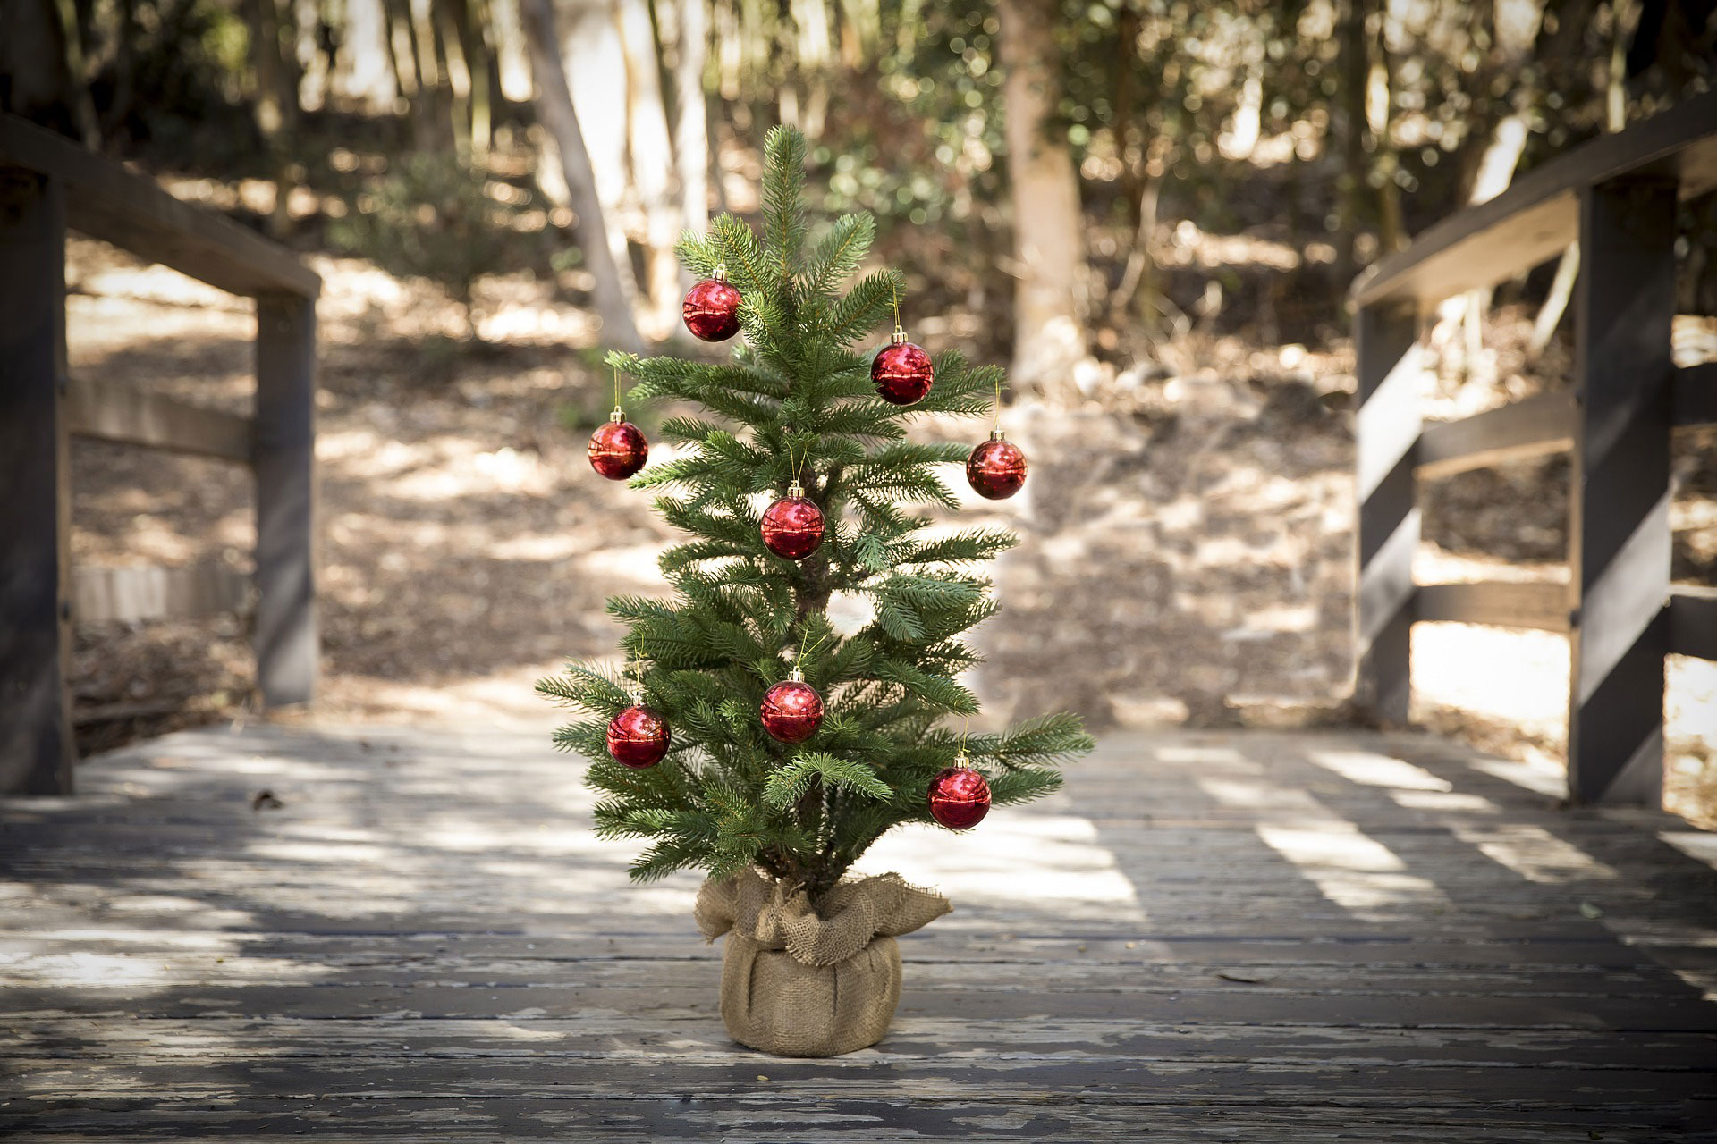
Sustainabili-TREE
By: Kathryn Dufour
Professor: Winnerjit Singh Rathor
Class: Internet Applications (LIB2024 010)

Slide 2
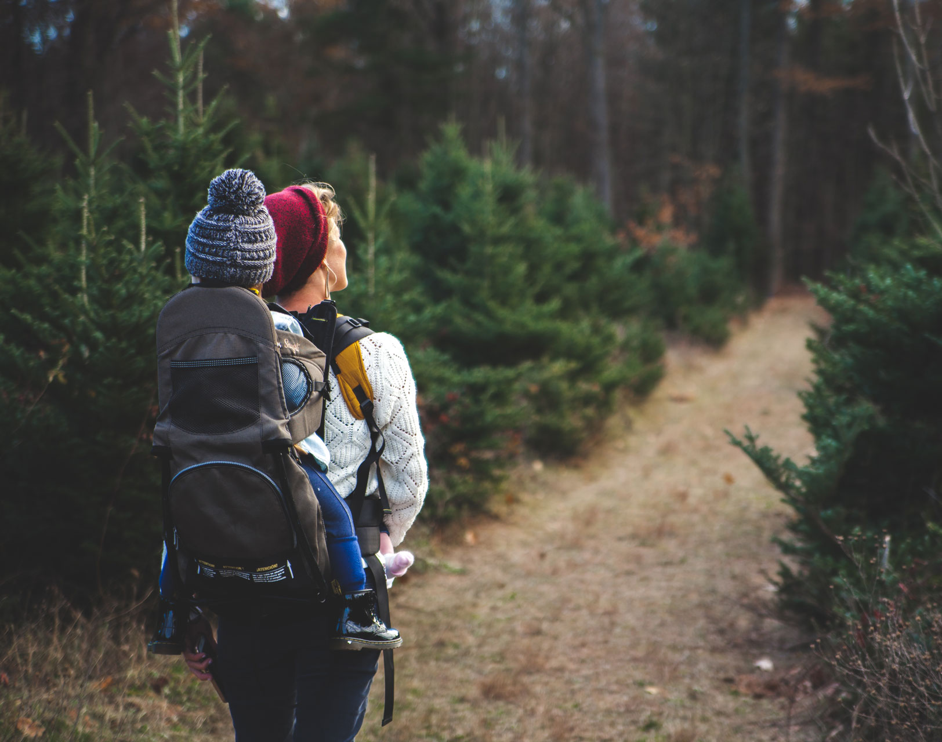
Basic Information
Company Name:
Sustainabili-TREE
Purpose:
Eco-friendly, Christmas tree-rental company
Website URL:

