Slide 1
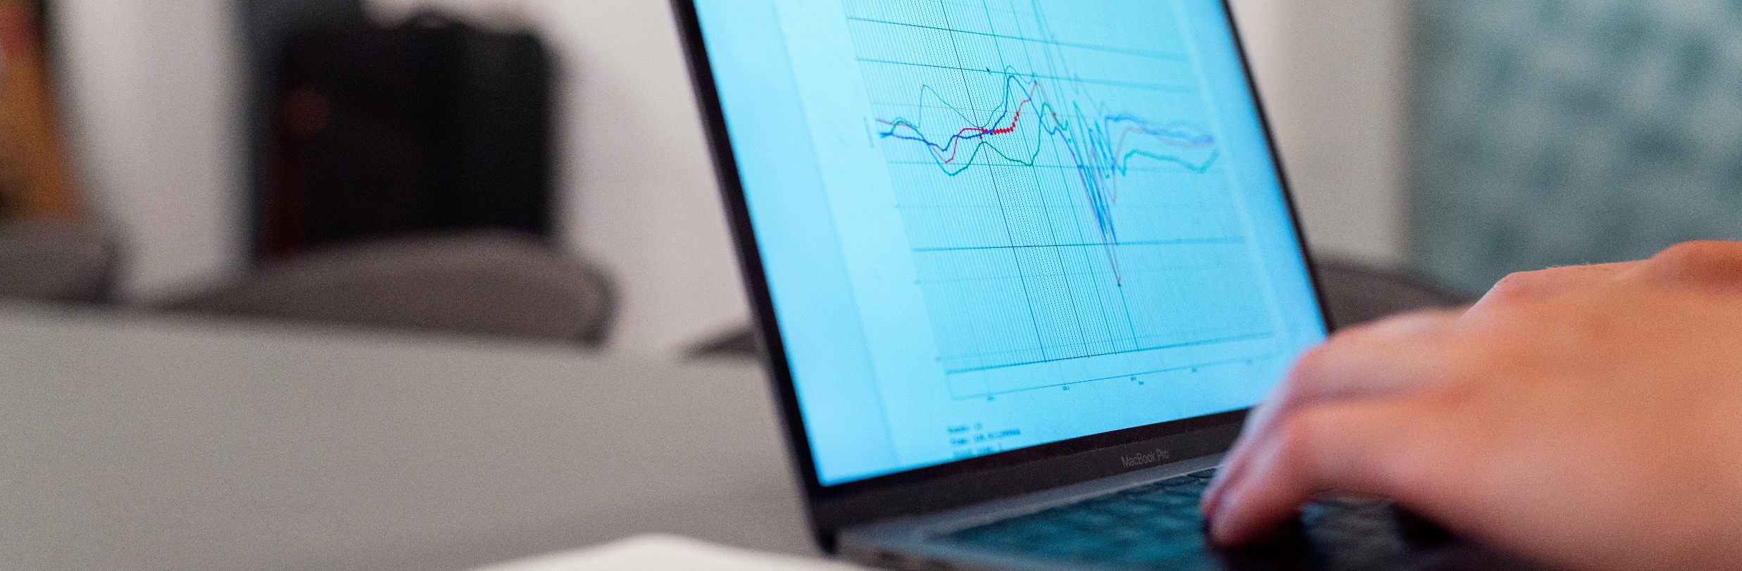

Slide 2
Project 1
Proposal.docx
Budget.xlsx
Annual report 2021.pdf
…
Admin
README.txt
Table1_28-01-2021.csv
Table2_28-11-2020.xlsx
…
Data
Analyses
README.txt
Univar_28-01-2021.r
Lin_reg_10-12-2020.r
…
Articles
Staph_incid_15-01-2021.Rmd
Figure 1.png
Figure 2.png
…
Staph_incid
Clin_mast
…
…

Slide 3
